Slide 1
FLASH PROCUREMENT - MANAGE SUPPLIER PORTAL TRAINING
Notes:
Narration:
Welcome to the Oracle Cloud Manage Supplier Portal Training. This training will enable users to understand different features a supplier contact have access to.

Slide 2
Welcome to the Flash Procurement Supplier Briefing & Training
During this event, please keep in mind following : Do’s & Don’ts
Do not disclose your identity during the event.
Just mention your name WITHOUT your company name
Everyone is muted
You are not able unmute yourself
You may not be able to see all the attendees and will see only the host(s) and yourself
Due to the nature of MS Team Live Event, do except a slight 10 to 60 seconds of delay in broadcasting the event
If you have any question, just type and raise your questions during the event and we will answer in the Q&A session at the end of the event

Slide 3
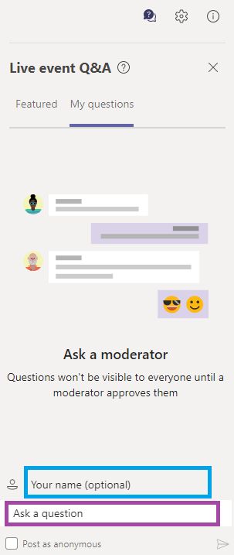
Steps to Post Your Question
1. Click the Q&A icon
2. Put your name here (optional)
Note: name only and no company information
3. Post your question here and it will soon be addressed

Slide 4
Post Go Live Support Structure
Supplier
Web, Phone, Email
1st Level
WD Buyer
SMO Team
(access issue)
2nd Level
WD IT Team
3rd Level
Project IT Team Experts & Consultants

Slide 5
Course Agenda
Topic | Objective
Introduction & Tasks Description | High Level introduction of supplier portal
Detailed description of Tasks | Detailed tasks description with screenshots
IMAGE/ICON
IMAGE/ICON
Notes:
At the end of this course users will have understanding of how a supplier contact can perform different tasks from supplier portal.

Slide 6
INTRODUCTION AND TASKS DESCRIPTION: MANAGE SUPPLIER PORTAL
Notes:
Narration:
This section will cover the introduction of Supplier Portal

Slide 7
SUPPLIER PORTAL LOGIN
Notes:
IT 2.021

Slide 8
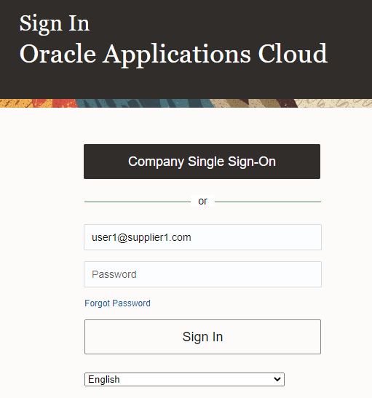
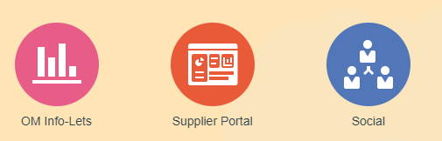
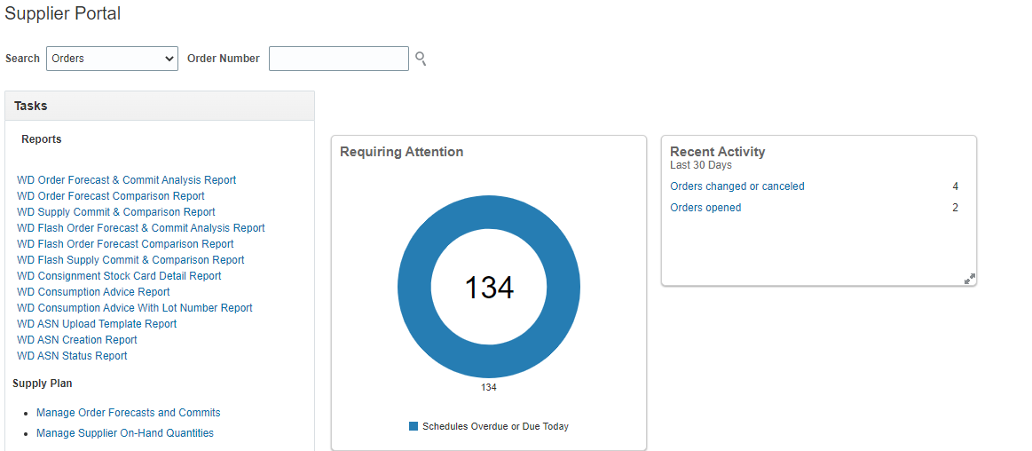
Supplier Portal Login
Formatting Tip
Formatting Tip
2
At the dashboard, click the Home icon to the Main Page
Home
3
Click the Supplier Portal icon to proceed
1
4
The Supplier Portal page
Input the username and password then Sign In
Notes:
When a supplier contact login to oracle cloud, he/she can see ‘Supplier Portal’ icon at home page.
Click on that to get into supplier portal.

Slide 9
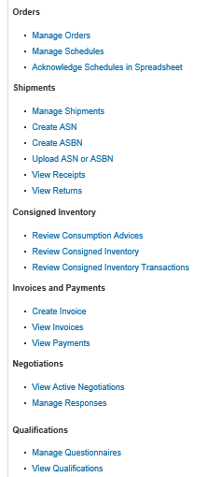
Manage Supplier Role
Supplier Self Service Tasks in Supplier Portal
Can manage orders & Schedule and initiate changes
Create ASN, Manage Shipments and View Receipts & Returns
Can review Consigned Inventory
Create /View Invoices, View Payments
View Negotiations & Create responses
Manage Questionnaires and View Qualifications
*Suppliers can not Manage/View BPAs
Notes:
These are the tasks a supplier contact can perform from supplier portal.
They can manage orders & Schedule and initiate changes.
They can create ASN, Manage Shipments and View Receipts & Returns
They can review Consigned Inventory
They can create and View Invoices, View Payments
They can view Negotiations & Create responses
They can manage Questionnaires and View Qualifications.
But supplier don’t have access to manage or view BPAs.
“WDC supplier portal” job role give access to all these tasks. No other setup required to access any of these tasks.

Slide 10
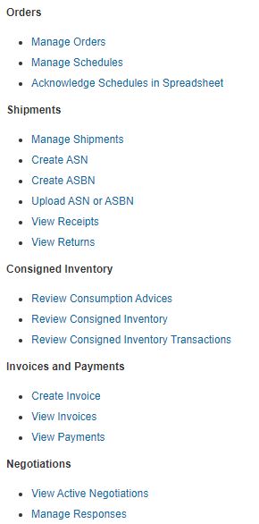
Applicable Tasks for Flash Procurement
Following Tasks Applicable for Flash Procurement:
Orders:
Manage Orders
Manage Schedules
Acknowledge PO (IDM Suppliers)
PO Confirmation
Shipments:
View Receipts
View Returns
Invoices and Payments
Create Invoice
View Invoice
View Payments
Notes:
When the suppliers get into the portal, they can see the overview of their orders.
They can see the orders or schedules that require their attention on urgent basis. Suppliers also get notifications on the recent activities done on their orders from buyer side.
Drill down to links in Infolets for those orders.
They can also manage orders and initiate changes.

Slide 11
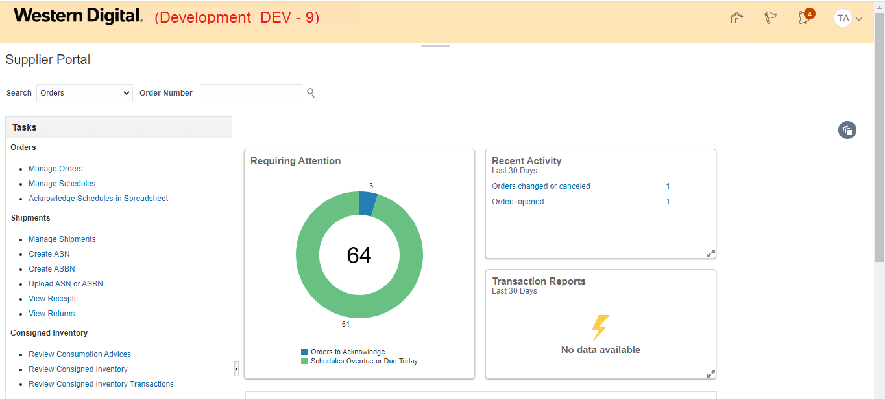
Supplier Portal
Suppliers also get notifications on the recent activities done on their orders from buyer side
Click on Manage Orders
Require Supplier Attention :
Orders to Acknowledge
Schedules Overdue or Due today
Notes:
When the suppliers get into the portal, they can see the overview of their orders.
They can see the orders or schedules that require their attention on urgent basis. Suppliers also get notifications on the recent activities done on their orders from buyer side.
Drill down to links in Infolets for those orders.
They can also manage orders and initiate changes.

Slide 12
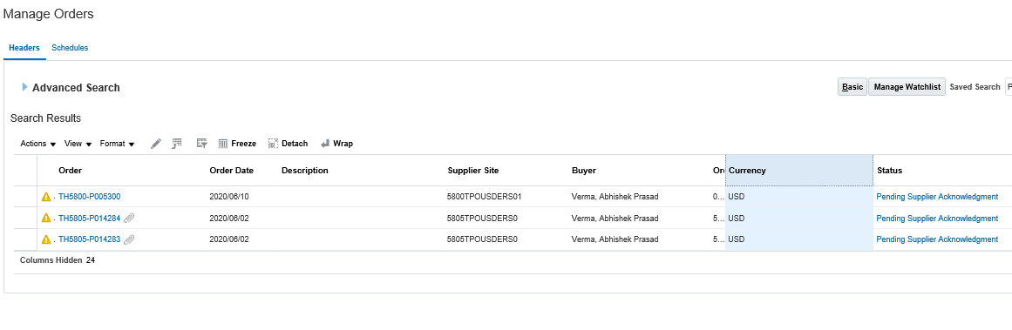
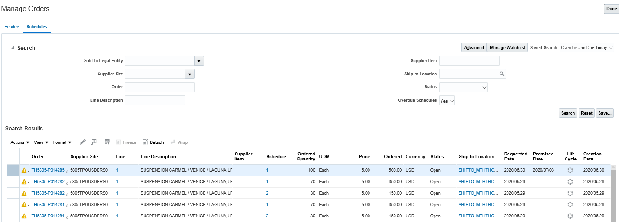
Require Supplier Attention
Drill down to links in Infolets for Orders to acknowledge, it will show all the orders which are pending supplier acknowledgement .
Drill down to links in Infolets for Schedules Overdue or Due today
, it will take to the schedule page and show the relevant orders
Notes:
From overview page, drill down to links in Infolets for Orders to acknowledge, it will take you to manage orders page and show all the orders which are pending supplier acknowledgement .
And if you Drill down to links in Infolets for Schedules Overdue or Due today, it will take to the schedule page and show the relevant orders.

Slide 13
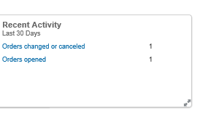
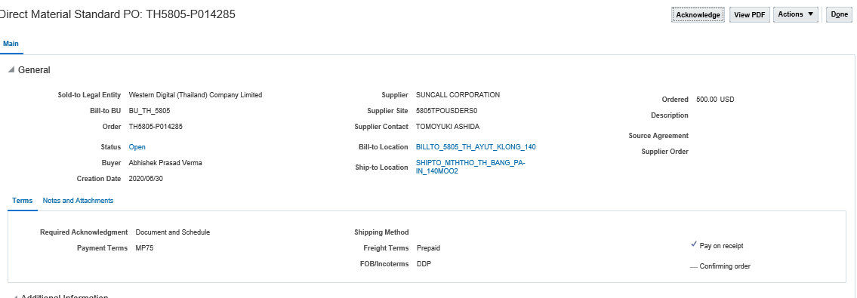
Recent Activities
Click on order’s link from recent activities , it will take to individual order level
Notes:
If Suppliers click on order’s link from recent activities , it will take to individual orders where they can see the changes done on their orders from buyer side.

Slide 14
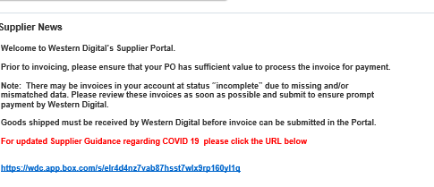
Supplier News
Notes:
If WD broadcasts any news for supplier, that is also visible in supplier portal

Slide 15
MANAGE ORDERS
Notes:
IT 2.021

Slide 16
Orders
Under the Orders tasks Supplier can
Manage Purchase orders
Acknowledge PO
Manage Schedule (Initiate PO change Order)
PO Confirmation

Slide 17
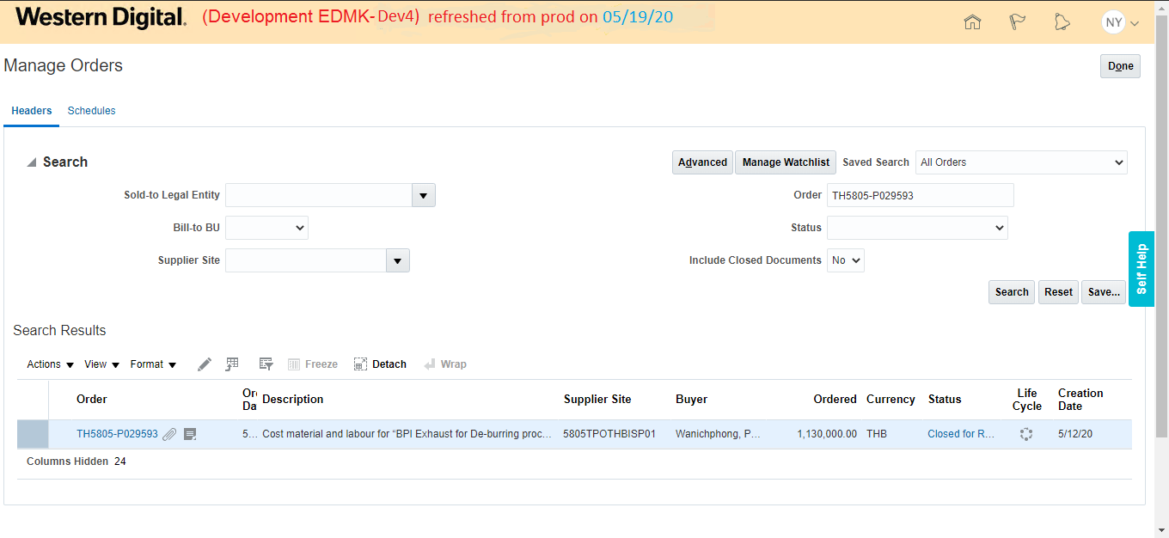
Manage Orders
Enter the Order Number and click on Search. The PO will appear in search results.
Click on PO number to open it
Notes:
Now come to manage orders screen.
Click on Manage Orders from left side tasks pane on supplier portal.
Manage Orders search page will open.
Remove any default value from search criteria, enter the Order Number and click on Search. The PO hyperlinks will appear in search results.
PO search can be done by Sold-to Legal Entity, Bill-to BU, Supplier Site, Order Status etc. apart from PO number. More search fields can also be added to the search by clicking on Advanced and then Add Fields.
From the search results suppliers can click on the PO number to Open it.

Slide 18
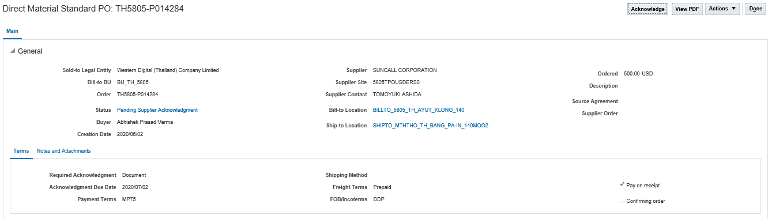
Purchase Order Header
Supplier can acknowledge the PO by clicking this button
Status: Canceled/Closed/Closed for receiving/Closed for Invoicing/Finally Closed/On-hold/Open/Pending Change approval/Pending Supplier Acknowledgement
Notes:
This screen shows contents of the PO Header.
Status: Various status values at the header level indicate the phase in which the PO is.
Example: Canceled/Closed/Closed for receiving/Closed for Invoicing/Finally Closed/On-hold/Open/Pending Change approval/Pending Supplier Acknowledgement
The Supplier acknowledgement field shows whether or not the PO needs supplier acknowledgement. If it is set to None, supplier acknowledgement is not required.
Supplier can acknowledge the PO by clicking the Acknowledge button from right side corner.

Slide 19
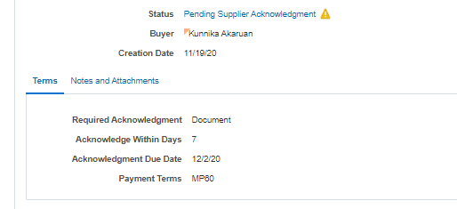
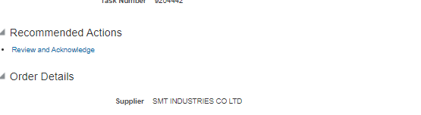
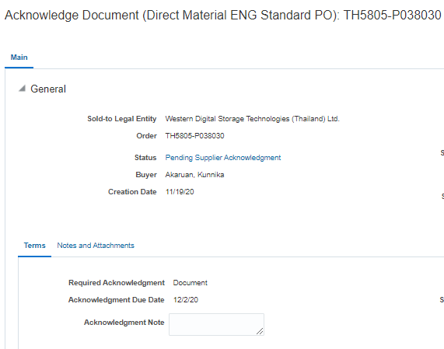
Supplier Acknowledgement (applicable for IDM suppliers)
Required Acknowledgment | Document at PO header
Step1. When required acknowledgement is set to ‘Document’ at PO level
Step2. Login as supplier→ Go to Bell notification→ Click on the notification which required acknowledgement→ click on Review and Acknowledge in the notification
Step3. It will open Acknowledge Document page where Required acknowledgement will show as ‘Document’
Notes:
Supplier Acknowledgement when required acknowledgement is set to ‘Document’ at PO level.
Login as supplier→ Go to Bell notification→ Click on the notification which required acknowledgement→ click on Review and Acknowledge in the notification.
It will open Acknowledge Document page where Required acknowledgement will show as ‘Document’

Slide 20
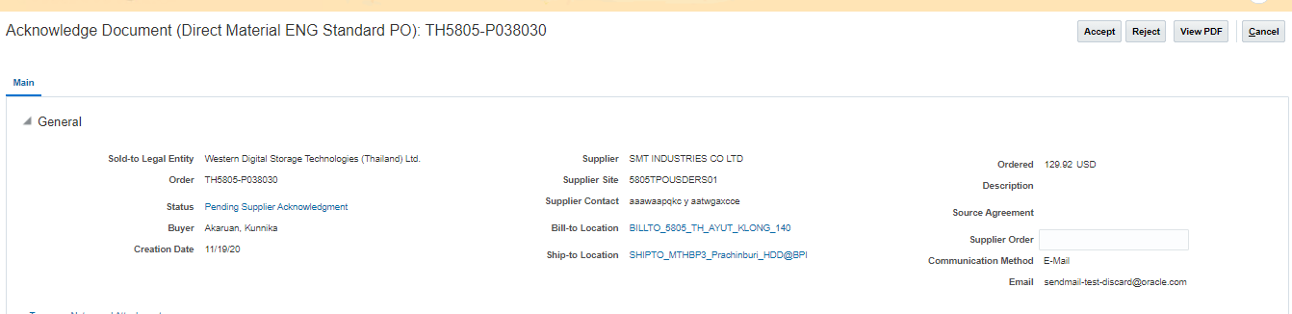
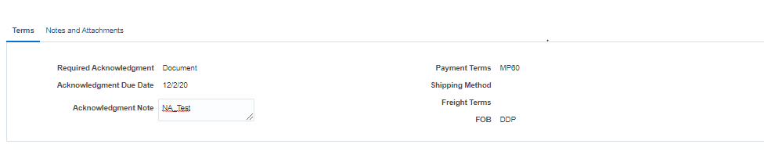
Supplier Acknowledgement Contd.
Required Acknowledgment | Document at PO header
Supplier will accept or reject at Header level
Supplier must enter an acknowledgment note when rejecting a document or a change order.
Notes:
Supplier will accept or reject at Header level.
Supplier must enter an acknowledgment note when rejecting a document or a change order.

Slide 21
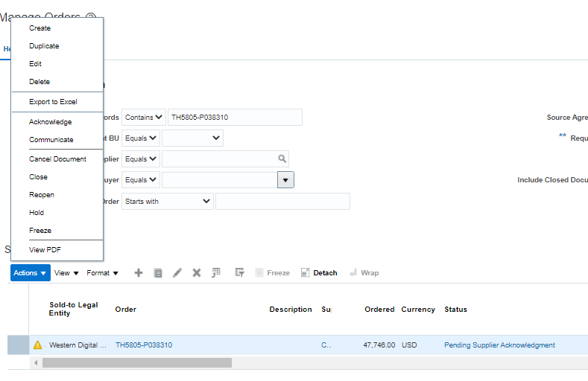
PO Acknowledgement By Buyer on Behalf of Supplier
Buyer can search the PO, Select the PO and then click on Action → Acknowledge
Notes:
A buyer can record a supplier's offline acknowledgment on the supplier's behalf, using the Acknowledge action on the document , when a purchase order or its change order is submitted for acknowledgment.
Buyer can search the PO in Manage Order tasks, Select the PO and then click on Action → Acknowledge
Once the acknowledge page opens, buyer can Accept/Reject accordingly.

Slide 22
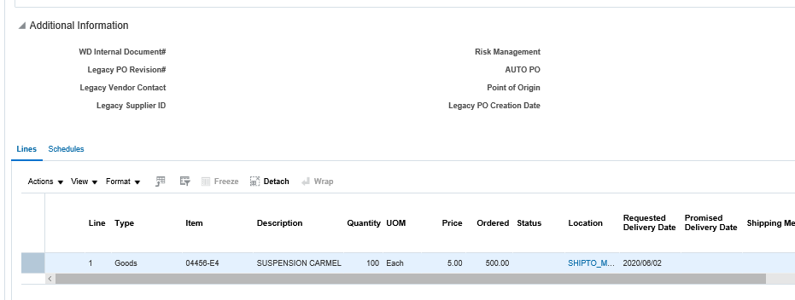
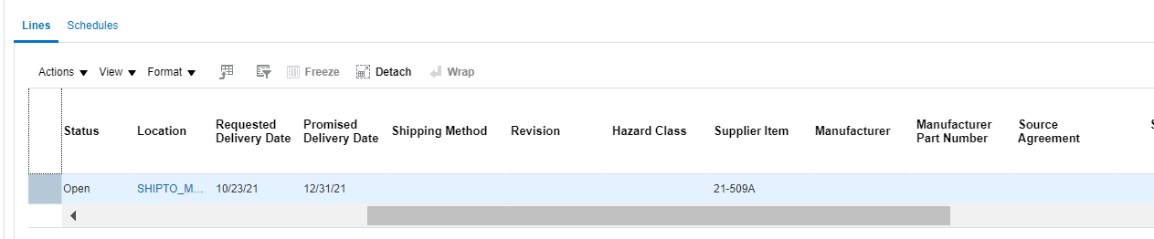
Purchase Order Line
Item, Price, Quantity, Promise Date all these fields are visible on a PO Line.
Scroll to right to see the Supplier Item, Manufacturer and MPN details
Note: Supplier, please ignore Supplier Item
Notes:
This screen shows contents of the PO Line.
Item, Price, Quantity, Promise Date all these fields are visible on a PO Line.

Slide 23
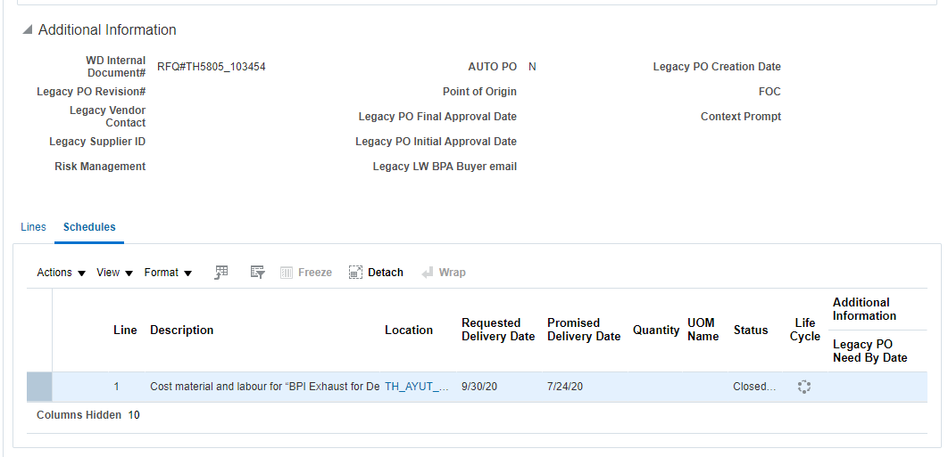
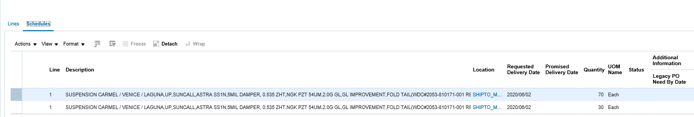
Purchase Order Schedule
Schedule Status : Cancelled/Closed/Closed for Receiving/Closed for Invoicing/Finally Closed/On-hold/Open.
Notes:
This screen shows contents of the PO Schedule.
A PO Line can be split into different schedules if the quantity and requested delivery date of the line are different.
Schedule Status: The Schedule status indicates the status in which the PO schedule is.
The values can be Cancelled/Closed/Closed for Receiving/Closed for Invoicing/Finally Closed/On-hold/Open.

Slide 24
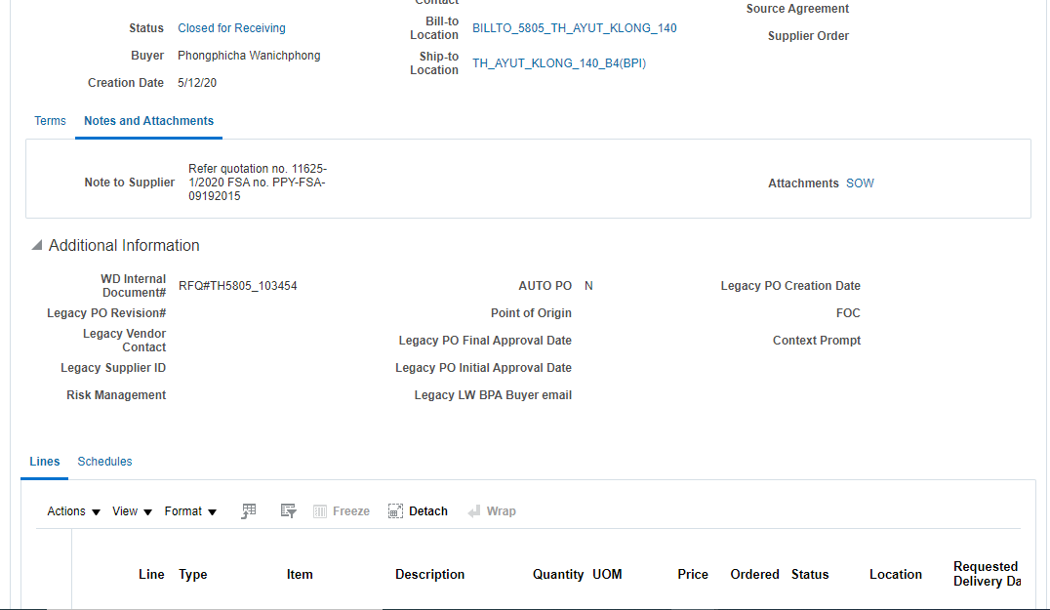
Note to Supplier
Note to Supplier.
Notes:
Click on Notes and Attachments at PO header to view if there is any note or attachment to supplier from buyer’s side.

Slide 25
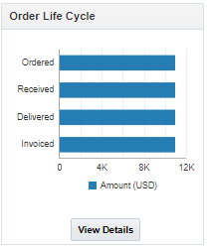
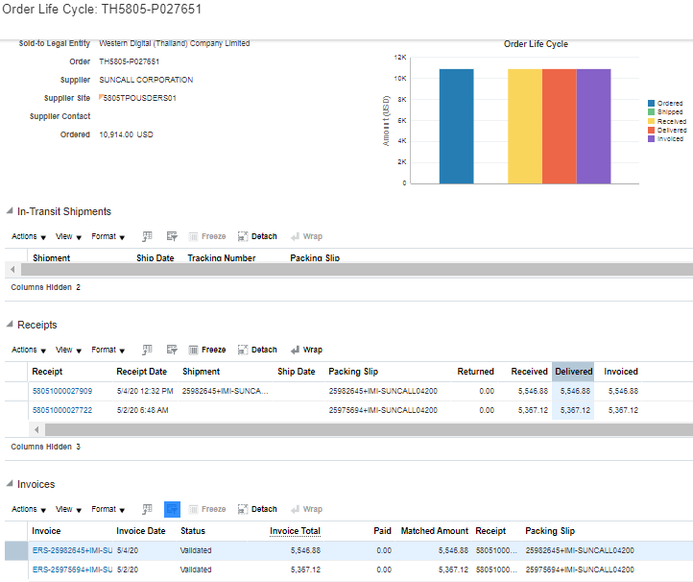
Purchase Order Lifecycle
Gives a detail picture of fulfilment and billing status
It shows the receipt number, date, received, delivered, invoiced amount, etc.
It shows the invoice number, status, paid amount, etc.
25
Notes:
PO Lifecycle:
On the top right corner of the PO header, there is a “Order lifecycle” section with a summary of the PO, the quantities ordered, received and invoiced by amount.
When order lifecycle details is clicked it opens a new screen that displays a detailed picture of the fulfillment and billings status of the Purchase Order. In the various sections on the page the supplier can view the in transit shipments, receipts, invoices, and when they click on the number, the details of the receipt, invoice are visible.

Slide 26
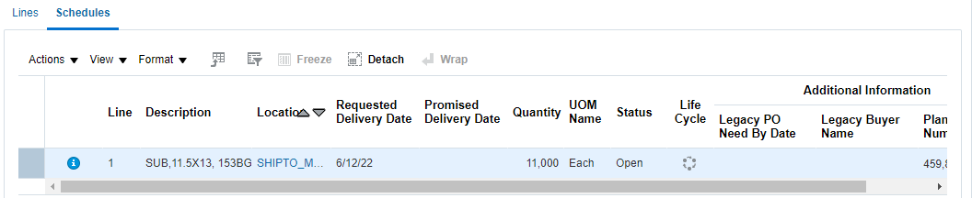
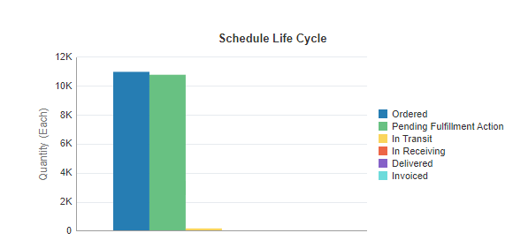
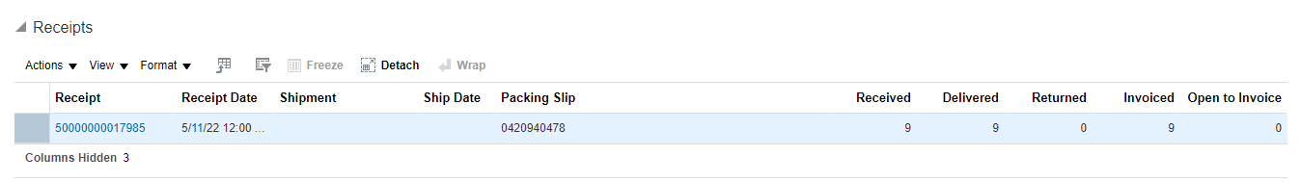
Purchase Order Lifecycle
Click this link to view the Life Cycle.
Give details about the schedule level life cycle.
26
Notes:
PO Lifecycle:
On the top right corner of the PO header, there is a “Order lifecycle” section with a summary of the PO, the quantities ordered, received and invoiced by amount.
When order lifecycle details is clicked it opens a new screen that displays a detailed picture of the fulfillment and billings status of the Purchase Order. In the various sections on the page the supplier can view the in transit shipments, receipts, invoices, and when they click on the number, the details of the receipt, invoice are visible.

Slide 27
PO CONFIRMATION MANUAL & UPLOAD
Notes:
IT 2.021

Slide 28
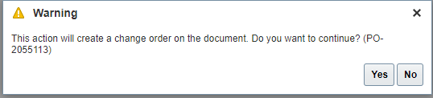
Create PO Change Order –Supplier Initiated
Step 2: Select the PO record in the search result
Step 1: Enter the Order Number and click on Search. The PO will appear in search results.
Step 3: Click on Edit icon to create PO Change order
Step 4: Warning message is displayed > Click on Yes to create PO Change order
Notes:
Now come to manage orders screen.
Click on Manage Orders from left side tasks pane on supplier portal.
Manage Orders search page will open.
Remove any default value from search criteria, enter the Order Number and click on Search. The PO hyperlinks will appear in search results.
PO search can be done by Sold-to Legal Entity, Bill-to BU, Supplier Site, Order Status etc. apart from PO number. More search fields can also be added to the search by clicking on Advanced and then Add Fields.
From the search results suppliers can click on the PO number to Open it.

Slide 29
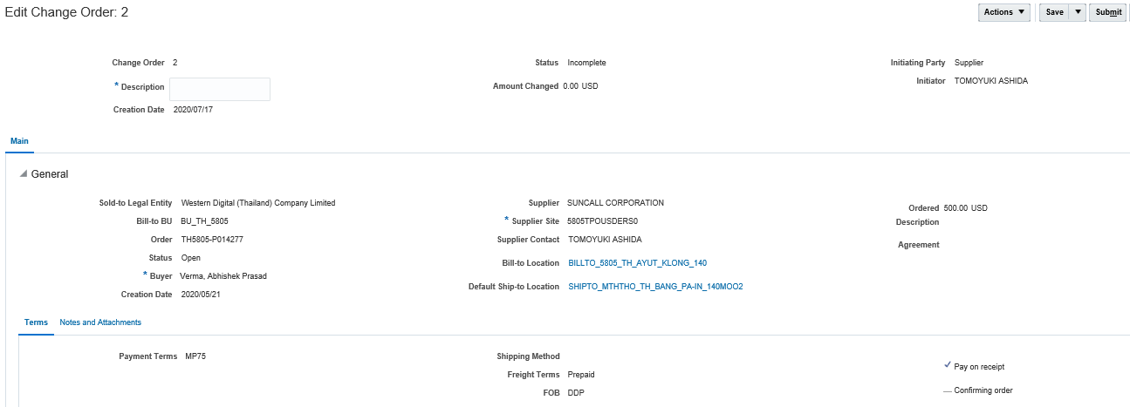
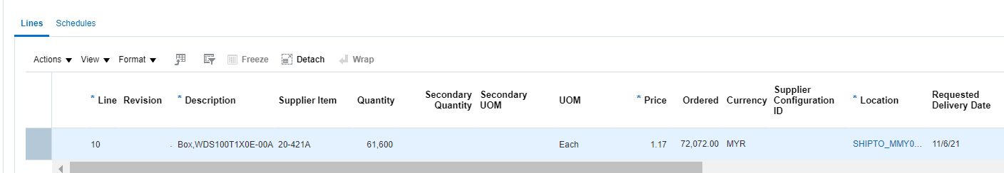
PO Amendment –Supplier Initiated
A change Order gets initiated, please input Description
Initiator party is supplier
Check the PO line details & then click on Schedule
Notes:
Lets talk about Supplier Initiated PO amendment . Supplier can also initiate a change in a PO.
For this Supplier has to follow these steps –
Click on Manage Orders from left side tasks pane on supplier portal.
Manage Orders search page will open.
Enter the Order Number and click on Search. The PO hyperlinks will appear in search results.
From the search results suppliers can click on the PO number to Open it.
Click on action→ Edit
A Change order will get initiated. And Initiating Party will be shown as supplier.
It is important to remember , Suppliers are allowed to change only Promised Date and Reason for Change field.
And these 2 supplier initiated changes need to be approved by buyer.
Supplier can also split a schedule .

Slide 30
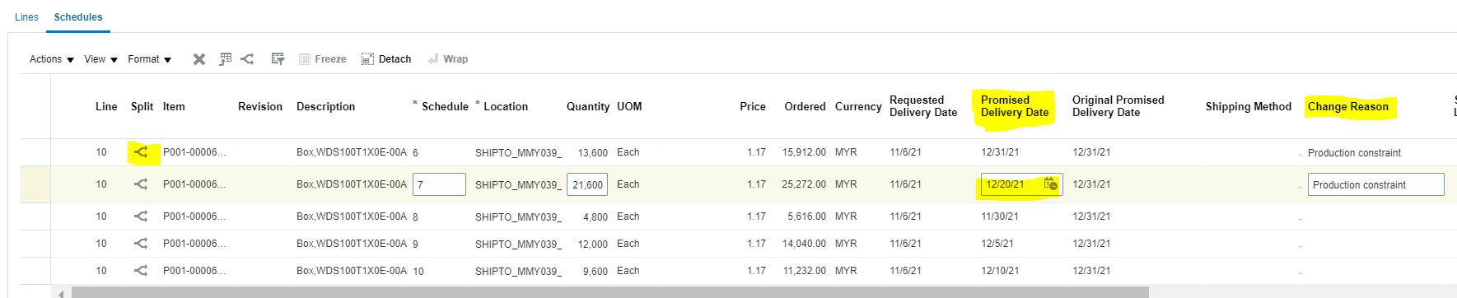
PO Amendment –Supplier Initiated
Supplier is can split the schedule as required and input promise date and change reason for each schedule.
Save the PO CO and Submit
Supplier is ONLY allowed to change promise date and change reason
Notes:
Lets talk about Supplier Initiated PO amendment . Supplier can also initiate a change in a PO.
For this Supplier has to follow these steps –
Click on Manage Orders from left side tasks pane on supplier portal.
Manage Orders search page will open.
Enter the Order Number and click on Search. The PO hyperlinks will appear in search results.
From the search results suppliers can click on the PO number to Open it.
Click on action→ Edit
A Change order will get initiated. And Initiating Party will be shown as supplier.
It is important to remember , Suppliers are allowed to change only Promised Date and Reason for Change field.
And these 2 supplier initiated changes need to be approved by buyer.
Supplier can also split a schedule .

Slide 31
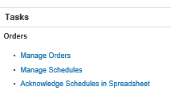
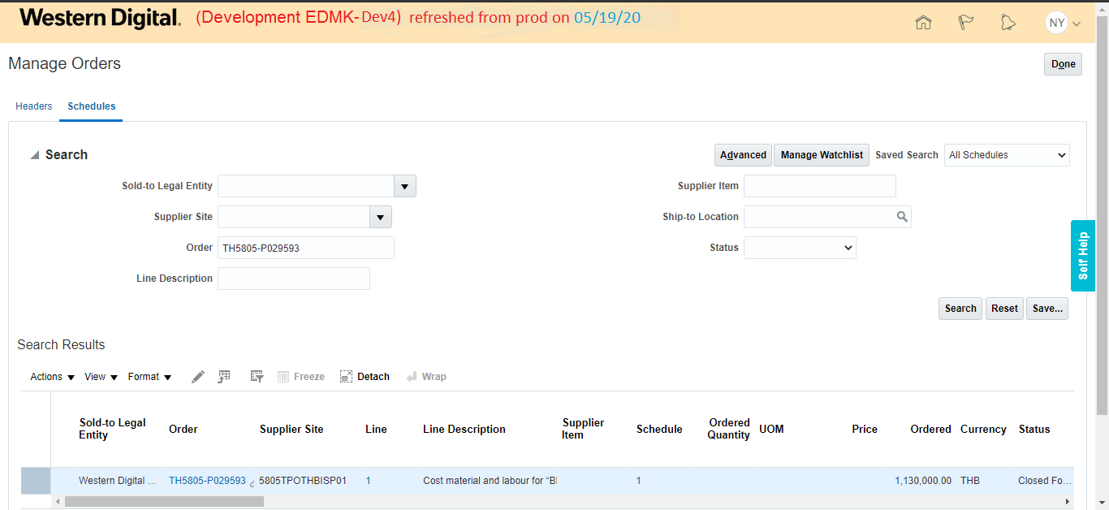
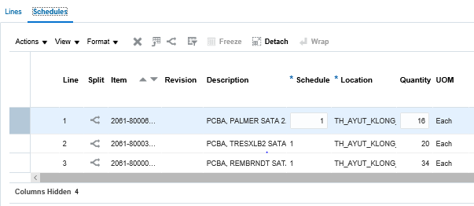
Manage Schedules
Click on Manage Schedules in left side tasks pane
Search the schedule with PO number
Click on PO number or schedule number in search results
Supplier can split a schedule
Notes:
Manage Schedules .
Suppliers can directly go to PO schedule page from home page.
For that , Click on Manage Schedules in left side tasks pane.
Search the schedule with PO number.
Click on PO number or schedule number in search results to view the schedule in detail.

Slide 32
PO Confirmation
PO confirmation is done by Buyer or Supplier User against each PO line / Schedule line
PO confirmation is updating the Promise delivery date (PDD) on the PO schedule line
PO confirmations can be performed with quantity less than or equal to PO line quantity

Slide 33
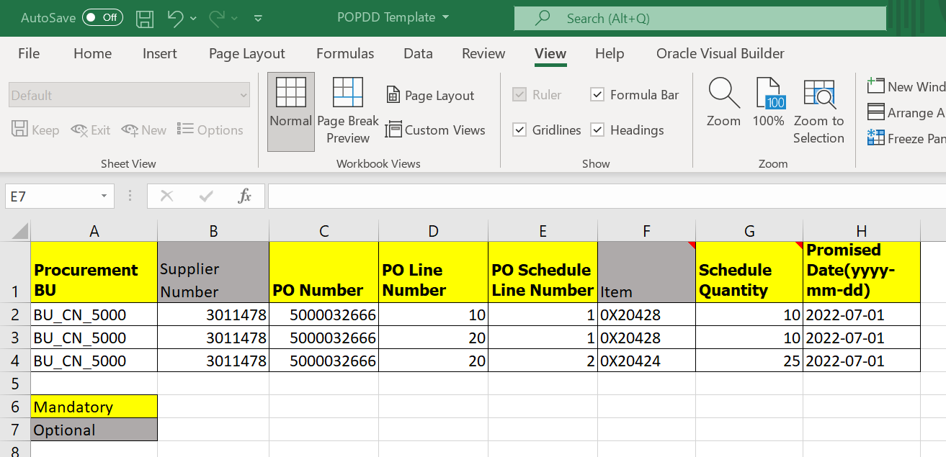
PO Confirmation Template
Sample PO confirmation Template

Slide 34
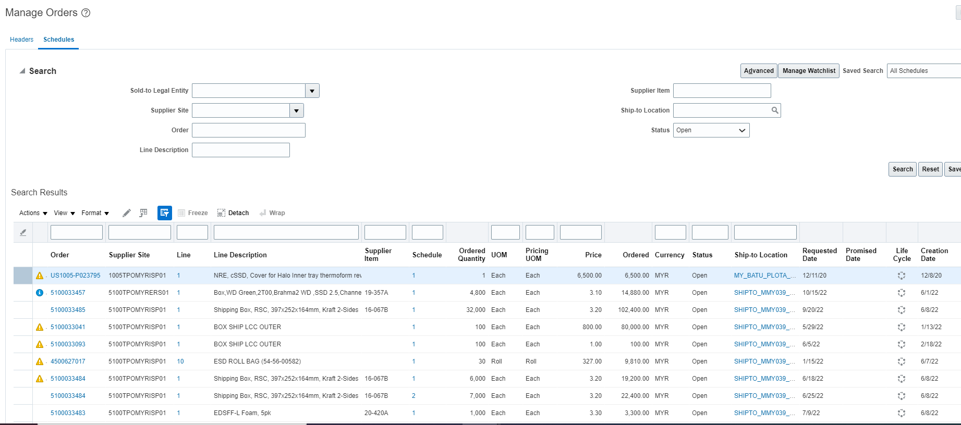
Step by step process
Step 1: Login to Oracle Cloud > Click on Supplier Portal > Click on Manage Schedules
Click on Manage Schedules in left side tasks pane
Status select Open
Click on Search
Search result is shown
Export the search result to excel

Slide 35
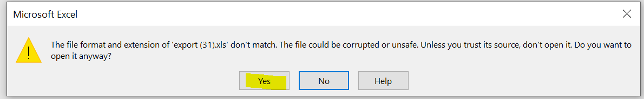
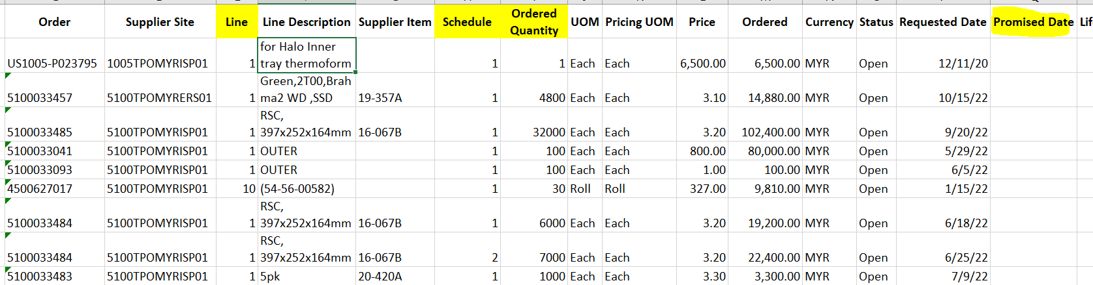
Step by step process
Step 2: The data will be Exported to excel file > Open the excel file > Click on Yes button to open the file
Step 3: Make the Line, Schedule and Ordered Quantity columns as Number format > Then copy paste the information from this export file to PO PDD template file

Slide 36
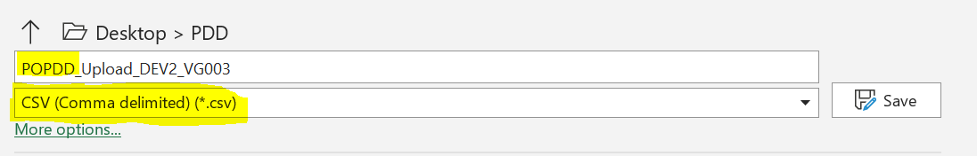
Step by step process
Step 4: Fill in the PO confirmation Template with the mandatory fields like BU, PO, PO line, PO Schedule lines, Schedule quantity and PDD details as below
Step 5: Save the file with File Name as POPDD_**** and CSV format as shown below

Slide 37
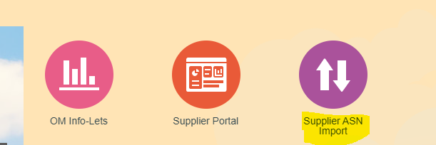
Step by step process
Step 6: Login to Oracle Cloud >Click on Supplier ASN Import icon on the landing page

Slide 38
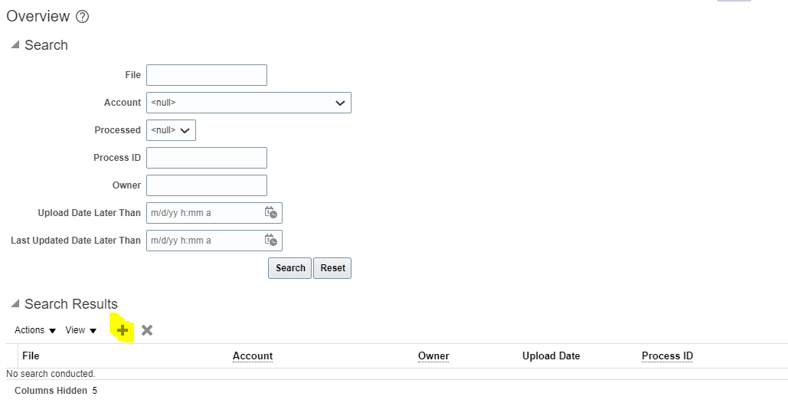
Step by step process
Step 7: File Import and Export (UCM) overview page is displayed as below
Click on the “+” icon to upload file

Slide 39
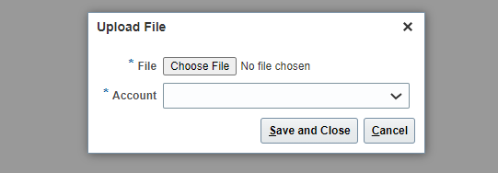
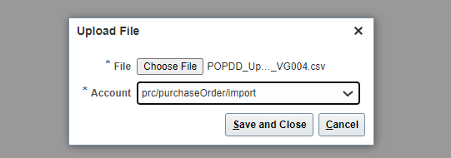
Step by step process
Step 8: Upload File pop up window will show up, User to choose the csv file and Account “prc/purchaseOder/import” as below
Step 9: The files uploaded will be picked up for processing every 10 mins so Buyer / Supplier have to wait Max 15 mins to get Success / Error email notification and PDD updates would be done in Oracle Cloud.

Slide 40
Points to consider during testing
All mandatory columns should be filled in and can’t be left BLANK
Populate the data same as in Cloud system without any extra space, no extra dot after PO line # or PO Schedule line # and no comma in schedule quantity field
Perform PO confirmation for PO / PO lines in OPEN status
PO confirmation file should be uploaded to UCM account - prc/purchaseorder/import and file name should start with POPDD_*** and csv format
Email notifications will be sent to person uploading the PO confirmation file to UCM in both Success and Error cases
Promised Date in the file should be in yyyy-mm-dd so please make this column as Text and populate the data and save as csv
Suppliers PO PDD file can include multiple POs / PO lines / Schedule lines but for their own POs

Slide 41
Shipments
Under the Shipment tasks Supplier can
View Receipts
View Returns

Slide 42
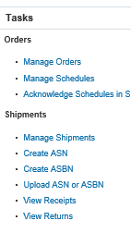
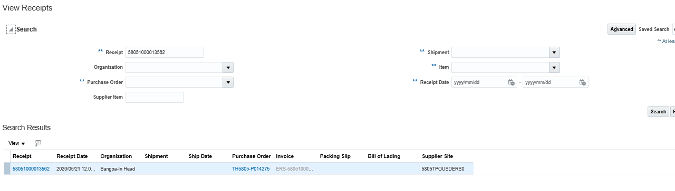
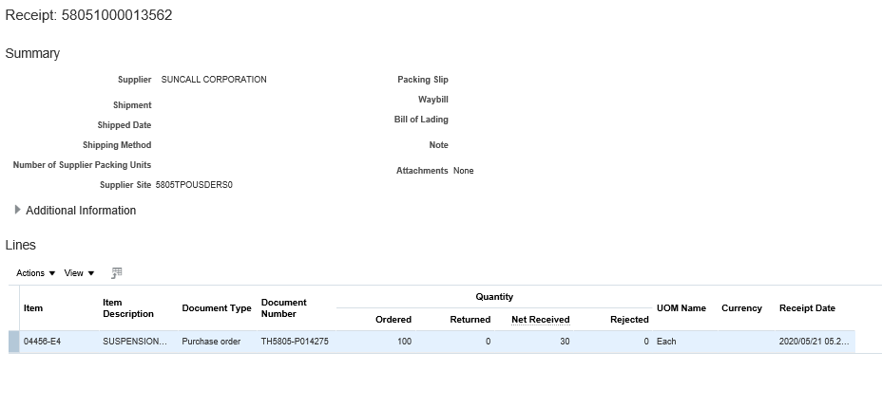
View Receipts
Search with Receipt Number/PO Number/Receipt Date/Shipment Number/Item
Click on View Receipts from left side tasks pane
Click on the receipt link from search results
Receipt Details
Notes:
Suppliers also have the visibility of receipts.
Click on View Receipts from left side tasks pane.
Search with Receipt Number or PO Number or Receipt Date or Shipment Number or Item.
Click on the receipt link from search results.
Receipt Details will be shown to supplier.

Slide 43
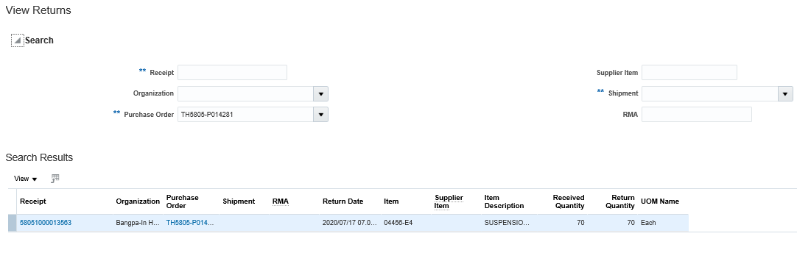

View Returns
Search with Receipt Number/PO Number//Shipment Number
Click on View Returns from left side tasks pane
Click on the receipt link from search results
Receipt Details
Notes:
Returns :
Suppliers have the visibility of Returns as well.
Click on View Returns from left side tasks pane.
Search with Receipt Number or PO Number or Shipment Number.
Click on the return receipt link from search results.
Return Details will be shown to supplier.

Slide 44
Invoices and Payment
Under the Invoices & Payment tasks Supplier can
Create Invoice
View Invoices
View Payments

Slide 45


Create Invoice(applicable for Service PO)
Click Create Invoice
Populate Invoice Number and Date
Select PO Number
Add the PO lines for which Invoice needs to be created
Validate the lines
Notes:
Invoice Creation
Suppliers can create invoices through portal.
Click on Create Invoices from left side tasks pane.
Select the identifying PO Number , corresponding fields will be populated
Date and Number are mandatory
Validate all the other fields such as Customer Name , Address, at heard level line
Add the PO lines for which you want to create invoice by clicking ‘+’ sign. Validate Quantity , Item , Price at line level.
If everything seems ok , then submit for invoice creation
ISP Vs ERS Supplier site : For the POs created on ERS site, invoice will be auto generated as soon as POs are received. Whereas for the POs created on ISP site, supplier can create the invoice.

Slide 46


View Invoices
Search with Invoice Number/PO Number/Supplier
Click on View Invoice from left side tasks pane
Click on the Invoice link from search results
Invoice Status: Approved
Invoice Details
Notes:
Suppliers can also view invoices.
Click on View Invoices from left side tasks pane.
Search with Invoice Number or PO Number or Supplier.
Click on the Invoice link from search results.
Invoice Details will be shown to supplier.

Slide 47


View Payments
Search with Payment Number or Supplier
Click on View Payments from left side tasks pane
Click on the Payment link from search results
Payments Details
Paid Status: Fully Paid
Notes:
Suppliers can also view payments.
Click on View Payments from left side tasks pane.
Search with Payment Number or Supplier.
Click on the Payment link from search results.
Payment Details will be shown to supplier.

Slide 48

Download Data
Most of the search pages contains excel download option. User can click on the link to export the data in to excel.
Click on this Icon to download the search results data in excel
48
Notes:
PO Lifecycle:
On the top right corner of the PO header, there is a “Order lifecycle” section with a summary of the PO, the quantities ordered, received and invoiced by amount.
When order lifecycle details is clicked it opens a new screen that displays a detailed picture of the fulfillment and billings status of the Purchase Order. In the various sections on the page the supplier can view the in transit shipments, receipts, invoices, and when they click on the number, the details of the receipt, invoice are visible.

Slide 49
Learning Summary
Following topics were covered in this training:
Introduction and Tasks Description : Manage Supplier Portal
Manage orders & Schedule and initiate changes
View Receipts & Returns
Create / View Invoices, View Payments
Notes:
Following topics are covered in this training:
Introduction and Tasks Description : Manage Supplier Portal
Manage orders & Schedule and initiate changes
Create ASN, Manage Shipments and View Receipts & Returns
Review Consigned Inventory
Create /View Invoices, View Payments

Slide 50
Knowledge Check
1. Supplier can create Invoice
True
False
2. Supplier can initiate a Change Order for a PO
True
False
3. Supplier can view invoice from
‘View Invoice’ link from tasks pane
PO life cycle
Both
4. Supplier can split a line into schedules
True
False
Notes:
Narration Text:
Please answer the following multiple choice questions.

Slide 51
Answer Key to the Knowledge Check
1. – True
2 – True
3 – Both
4 – True
Notes:
Narration Text:
The correct responses to the previous questions are as follows.

