Slide 1
FLASH SUPPLY CHAIN COLLABORATION TRAINING FORECAST REVIEW & COMMIT

Slide 2
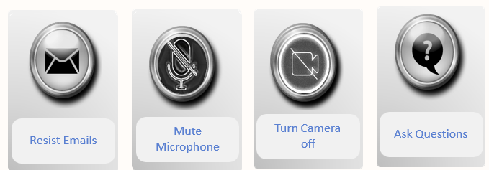
Ground Rules during classroom training sessions

Slide 3

Ground Rules during on-line training sessions

Slide 4
COURSE AGENDA:
Topic | Objective
Review Supplier Forecast & Provide Supply Commit | How suppliers will review forecast and provide commit against the forecast

Slide 5
REVIEW SUPPLIER FORECAST & PROVIDE SUPPLY COMMIT

Slide 6
Review Supplier Forecast & Update Supply Commit-Overview
Supply Planning Collaboration: Order forecasts will be shared with suppliers and get their commitment to
deliver critical components, assemblies and materials when you need them.
Forecast
Use Manage Order Forecasts and Commits page to
View Order Forecast Data
Update Commits against the Forecast
Download & Upload Commit Data
Download Forecast, Commit along with other measures
Buyers / Planners
Suppliers
Commit
Following topics will be covered
Order Forecast & Commit Page (Supplier View)
Commit against Forecast (Different Options)
7

Slide 7
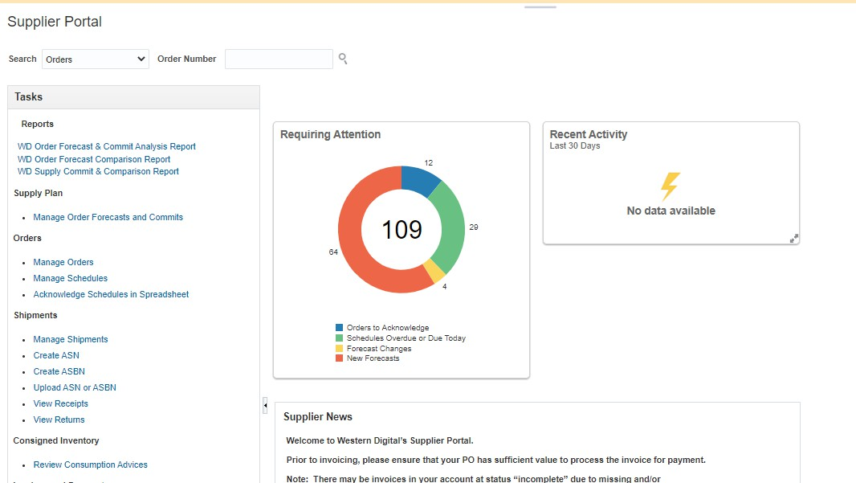
1.0 Order Forecast and Commit (Supplier’s View)
Navigation – Supplier Portal Work area → Suppliers Landing Page
Suppliers will see summary of the new forecasts

Slide 8
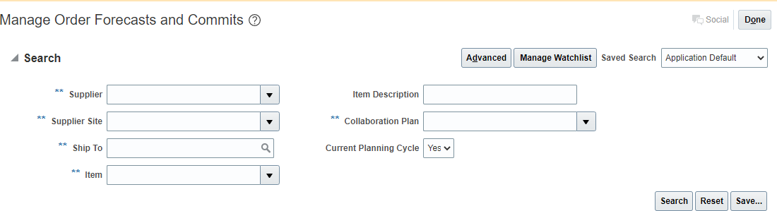
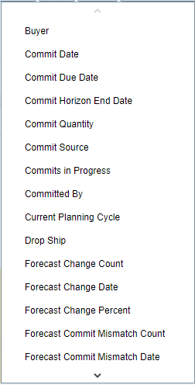
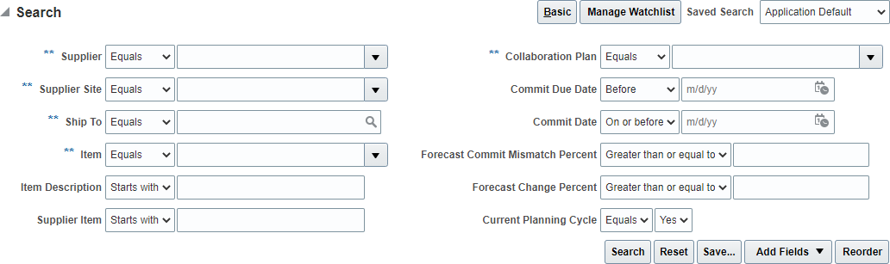
Order Forecast and Commit (Supplier’s View)
Navigation – Supplier Portal Work area → Supply Plan → Manage Order Forecasts and Commits
Search for Forecast based on multiple search criteria available. For more details, click on Advanced.
1
3
2
To add more fields on main search screen, click on Add Fields

Slide 9
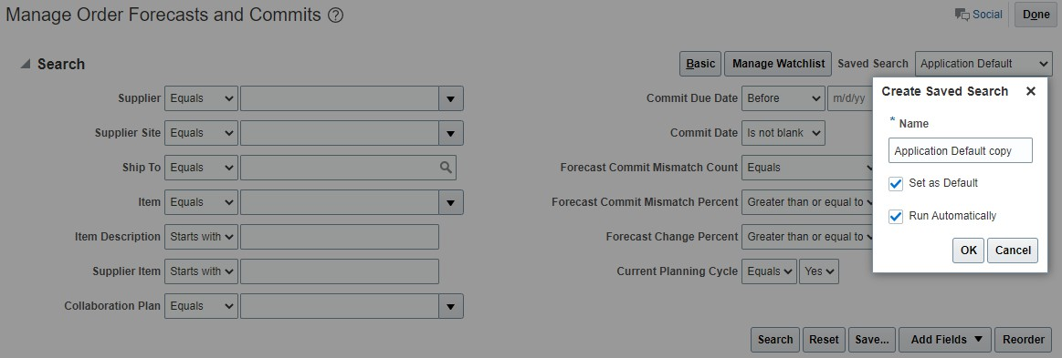
Order Forecast and Commit – Save Search Criteria
Once the fields are added, provide default values and save the search criteria
Click on Save and provide a Name for the search criteria provided.
Check Set as Default if the same search criteria need to be run as default.
Check Run Automatically, if the save search criteria needs to be run automatically whenever the screen opens

Slide 10
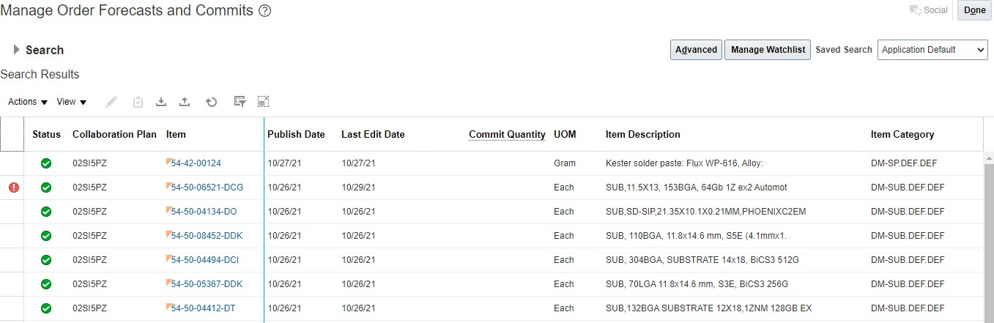
Order Forecast and Commit
Based on the Search criteria, search result will be shown
Click on the Item link to see the details of an item

Slide 11
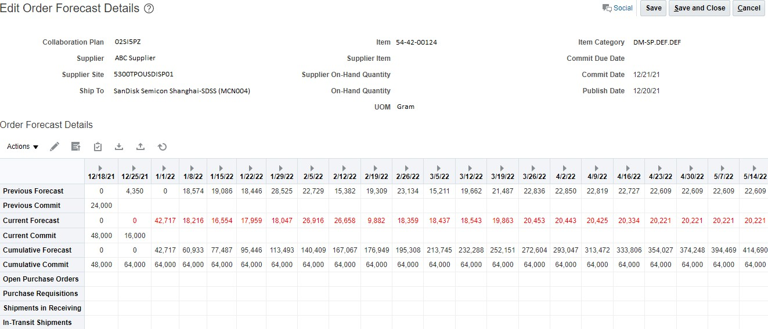
Order Forecast and Commit
Details of the selected item will be shown
Review Order Forecast (Current & Cumulative)

Slide 12
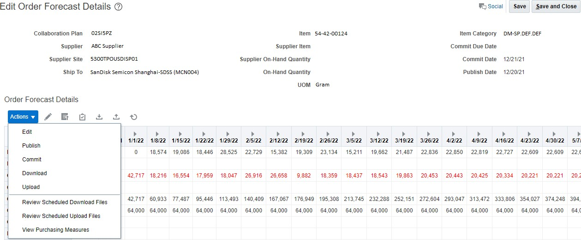
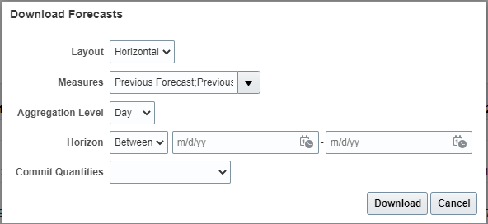

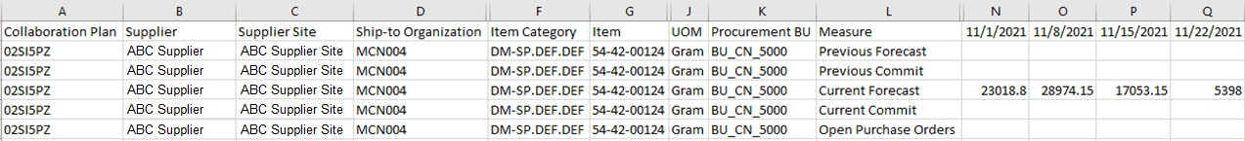
Order Forecast and Commit
Download all records for review
1
Click on Action and Download
Select different parameters for download
2
3
Downloaded CSV in Excel

Slide 13
2.0 Commit against Forecast
Navigation– Supplier Portal Work area → Supply Plan → Manage Order Forecasts and Commits
Search for Forecast based on multiple search criteria available and select the item for which commit to be provided
Note: Commit can be done only at the level of Forecast Granularity i.e if Forecast is Weekly, commit can also be done Weekly. Daily commits cannot be done in this case

Slide 14
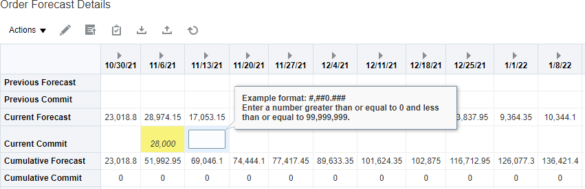
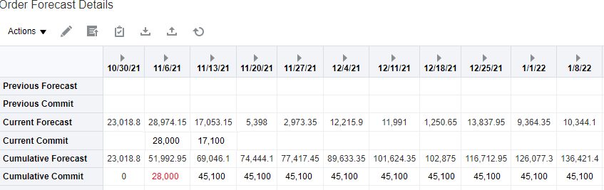
Commit against Forecast – Option 1
Option 1 – Update Commit values for individual buckets manually
1
Update Commit values for individual records and save
2
After saving the records, Cumulative Commit will be calculated and displayed

Slide 15
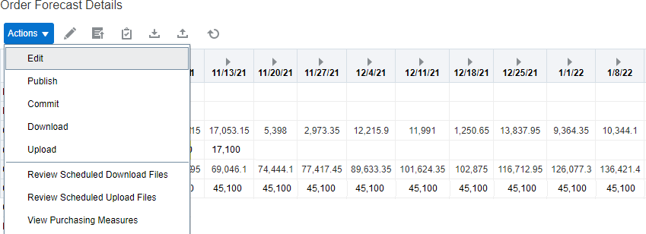
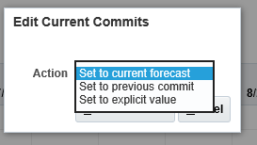
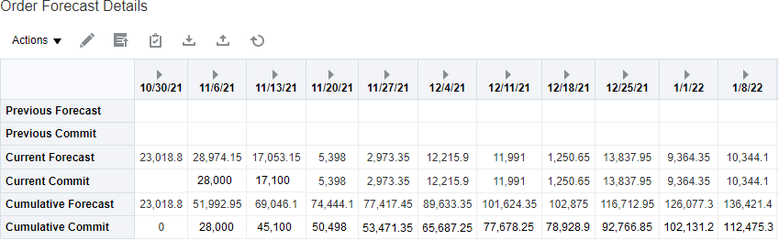
Commit against Forecast – Option 2
Option 2 – Mass update the commit values with different options available
Select multiple records or all records and click on Action → Edit or Edit button
1
Select multiple records or all records and click on Action
→ Edit or click on Edit button
3
Once updated, click on Commit
button or Action → Commit
2
Select the option for Commit and click on Save and Close
Set to Current forecast
Set to previous commit
Set to explicit values

Slide 16
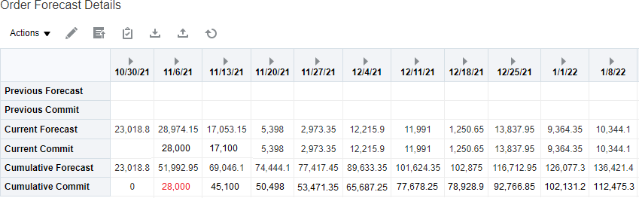

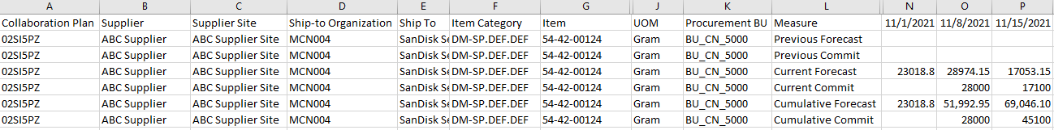
Commit against Forecast – Option 3
Option 3 – Mass update – Download data in Excel, Edit/update data and Upload data
Forecast and Commit data can be downloaded in excel format and necessary changes can be made to
commit data. Once done, the file can be uploaded back .
Download records by clicking on Action → Download or by clicking download button
1
3
Downloaded CSV in Excel
Select different parameters for download
2
2

Slide 17
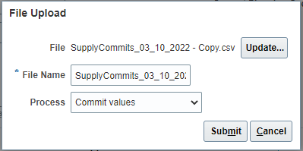
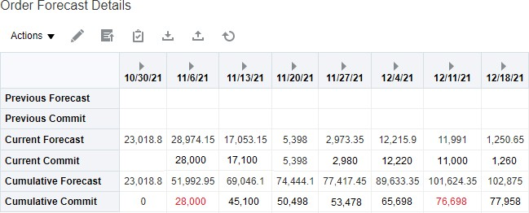
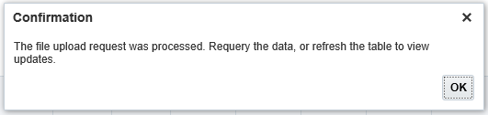
Commit against Forecast – Option 3
Make changes to the excel file (Add/Edit the commit values) and upload the file
4
Upload file by clicking on Action → upload or by clicking upload button and click on Submit
For all records, where Current Commit is less than Current Forecast, Cumulative commit value is shown in RED
5
6
Click on Ok and re query the data to see the uploaded values

Slide 18
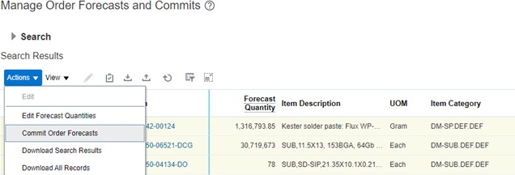
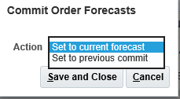
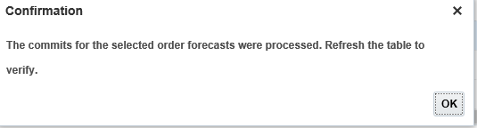
Commit against Forecast – Option 4
Option 4 – Mass update the commit values for multiple items together
Select multiple items records on the main search page. Click on Action → Commit Order Forecast
1
Select multiple records or all records and click on Action
→ Commit Order Forecast
2
3
Select the option for Commit and click on Save and Close
Set to Current forecast
Set to previous commit

Slide 19
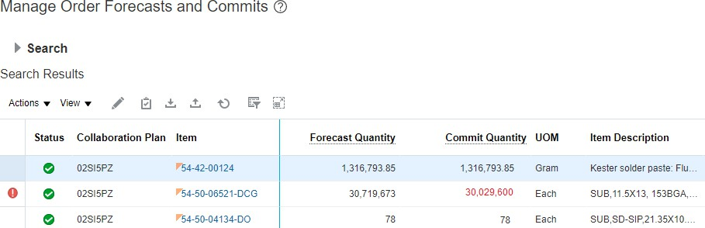
Commit against Forecast – Option 4
Re query the records to see the changes
Commit values are updated based on the parameter selected
Can see exceptions where forecast
does not match commit

Slide 20
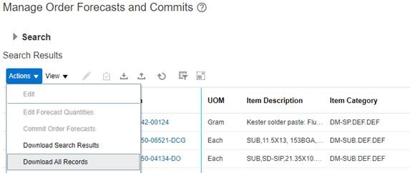
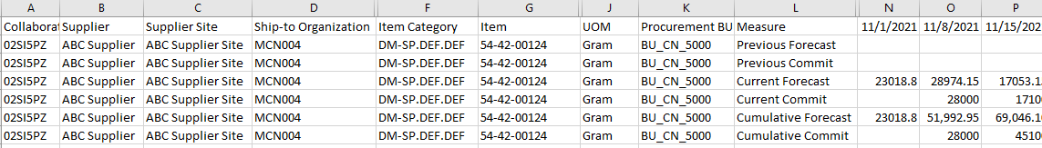
Commit against Forecast – Option 5
Option 5 – Mass update the commit values for multiple items together by downloading in excel and
uploading the updated file
Search for specific criteria and . Click on Action → Download Search Result
1
Select multiple records or all records and click on Action
→ Download Search result
Note records for multiple items are downloaded
2

Slide 21
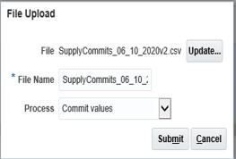
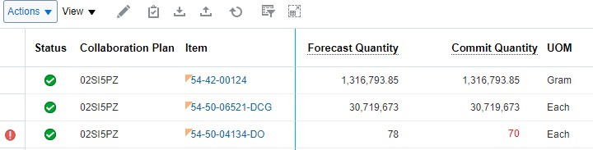
Commit against Forecast – Option 5
Make changes to the excel file (Add/Edit the commit values) and upload the file
Upload file by clicking on Action → upload or by clicking upload button and click on Submit
3
4
Click on Ok and re query the data to see the uploaded values

Slide 22
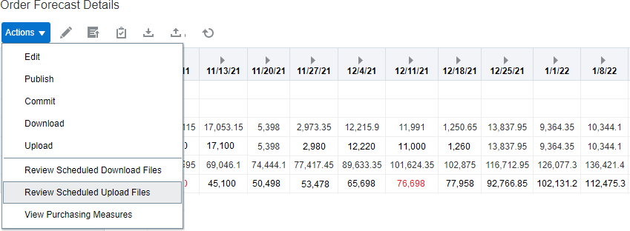
Status of File after uploading Commit
Navigation – Supplier Portal Work area → Supply Plan → Manage Order Forecasts and Commits → Action
→ Review Scheduled Upload Files
1
1
Open Review Upload Files

Slide 23
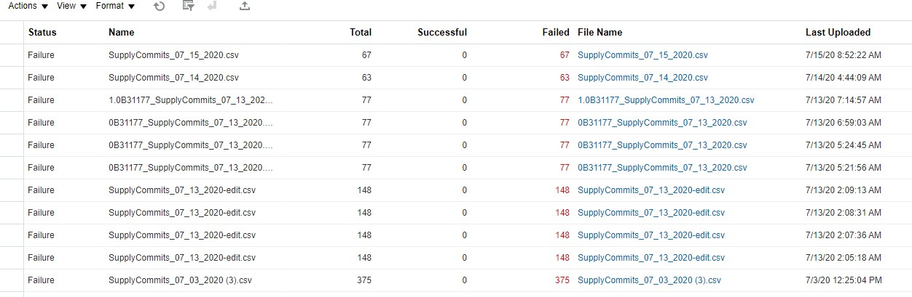
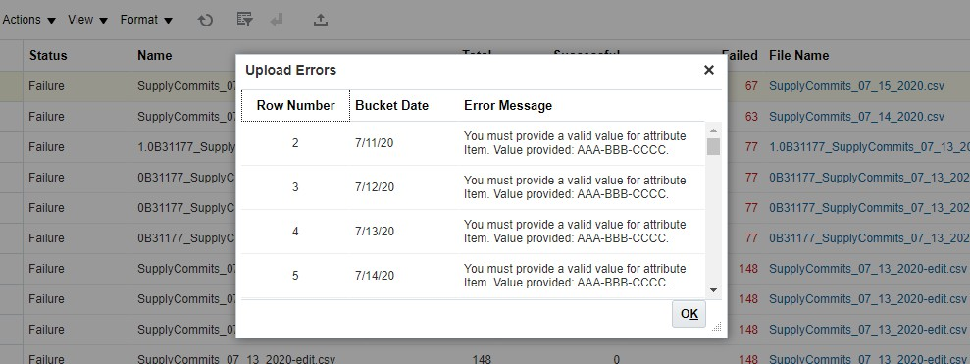
Status of File after uploading Commit
2
Click on Error link to see the error reason
Check number of records succeeded and number of records in error

Slide 24
Learning Summary
Following topics are covered in the section:
Order Forecast & Commit Page
Search based on different parameters available
Download records for review
Commit against forecast
Manual update
Mass update commit values by using different options
Download records, Edit records and upload
Mass update for multiple items together using various commit options available
Download records for multiple items, edit and upload

Slide 25
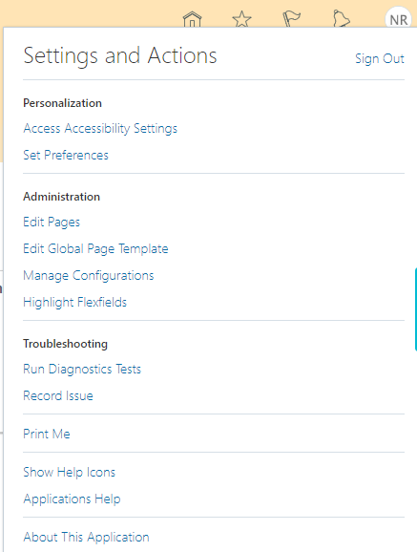
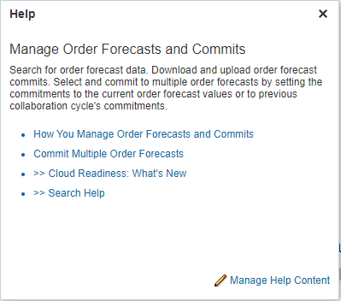
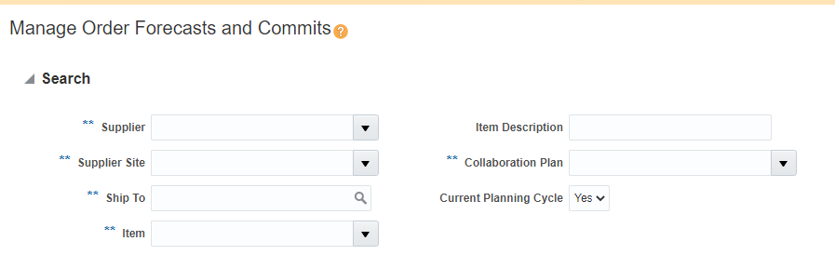
Additional References
1
On Setting and Actions, click on Show Help Icons to enable help.
3
2
Help Menu will get enables for each page and Users can click on help menu to get additional help.

