Slide 1
FLASH SUPPLY CHAIN COLLABORATION TRAINING - REPORTS

Slide 2
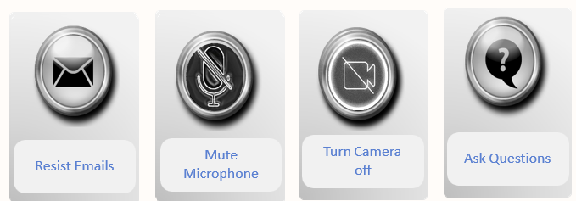
Ground Rules during classroom training sessions

Slide 3
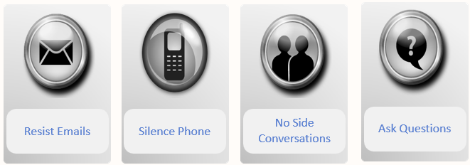
Ground Rules during on-line training sessions

Slide 4
COURSE AGENDA:
Topic | Objective
Forecast Commit Analysis Report | To understand how to run report and various details covered in the report
Order Forecast & Comparison Report | To understand how to run report and various details covered in the report
Supply Commit & Comparison Report | To understand how to run report and various details covered in the report

Slide 5
FORECAST COMMIT ANALYSIS REPORT

Slide 6
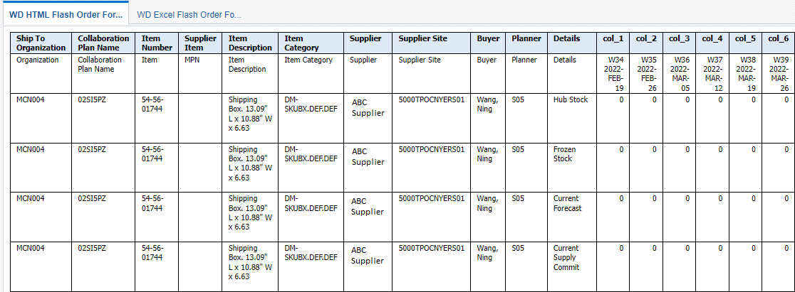
Forecast Commit Analysis Report
Forecast is published to Suppliers every week and Supplier will provide Commit against the Forecast every week. When the Forecast is published to the supplier and after the commitment is received from suppliers, planners & Suppliers will need some additional information along with forecast & commit values to arrive at some critical decisions. The additional details along with the forecast and commit details will help planner & suppliers to take necessary action to correct the plan. The report will provide the additional details as required in a specific format and will have the functionality to download the report in excel format also
7

Slide 7
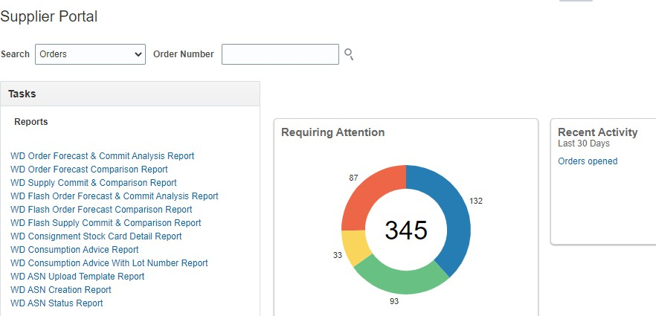
Forecast Commit Analysis Report – How to Run
Navigation – Supplier Portal → Reports displayed on Left Side → Click on WD Flash Order Forecast &
Commit Analysis Report
Click on report and the report will open in a new window
WESTERN DIGITAL CONFIDENTIAL

Slide 8
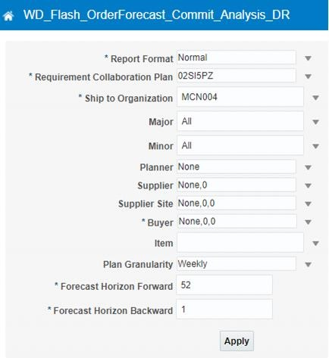
Forecast Commit Analysis Report – Parameters
When Click on Open, a new page will open which has parameter window
Provide different parameters to execute the report. Some of the parameters are mandatory and some optional. Select relevant parameters as applicable and click on Apply to run the report

Slide 9
Forecast Commit Analysis Report – HTML Output
Provide relevant parameters and click on Apply
Report output can be viewed on the screen by selecting WO HTML Order Forecast Commit Analysis Data Report tab or can be downloaded in excel format using WO Excel Order Forecast Commit Analysis Data Report

Slide 10
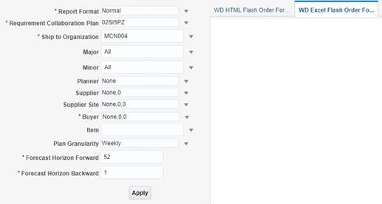
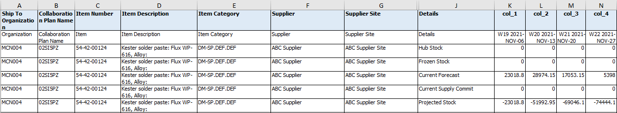
Forecast Commit Analysis Report – Excel Output
Provide relevant parameters and click on Apply after selecting Excel Tab
Report output can be downloaded in excel format using WO Excel Order Forecast Commit Analysis Data Report

Slide 11
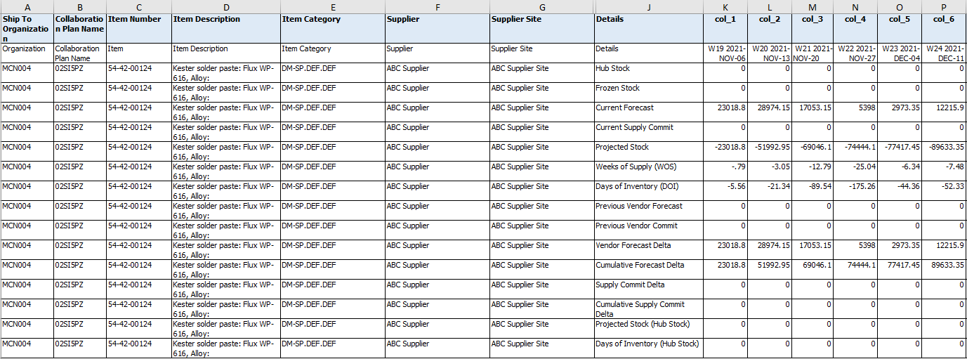
Forecast Commit Analysis Report – Measures – 1 /3
Key Measures explanation
HUB Stock : On-Hand QTY, we receive either from VMI or through supplier upload every day 7 A.M (if any)
Frozen Stock : On-Hand Quantity, which is received from VMI or suppliers as on Monday 7 A.M
Current Forecast : Latest MRP forecast for the suppliers
Current Supply Commit : Latest supply commit provided by suppliers

Slide 12
Forecast Commit Analysis Report – Measures – 2/3
Key Measures explanation
Projected Stock : (Frozen Stock + Current Supply Commit) – Current Vendor Forecast
Weeks of Supply (WOS) : Projected stock (N Week) / Current Vendor forecast (N + 1 Week)
Days of Inventory (DOI) : Projected stock (N Week) / Current Vendor forecast (N + 1 Week) / 7 days
Previous Vendor Forecast : Last week Vendor forecast
Previous Vendor commit : Last week Supply Commit

Slide 13
Forecast Commit Analysis Report – Measures – 3/3
Key Measures explanation
Vendor Forecast Delta: Current Vendor Forecast – Previous Vendor Forecast
Cumulative Forecast Delta : Cumulative Delta (10)
Supply Commit Delta : Current Supply Commit – Previous Supply Commit
Cumulative Supply Commit Delta : Cumulative Delta (12)
Projected Stock (Hub Stock) : (Hub Stock + Current Supply Commit) – Current Vendor Forecast
Days of Inventory (Hub Stock) : Projected Stock (Hub Stock) / Current Vendor Forecast (Week N+1)/7

Slide 14
ORDER FORECAST & COMPARISON REPORT

Slide 15
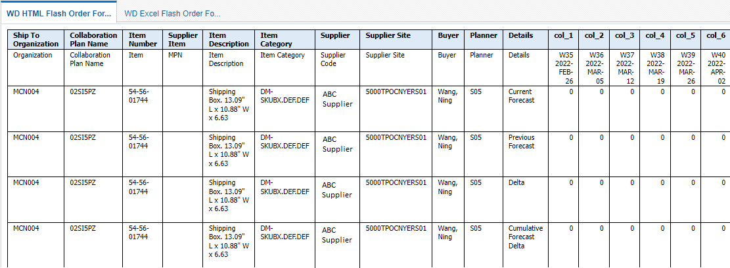
Order Forecast & Comparison Report
Forecast is published to Suppliers every week and Supplier will provide Commit against the Forecast every week. When the Forecast is published to the supplier, planners & Suppliers will review the Forecast, Previous Forecast & Delta. Current forecast details along with previous forecast and delta will help planner & suppliers to take necessary action to correct the forecast if required. The report will provide the forecast details as required in a specific format and will have the functionality to download the report in excel format also.

Slide 16
Order Forecast & Comparison Report– How to Run
Navigation – Supplier Portal → Reports displayed on Left Side → Click on WD Flash Order Forecast
Comparison Data Report
Click on report and the report will open in a new window

Slide 17
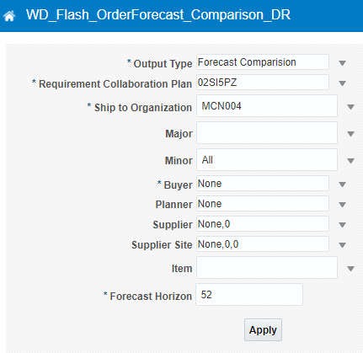
Order Forecast & Comparison Report – Parameters
When Click on Open, a new page will open which has parameter window
Provide different parameters to execute the report. Some of the parameters are mandatory and some optional. Select relevant parameters as applicable and click on Apply to run the report

Slide 18
Order Forecast & Comparison Report – HTML Output
Provide relevant parameters and click on Apply
Report output can be viewed on the screen by selecting WO HTML Order Forecast Comparison Data Report tab or can be downloaded in excel format using WO Excel Order Forecast Comparison Data Report

Slide 19
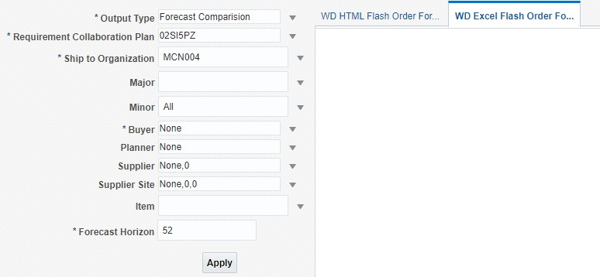
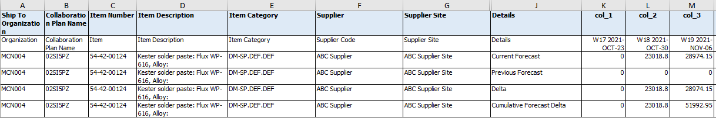
Order Forecast & Comparison Report – Excel Output
Provide relevant parameters and click on Apply after selecting Excel Tab
Report output can be downloaded in excel format using WO Excel Order Forecast & Comparison Data Report

Slide 20
SUPPLY COMMIT & COMPARISON REPORT

Slide 21
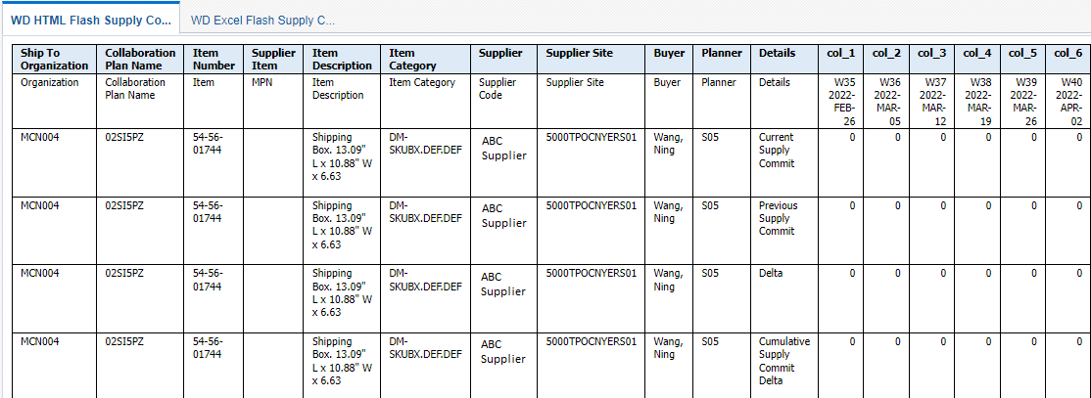
Supply Commit & Comparison Report
Forecast is published to Suppliers every week and Supplier will provide Commit against the Forecast every week. When the Forecast is published to the supplier and after the commitment is received from suppliers, planners & Suppliers will review the Commit and needs details on the previous commit along with Delta. The additional details along with the forecast and commit details will help planner & suppliers to take necessary action to correct the commit if required. The report will provide the additional details as required in a specific format and will have the functionality to download the report in excel format also.

Slide 22
Supply Commit & Comparison Report– How to Run
Navigation – Supplier Portal → Reports displayed on Left Side → Click on WD Flash Supply Commit and
Comparison Data Report
Click on report and the report will open in a new window

Slide 23
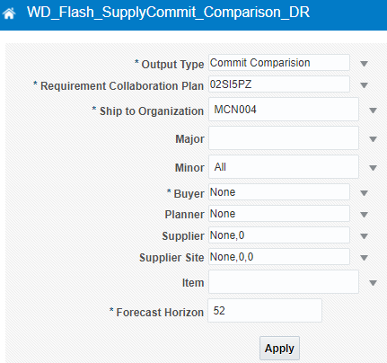
Supply Commit & Comparison Report – Parameters
When Click on Open, a new page will open which has parameter window
Provide different parameters to execute the report. Some of the parameters are mandatory and some optional. Select relevant parameters as applicable and click on Apply to run the report

Slide 24
Supply Commit & Comparison Report – HTML Output
Provide relevant parameters and click on Apply
Report output can be viewed on the screen by selecting WO HTML Order Forecast Comparison Data Report tab or can be downloaded in excel format using WO Excel Order Forecast Comparison Data Report

Slide 25
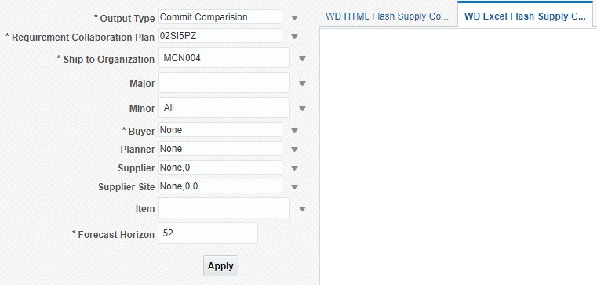
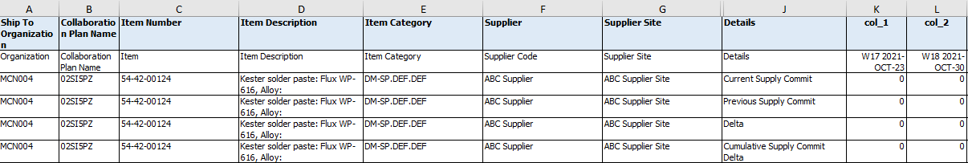
Supply Commit & Comparison Report – Excel Output
Provide relevant parameters and click on Apply after selecting Excel Tab
Report output can be downloaded in excel format using
WO Excel Supply Commit & Comparison Data Report

Slide 26
SCHEDULING REPORT DOWNLOAD
| WESTERN DIGITAL CONFIDENTIAL
3/22/2022

Slide 27
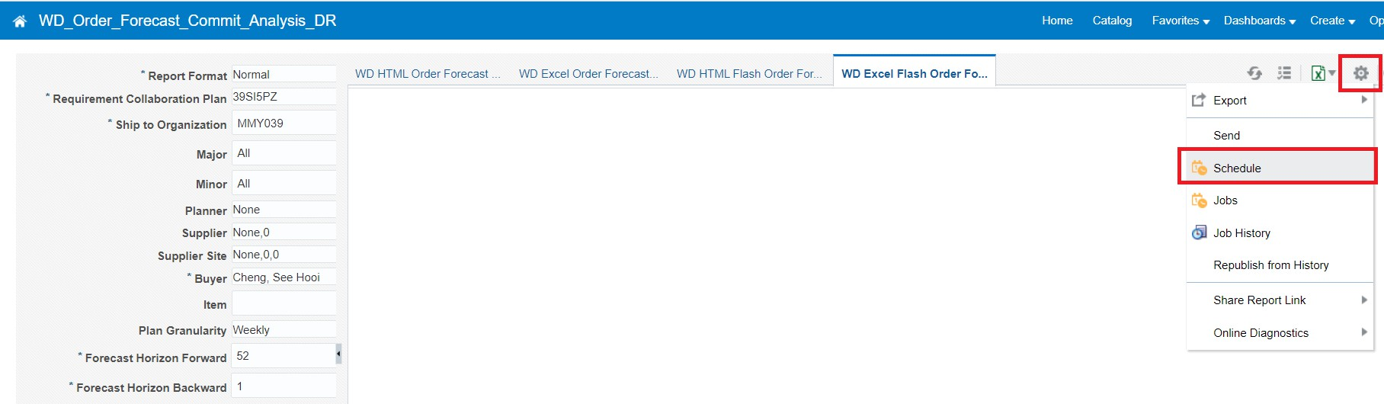

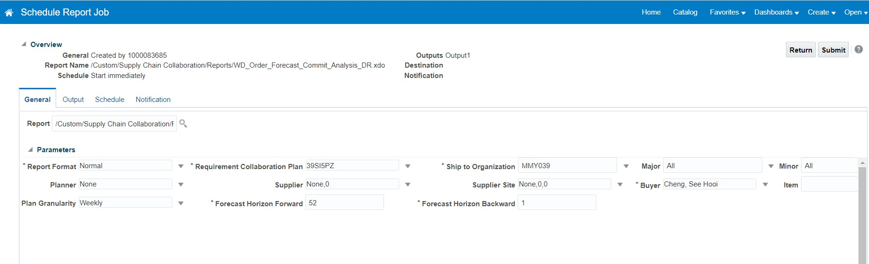
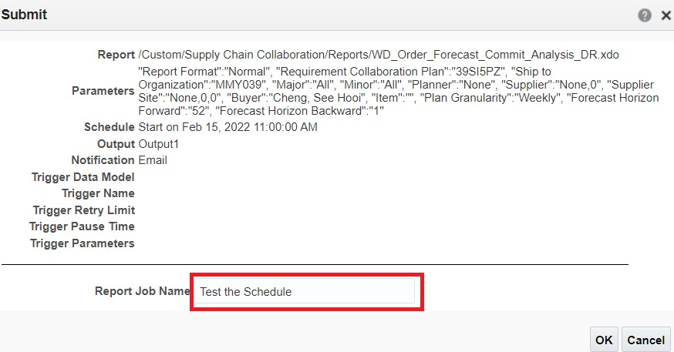
SCC Reports – Schedule Download
If a report takes too long to download, you may create a schedule to download it
Navigation: In the report page, Action icon -> Schedule -> Configure the schedule -> Submit -> Provide a
schedule name
1. Action icon
2. Schedule
3. Configure the settings of the schedule
4. Submit
5. Provide a schedule name

Slide 28
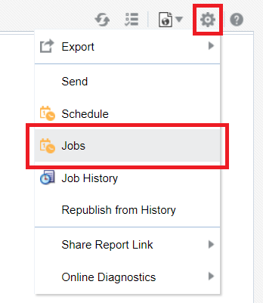
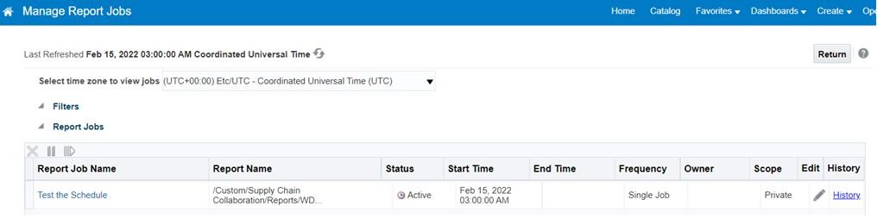
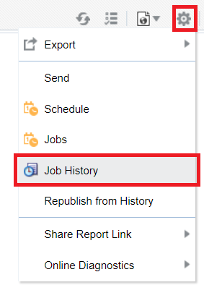
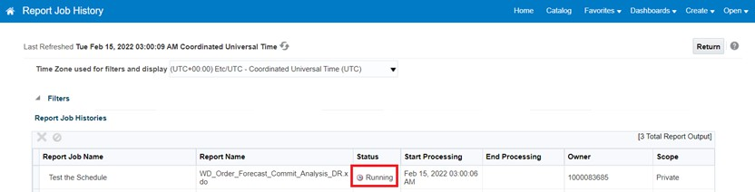
SCC Reports – Monitor Scheduled Download
To monitor the scheduled download,
Navigation: In the report page, Action icon -> Jobs or Job History -> Report Jobs/Report Job Histories
2. Jobs – To monitor the job status before schedule triggered
1. Action icon
4. Look for the schedule name and check the status of the schedule
3. Job History – To monitor the job status after schedule triggered

Slide 29
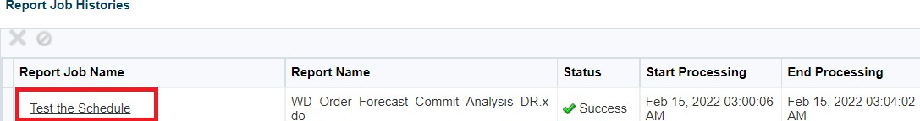
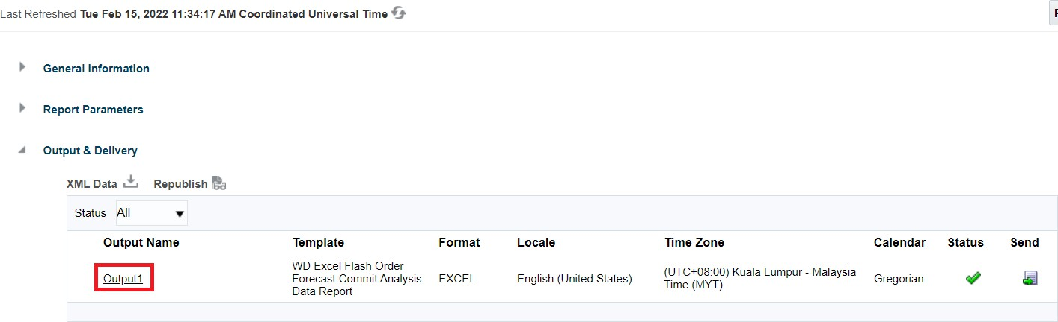
SCC Reports – Download the scheduled report
To download the scheduled report,
Navigation: In the report page, Action icon -> Job History -> Select Report Job Name -> Choose Output
Name and download.
1. Action icon
3. Look for the schedule name and ensure the status is success
2. Job History
4. Look for the output name and click to download

Slide 30
TOPIC LEARNING SUMMARY
Learning from the section:
Forecast Commit Analysis Report
Order Forecast & Comparison Report
Supply Commit & Comparison Report

