Slide 1
FLASH SUPPLY CHAIN COLLABORATION TRAINING
SUPPLIER ON HAND UPLOAD

Slide 2
COURSE AGENDA:
Topic | Objective
Manage Supplier Onhand | How suppliers can upload items on hand quantities

Slide 3
MANAGE SUPPLIER ONHAND

Slide 4
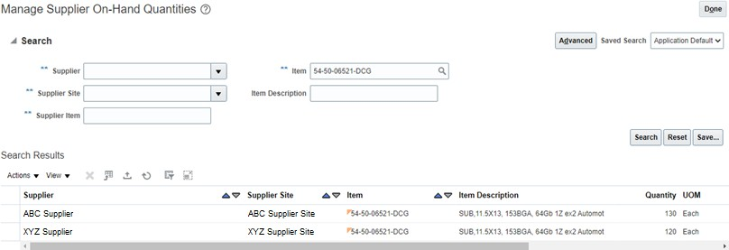
Overview – Manage Supplier On hand
Note: For VMI suppliers, On-Hand will be loaded automatically in the system based on VMI feeds from Agility; hence suppliers need not upload the on-hand through Supplier portal. Also, the on-hand should be inventory available for WD for a specific Manufacturing location.
Supplier can upload the On Hand quantities for a specific Supplier site on the portal thus enabling better
planning decisions
Allows users to manage supplier on-hand quantities at the supplier site level
Supplier on-hand quantities can be managed by either Supplier or Planner on behalf of supplier
Supplier on-hand quantities are visible on Manage Supplier On Hand Quantities page and in Forecast
Commit and Analysis Report providing additional information to take planning decisions
7

Slide 5
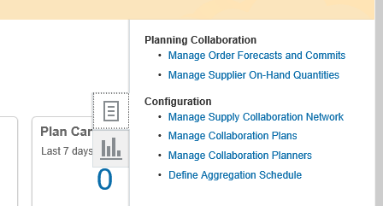
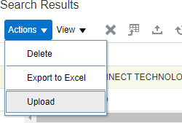
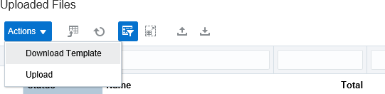

Upload Supplier On-Hand Quantities
Navigation for Planners – Supply Chain Collaboration work area → Tasks → Manage Supplier On-Hand Quantities
Navigation for Suppliers – Supplier Portal Work area → Supply Plan → Manage Supplier On-Hand
Quantities
1
2
Click on Action → Upload
A new window will open
Update the template with Data (Item and On-Hand quantities)
3
Click on Download Template to download template for the first time

Slide 6
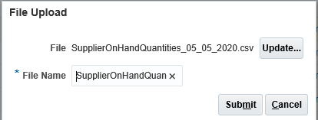
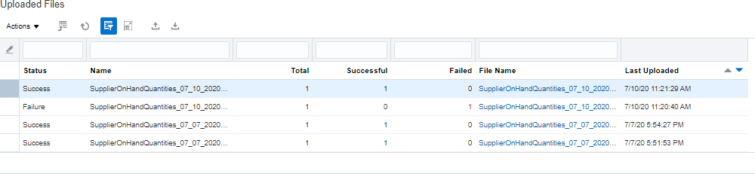
Upload Supplier On-Hand Quantities
Once the file is updated with current on hand quantities data, upload the file on portal.
4
5
Post Submit, user can monitor the upload status

Slide 7
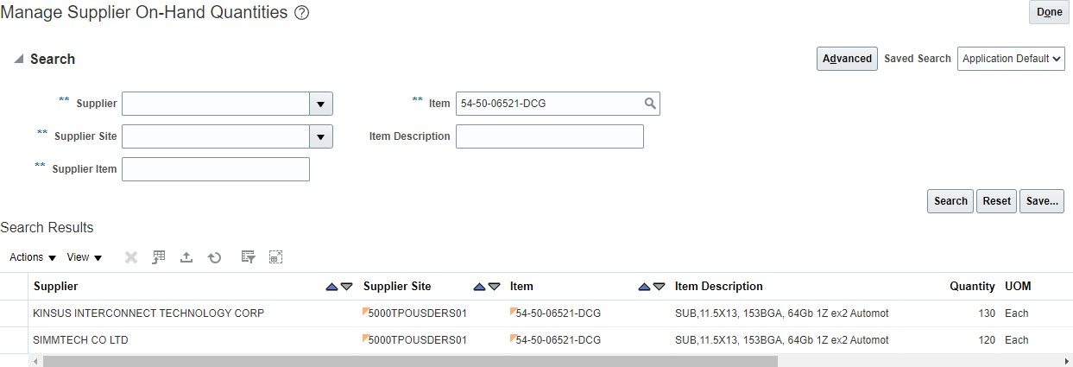
View Supplier On Hand Quantities
Navigation – Supplier Portal Work area -- Supply Plan -- Manage Supplier On-Hand Quantities
1
Provide Search Criteria and click on Search
Search Result will show details of Supplier On hand quantities based on search criteria
2

