Slide 1
4A – Consignment Report at Supplier Portal
25 June 2021
DM BUSINESS SUPPORT

Slide 2
4A – Consignment Report at Supplier Portal
Introduction Consignment Report Available at Supplier Portal
Supplier able to run below report at supplier portal weekly. Report status refresh weekly every Monday GMT 00:00:00.
Consignment Stock Card Detail Report
Report that contains all previous week transaction types, lot number and quantity under consigned item by supplier on period of WD fiscal cut off week calendar.
Consumption Advice Report
Report that contains item that consumed from consigned inventory quantity, Invoice number and amount by Supplier on that period of week.
Date of creation consumption invoice number is 1 day delay from actual transaction date.

Slide 3
Thing That Supplier Must Do
Fundamental Rule Supplier Contact List Able to Run The Report
The Contact list need update with contact addresses in the Supplier portal
The Contact list need to have role WDC Supplier Portal Full Access JR
Ensure Contact List is Up To Date
Supplier need to ensure the contact list in portal is up to date. This is to ensure supplier information protected and allow system to communicate to right party
Remove inactivate contact list from supplier Portal. Eg: Those contact list that previously signup as supplier portal and that person already left the supplier company. Kindly removed it from the portal

Slide 4
1) CONSIGNMENT STOCK CARD DETAIL REPORT

Slide 5
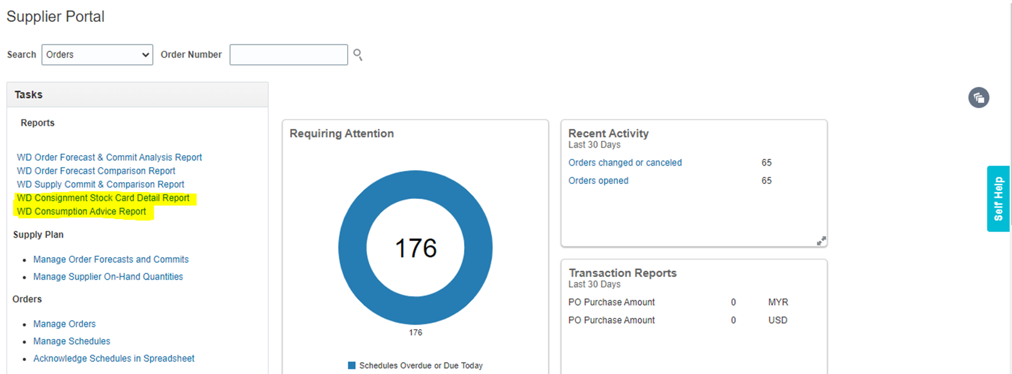
WD Consignment Stock Card Detail Report- How to Run
Navigation – Supplier Portal → Reports displayed on Left Side → Click on WD Consignment Stock Card Detail Report

Slide 6
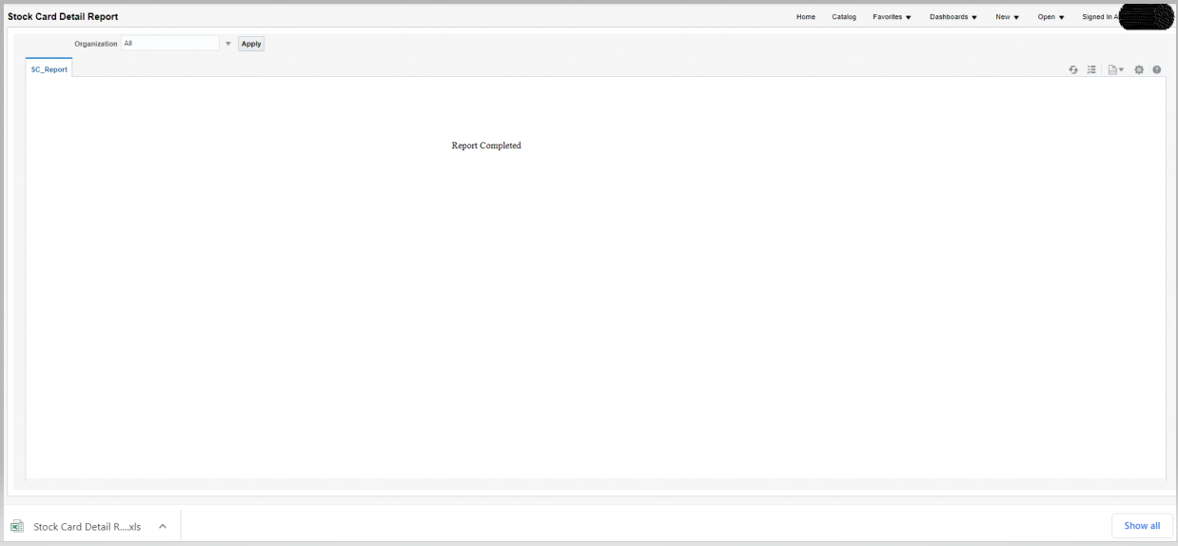
WD Consignment Stock Card Detail Report- Parameter
When Click on Open, a new page will open which has parameter window
Click on Apply for all organization or click search to find organization and apply
Report completed the Excel output will prompted below

Slide 7
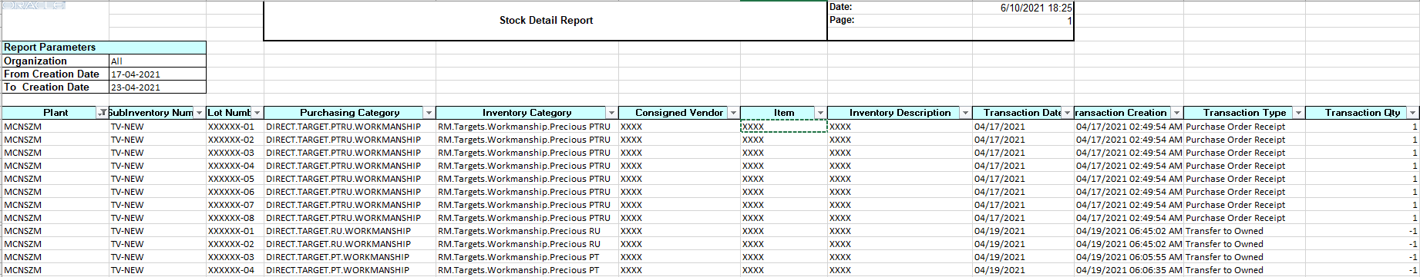
WD Consignment Stock Card Detail Report- Excel Output
Excel Output:
Data content weekly period according to WD fiscal Calendar cut off Sat to Fri GMT 00:00:00.
Data will refresh every Monday GMT 00:00:00
Report output can be downloaded in excel format.

Slide 8
2) CONSUMPTION ADVISE REPORT

Slide 9
WD Consumption Advice Report- How to Run
Navigation – Supplier Portal → Reports displayed on Left Side → Click on WD Consumption Advice Report
Click on report and the report will open in a new window

Slide 10
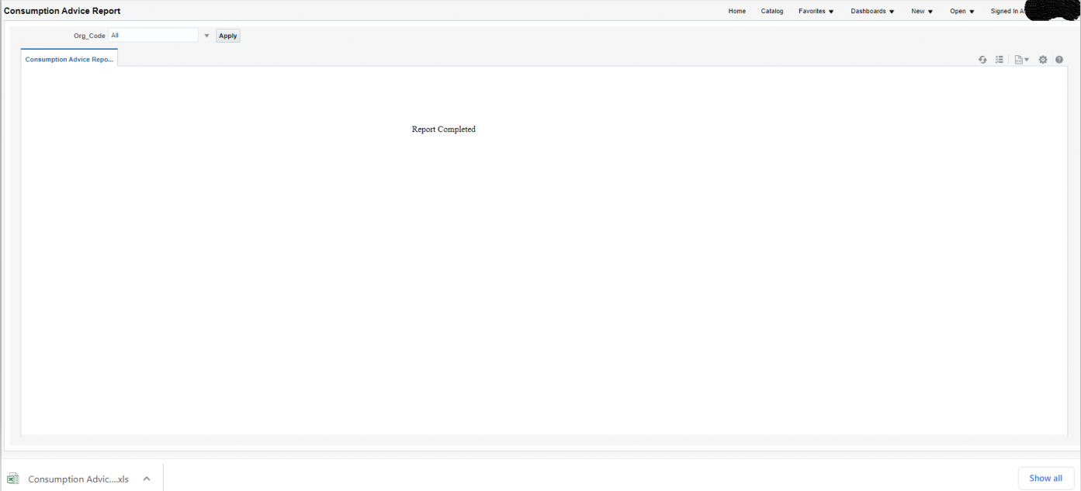
WD Consumption Advice Report- Parameter
When Click on Open, a new page will open which has parameter window
Click on Apply for all organization or click search to find organization and apply
Report completed the Excel output will prompted below

Slide 11
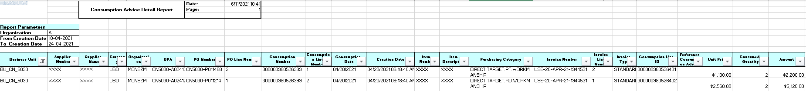
WD Consumption Advice Report- Excel Output
Excel Output:
Date of creation consumption invoice number is 1 day delay from actual transaction date
Data content weekly period according to WD fiscal Calendar cut off Sun to Sat GMT 00:00:00.
Data will refresh every Monday GMT 00:00:00
Report output can be downloaded in excel format.

