Slide 1
4A – CONSIGNED INVENTORY
25 June 2021
DM BUSINESS SUPPORT

Slide 2
1) REVIEW CONSUMPTION ADVICES

Slide 3
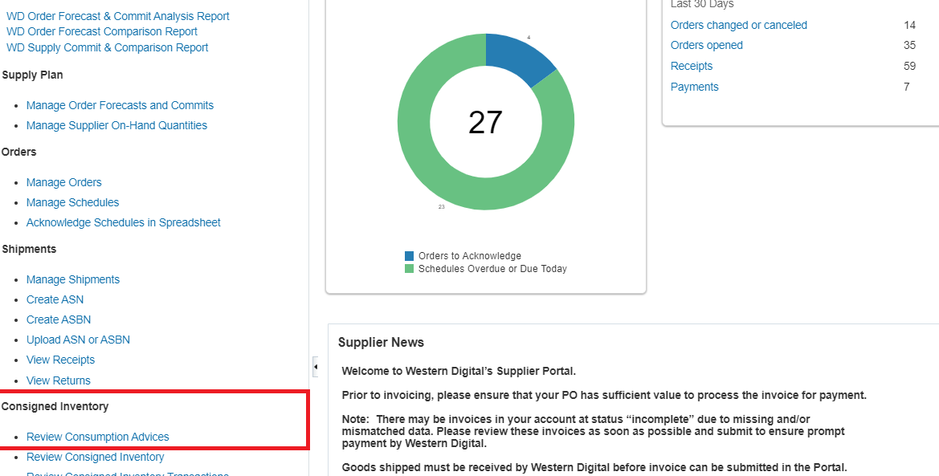
Review Consumption Advices
A consumption advice is a periodic summary report of consumption transactions that reports the usage of consigned inventory to the supplier based upon a consumption advice frequency. The consumption advice stores the details needed to communicate information to the supplier such as item quantity and value of the inventory consumed in the warehouse. The consumption advice also serves as the document to initiate financial settlement for the consumed material
Click on report and the report will open in a new window

Slide 4
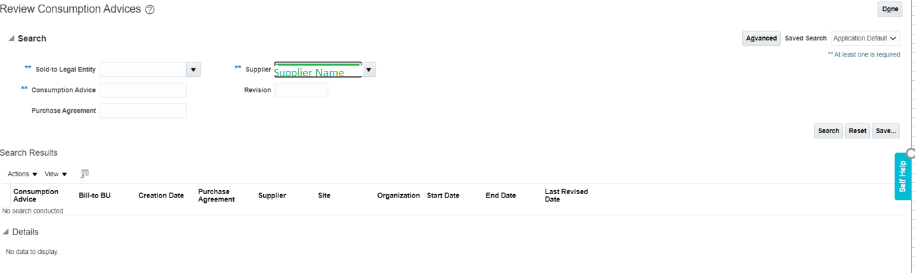
Review Consumption Advices – Parameters
When Click on Open, a new page will open which has parameter window
Provide different parameters to execute the report. Some of the parameters are mandatory and some optional. Select relevant parameters as applicable and click on Search to run the report
Click on Advance Search to add creation date; select between in order to review the period of consumption advice

Slide 5
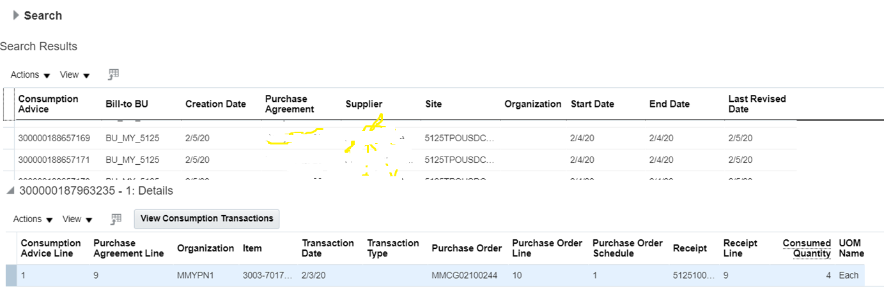
Review Consumption Advices – Output
The result returned will be depending on search parameter
Search this icon to export output to Excel
Search output can be viewed on the screen
Click View to to select Lot # in details

Slide 6
2) REVIEW CONSIGNED INVENTORY

Slide 7
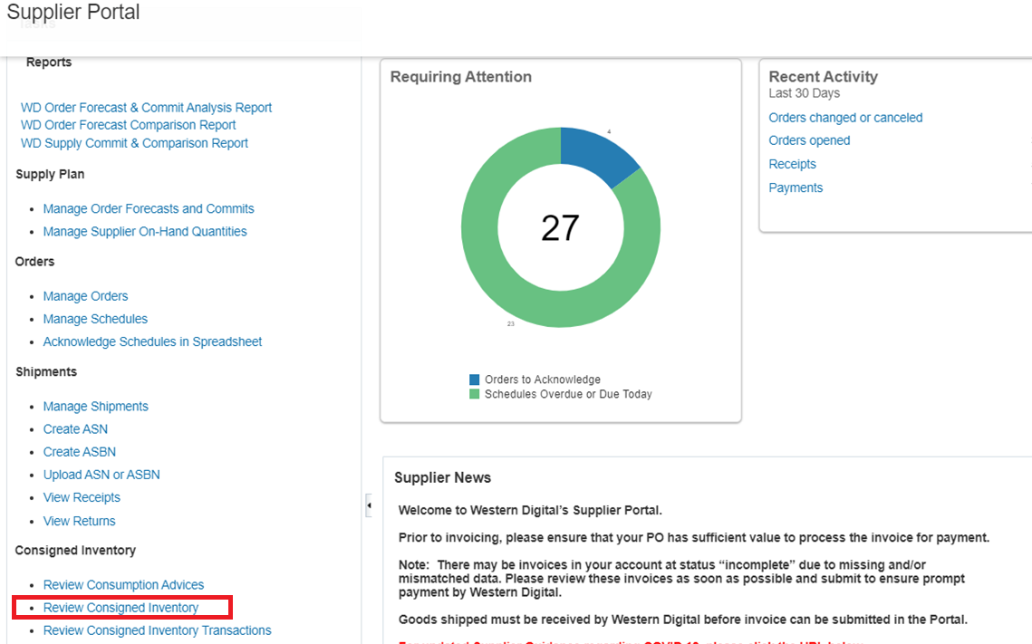
Review Consigned Inventory
Consigned inventory refers to items that are in the possession of one party, but remain the property of another party by mutual agreement
Click on report and the report will open in a new window

Slide 8
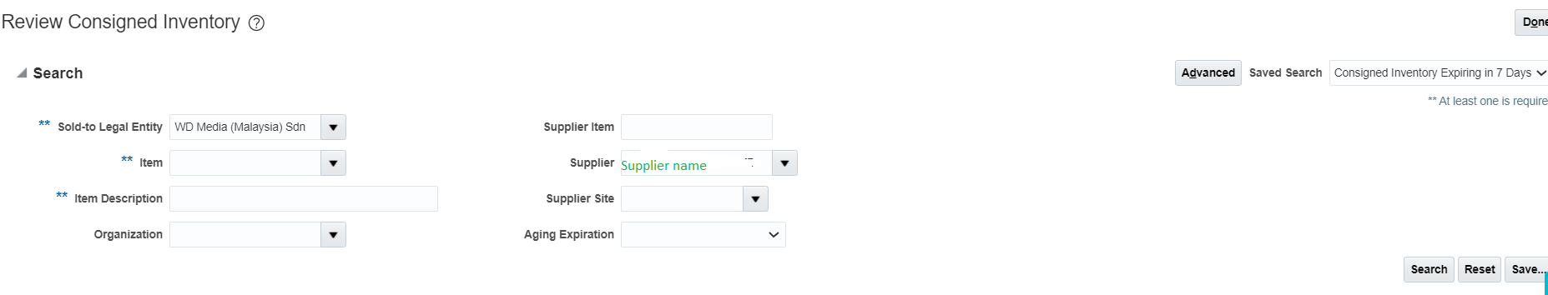
Review Consigned Inventory– Parameters
When Click on Open, a new page will open which has parameter window
Provide different parameters to execute the report. Some of the parameters are mandatory and some optional. Select relevant parameters as applicable and click on Search to run the report

Slide 9
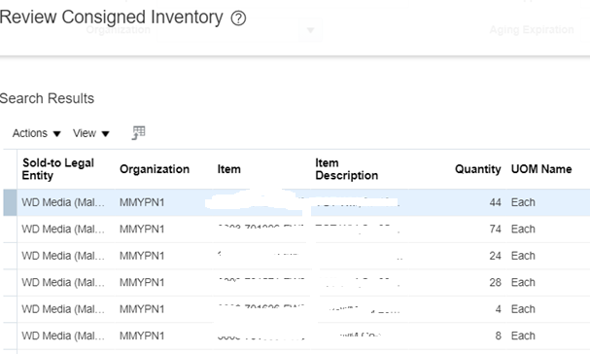
Review Consigned Inventory– Output
The result returned will be depending on search parameter
Search this icon to export output to Excel
Search output can be viewed on the screen
Click to item to view detail lot# info

Slide 10
3) REVIEW CONSIGNED INVENTORY TRANSACTIONS

Slide 11
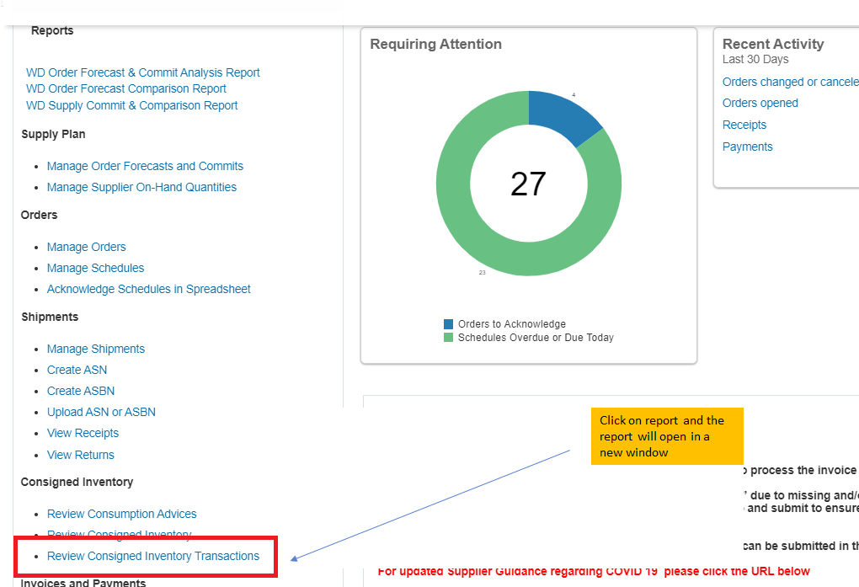
Review Consigned Inventory Transactions
Consigned Inventory transaction refer to ownership changes for the consigned inventory
Click on the report and the report will open in a new window

Slide 12
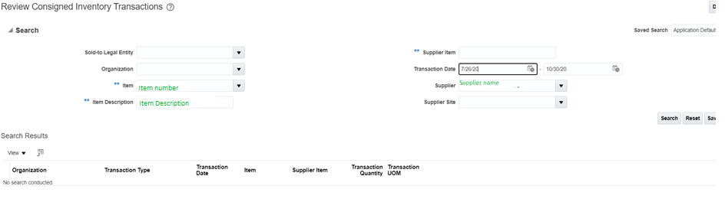
Review Consigned Inventory Transactions– Parameters
When Click on Open, a new page will open which has parameter window
Provide different parameters to execute the report. Some of the parameters are mandatory and some optional. Select relevant parameters as applicable and click on Search to run the report

Slide 13
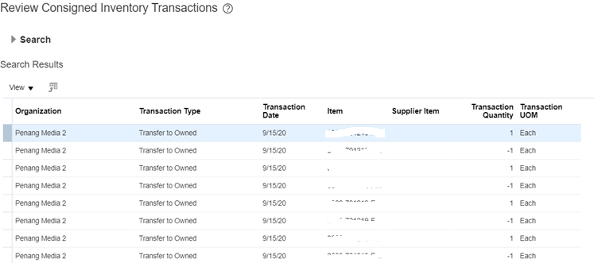
Review Consigned Inventory Transactions – Output
The result returned will be depending on search parameter
Search output can be viewed on the screen

