Slide 1
CREATE AND MANAGE
INVOICES

Slide 2
Invoice Components
Let’s begin our course by understanding the invoice components.
The invoice information is divided into the following components in Cloud:
  Invoice Header defines common information about an invoice, such as Invoice Number, Invoice Amount, Supplier, and Payment Terms
  Invoice Lines record the details of goods and services including tax, freight, and miscellaneous charges. They capture the details necessary for integration with applications
Header
Lines
Notes:
Let’s first gain an understanding of what an invoice is. Invoice is an itemized list of goods shipped or services rendered, with an account of all costs. The invoice information is divided into four components – Invoice Header, Invoice Lines, Installments, and Invoice Distributions. Let’s learn more about each component.

Slide 3
Key Benefits
Key benefits for creating invoices are as follows:
Suppliers will use the Oracle Supplier Portal to navigate to Open Purchase Orders and create invoices against them
Suppliers will be able to create, view and manage both 2-Way and 3-Way Invoices matched against Orders
Suppliers will be able to enter all the invoice details such as Identifying Purchase Order, invoice number, invoice type (credit memo and standard invoice), and date through a single unified platform
Suppliers will be able to search for invoices using various criteria such as invoice number, invoice status, paid status etc.
Notes:
Great. Now let’s learn about the key benefits for managing invoices. Read each of the key benefits mentioned on the screen.

Slide 4
Create Invoices: Process Flow
Let’s learn about the process to create invoices against an open Purchase Order.
Search for Purchase Order
External Supplier:
Search for the open Purchase Order
Add Line Item and Create Invoice
External Supplier:
Add Purchase Order line items and create invoice
Submit Invoice for further Processing
External Supplier:
Submit invoice for further processing (validation, approval, and payment) and confirm submission
Validate and Approve Invoice
Western Digital Finance Team:
Validate and approve the submitted invoice
Steps performed by Suppliers
Please note: Goods must be received by Western Digital before invoice can be submitted in the Portal
Steps performed by Western Digital
Notes:
Let’s learn about the process to manage invoices against an Open Purchase Order. View the process flow as shown.

Slide 5
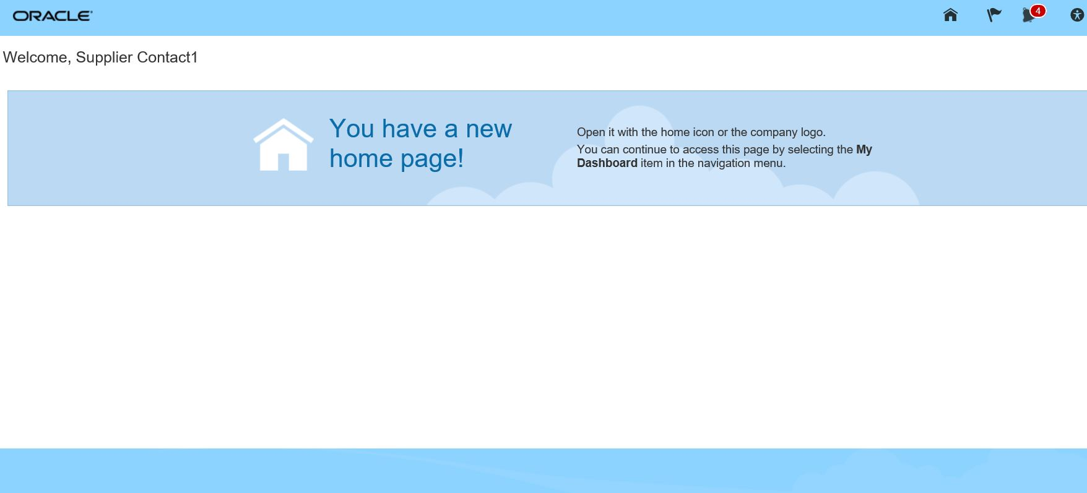
Create and Submit Invoice
Let’s first learn how to create and submit an invoice. Let’s navigate to the Oracle Cloud homepage.
1. Access Home
From the Oracle Cloud homepage, click the Home icon. This will take you to the Oracle Cloud main page.
2. Go to Supplier Portal
3. Access Section
4. Enter Details
5. View Line Items
Notes:
Let’s first learn how to create and submit an invoice. From the Oracle Cloud homepage, click the Home icon. This will take you to the Oracle Cloud main page.

Slide 6
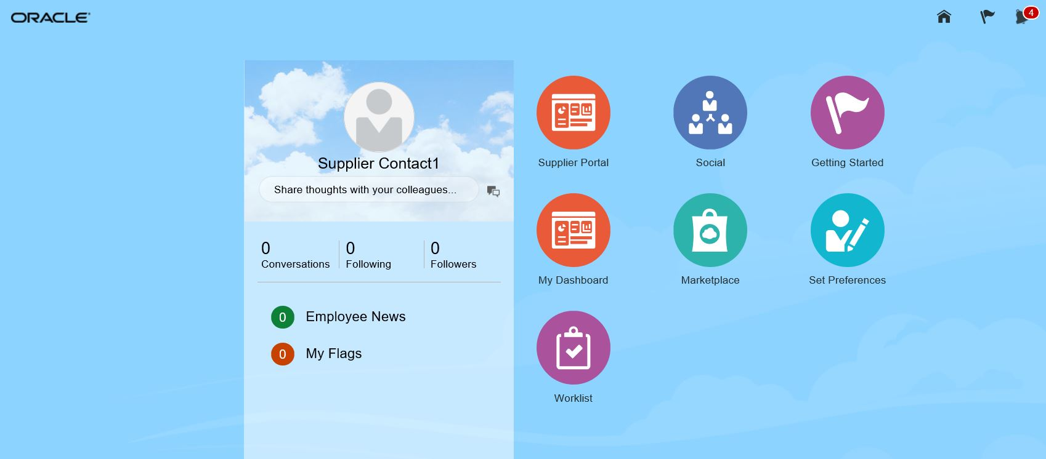
Create and Submit Invoice (Cont’d)
Let’s view the steps to access the Supplier Portal.
1. Access Home
Click on the Supplier Portal icon. This will take you to the Supplier Portal page.
From here you can access the links to create invoices.
2. Go to Supplier Portal
3. Access Section
4. Enter Details
5. View Line Items
Notes:
Click on the Supplier Portal icon. This will take you to the Supplier Portal page. From here you can access the links to manage invoices.

Slide 7
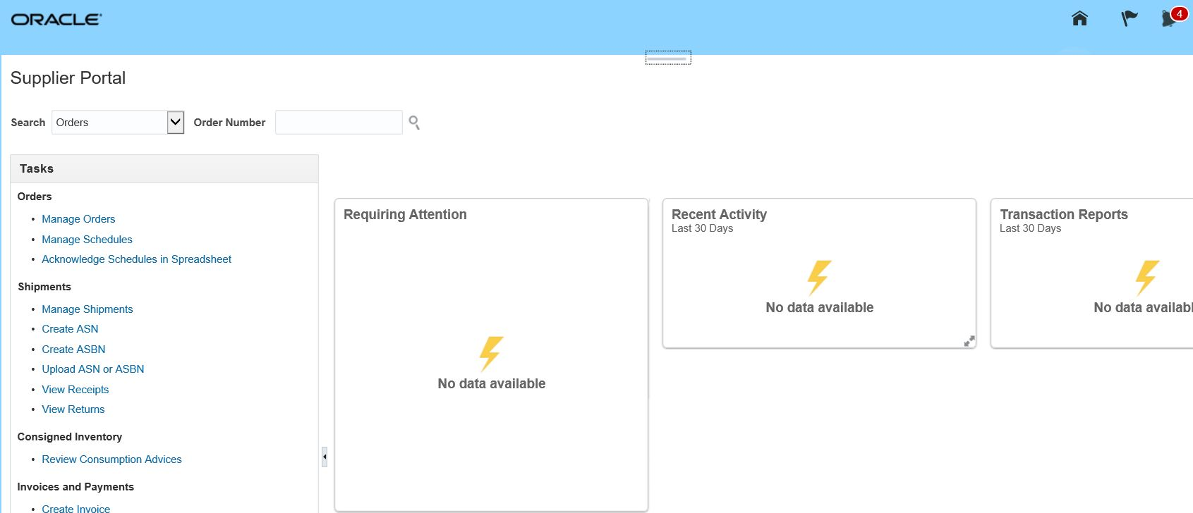
Create and Submit Invoice (Cont’d)
Let’s view the steps to navigate to access the Create Invoice section.
1. Access Home
From the Supplier Portal page that appears, go to the Tasks section.
Then, click the Create Invoice link to navigate to invoice creation page.
2. Go to Supplier Portal
3. Access Section
4. Enter Details
5. View Line Items
Notes:
From the Supplier Portal page that appears, go to the Tasks section. Then, click the Create Invoice link to navigate to invoice creation page.

Slide 8
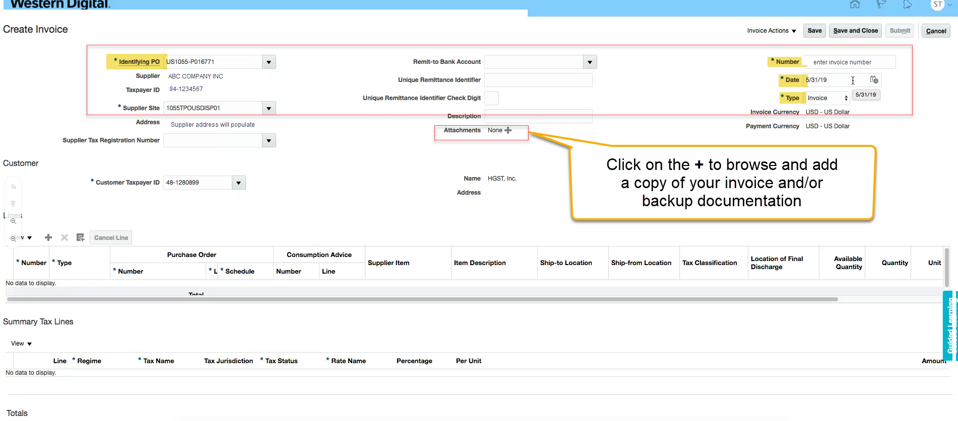
Create and Submit Invoice (Cont’d)
Let’s view the steps to enter details for a new Invoice.
1. Access Home
Enter the identifying Purchase Order, the invoice number, supplier and date in the respective fields. Add attachments as needed.
2. Go to Supplier Portal
3. Access Section
Note: Please attach a copy of your internal invoice and any backup supporting documentation. Ensure that you enter data in all the mandatory fields.
4. Enter Details
Important: Please verify your bank account info is correct. If not, please update according to Maintain Supplier Profile instructions
5. View Line Items
Notes:
Enter the identifying Purchase Order, the invoice number, supplier and date in the respective fields.

Slide 9
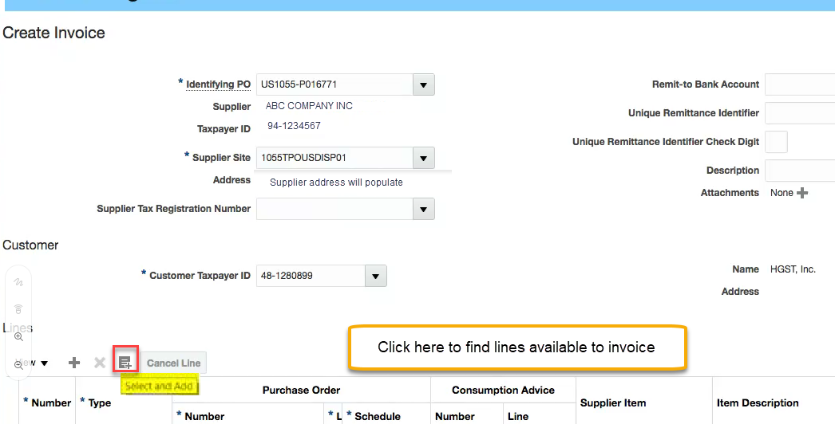
Create and Submit Invoice (Cont’d)
Let’s view the steps to view the various Purchase Order line items linked to the Purchase Order.
1. Access Home
2. Go to Supplier Portal
From the Create Invoice page, click on the Select and Add button to add the Purchase Order line items.
3. Access Section
4. Enter Details
5. View Line Items
Notes:
From the Create Invoice page, click on the Select and Add button to add the Purchase Order line items.

Slide 10
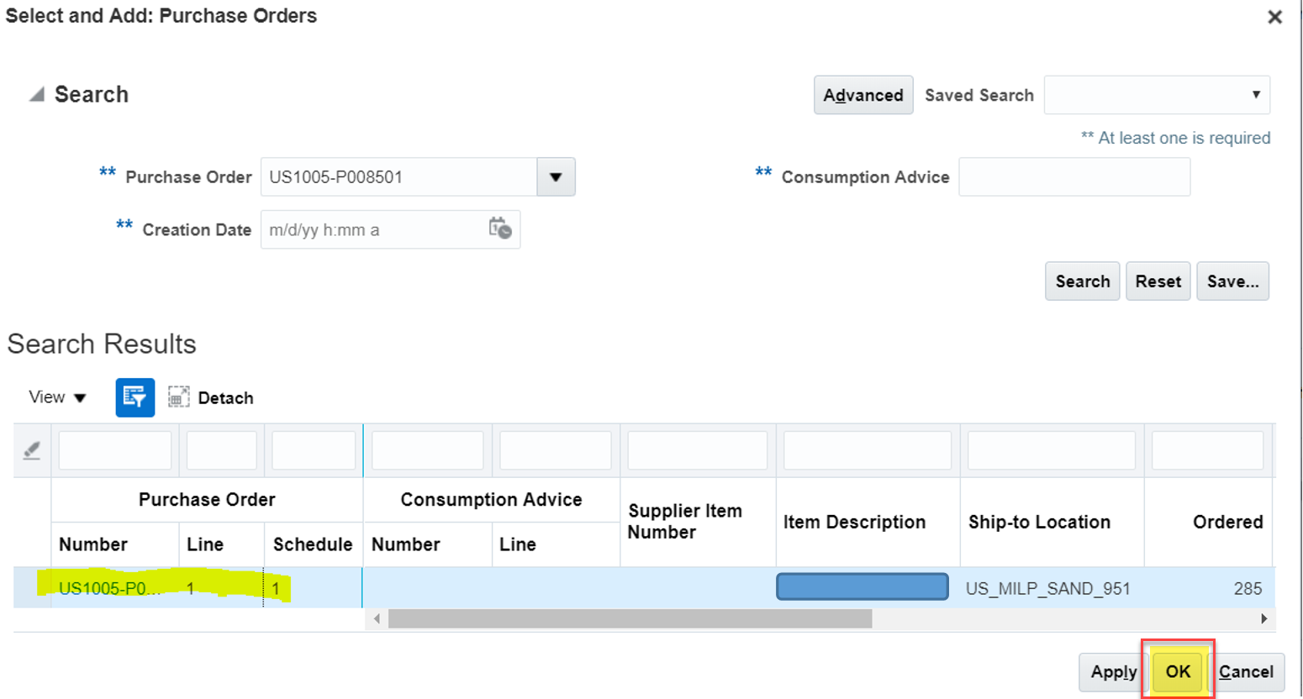
Create and Submit Invoice (Cont’d)
Let’s view the steps to add the specific Purchase Order line item to the Invoice.
6. Add Line Item
From the Search section, enter the Purchase Order number. Select the line item and click the OK button.
Note: To select multiple lines, hold the Ctrl key down while selecting.
7. Calculate Tax
8. Submit Invoice
9. View Confirmation
10. Review Submitted Invoice
Notes:
Click on the Schedules tab.

Slide 11
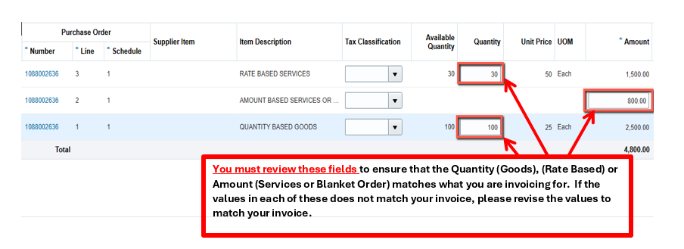
Create and Submit Invoice (Cont’d)
Let’s view the steps to review/add the specific amounts for the Purchase Order line item to the Invoice.
6. Add Line Item
Change the Quantity (goods), Rate Based or Amount (services or blanket orders) to match your invoice.
Note: If you do not review/revise the fields, you will invoice for the total available amount.
7. Calculate Tax
8. Submit Invoice
9. View Confirmation
10. Review Submitted Invoice
Notes:
Click on the Schedules tab.

Slide 12
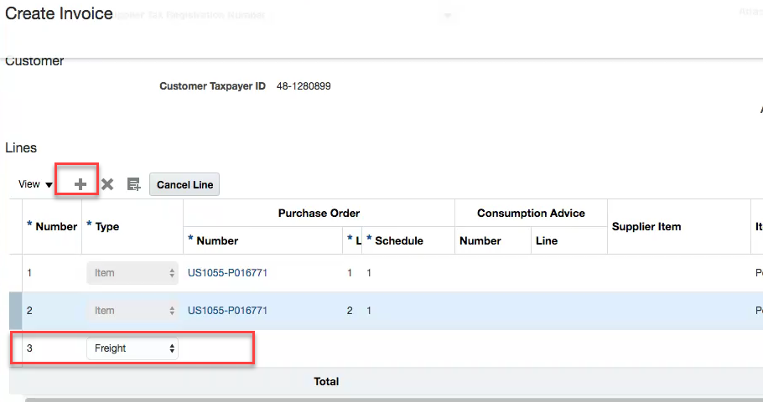
Create and Submit Invoice (Cont’d)
Let’s view the steps to add approved Freight charges to the Invoice.
6a. Add Freight charges
To add approved Freight Charges, click on the + sign and add the appropriate charges in amount.
Select the line item and click the OK button.
7. Calculate Tax
8. Submit Invoice
9. View Confirmation
10. Review Submitted Invoice
Notes:
Click on the Schedules tab.

Slide 13
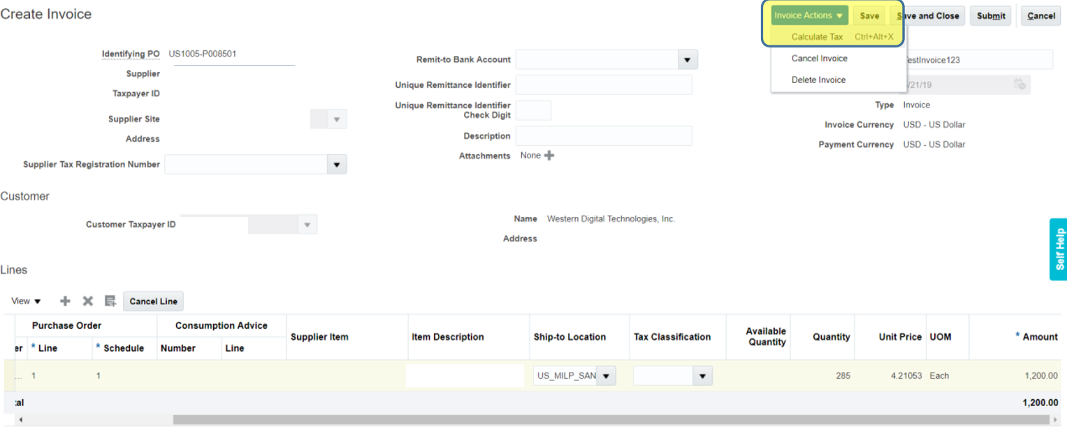
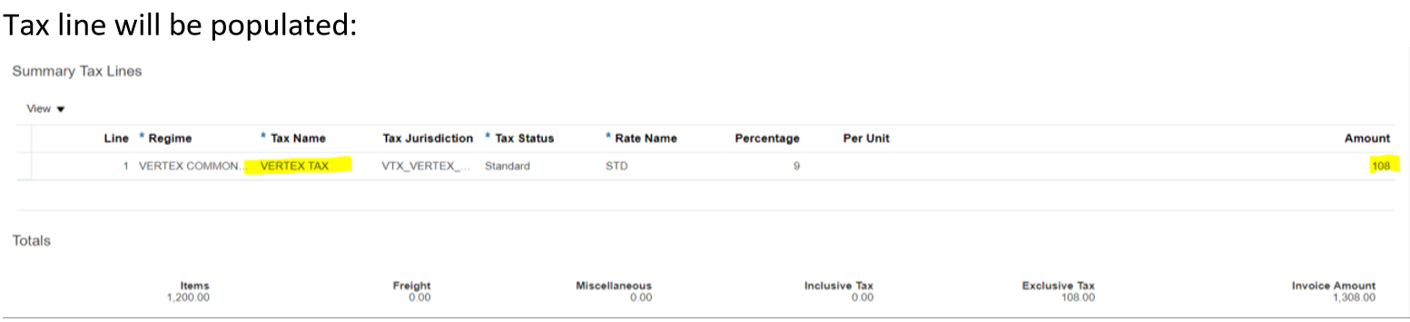
Create and Submit Invoice (Cont’d)
Let’s view the steps to calculate the invoice tax.
6. Add Line Item
After entering the details, and adding the line item, click the Invoice Options drop down and select Calculate Tax. Tax line will be populated.
Adjust the amount if necessary. Adjust to 0.00 if there is no tax to be invoiced. Click Calculate Tax again if you have adjusted the amount.
7. Calculate Tax
8. Submit Invoice
9. View Confirmation
10. Review Submitted Invoice
Notes:
After entering the details, and adding the line item, click the Submit button to create the invoice.

Slide 14
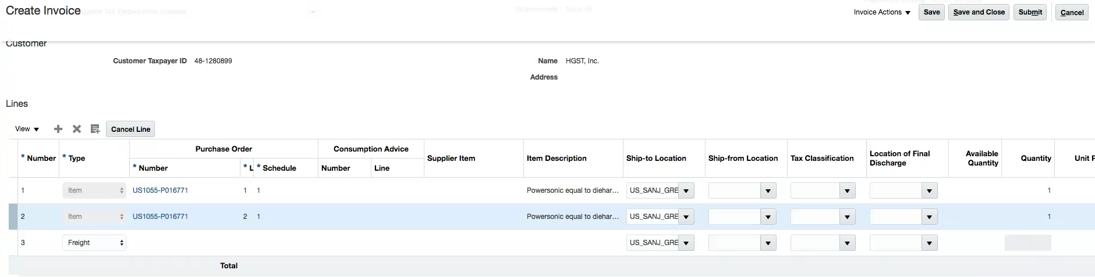
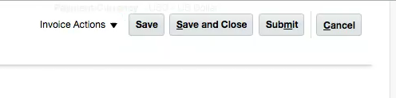
Create and Submit Invoice (Cont’d)
Let’s view the steps to submit the Invoice for creation.
6. Add Line Item
After calculating the tax on the invoice, review the invoice total amount before submitting to ensure it matches your internal invoice amount.
Click the Submit button to submit the invoice for processing.
7. Calculate Tax
8. Submit Invoice
Important: If you select Save and Close, your invoice is NOT submitted. You will need to complete the invoice and Submit before AP can process the invoice for payment.
9. View Confirmation
10. Review Submitted Invoice
Notes:
After entering the details, and adding the line item, click the Submit button to create the invoice.

Slide 15
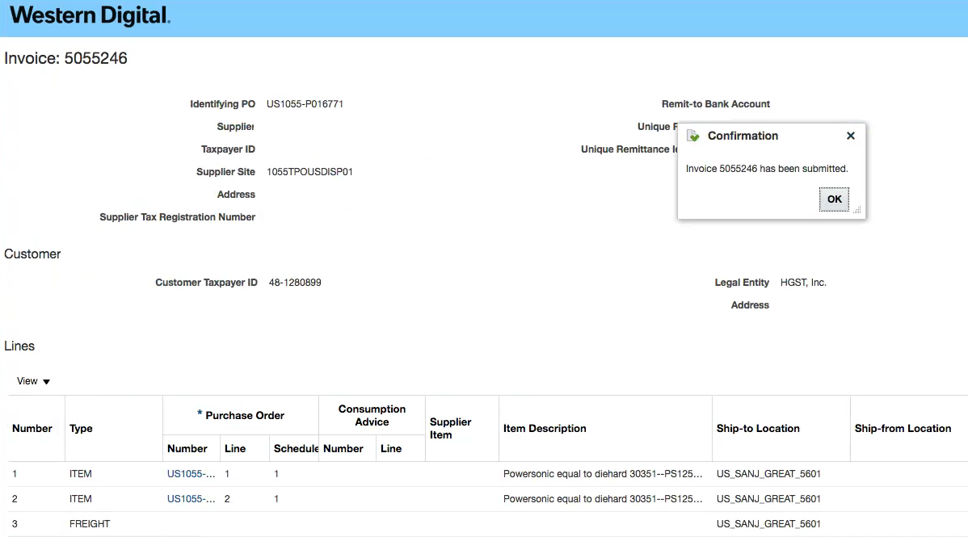
Create and Submit Invoice (Cont’d)
Let’s understand the steps to view the confirmation of invoice submission.
6. Add Line Item
7. Calculate Tax
The Invoice page appears. A confirmation message appears that the invoice has been submitted.
8. Submit Invoice
9. View Confirmation
10. Review Submitted Invoice
Congratulations! You have successfully created and submitted an invoice in the Oracle Cloud. Great job!
Notes:
The Invoice page appears. A confirmation message appears that the invoice has been submitted. Congratulations! You have successfully created and submitted an invoice in the Oracle Cloud. Great job!

Slide 16
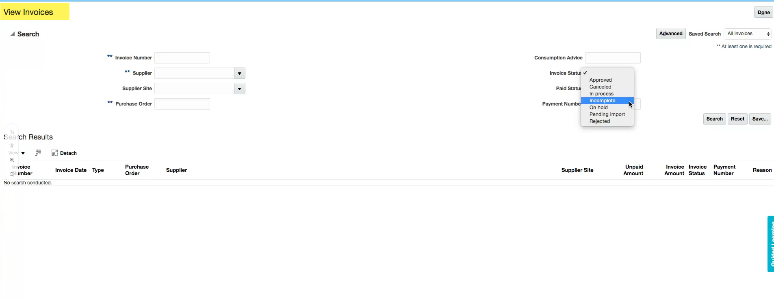
Create and Submit Invoice (Cont’d)
Let’s view the steps to review invoices.
6. Add Line Item
Query by any of the criteria available. Ensure to enter one of the mandatory fields prefixed by **. Click the Search button.
7. Calculate Tax
8. Submit Invoice
Click the invoice to view details or, if incomplete, complete the invoice and Submit for processing.
9. View Confirmation
10. Review Submitted Invoice
Notes:
The Invoice page appears. A confirmation message appears that the invoice has been submitted. Congratulations! You have successfully created and submitted an invoice in the Oracle Cloud. Great job!

Slide 17
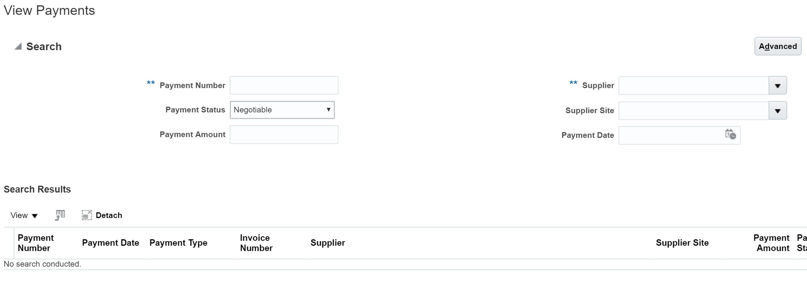
Create and Submit Invoice (Cont’d)
Let’s view the steps to review the payments.
11. Review Payments
Query by any of the criteria available.
Note: Payment status “Negotiable” = paid to supplier but bank reconciliation has not completed
Ensure to enter one of the mandatory fields prefixed by ** to view the payments.
Notes:
The Invoice page appears. A confirmation message appears that the invoice has been submitted. Congratulations! You have successfully created and submitted an invoice in the Oracle Cloud. Great job!

