Slide 1
EXPORTING INFORMATION FROM SUPPLIER PORTAL FOR ACCOUNT RECONCILIATION

Slide 2
Agenda
Business Purpose:
Supplier should able to export information for Invoice and Payment Details once he logs into the Supplier Portal in order to assist with reconciliation.
Proposed Solution:
Supplier should able to export the following details and be provided with instructions.
  POs
  Invoices
  Receipts
  Payments

Slide 3
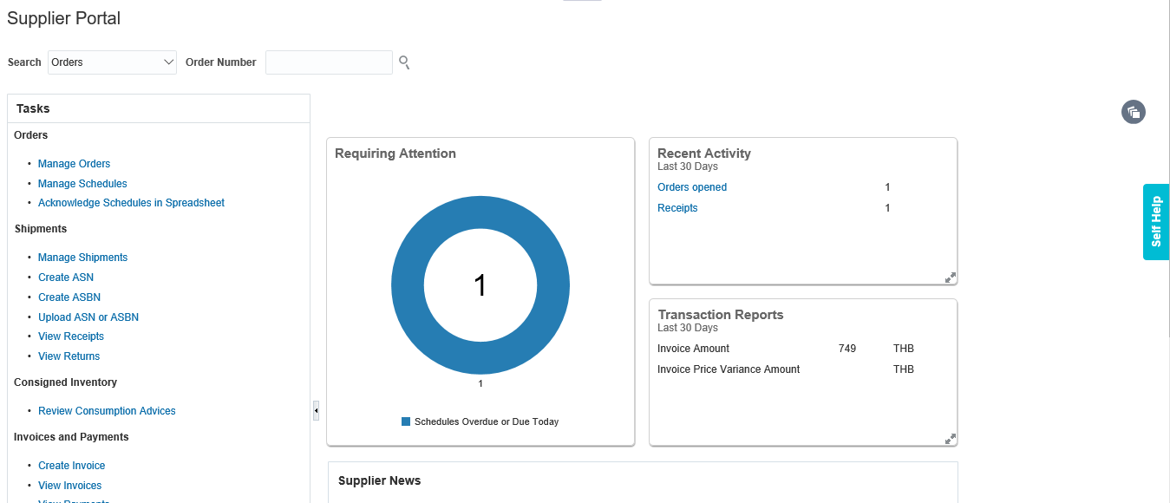
Step 1 – Login to Supplier Portal
URL: https://edmk.login.us2.oraclecloud.com

Slide 4
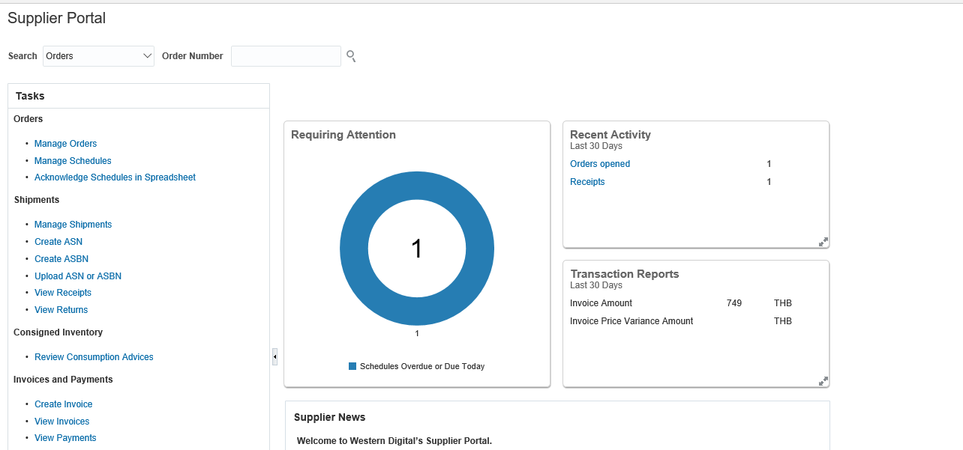
Step 2 – In Tasks Section, under Invoices and Payments, Click on View Invoices to View Invoice Details
1
2
3

Slide 5
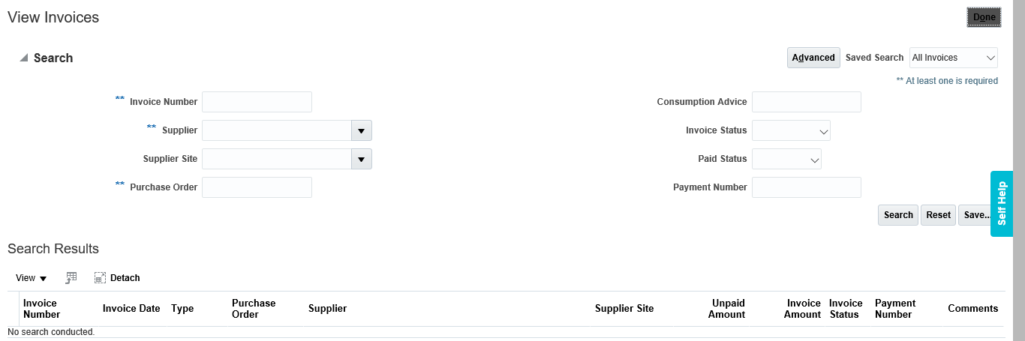
Step 3 – Supplier will have multiple Search Options to Query the Invoice Details

Slide 6
Step 4 – Search Criteria, Invoices
Invoice can be searched using Invoice Number, Supplier Name or Purchase Order
*Invoice Number: You can search with Specific Invoice Number
*Supplier Name: Invoice can be searched with Supplier Name
*Purchase order: Enter the Purchase Order details to query the list of invoices created against the PO.
Invoice Status: You can query specific invoice Status such as Approved, Cancelled, In process, Incomplete, On hold, Pending import and Rejected
Paid Status: You can query Payment Status of the Invoice such as Paid, Unpaid and Partially Paid.
Payment: : You can query using Payment number as well.
Note: Invoice Status/ Paid Status/ Payment criteria must be searched along with any one of the Mandatory fields such as Invoice Number/ Supplier Name/ Purchase Order.

Slide 7
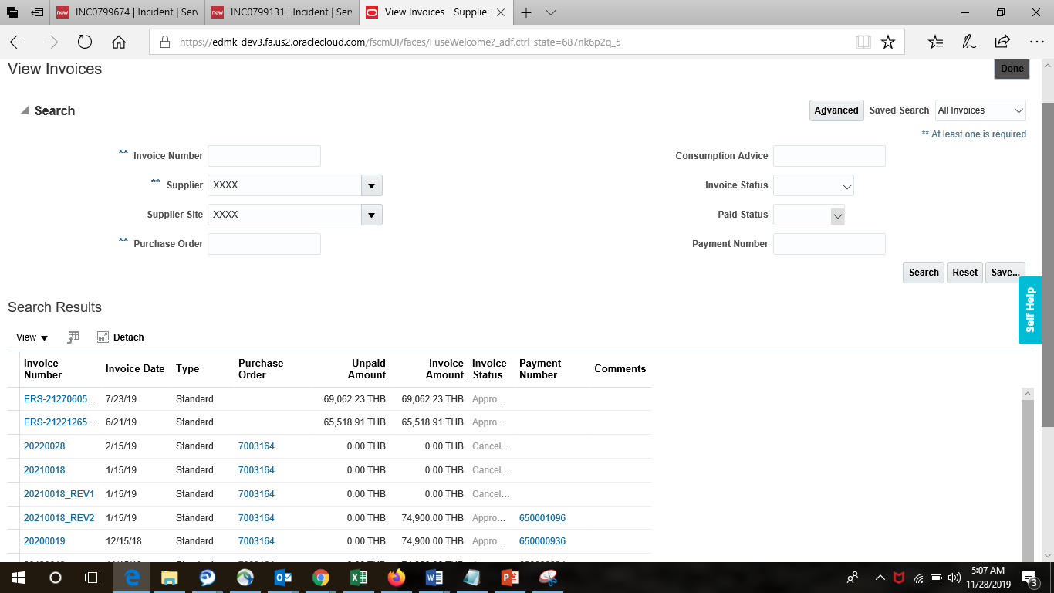
Step 5 – Search for Invoices by Invoice number, Supplier Name, or Purchase Order number
Enter only one of the following criteria

Slide 8
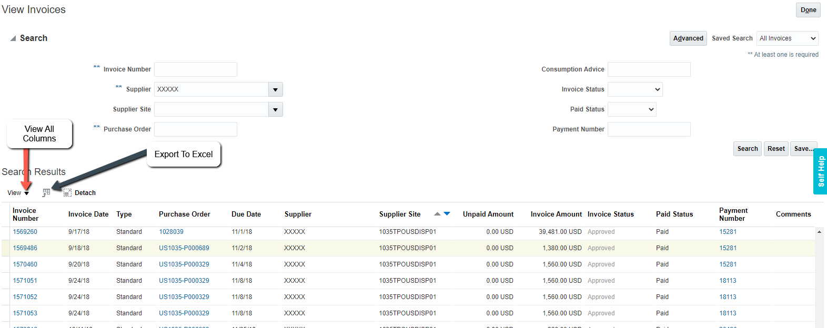
Step 6 – Export Invoices to Excel
Click on View icon and select Columns. You can click on Show All or select specific items that you want on the report
Click on Export to Excel icon in Search results to Export the data to Excel spreadsheet

Slide 9
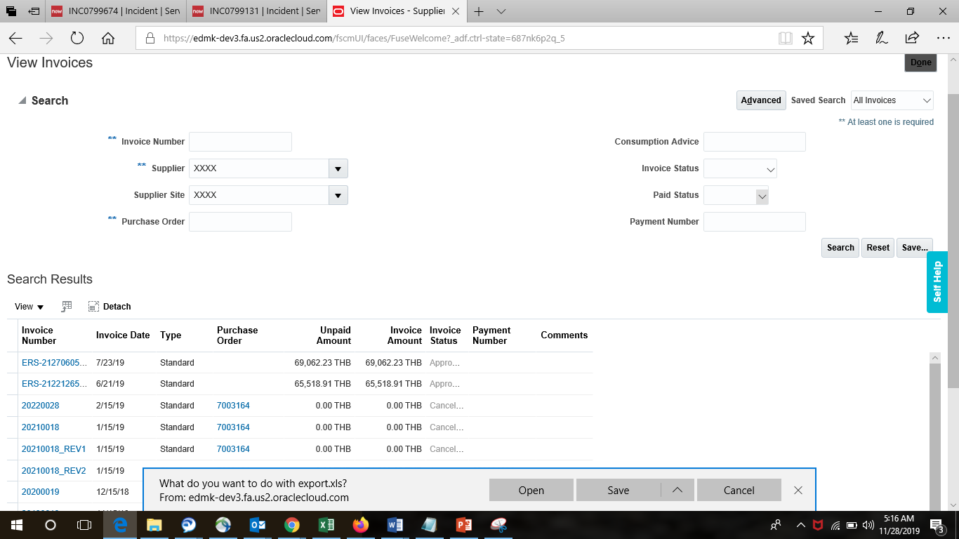
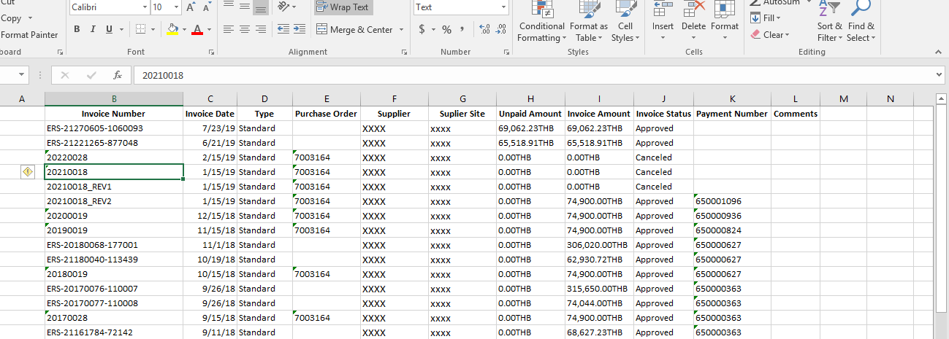
Step 7 – Save and Open Invoices in Excel

Slide 10
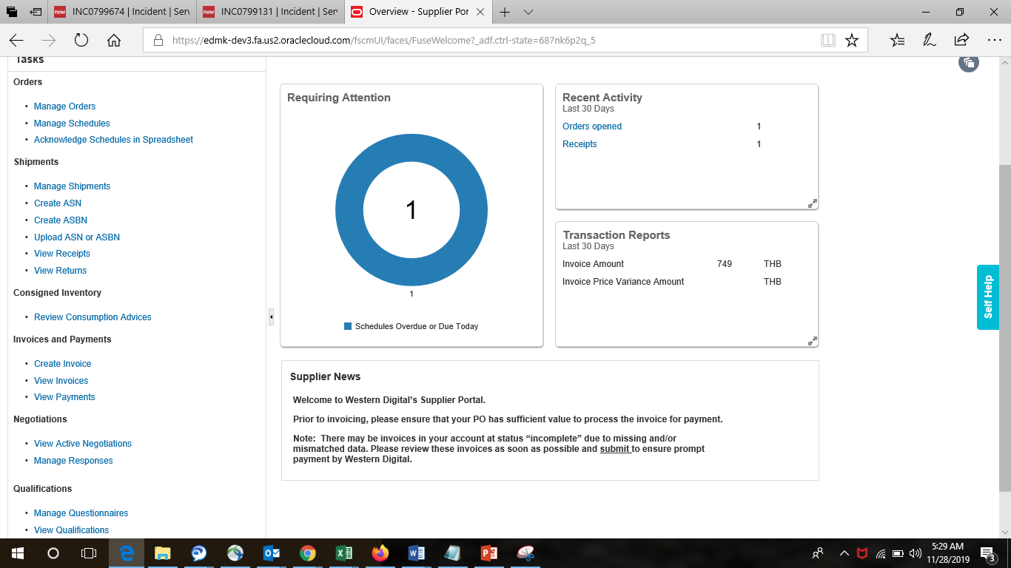
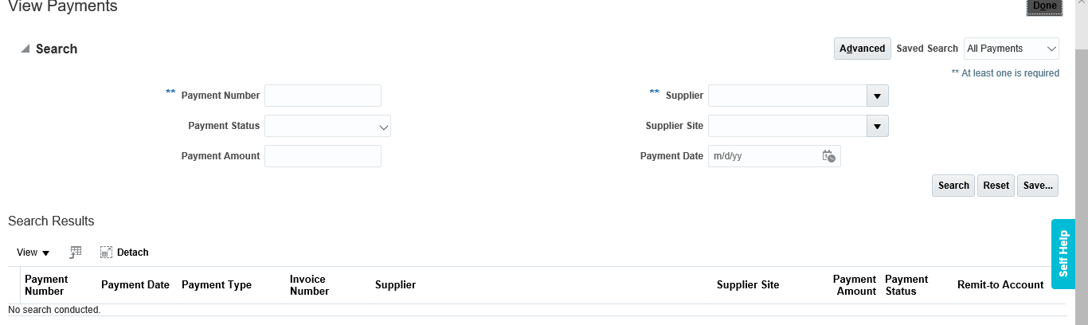
Step 8- View Payments
In Invoice and Payment Task click on View Payments

Slide 11
Step 9 - Search Criteria, Payments
Payments can be searched using Payment Number/ Supplier Name
*Payment Number: You can query using Payment number.
*Supplier Name: Payments can be searched with Supplier Name.
Payment Status: You can query specific Payment Status such as Cleared, Cleared but unaccounted, Issued, Negotiable, Stop initiated, Voided.
Payment Amount: You can query Payment Status by entering the Payment amount details.
Payment Date: : You can query Payment Status by entering the Payment date.
Note: Payment Status/ Payment Amount / Payment date must be searched along with any one of the Mandatory fields such as Payment Number/ Supplier Name.

Slide 12
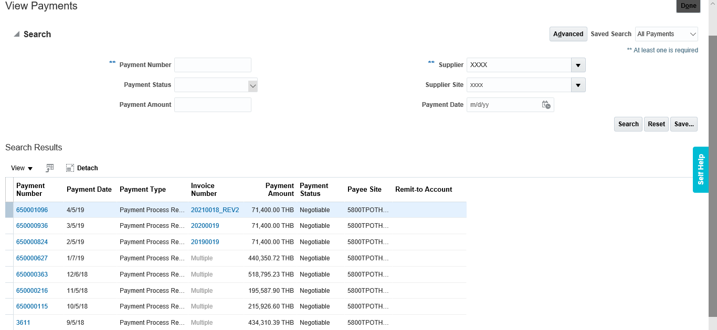
Step 10- Search with Supplier Name
Click on View Columns icon and select Show All or select specific items that you want on the report
Click on Export to Excel icon in Search results to Export the data to Excel spreadsheet
Hint: Click on Payment number link to view all invoices against that payment

Slide 13
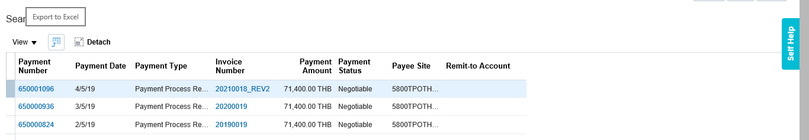
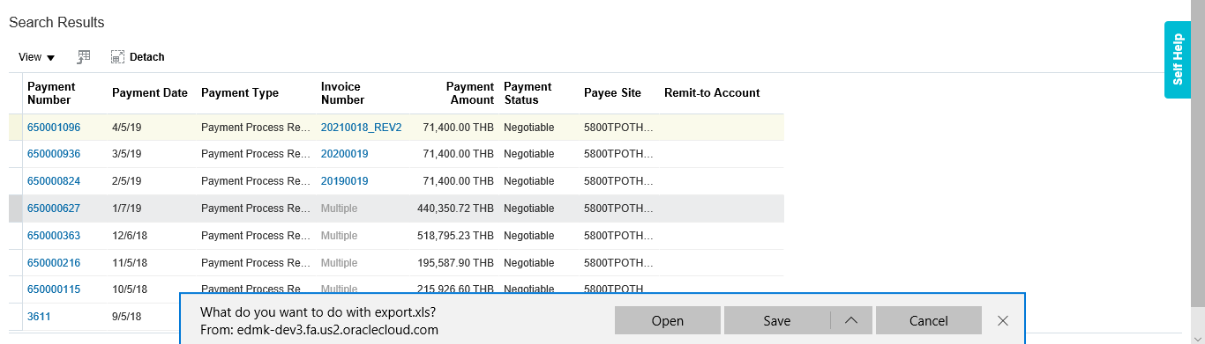
Step 11- Export the Payment Details

Slide 14
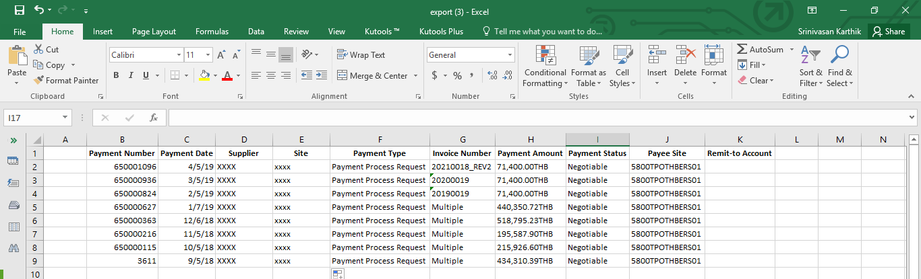
Step 12 – Save and Open Payment details

Slide 15
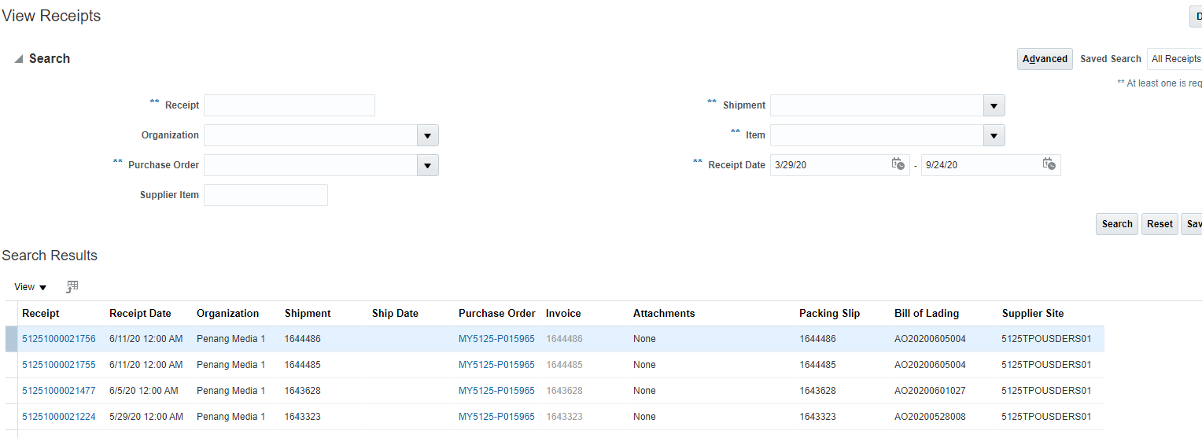
Step 13 – Search for Receipts by Receipt, Purchase Order, Shipment, Item or Receipt Date
Enter only one of the following criteria

Slide 16
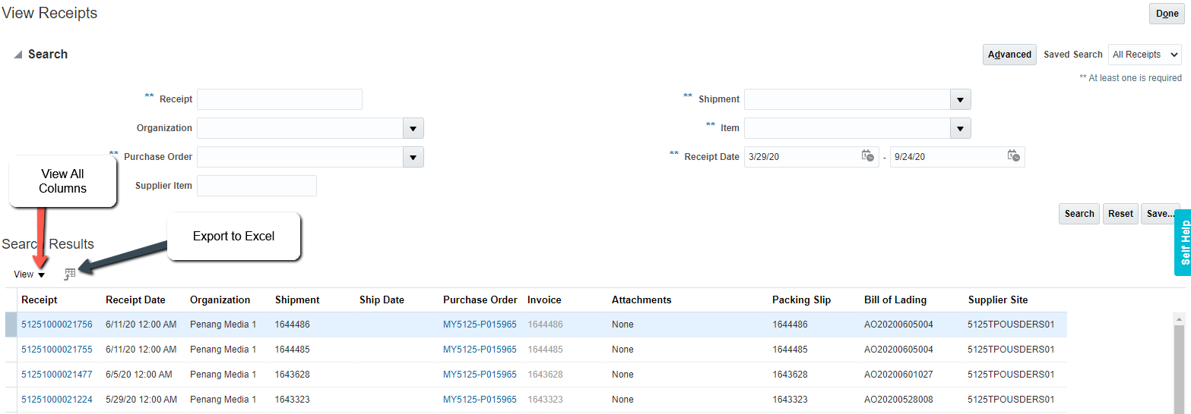
Step 14 – Export Receipts to Excel
Click on View icon and select Columns. You can click on Show All or select specific items that you want on the report
Click on Export to Excel icon in Search results to Export the data to Excel spreadsheet

Slide 17
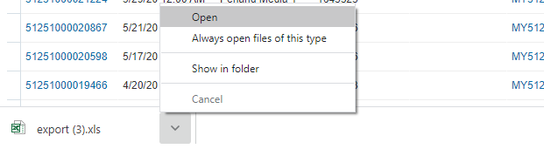
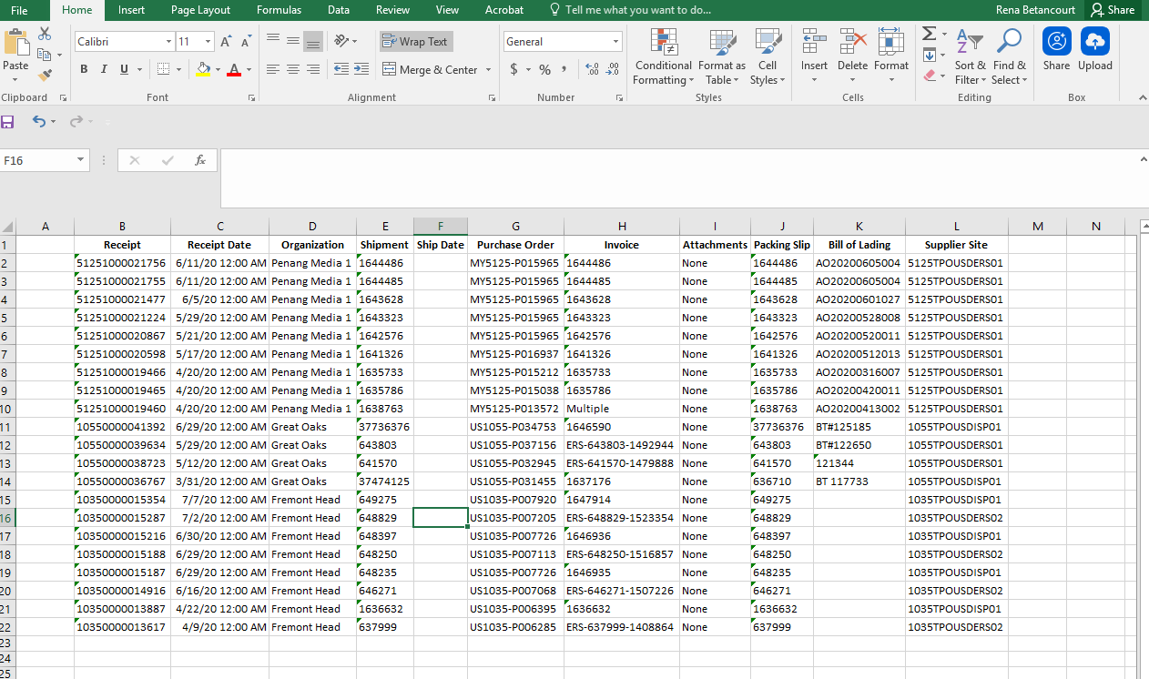
Step 15 – Save and Open Receipts in Excel

