Slide 1
SUPPLIER REGISTRATION PROCESS

Slide 2
Course Objectives
This course is designed to teach you how to register through the Oracle Cloud Supplier Portal.
In this course, you will be able to:
Explain the supplier registration process
List the steps to register yourself as a supplier

Slide 3
REGISTERING AS A SUPPLIER

Slide 4
Registering as a Supplier: Overview
This is a high-level overview of the registration process
Log in to Oracle Cloud
Complete Supplier Registration
Sandisk Approves Supplier Registration
The supplier will need to click the registration link to register
After accessing the portal, add contacts, addresses, bank and other details
Sandisk will receive the registration, will review and approve.
Step is performed by supplier
Step is performed in the system

Slide 5
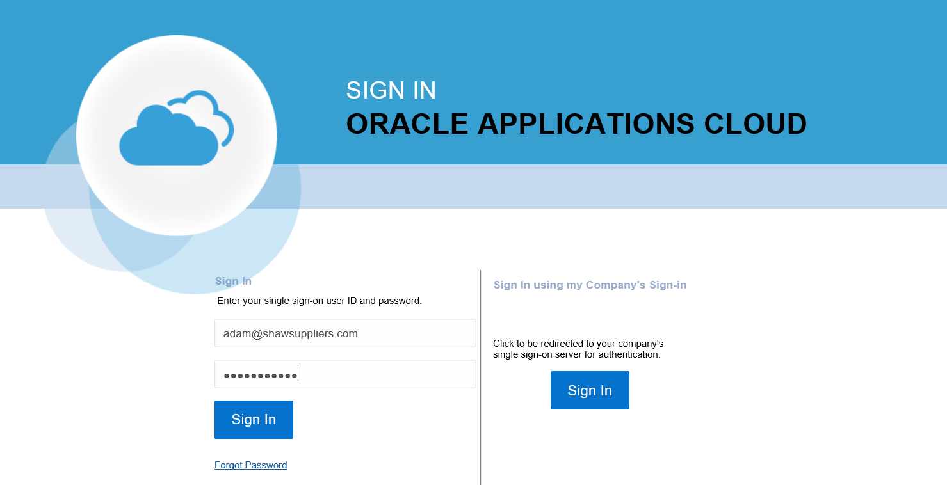
Registering As A Supplier
Let’s review the steps to open the registration link:
1. Log in to Oracle Cloud
From the Sign In Oracle Applications Cloud page:
Enter your username and password
Click the Sign In button.
2. Access Details
3. Access Contacts
4. Access Address
Registration link will be received via email.
Your user ID will be auto-generated. For the password, you will receive a link which directs you to a create a password page. If your password has expired you can create a new password through the ‘forgot password’ link
5. Create Address

Slide 6
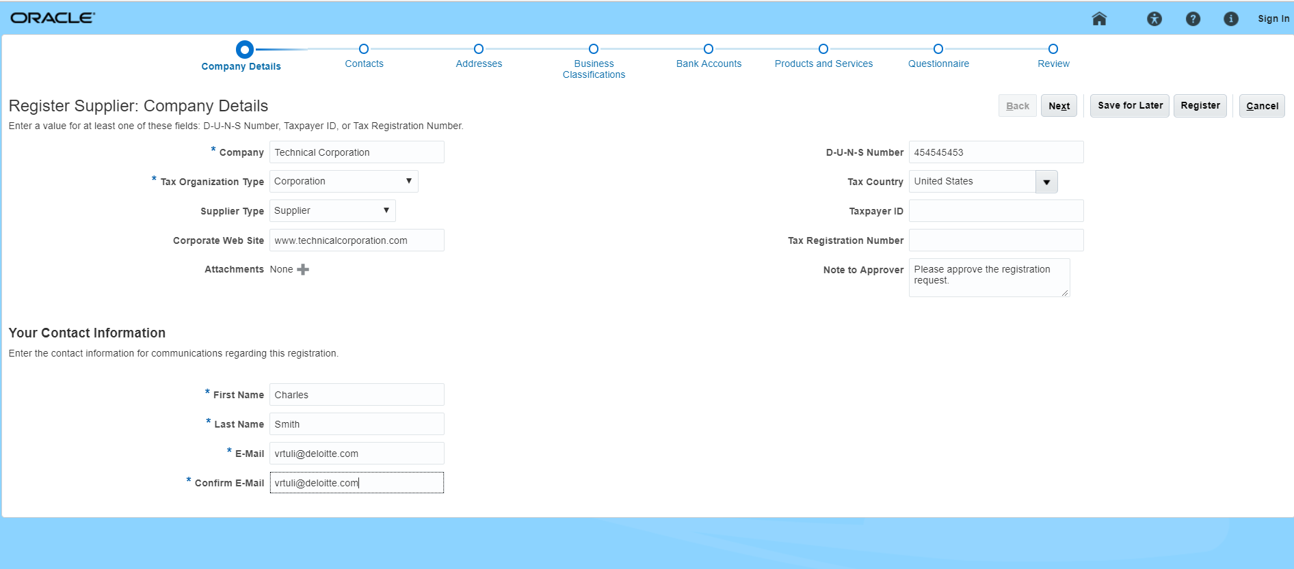
Registering As A Supplier
Let’s review the steps to enter the company details:
1. Log in to Oracle Cloud
The Register Supplier: Company Details screen is displayed.
Enter the Company name, Tax Organization Type, and the other fields.
Enter the required details in the Your Contact Information section.
Click the Next button to proceed.
2. Access Details
3. Access Contacts
4. Access Address
5. Create Address

Slide 7
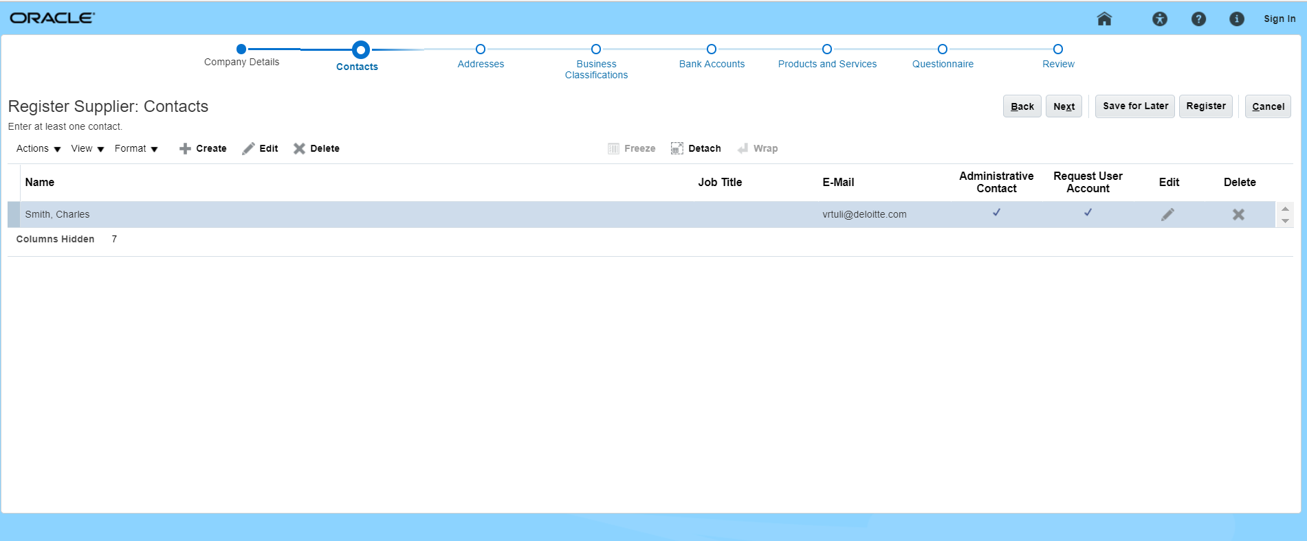
Registering As A Supplier
Let’s review the steps to access contacts:
1. Log in to Oracle Cloud
The Register Supplier: Contacts screen is displayed.
The contact information is auto-populated.
Click the Next button to proceed.
2. Access Details
3. Access Contacts
4. Access Address
5. Create Address

Slide 8
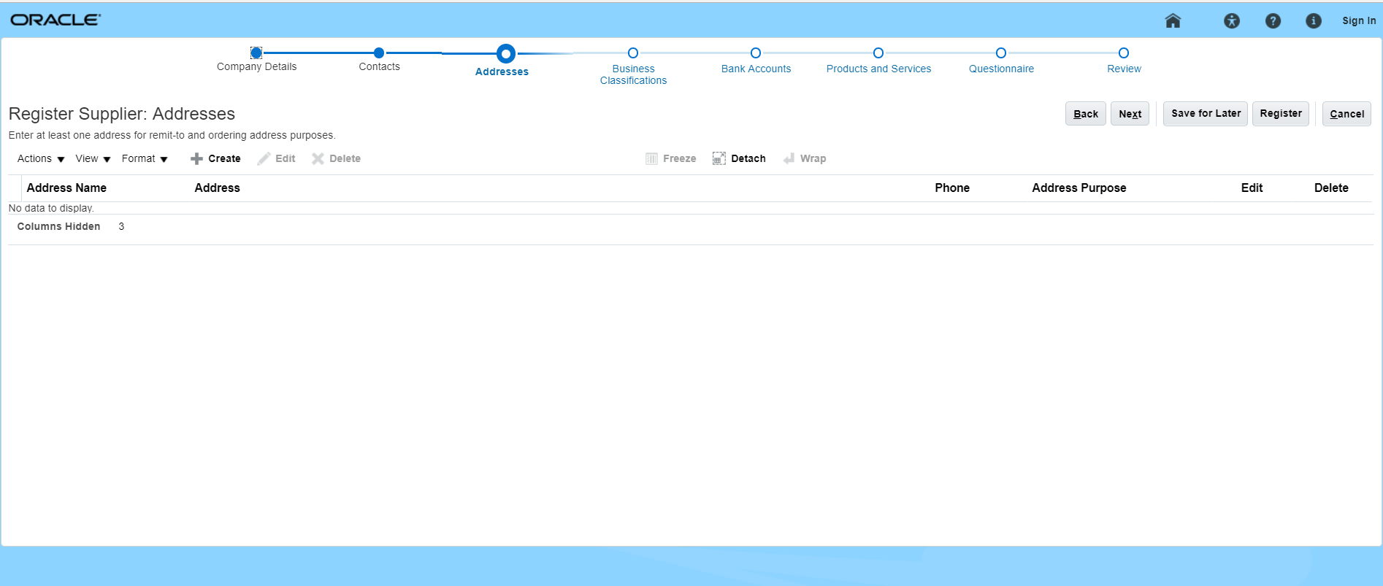
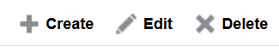
Registering As A Supplier
Let’s review the steps to access address:
1. Log in to Oracle Cloud
The Register Supplier: Addresses screen is displayed.
Click the Create icon to add an address.
2. Access Details
3. Access Contacts
4. Access Address
5. Create Address

Slide 9
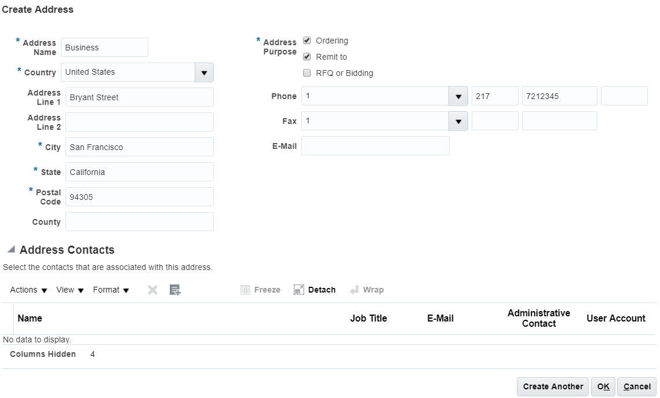
Registering As A Supplier
Let’s review the steps to create address:
1. Log in to Oracle Cloud
The Create Address screen is displayed. Enter details such as Address Name, Country, City, State, and Postal Code.
Also, select the Ordering and Remit to checkbox for the Address Purpose field.
Click the OK button. Then, click the Next button on the main address page.
2. Access Details
3. Access Contacts
4. Access Address
5. Create Address

Slide 10
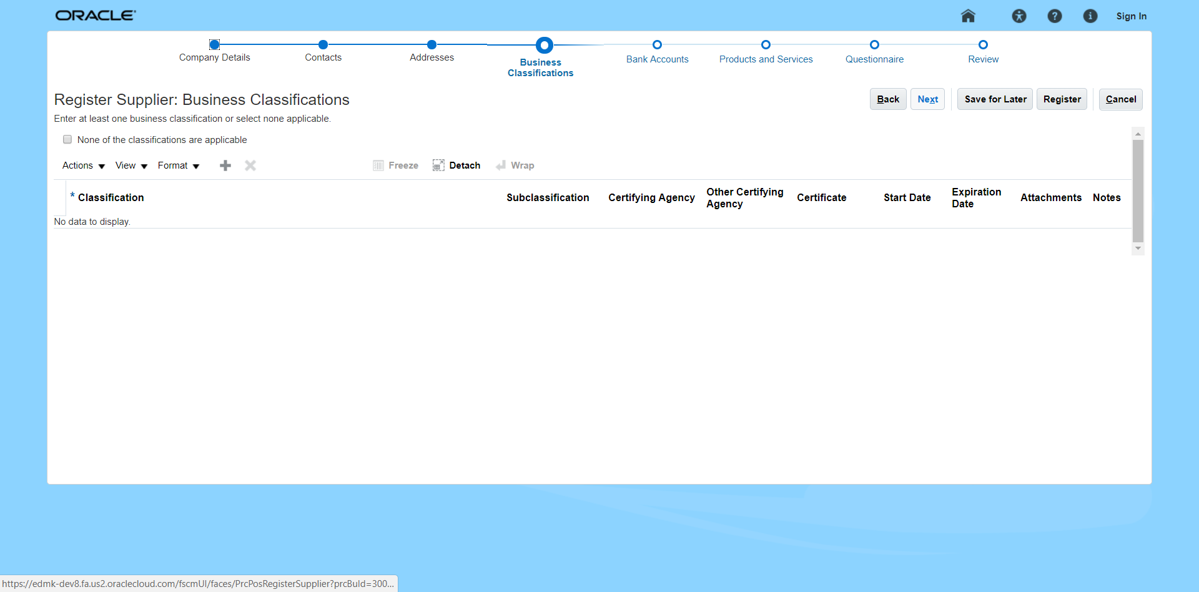

Registering As A Supplier
Let’s review the steps to access business classifications:
6. Access Business Classifications
The Register Supplier: Business Classifications screen is displayed.
Click the Add Row icon to add a Business Classification.
7. Add Business Classifications
8. Access Bank Accounts
9. Create Bank Account
10. Confirm Submission

Slide 11
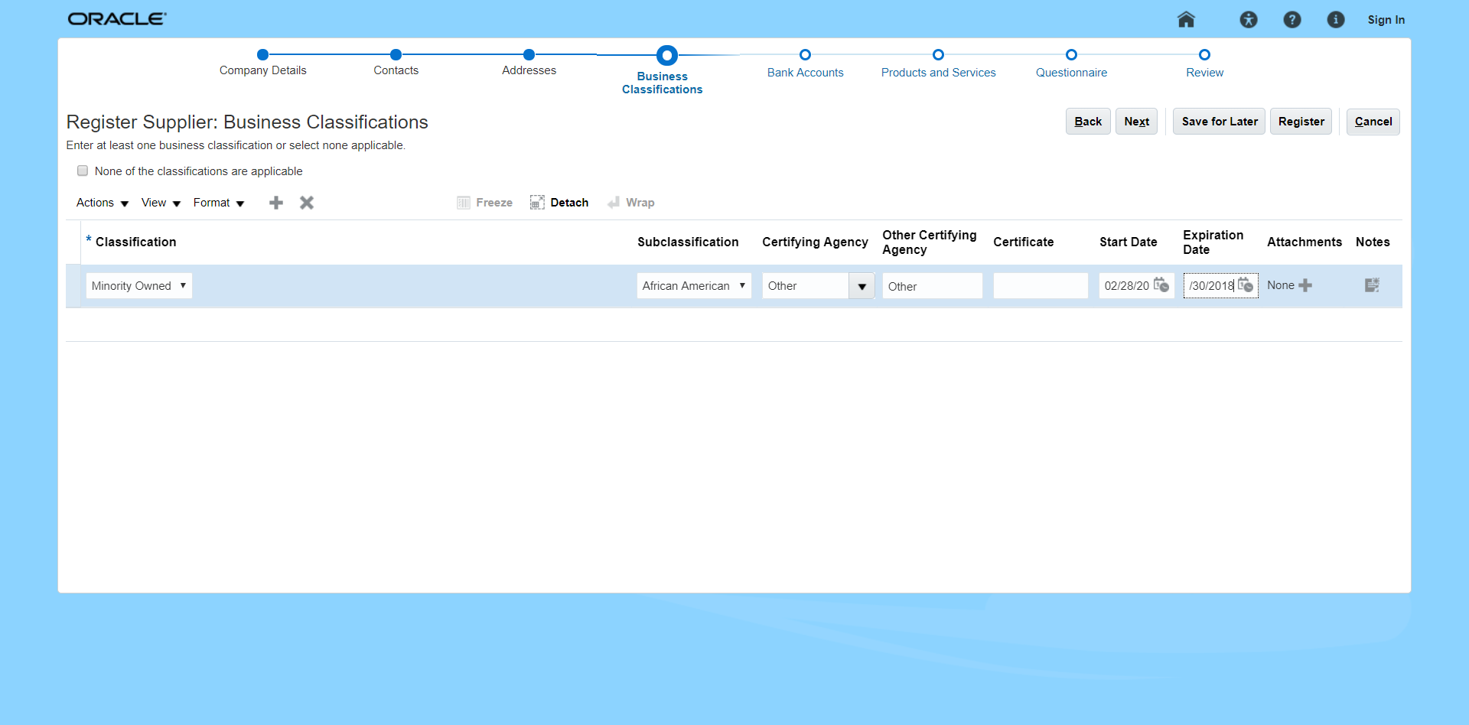
Registering As A Supplier
Let’s review the steps to add business classifications:
6. Access Business Classifications
Select the classification from the Classification drop down menu.
Also select the Subclassification, Certifying Agency, Start Date, and the Expiration Date.
Click the Next button to proceed.
7. Add Business Classifications
8. Access Bank Accounts
9. Create Bank Account
10. Confirm Submission

Slide 12
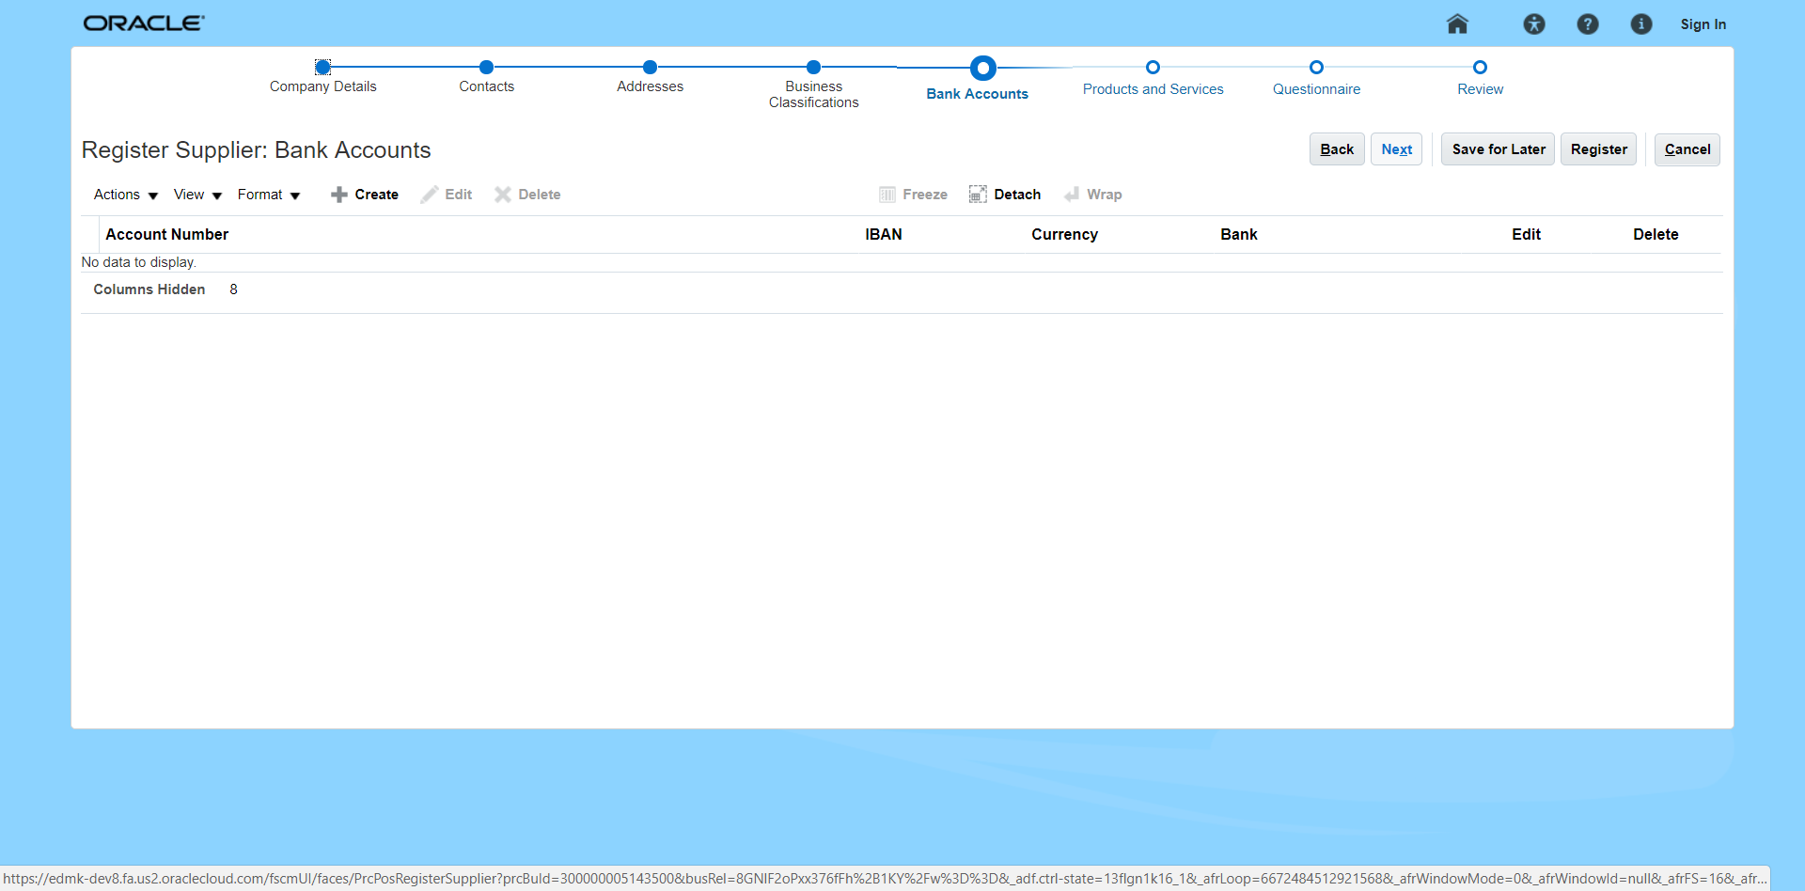
Registering As A Supplier
Let’s review the steps to access bank accounts:
6. Access Business Classifications
The Register Supplier: Bank Accounts screen is displayed.
Click the Create icon to add a bank account.
7. Add Business Classifications
8. Access Bank Accounts
9. Create Bank Account
10. Confirm Submission

Slide 13
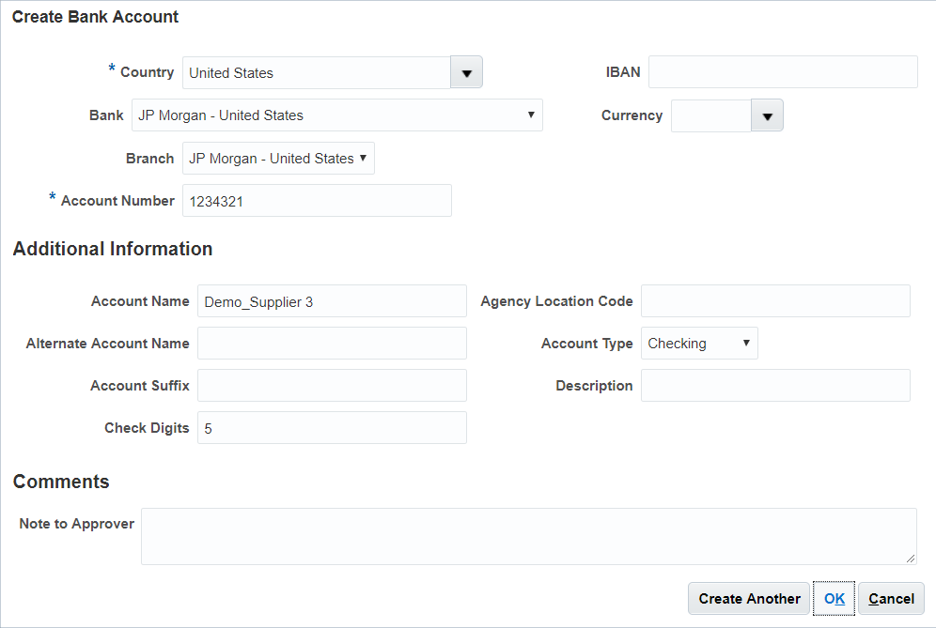
Registering As A Supplier
Let’s review the steps to create bank accounts:
6. Access Business Classifications
The Create Bank Account screen is displayed. Enter details such as Country, Account Number etc.
Also, add the Bank, Branch, Account Name, Check Digits, and Account Type.
Click the OK button. Then, click the Next button on the main address page.
7. Add Business Classifications
8. Access Bank Accounts
9. Create Bank Account
10. Access Products and Services

Slide 14
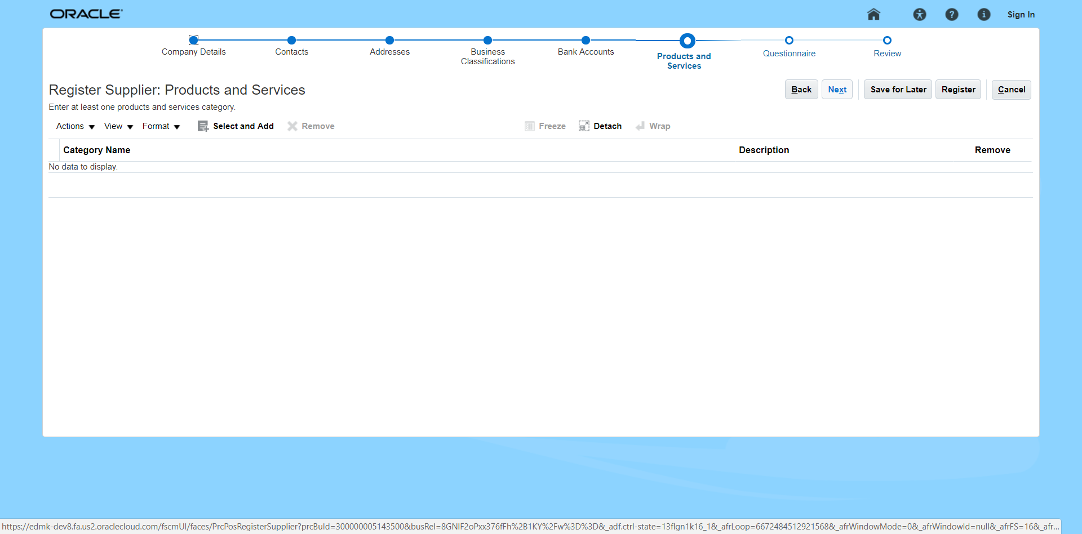

Registering As A Supplier
Let’s review the steps to access products and services:
6. Access Business Classifications
The Register Supplier: Products and Services screen is displayed.
Click the Select and Add icon to add the products and services.
7. Add Business Classifications
8. Access Bank Accounts
9. Create Bank Account
10. Access Products and Services

Slide 15
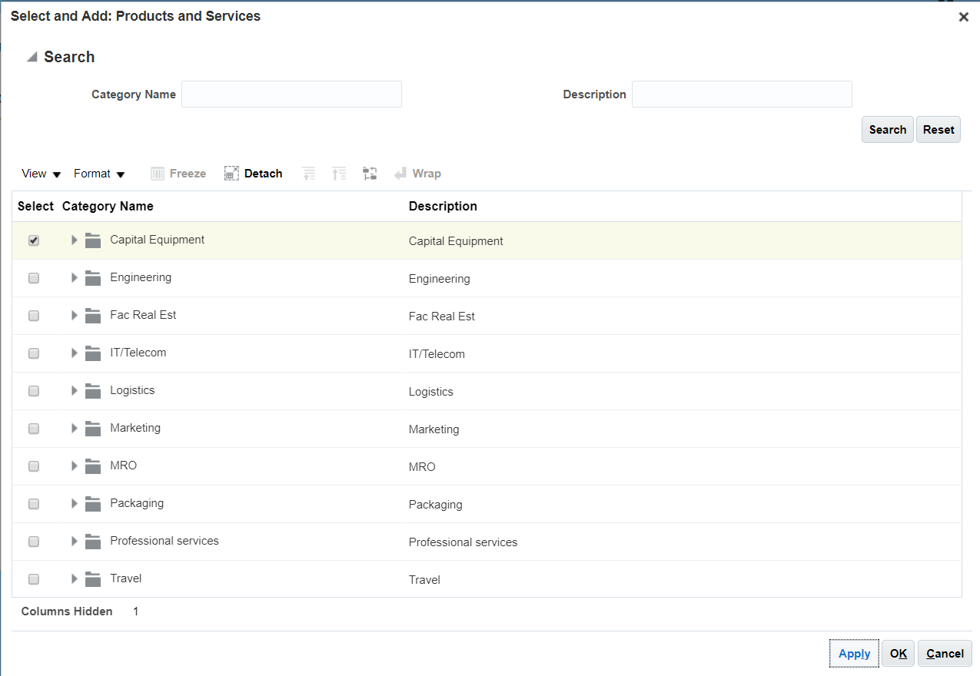
Registering As A Supplier
Let’s review the steps to select and add products and services:
11. Select and Add Products and Services
The Select and Add: Products and Services screen is displayed. Select the checkboxes next to the Products and/or Services you want to add.
Click the Apply button.
Click the OK button. Then, click the Next button on the main address page.
12. Complete Questionnaire
13. Submit for Approval
14. Confirm Submission

Slide 16
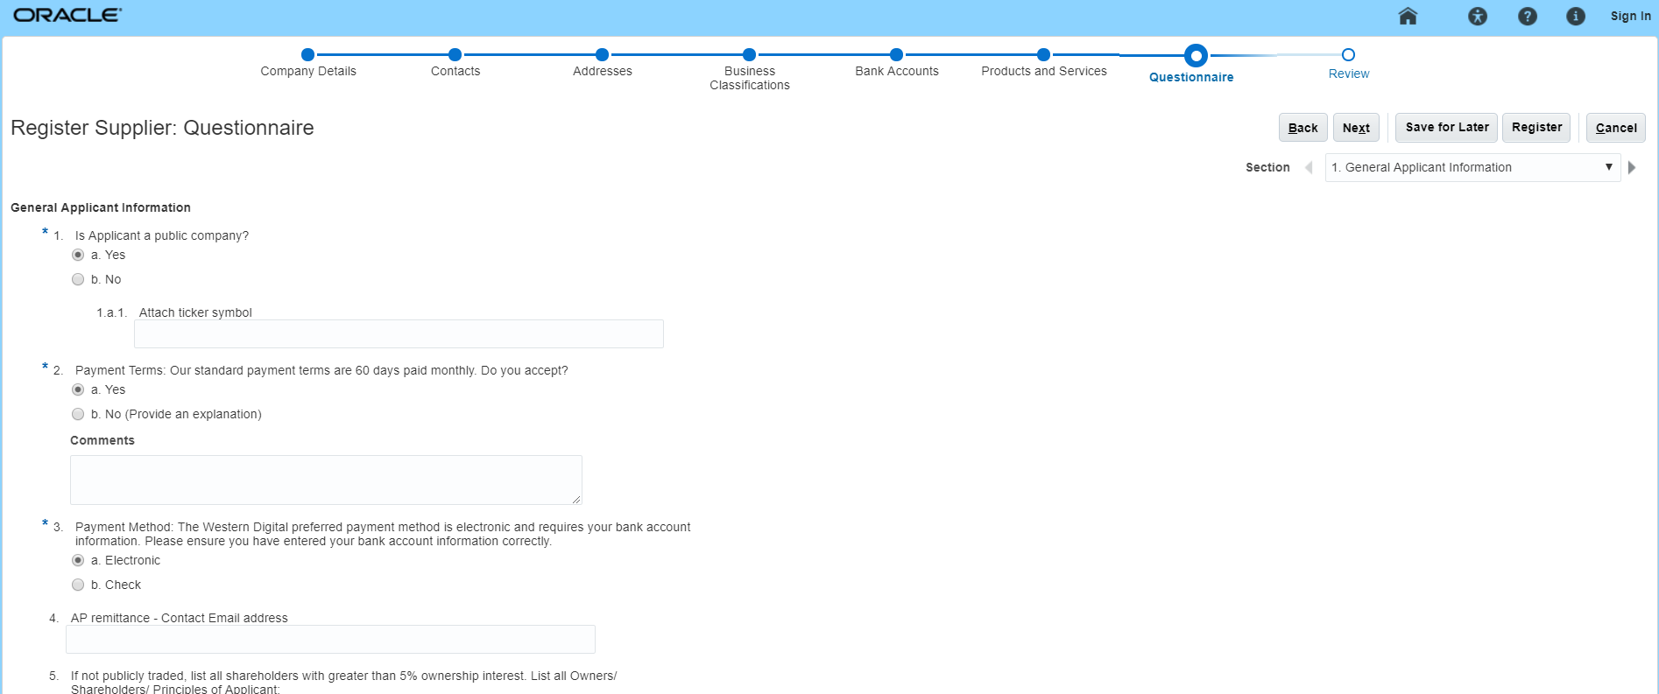
Registering As A Supplier
Let’s review the steps to create questionnaire:
11. Select and Add Products and Services
The Questionnaire screen is displayed. Answer all the mandatory questions, and the optional questions.
Click Next to proceed.
12. Complete Questionnaire
13. Submit for Approval
14. Confirm Submission
If you need to navigate to other sections, use the Section option on the right-hand side of the screen.

Slide 17
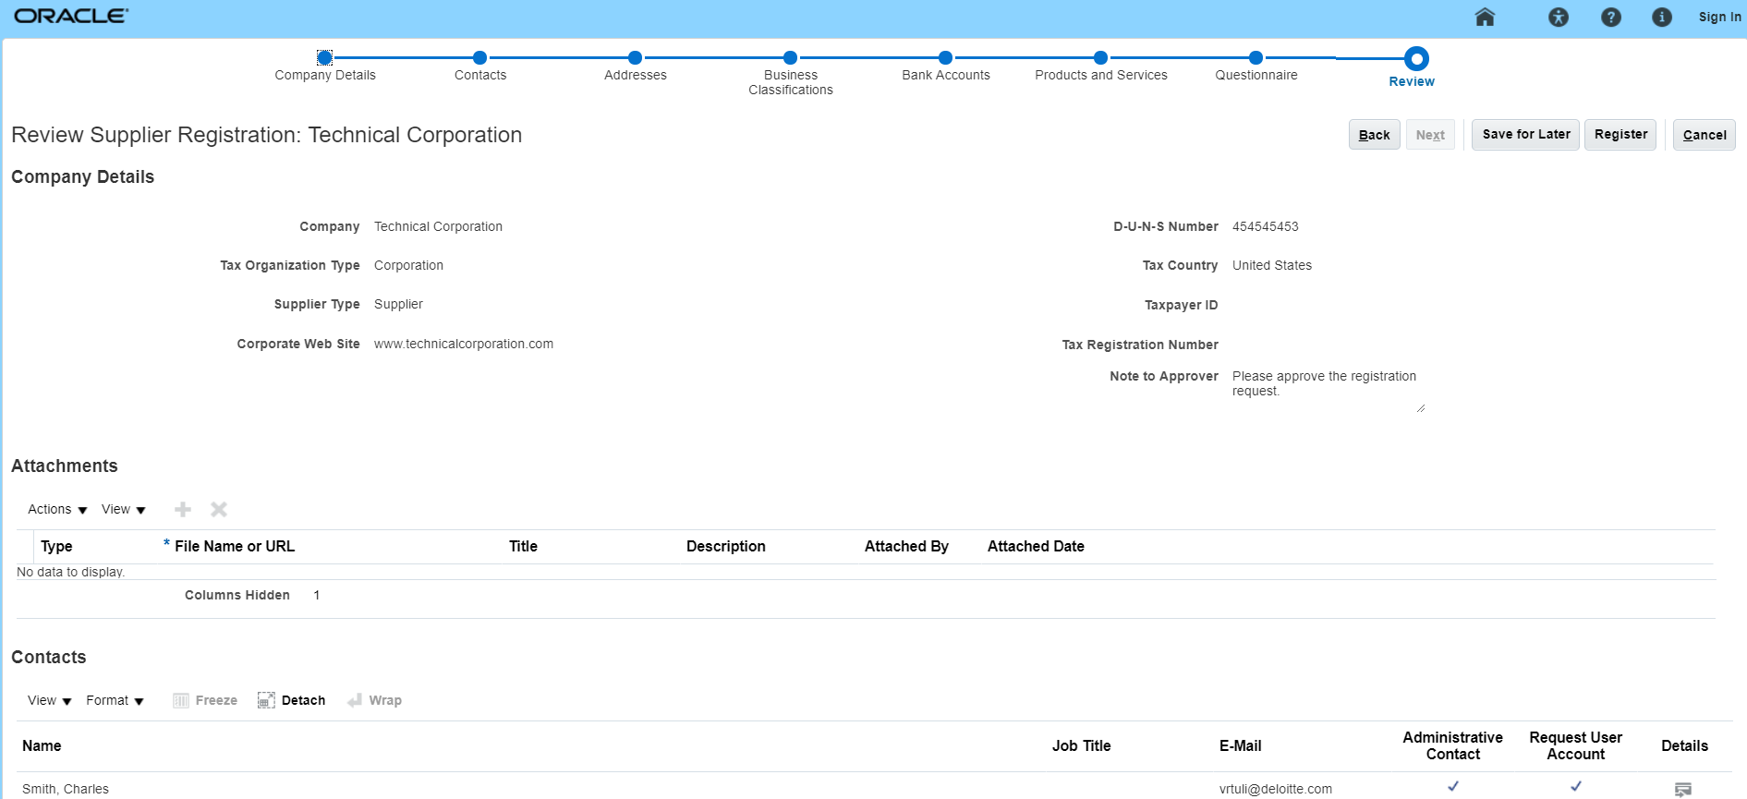
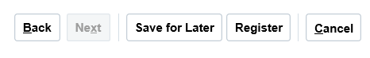
Registering As A Supplier
Let’s review the steps to submit for approval:
11. Select and Add Products and Services
Review all the details. Submit the registration by clicking the Register button.
12. Complete Questionnaire
13. Submit for Approval
You will also need to add:
Business Classifications
Bank Accounts
Product and Services
Only when you enter this additional information can you click the Register button.
14. Confirm Submission

Slide 18
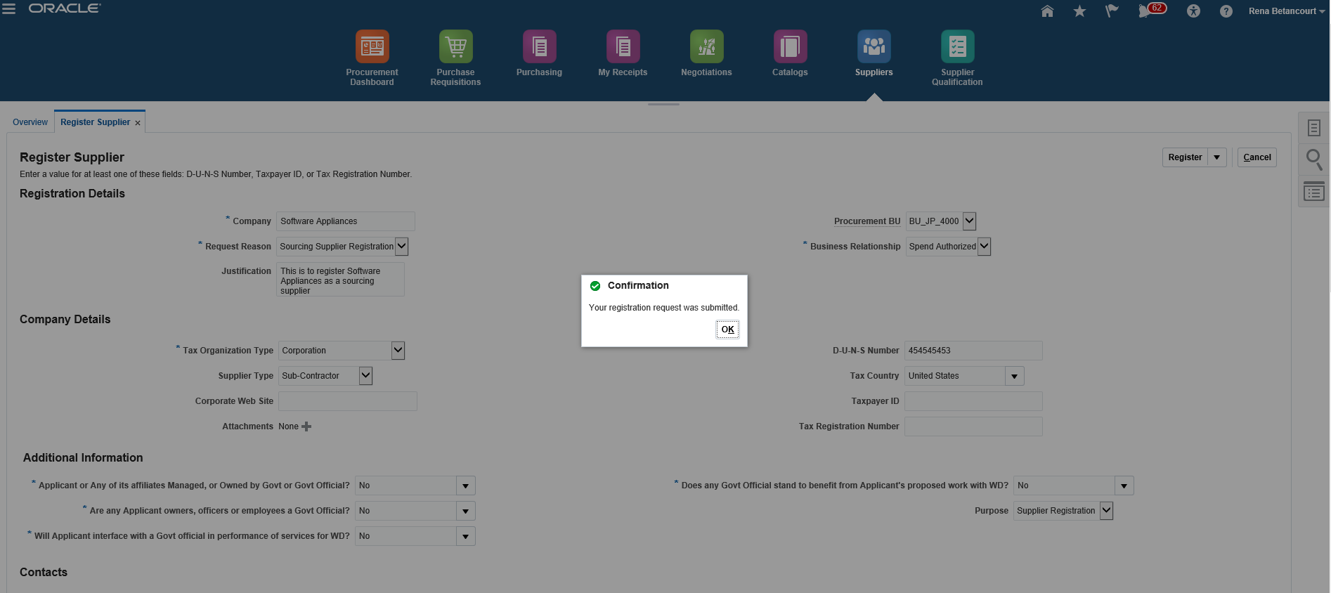
Registering As A Supplier
Let’s review the steps to confirm the submission:
11. Select and Add Products and Services
The Confirmation pop-up window appears. Click the OK button.
12. Complete Questionnaire
13. Submit for Approval
14. Confirm Submission
Once the registration has been submitted, it is sent for approval.
Congratulations! You have now viewed the Supplier Registration Process in the Oracle Cloud Portal!

