Slide 1
SEARCH AND VIEW PURCHASE ORDERS

Slide 2
Purchasing: Process Flow
Let’s learn about the three steps in the purchasing process.
Search for and View Purchase Order
Receive and Acknowledge Purchase Order
Accept or Reject Purchase Order
Let’s now view the transaction steps to maintain the supplier profile.
Notes:
Let’s now learn about the three steps in the purchasing process. Let’s now view the transaction steps to maintain the supplier profile.

Slide 3
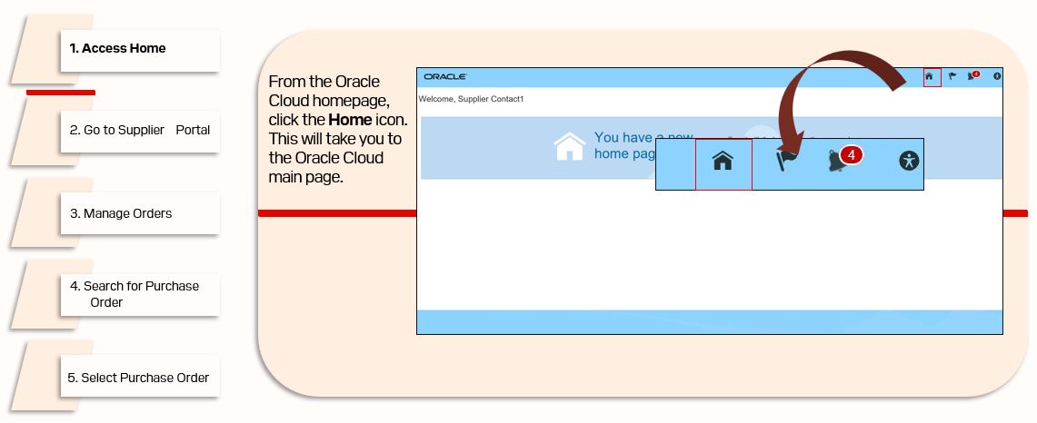
Search and View Purchase Orders
Let’s start the process to search and view Purchase Orders by navigating to the Oracle Cloud homepage.

Slide 4
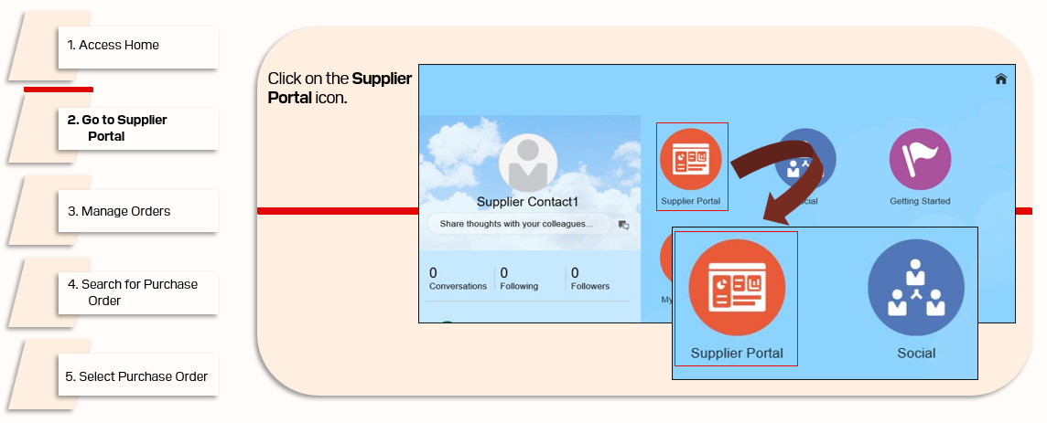
Search and View Purchase Orders (Cont’d)
Let’s view the steps to access the Supplier Portal.

Slide 5
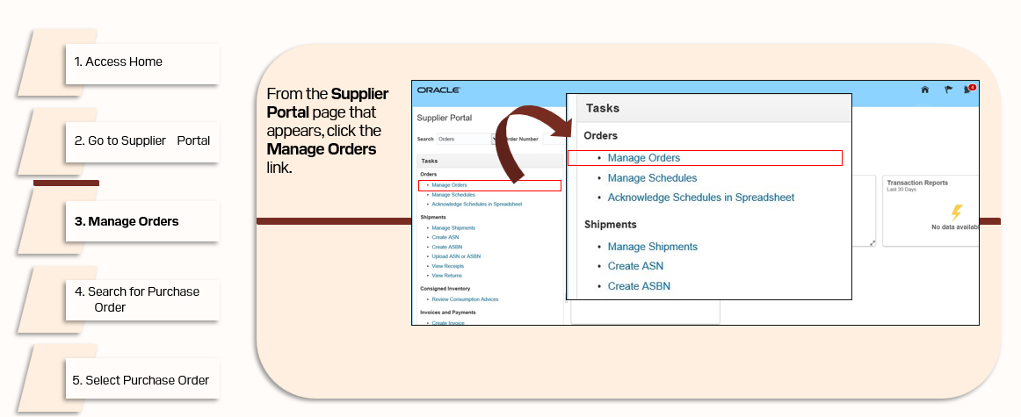
Search and View Purchase Orders (Cont’d)
Let’s view the steps to navigate to the Manage Orders page.

Slide 6
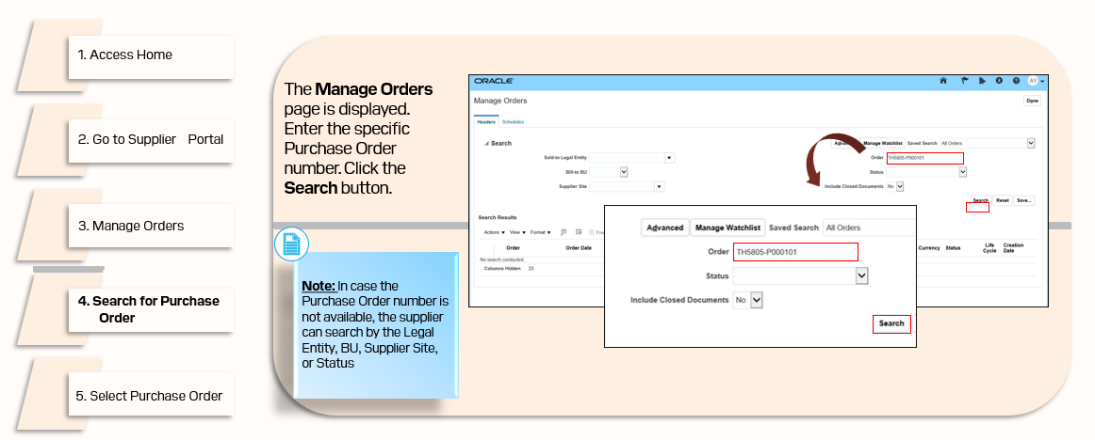
Search and View Purchase Orders (Cont’d)
Let’s view the steps to search for a specific Purchase Order.

Slide 7
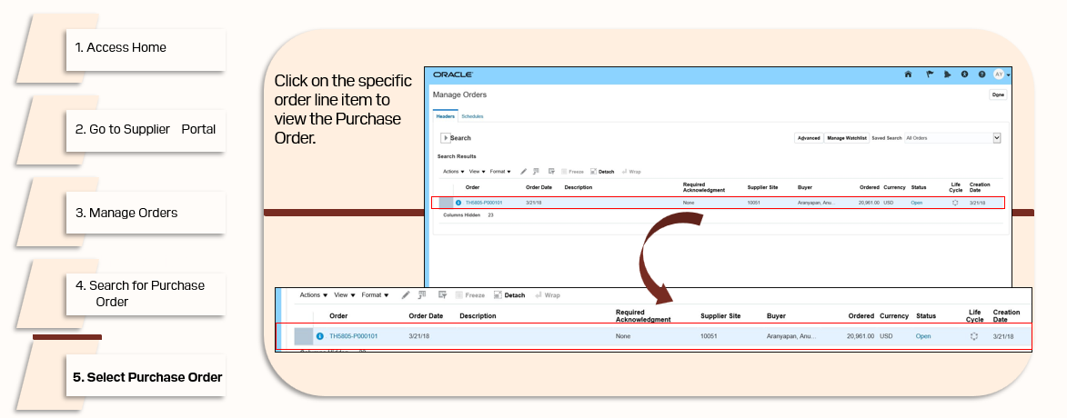
Search and View Purchase Orders (Cont’d)
Let’s view the steps to select the specific Purchase Order.

Slide 8
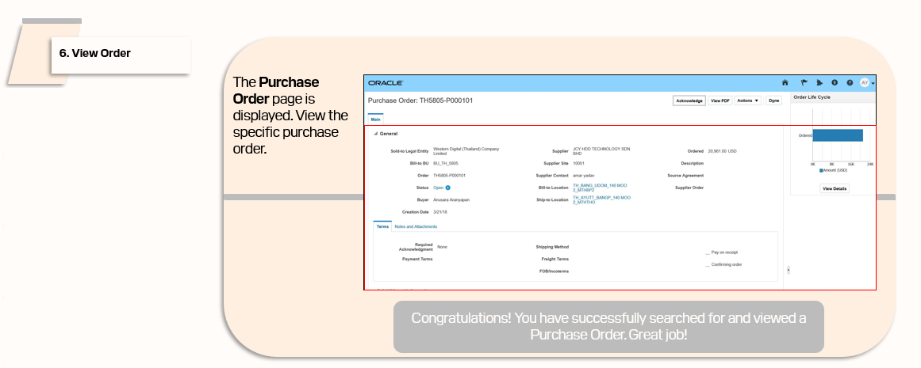
Search and View Purchase Orders (Cont’d)
Let’s view the steps to view the specific Purchase Order.

