Slide 1
SUPPLIER QUALIFICATION MANAGEMENT TRAINING - SUPPLIER RESPONSE TO QUESTIONNAIRE
2021
Global Procurement, Responsible Supply Chain

Slide 2
We Are Transforming to Supplier Portal Platform
From email request or engagement to Supplier Portal: Oracle Cloud
Module → Supplier Qualification Management (SQM)
Team Engaging with our valued suppliers → Responsible Supply Chain (RSC)
Objective:
Responsible supply chain broadly defined as a collaborative commitment to engage with supply partnersto ensure a socially responsible and sustainable value chain is achieved.
Investing with our supply partners to initiate and implement sustainable measures that influence responsible sourcing to mitigate social and environmental risks throughout Western Digital supply chain.
Facilitating important initiatives, information sharing, industry collaboration and implementation of best practices, benchmarking and monitoring performance improvement are pertinent for our successful engagement.

Slide 3
List of Questionnaires
Questionnaires related to Corporate Social and Environmental Responsibility (Labor, Health and Safety, Environmental, Ethics, and Management System)
Global Commitment Citizenship letter
International Organization for Standardization certification (e.g. ISO 9001, ISO14001, etc)
Responsible Minerals Initiative questionnaire – scoping and minerals usage
IPE Monitoring Program (applicable to manufacturing site in China only)
Drought / Flood BCP monitoring (applicable to manufacturing site in Thailand only)

Slide 4
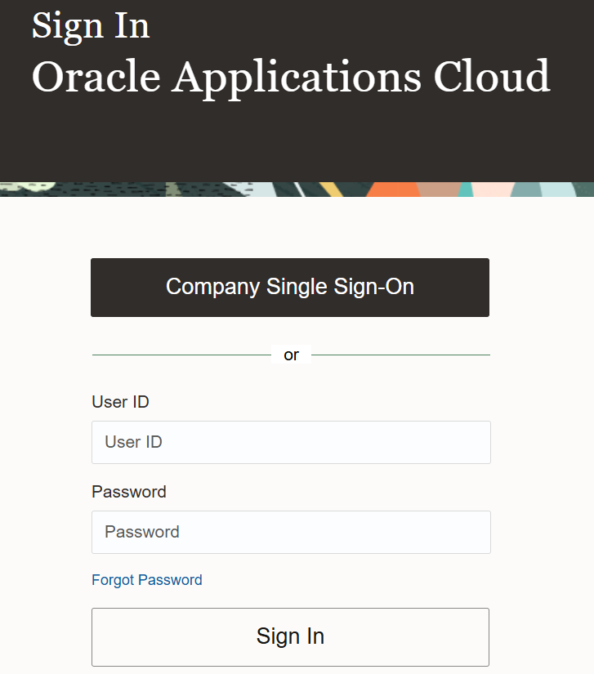
Logging in to the Supplier Portal
Use this link to access the Supplier Portal: https://edmk.fa.us2.oraclecloud.com/
1. Enter your User ID.
Your User ID your first name.last name
Enter your Password. This is a password you have created once you receive the initial email with your login details.

Slide 5
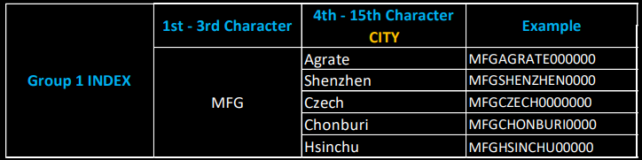
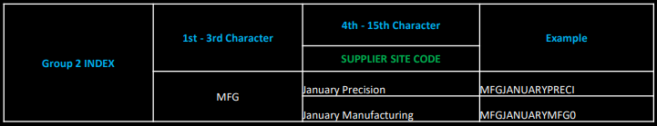
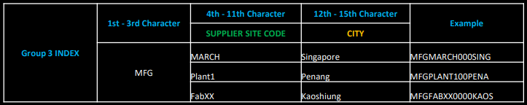
SUPPLIER SITE CODE DERIVATION
Example: Option 1 is applicable to Suppliers with multiple Sites in different Cities
Option 2 is applicable for Suppliers with Sites for different Product lines
Option 3 is applicable for Suppliers with Sites in same City with different addresses

Slide 6
SUPPLIER CAN RESPOND TO QUESTIONNAIRE IN BELOW METHODS:
From Worklist Notification in Supplier Portal
01
From Manage Questionnaires Task in Supplier Portal
02
From Email Notification
03

Slide 7
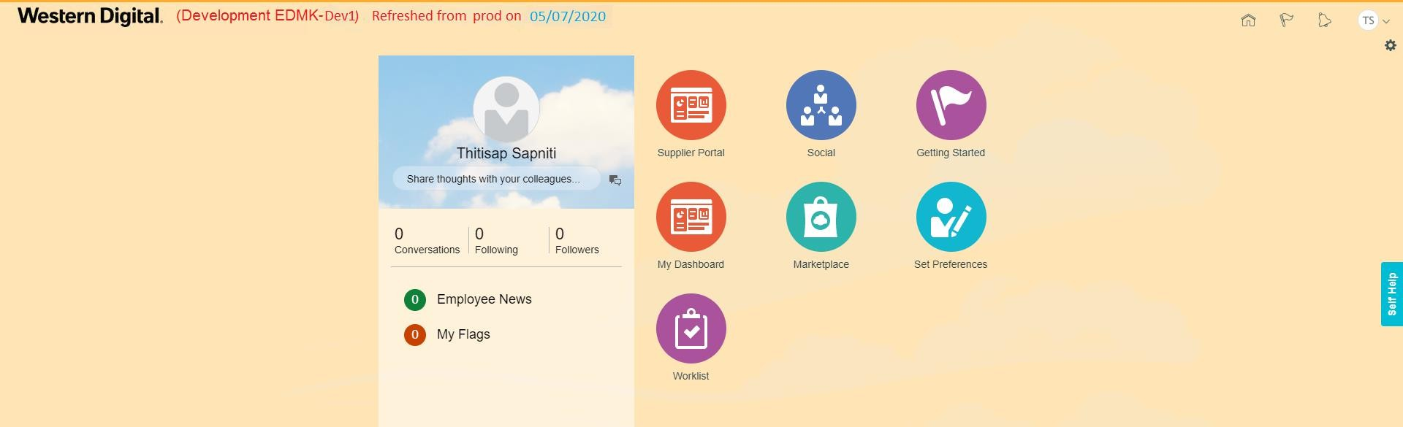

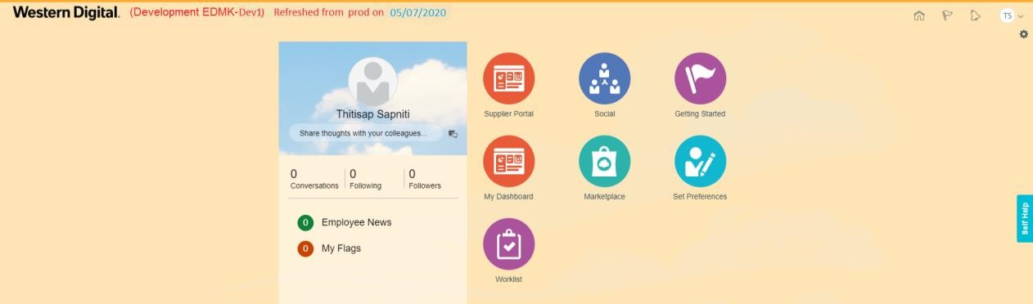
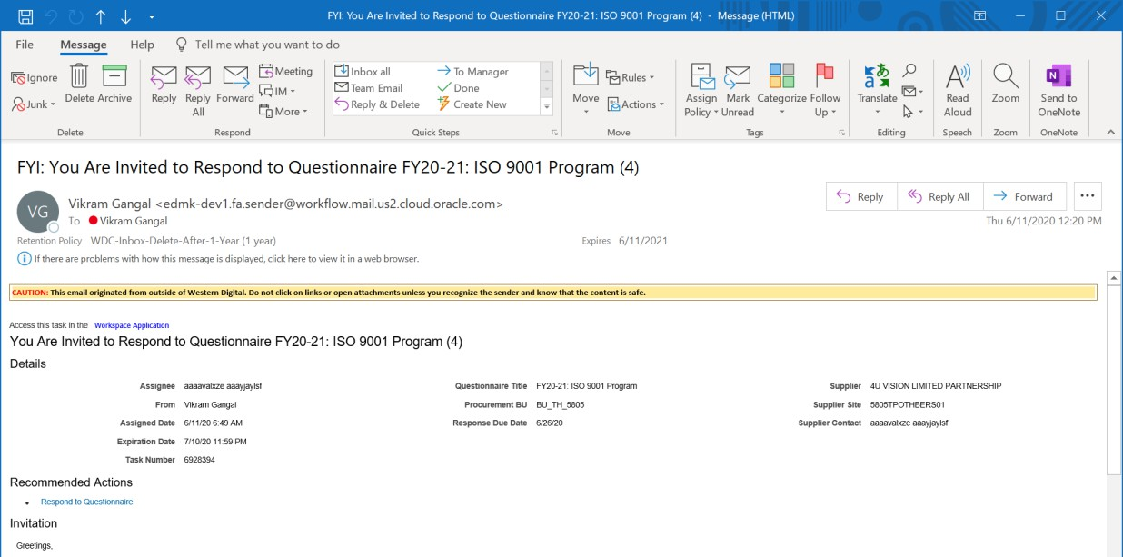
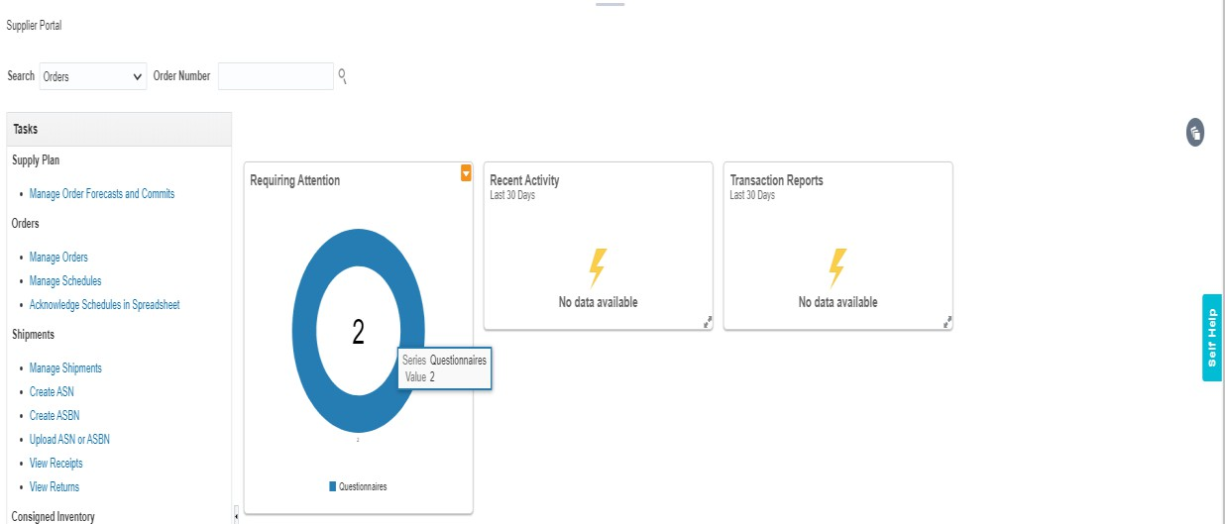
1) From Worklist Notification
in Supplier Portal
2) From Manage Questionnaires Task in Supplier Portal
3) From Email Notification

Slide 8
1) SUPPLIER USER CONTACT
RESPONDING TO QUESTIONNAIRE
FROM WORKLIST NOTIFICATION IN
SUPPLIER PORTAL

Slide 9
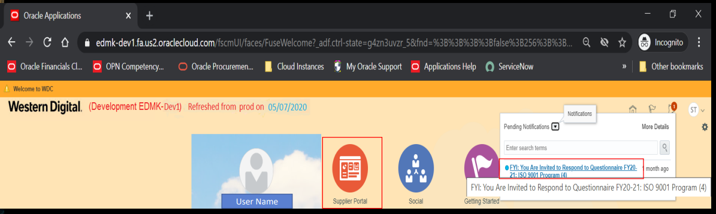
Supplier Contact User can Login to Supplier Portal using their Credentials and see the FYI Notification to Respond to Questionnaire

Slide 10
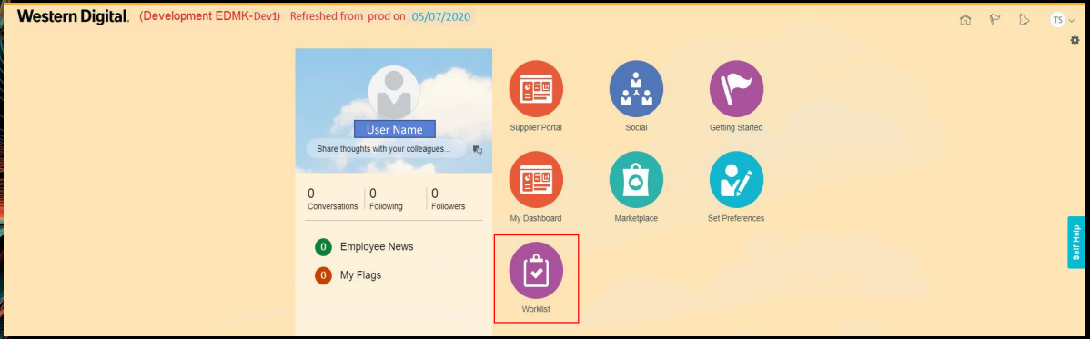
Alternatively, Supplier Contact User can Login to Supplier Portal using their Credentials and navigate to Worklist to see all their Notifications

Slide 11
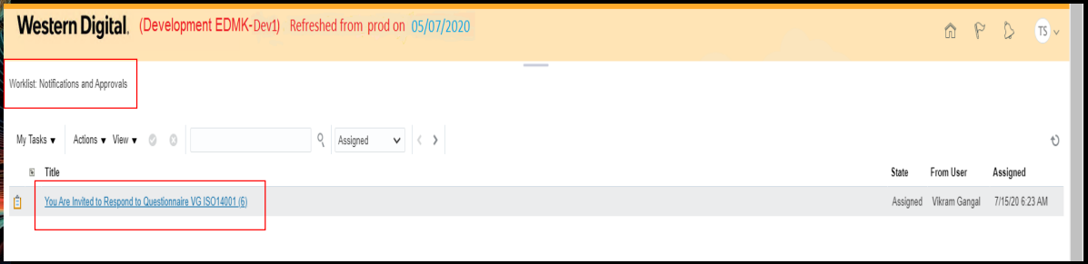
Supplier Portal > Worklist Notifications and Approvals, Supplier can see all their Notification > Click on Notification hyperlink to view the details

Slide 12
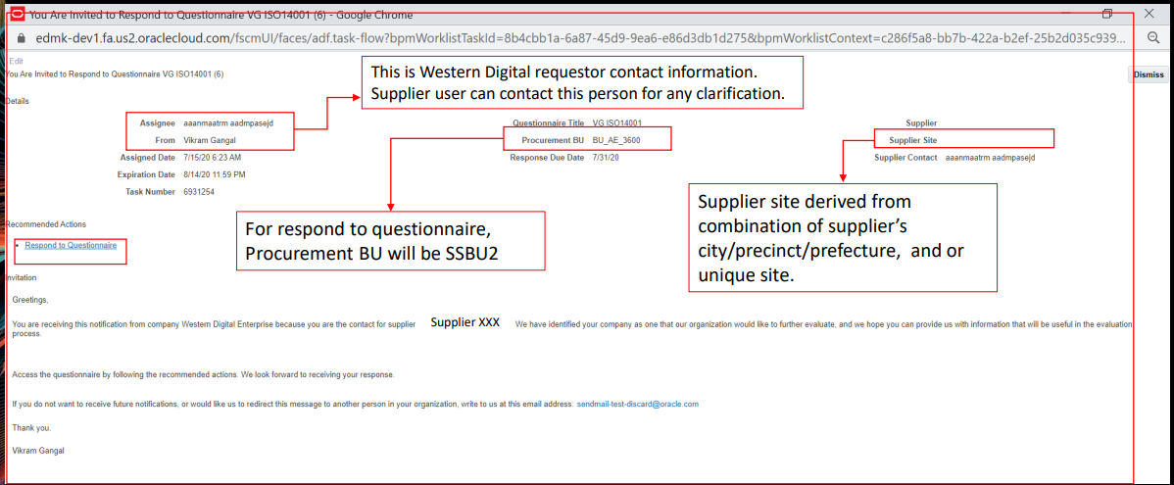
Supplier Portal > Respond to Questionnaire notification details page are displayed as shown below > Click on Respond to Questionnaire hyperlink

Slide 13
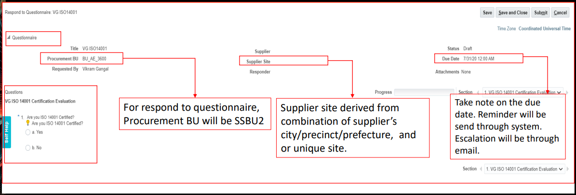
Supplier Portal > Respond to Questionnaire page shows up as shown below which displays the Initiative Title, Supplier and Questions details

Slide 14
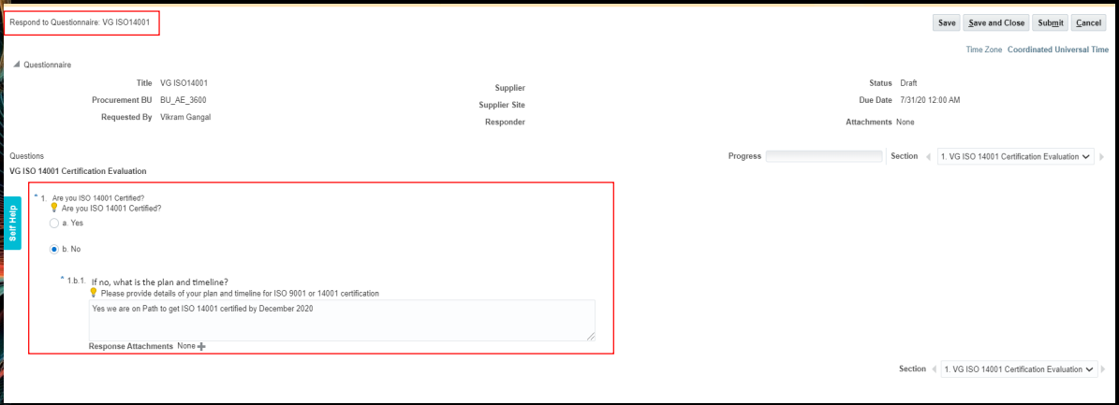
Supplier Contact to key in the answers to the questions as below and click on Submit

Slide 15
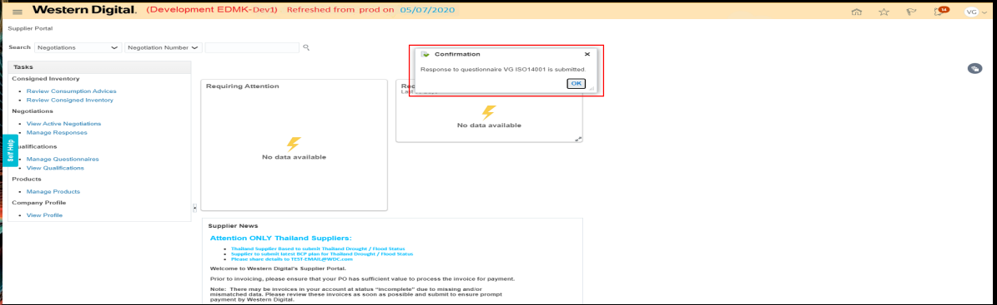
Confirmation message saying Response to questionnaire is submitted as shown below

Slide 16
2) SUPPLIER USER CONTACT RESPONDING TO QUESTIONNAIRE FROM MANAGE QUESTIONNAIRE TASK IN SUPPLIER PORTAL

Slide 17
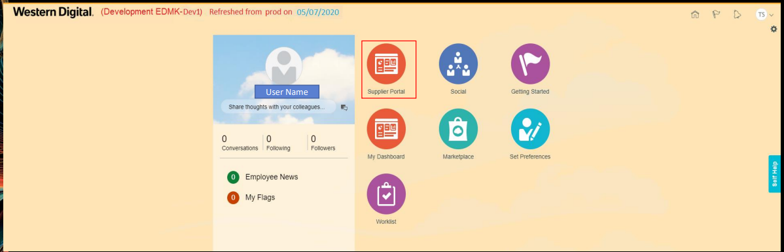
Supplier Response from Supplier Portal Supplier User contact to Login to Supplier Portal

Slide 18
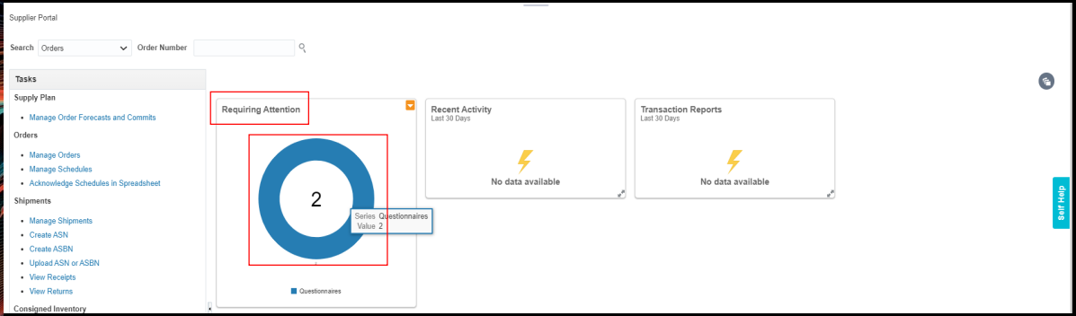
Notice the Requiring Attention infolet > count of Questionnaires awaiting Supplier contact response as displayed > Click on the circle to navigate to Manage Questionnaires task

Slide 19
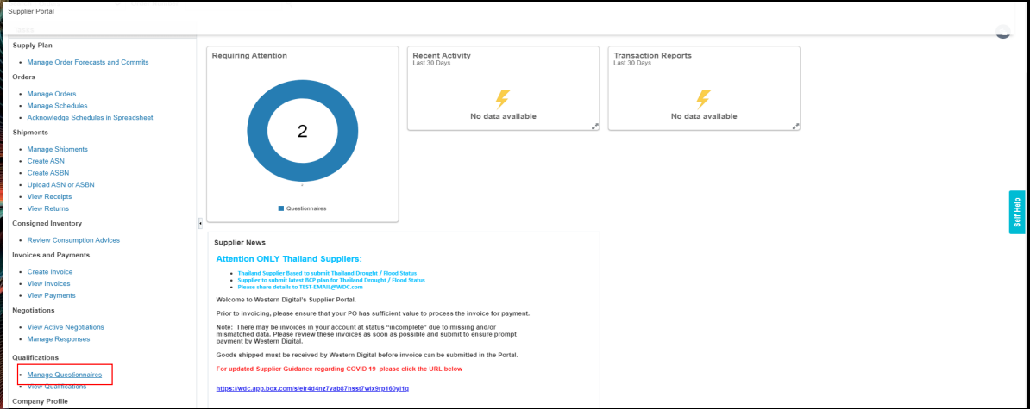
Navigate to Manage Questionnaires task > Click on Manage Questionnaires task

Slide 20
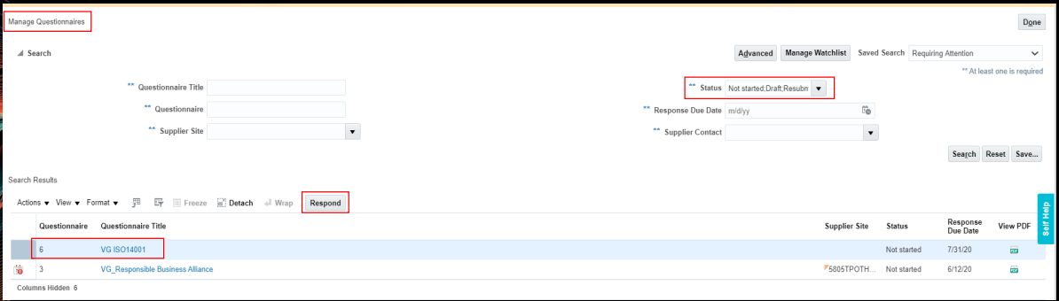
In Manage Questionnaires task > All the Questionnaires pending Supplier response is shown as below. Supplier User can Select the Questionnaire they would like to respond and Click on Respond button

Slide 21
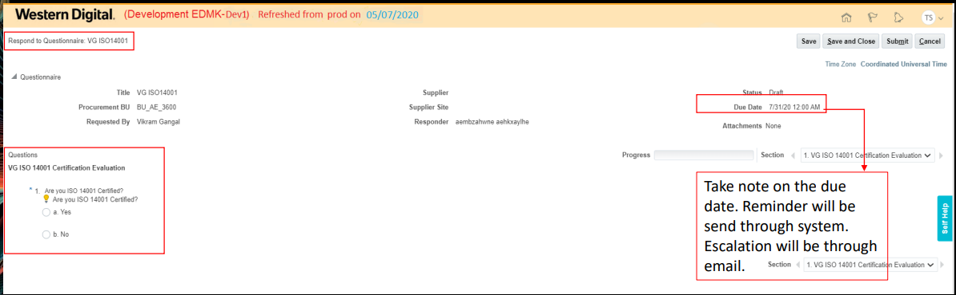
Respond to Questionnaires pages is displays as below wherein Supplier User and input their response

Slide 22
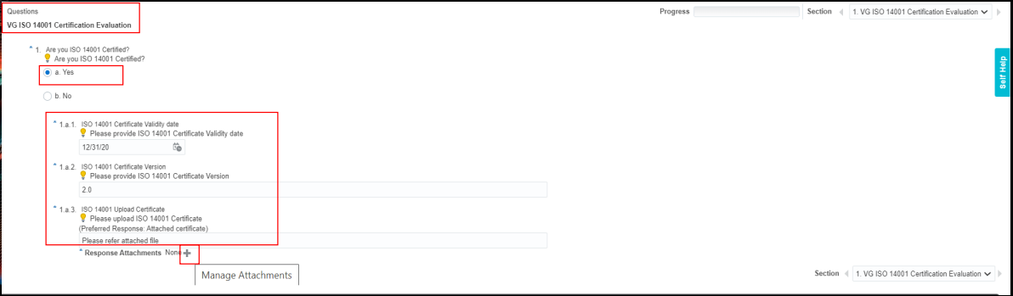
Supplier User input their response and based on the response the follow up (branching questions) are displayed as shown below.
Supplier User can click on + icon next to the Response Attachments to add attachments as their response

Slide 23
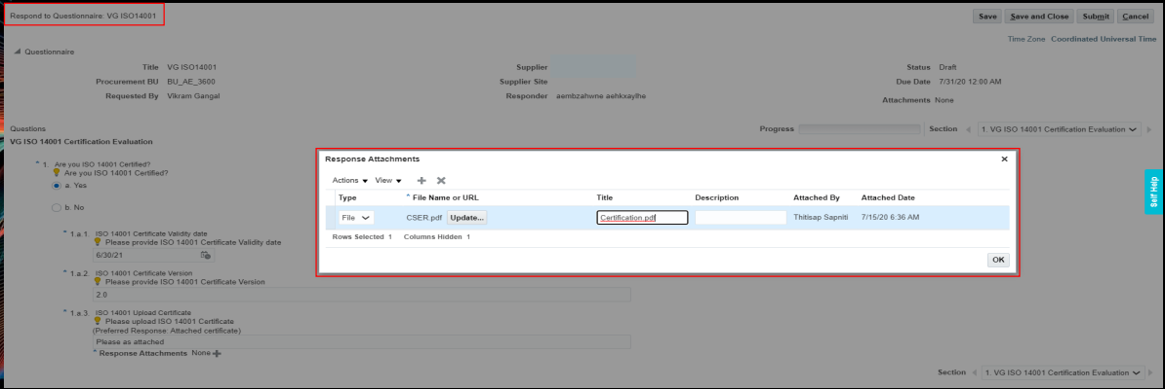
Response attachments popup window is displayed; Supplier User can select Type as File, browse the attachment from their local system and Click on OK as shown below

Slide 24
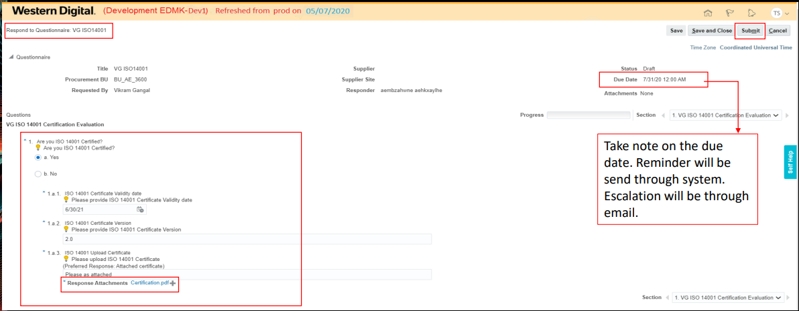
Response attachments are added to Questionnaire and Supplier User has input their response > Click on Submit

Slide 25
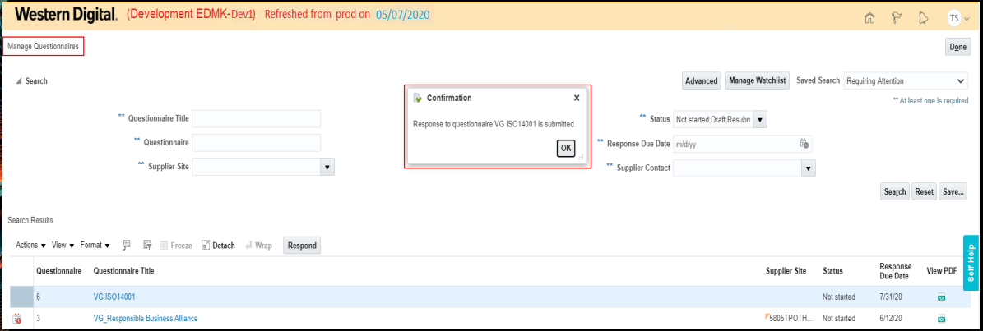
Confirmation message is displayed that Respond to
Questionnaire is submitted by Supplier User > Click OK

Slide 26
3) SUPPLIER USER CONTACT RESPONDING TO QUESTIONNAIRE FROM EMAIL NOTIFICATION

Slide 27
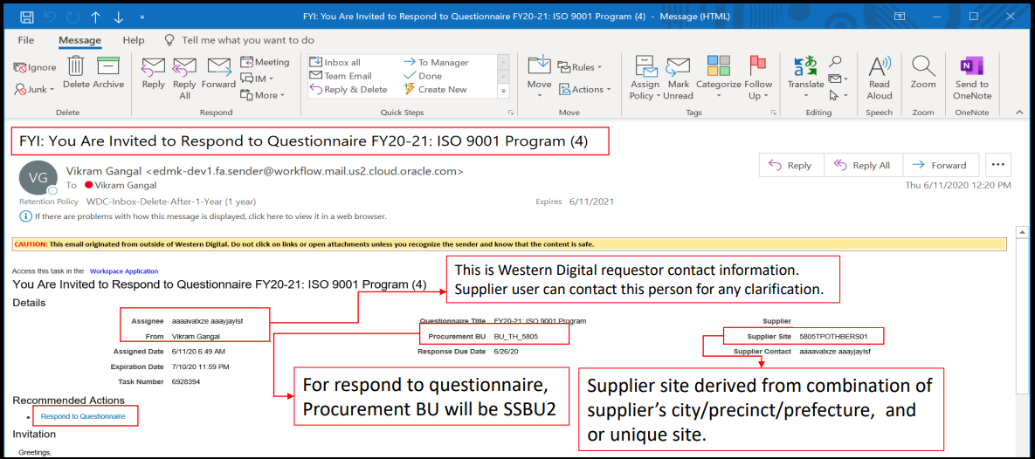
After the Initiative is Launched. Supplier User can click on Respond to Questionnaire link and submit their response

Slide 28
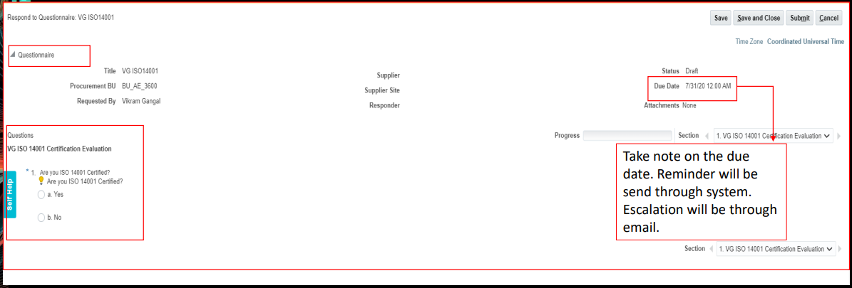
Respond to Questionnaire page shows up as shown below which displays the Initiative Title, Supplier and Questions details. Supplier contact can input their Response and Submit

