Slide 1
MAINTAIN SUPPLIER PROFILE

Slide 2
Maintaining Supplier Profile: Process Flow
Let’s learn about the process the suppliers follow to update their profile. First, the suppliers will access the Oracle Cloud to search for their profile, and then make changes to the profile. The supplier will then submit the change request, which will be routed to the approver within Western Digital for approval.
Log into Supplier Portal
Search and Update Supplier Profile
Submit Change Request

Slide 3
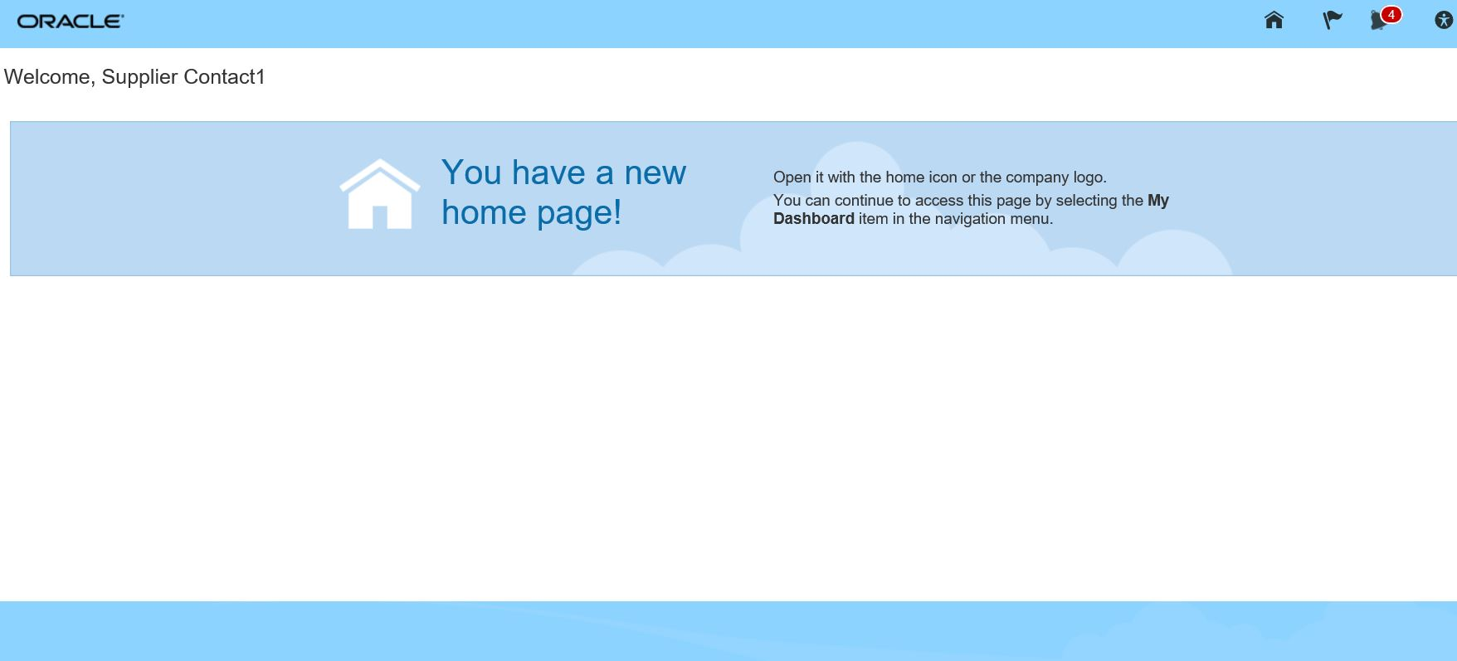
Maintaining Supplier Profile Information
Let’s view the steps to maintain the supplier profile information. Let’s navigate to the Oracle Cloud homepage.
1. Access Home
From the Oracle Cloud homepage, click the Home icon. This will take you to the Oracle Cloud main page.
2. Go to Supplier Portal
3. Manage Profile
4. Edit Profile
5. Confirm Edit

Slide 4
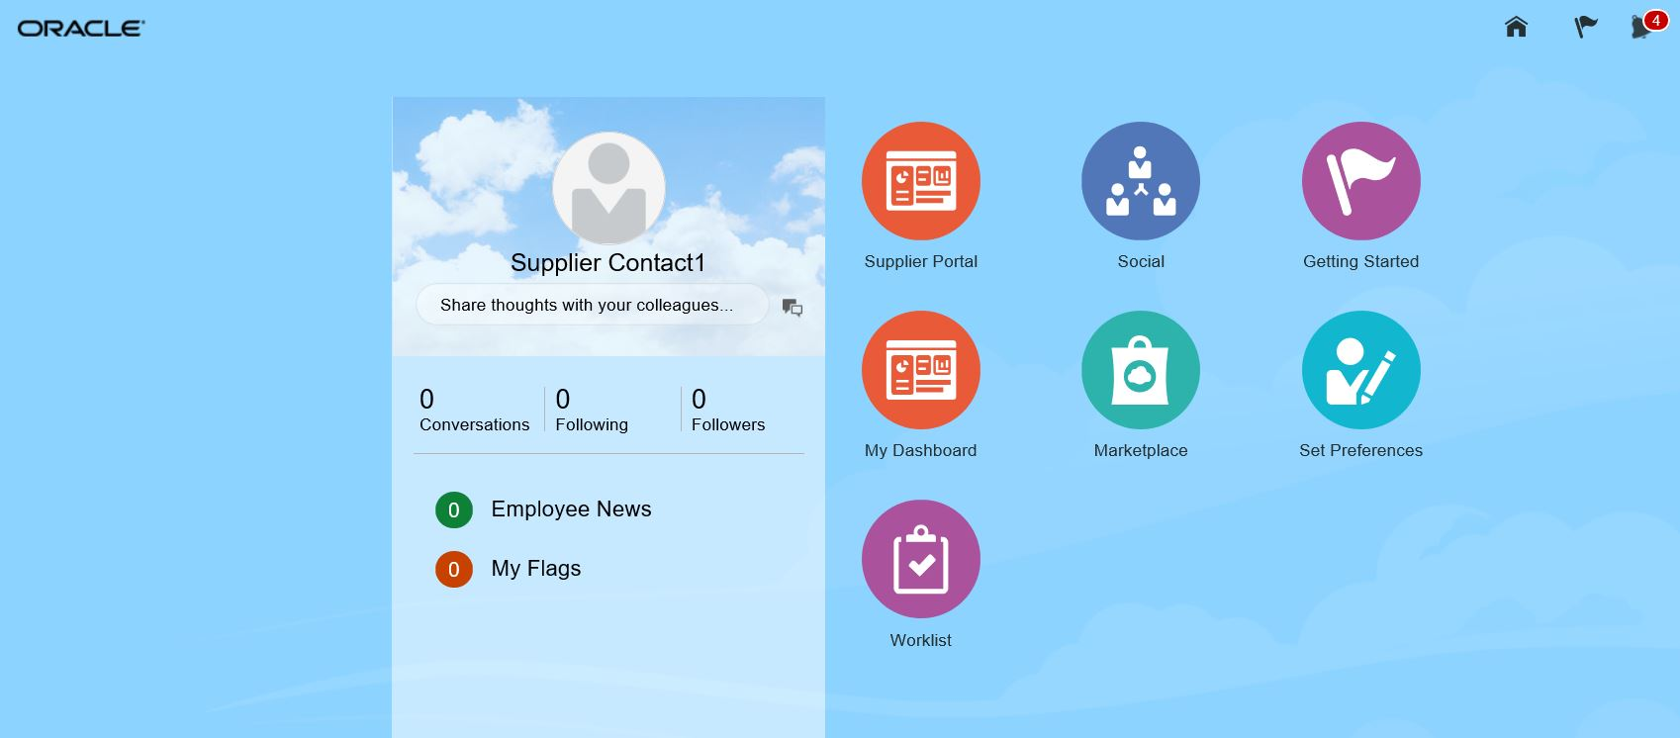
Maintaining Supplier Profile Information (Cont’d)
Let’s view the steps to access the Supplier Portal.
1. Access Home
Click on the Supplier Portal icon.
2. Go to Supplier Portal
3. Manage Profile
4. Edit Profile
5. Confirm Edit

Slide 5
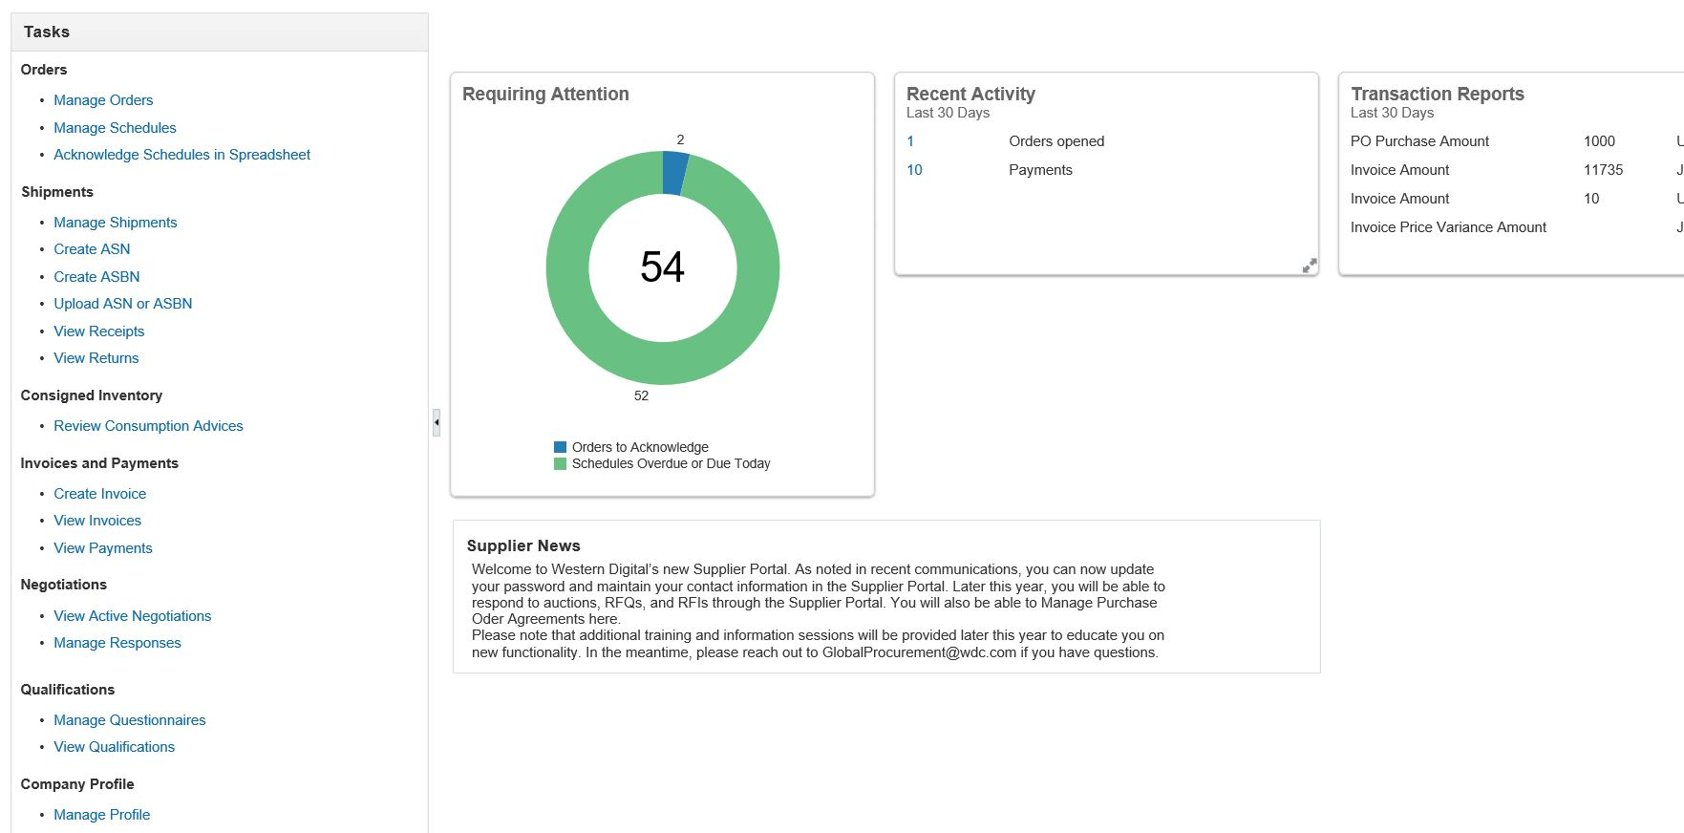
Maintaining Supplier Profile Information (Cont’d)
Let’s view the steps to navigate to the Manage Profile page.
1. Access Home
Click the Manage Profile link in order to navigate to the supplier profile page.
2. Go to Supplier Portal
3. Manage Profile
4. Edit Profile
5. Confirm Edit

Slide 6
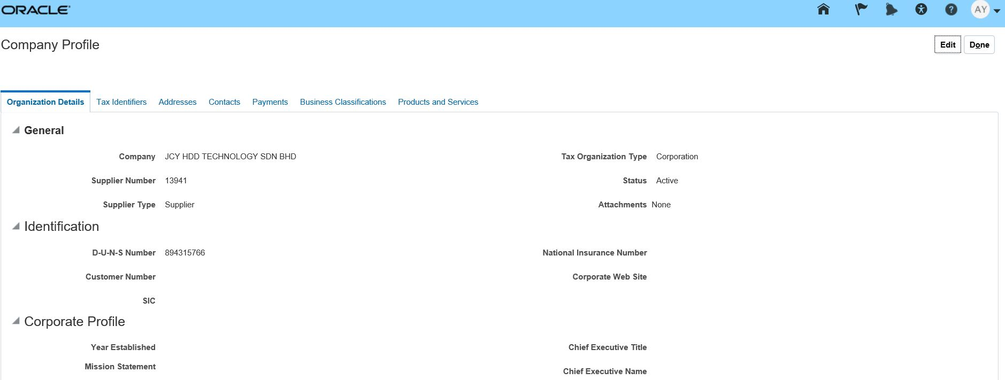
Maintaining Supplier Profile Information (Cont’d)
Let’s view the steps to edit profile information.
1. Access Home
From the Company Profile page, click the Edit button.
2. Go to Supplier Portal
3. Manage Profile
4. Edit Profile
5. Confirm Edit

Slide 7
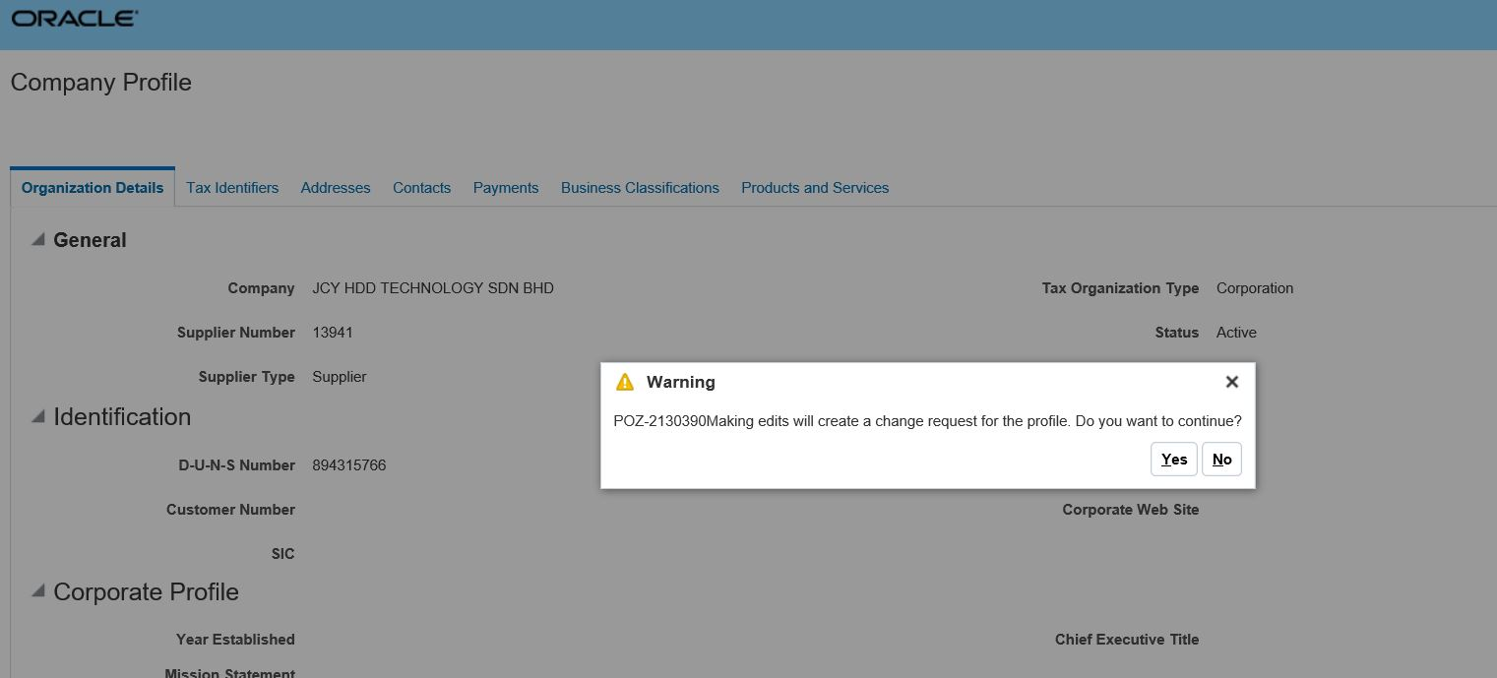
Maintaining Supplier Profile Information (Cont’d)
Let’s view the steps to confirm the edit details.
1. Access Home
From the Warning pop-up window that appears to confirm the edit, click the Yes button.
2. Go to Supplier Portal
3. Manage Profile
4. Edit Profile
5. Confirm Edit

Slide 8
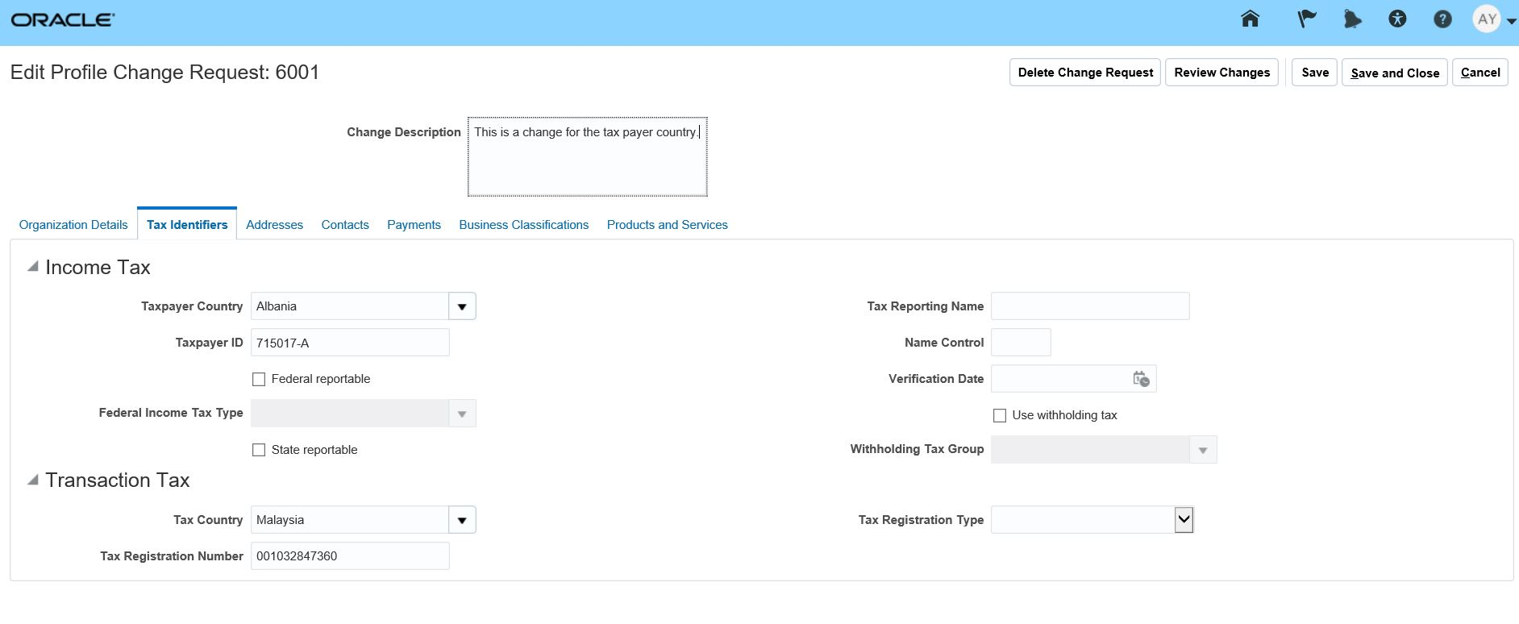
Maintaining Supplier Profile Information (Cont’d)
Let’s view the steps to enter the specific edits.
6. Enter Changes
Navigate to the specific tab. In this example, navigate to the Tax Identifiers tab.
From the Taxpayer Country drop-down menu, select a new country. Enter description in this Change Description field. Click the Review Changes button.
7. Submit Changes
8. View Confirmation
9. View Confirmation
10. View Rejected PO

Slide 9
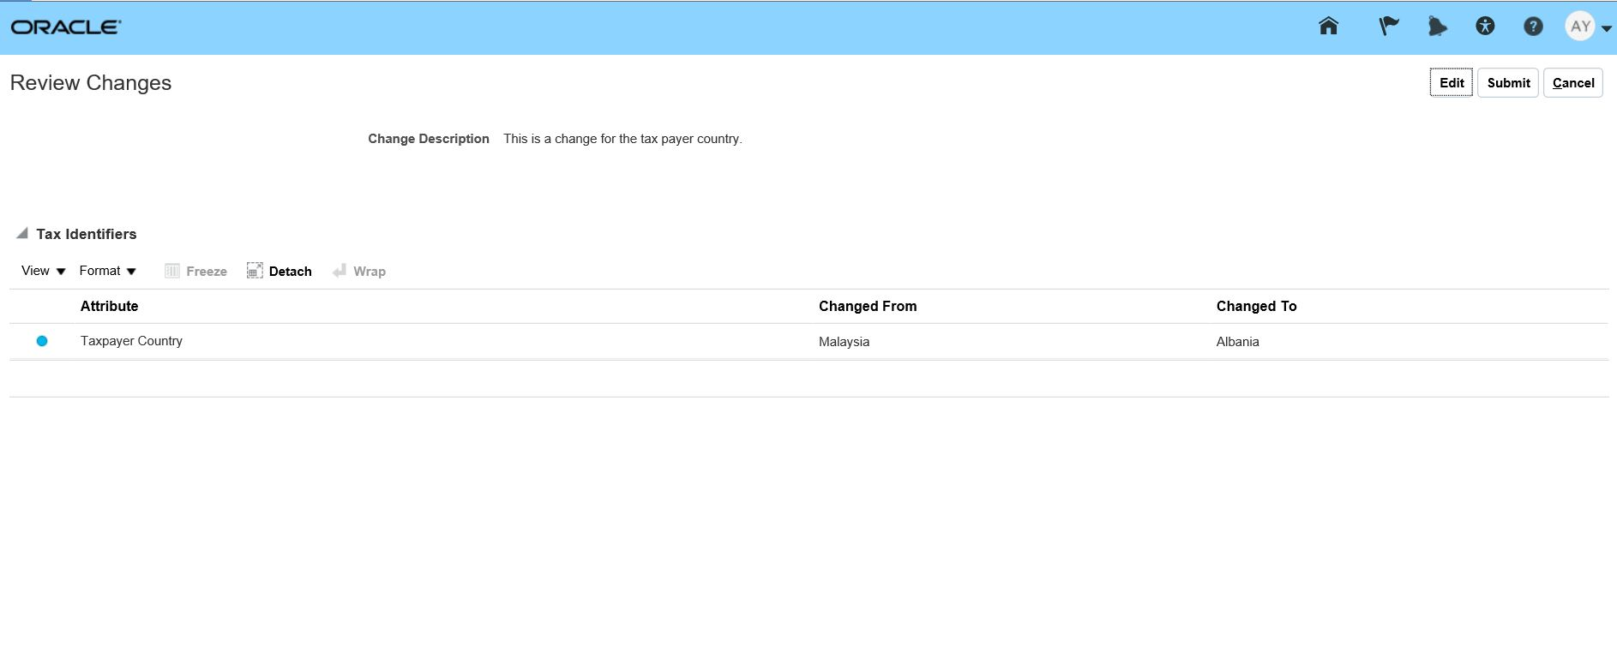
Maintaining Supplier Profile Information (Cont’d)
Let’s view the steps to review and then submit the changes for approval.
6. Enter Changes
Review the specific changes and click the Submit button.
7. Submit Changes
8. View Confirmation
9. View Confirmation
10. View Rejected PO

Slide 10
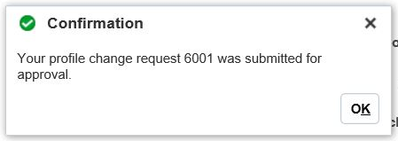
Maintaining Supplier Profile Information (Cont’d)
Let’s view the confirmation for the change request submission.
6. Enter Changes
View the confirmation.
7. Submit Changes
8. View Confirmation
Note: The change request goes to the approver. Once approved, the supplier information will be updated.
Congratulations! You have successfully submitted a change request to update profile information! Great job!
10. View Rejected PO

Slide 11
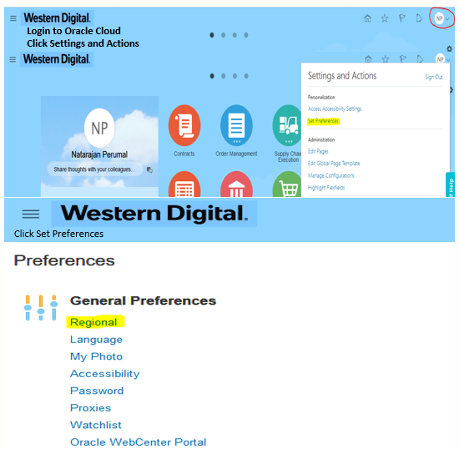
Updating Time Zone

