Slide 1
RESPONDING TO AUCTION

Slide 2
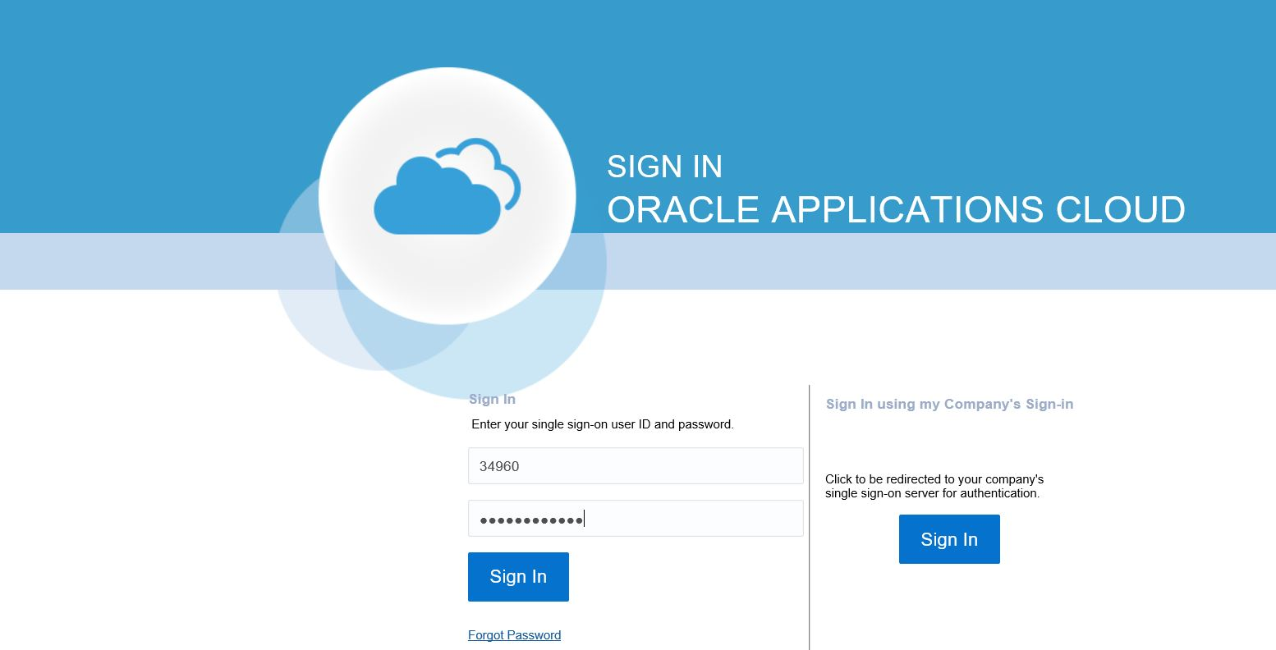
Respond to Auctions
Let’s view the transaction steps for performing sourcing negotiations. First, let’s log into Oracle Cloud.
1. Access Cloud
Enter the specific link for Oracle Cloud in the browser. Then, enter your username and password.
Click the Sign In button.
2. Access Home
3. Go to Supplier
Portal
4. View Negotiation
5. Edit Profile

Slide 3
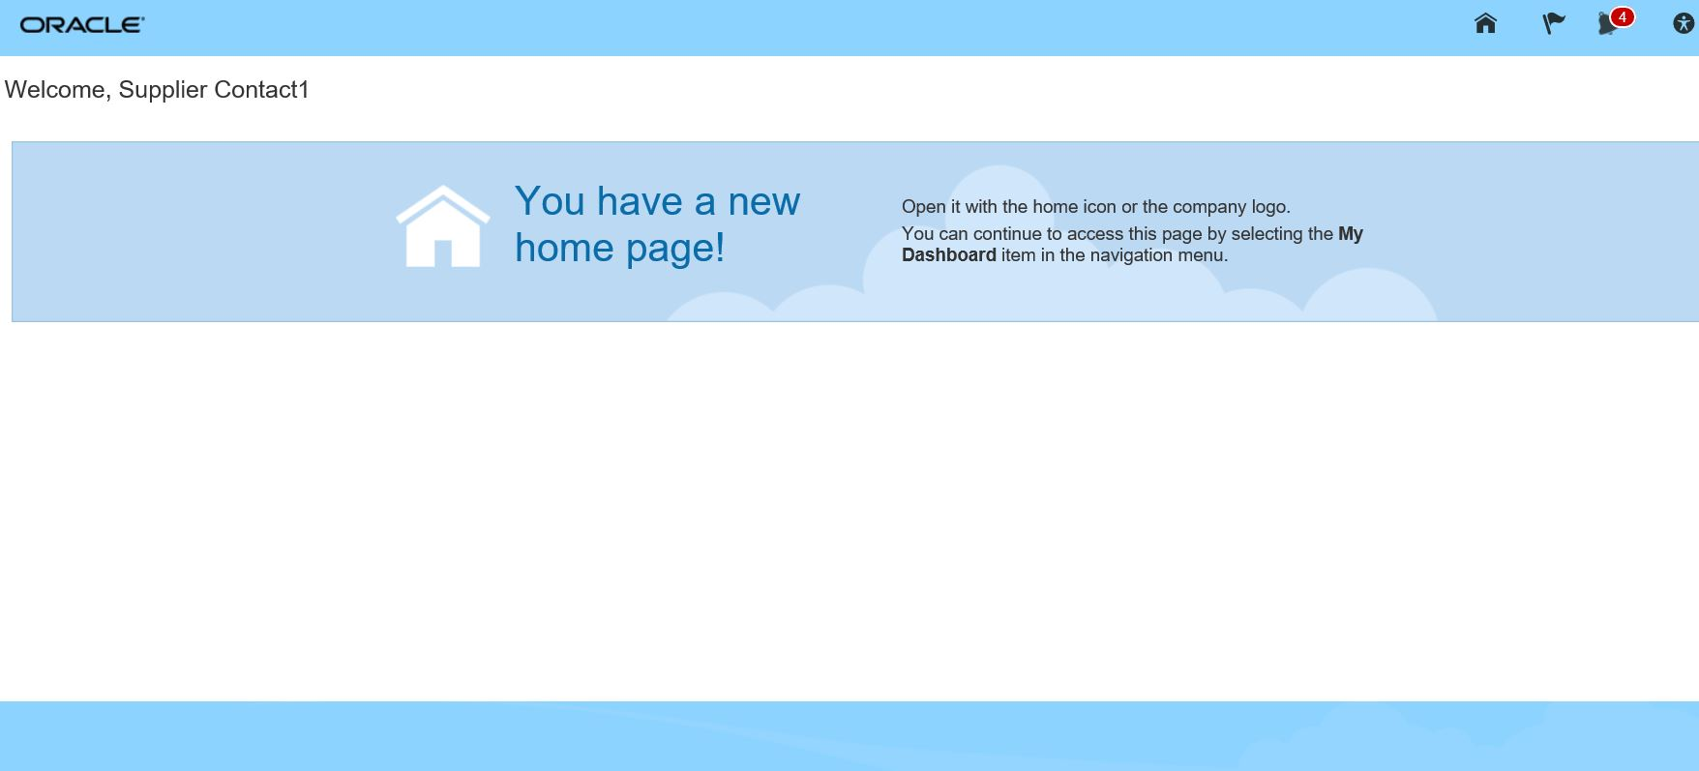
Respond to Auctions
Let’s view the steps to navigate to the Oracle Cloud homepage.
1. Access Cloud
From the Oracle Cloud homepage, click the Home icon. This will take you to the Oracle Cloud main page.
2. Access Home
3. Go to Supplier
Portal
4. View Negotiation
5. Acknowledgement

Slide 4
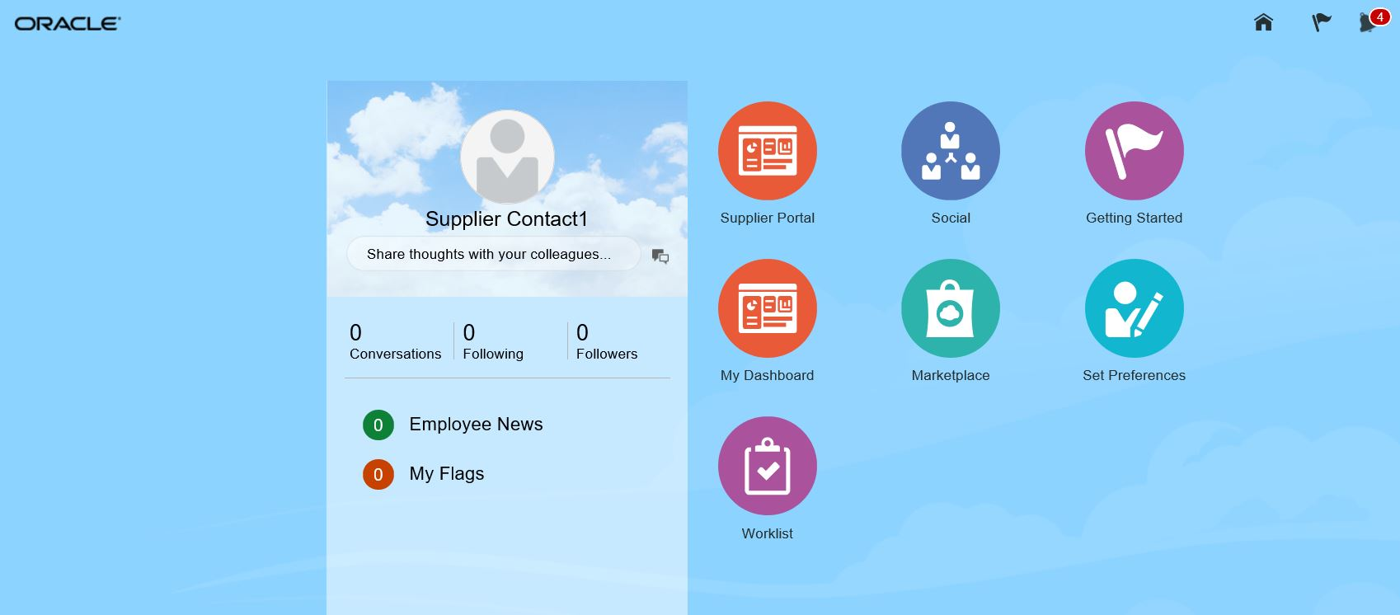
Respond to Auctions
Let’s view the steps to access the Supplier Portal.
1. Access Cloud
Click on the Supplier Portal icon.
2. Access Home
3. Go to Supplier
Portal
4. View Negotiation
5. Acknowledgement

Slide 5
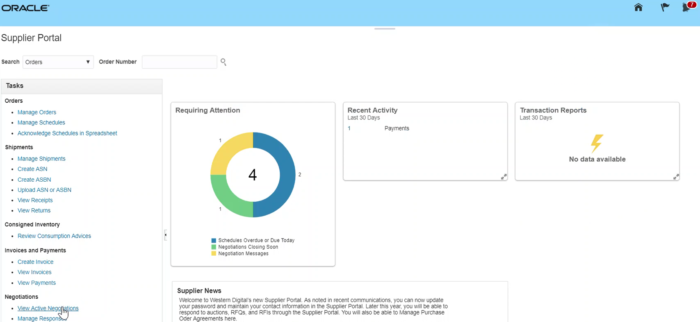
Respond to Auctions
Let’s view the steps to navigate to the View Negotiations page.
1. Access Cloud
From the Supplier Portal page that appears, click the View Active Negotiations link.
2. Access Home
3. Go to Supplier
Portal
4. View Negotiation
5. Acknowledgement

Slide 6
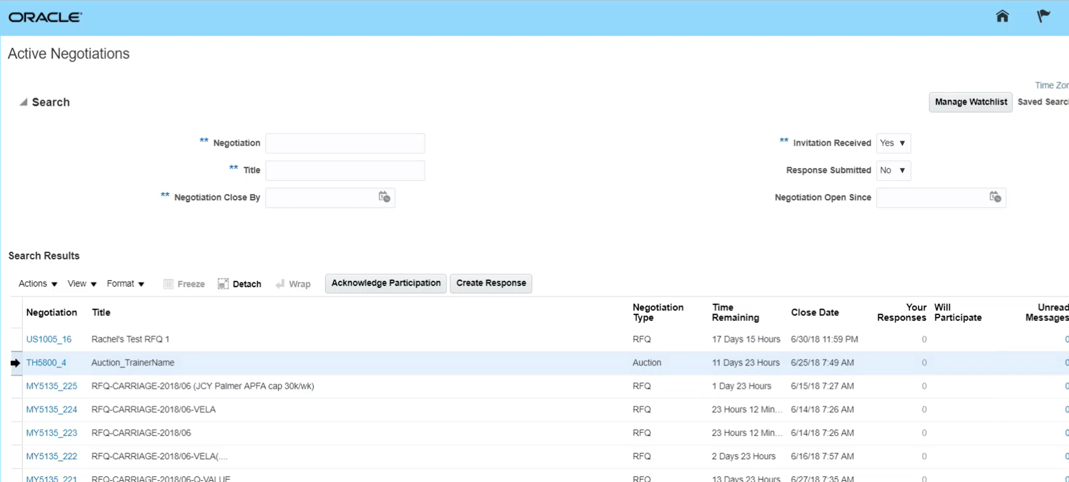
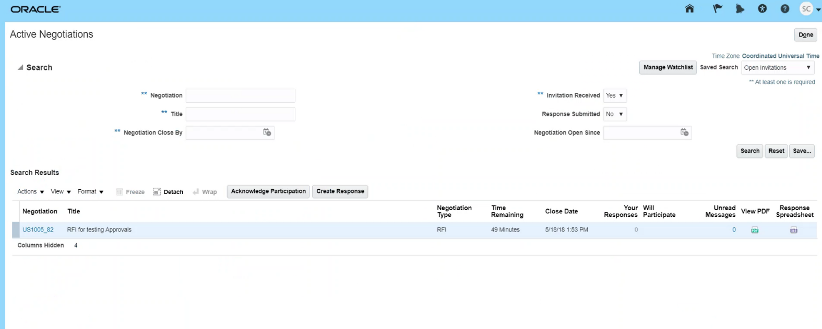
Respond to Auctions
Let’s view the steps to acknowledge participation.
1. Access Cloud
From the Active Negotiations page, select the negotiation line item. Click Acknowledge Participation.
2. Access Home
3. Go to Supplier
Portal
4. View Negotiation
5. Acknowledgement

Slide 7
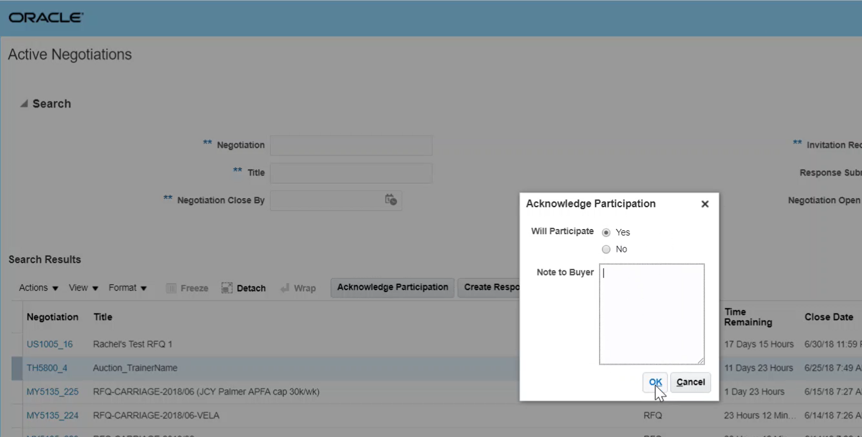
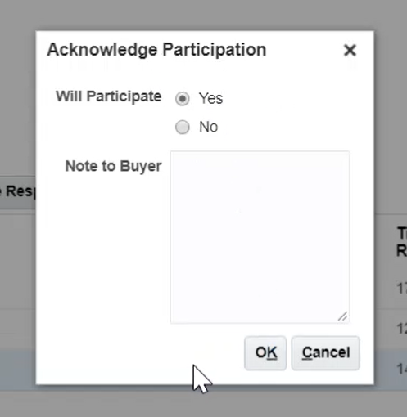
Respond to Auctions
Let’s view the steps to confirm participation.
6. Confirm Participation
Click the Yes radio button to acknowledge participation in the negotiation.
Click the OK button to proceed.
7. Create Response
8. Overview Train stop
9. Requirements
Train stop
10. Lines Train stop

Slide 8
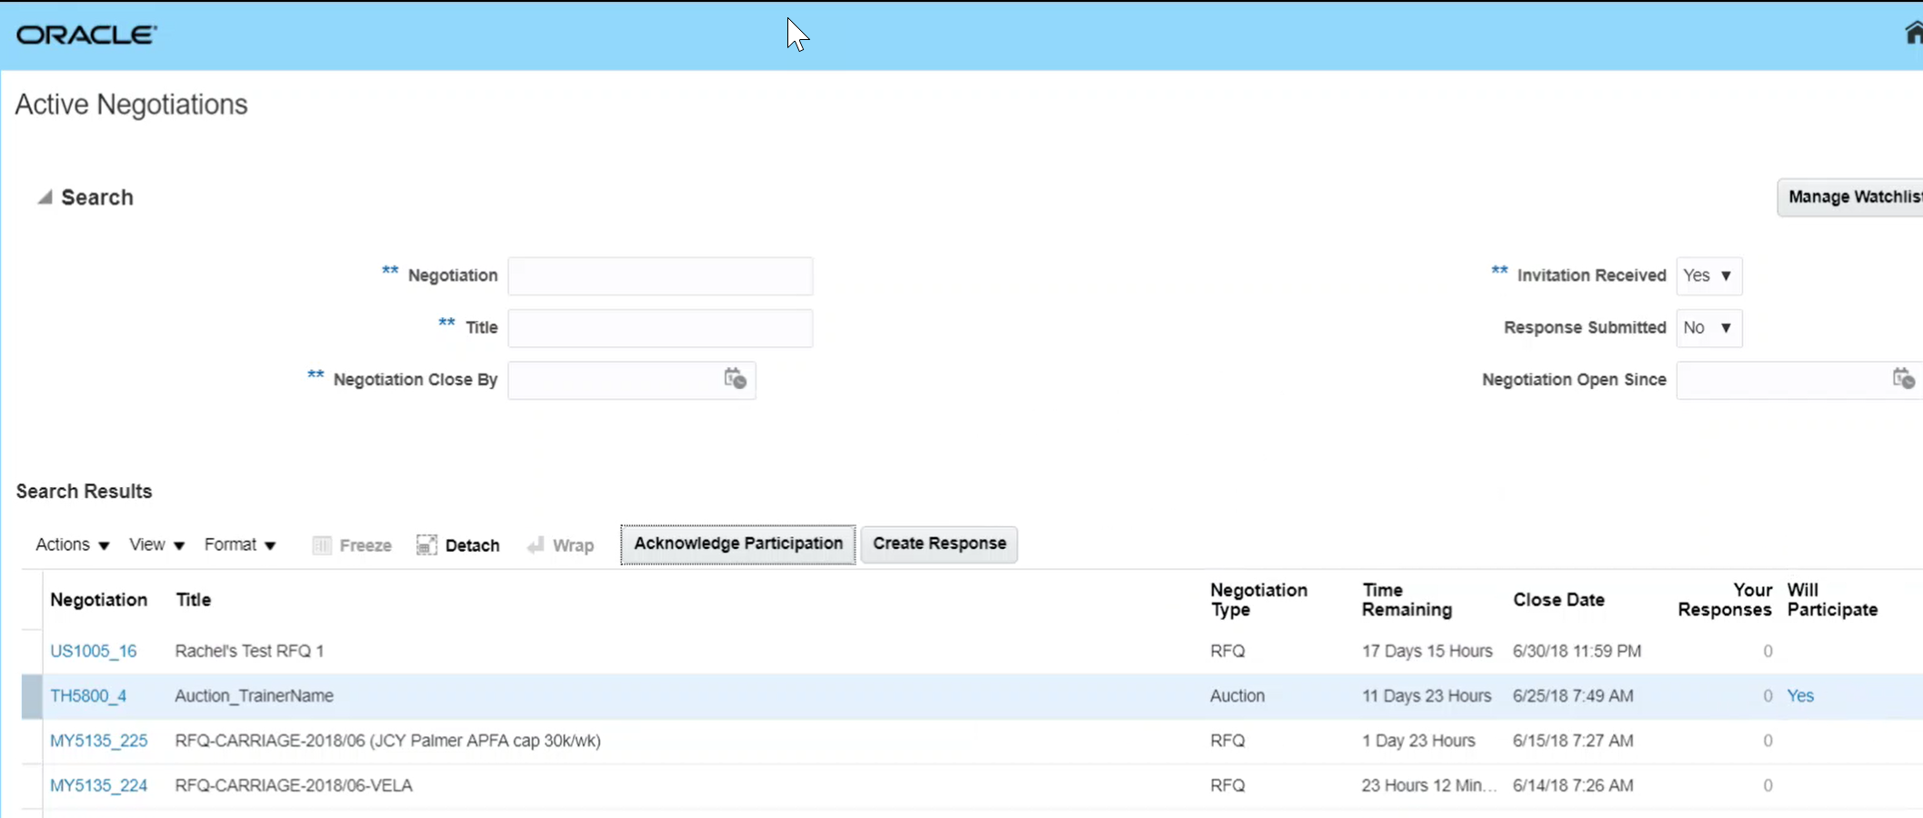
Respond to Auctions
Let’s view the steps to go to the create responses section.
6. Confirm Participation
Select the specific negotiation line item. Click the Create Response button.
7. Create Response
8. Overview Train stop
9. Requirements
Train stop
10. Lines Train stop

Slide 9
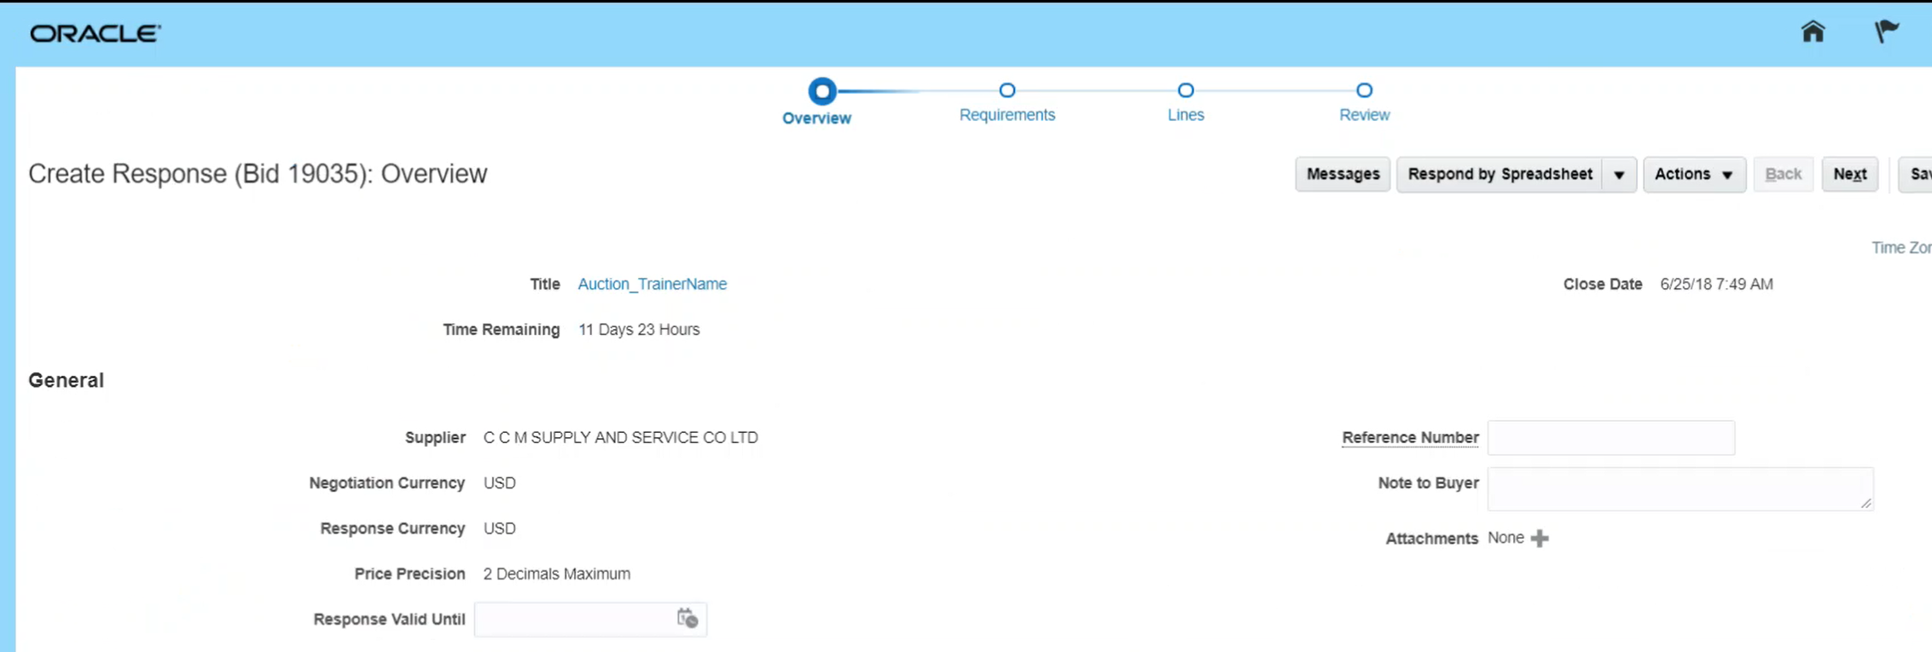
Respond to Auctions
Let’s view the steps to enter information under the Overview train stop.
On the Overview page, enter information in the Response Valid Until and Reference Number fields.
6. Confirm Participation
7. Create Response
8. Overview Train stop
Add attachment if required, by clicking on the + Add icon.
Click on the Next button.
9. Requirements
Train stop
10. Lines Train stop

Slide 10
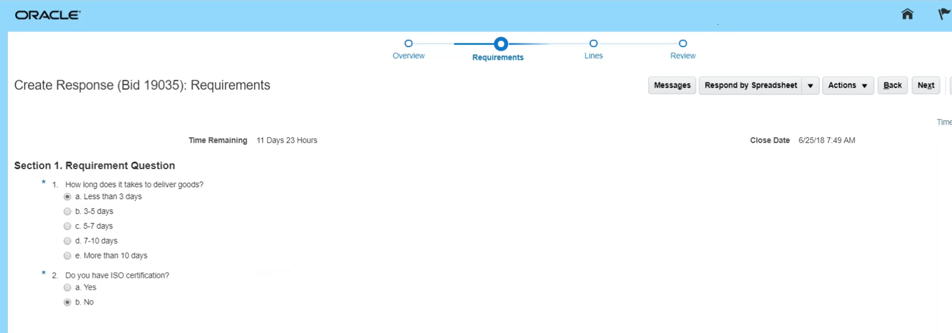
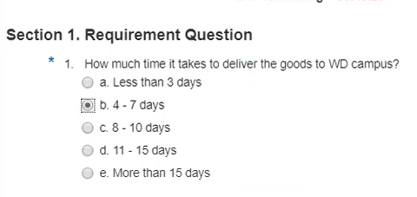
Respond to Auctions
Let’s view the steps to enter information under the Requirements train stop.
6. Confirm Participation
From the Create Response page, enter the response to the question. Click the Next button.
7. Create Response
8. Overview Train stop
9. Requirements Train stop
10. Lines Train stop

Slide 11
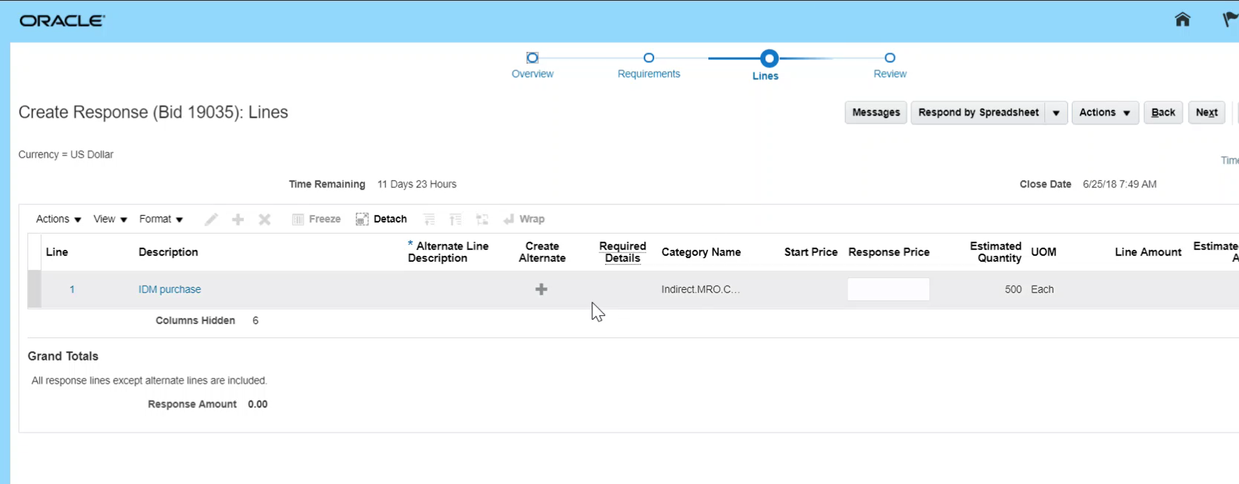
Respond to Auctions
Let’s view the steps to enter information under the Lines train stop.
6. Confirm Participation
Enter information in the Response Price field.
Click the Next button.
7. Create Response
8. Overview Train stop
9. Requirements
Train stop
10. Lines Train stop

Slide 12
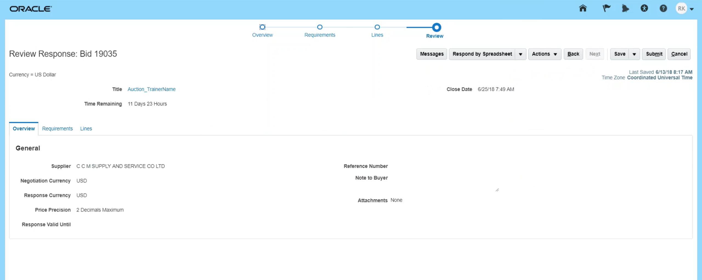
Respond to Auctions
Let’s view the steps to review details under the Review train stop.
11. Review Train stop
Review the information under Review train stop.
12. Submit Responses
13. Confirm Submission
14. View Confirmation

Slide 13
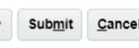
Respond to Auctions
Let’s view the steps to submit the supplier response.
11. Review Train stop
Click the Submit button to submit the response.
12. Submit Responses
13. Confirm Submission
14. View Confirmation

Slide 14
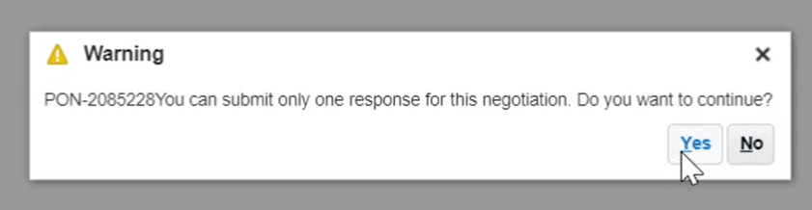
Respond to Auctions
Let’s view the steps to confirm the submission of the response.
11. Review Train stop
From the Warning pop-up window that appears, click the Yes button.
12. Submit Responses
13. Confirm Submission
14. View Confirmation

Slide 15
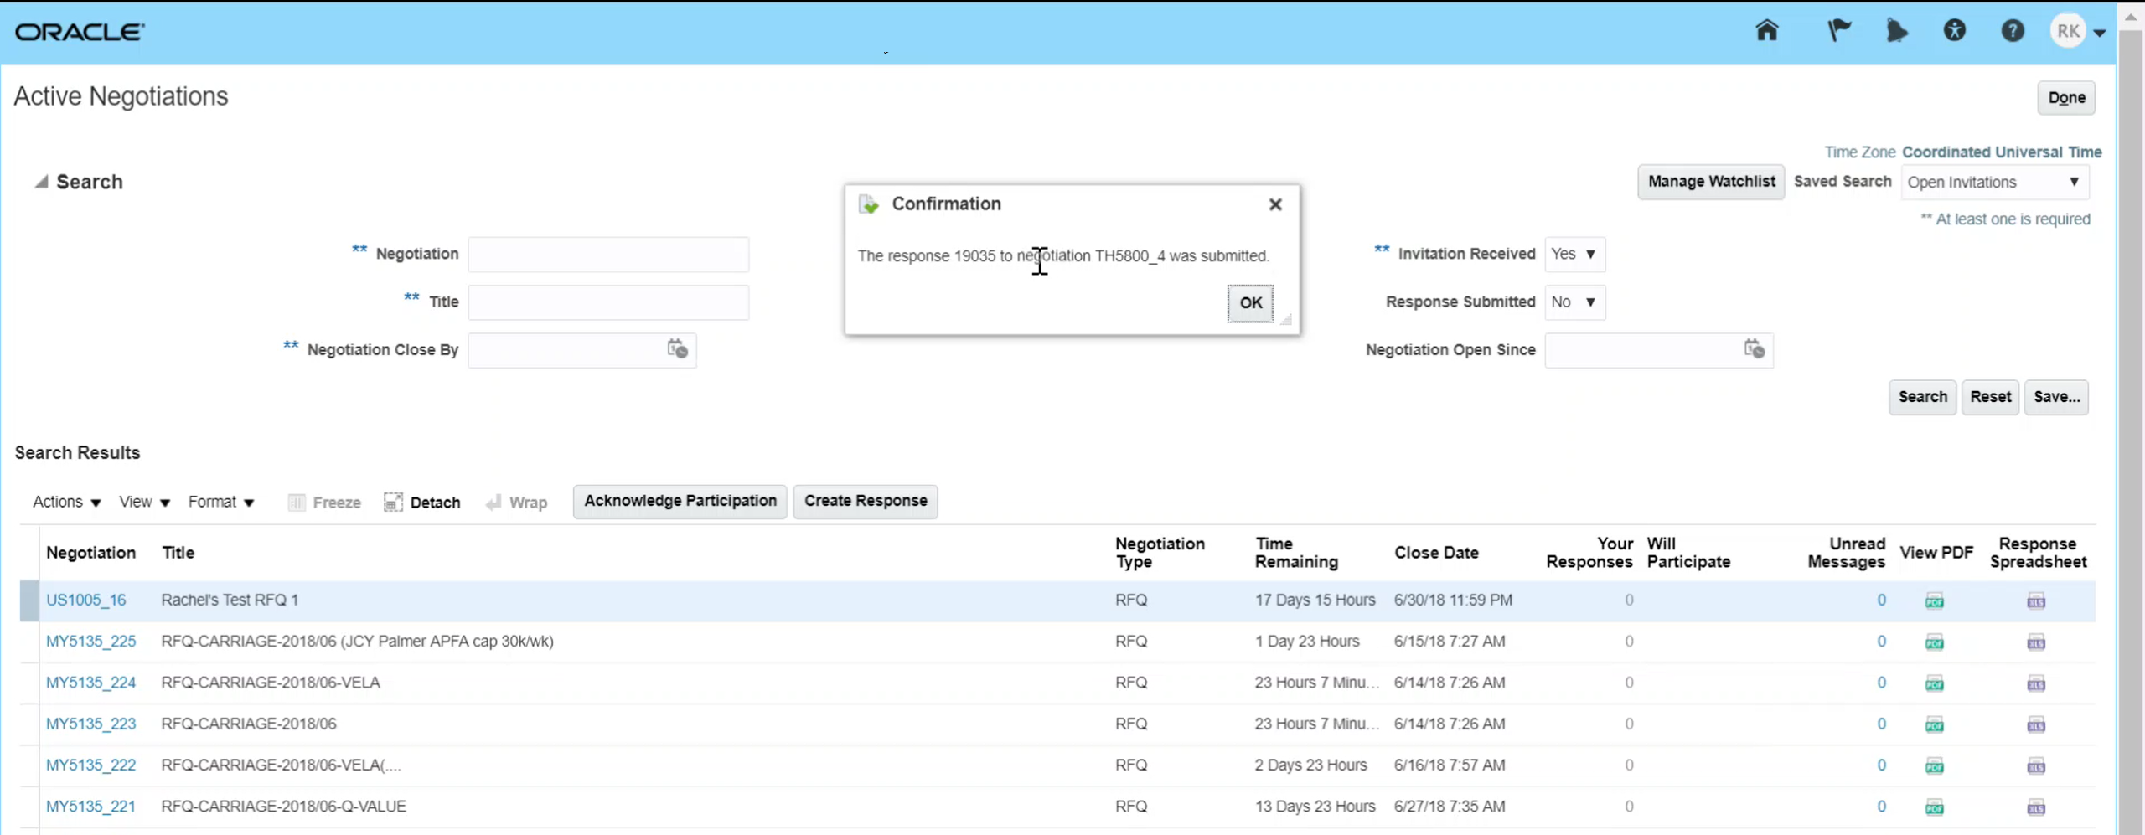
Respond to Auctions
Let’s view the steps to view the confirmation of the response.
11. Review Train stop
The confirmation pop-up window appears. The supplier response has been submitted. Click on the OK button.
12. Submit Responses
13. Confirm Submission
14. View Confirmation
Congratulations! You have successfully submitted the response! Great job!

