Slide 1
SOURCING OVERVIEW FOR SUPPLIERS

Slide 2
Different Types of Negotiations
Let’s learn about the three negotiation types for sourcing: RFIs, RFQs and Auctions.
Requests for Information (RFIs)
Requests for Quotations (RFQs)
Buyer’s Auctions
RFIs are documents submitted online/offline. These are submitted by the buyer to gather information about the supplier.
After the buyer receives the completed RFI, the buyer then submits a RFQ document to the supplier which includes details of the quantities, and materials.
After the buyer receives the RFQ, the buyer invites selected suppliers to an auction process and awards a contract to a specific supplier.
Note: For the RFQ, there are two stages, and the supplier would respond to technical and then commercial questions.

Slide 3
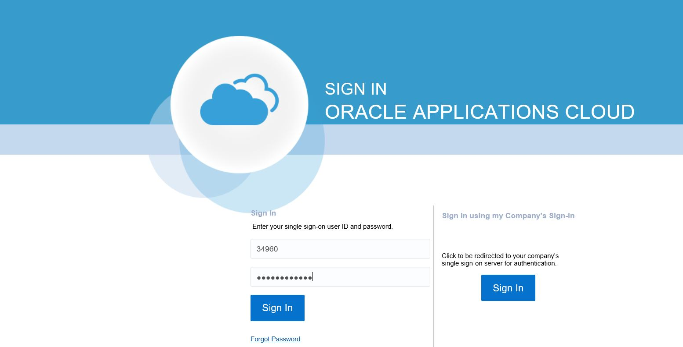
Perform Sourcing Negotiation (RFI/RFQ/Auction)
Now that you have maintained the supplier profile, let’s learn how to perform sourcing negotiations. Let’s navigate to Oracle Cloud.
1. Access Cloud
Enter the specific link for Oracle Cloud in the browser. Then, enter your username and password.
Click the Sign In button.
2. Access Home
3. Go to Supplier
Portal
4. View Negotiation
5. Edit Profile

Slide 4
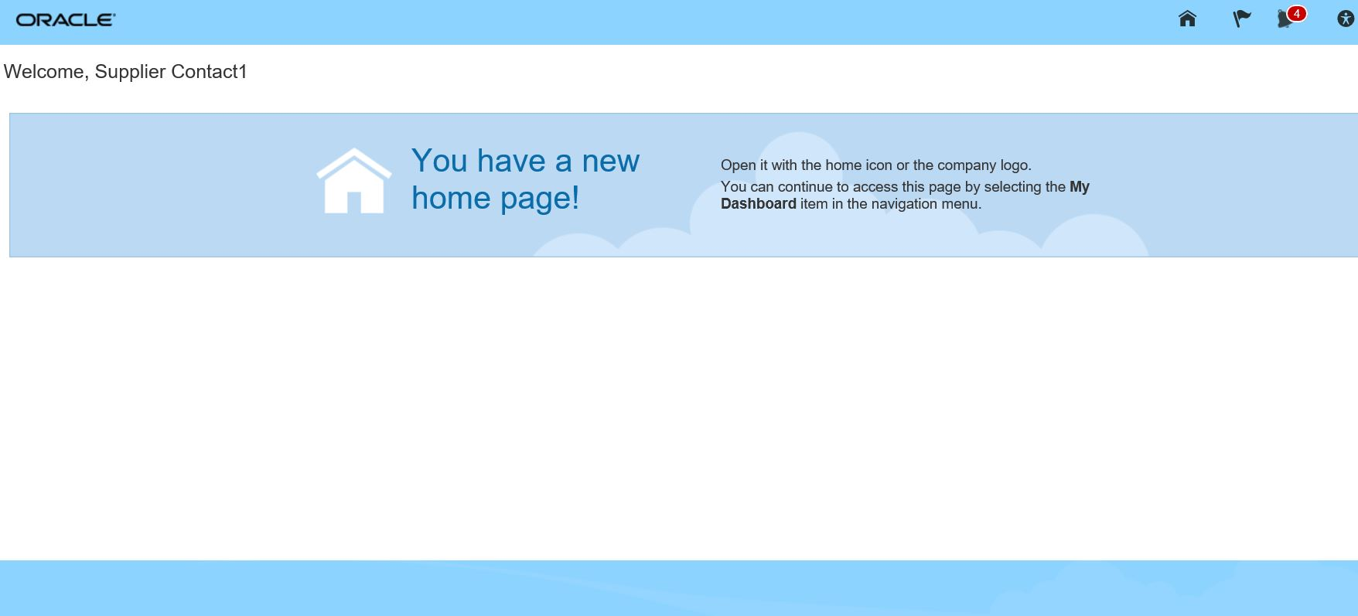
Perform Sourcing Negotiation (RFI/RFQ/Auction) (Cont’d)
Let’s view the steps to navigate to the Oracle Cloud homepage.
1. Access Cloud
From the Oracle Cloud homepage, click the Home icon. This will take you to the Oracle Cloud main page.
2. Access Home
3. Go to Supplier
Portal
4. View Negotiation
5. Acknowledgement

Slide 5
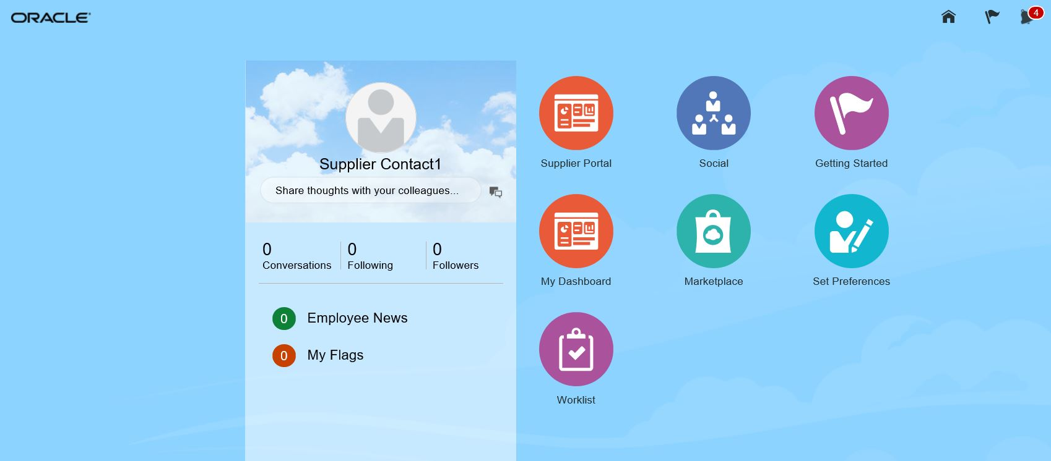
Perform Sourcing Negotiation (RFI/RFQ/Auction) (Cont’d)
Let’s view the steps to access the Supplier Portal.
1. Access Cloud
Click on the Supplier Portal icon.
2. Access Home
3. Go to Supplier
Portal
4. View Negotiation
5. Acknowledgement

Slide 6
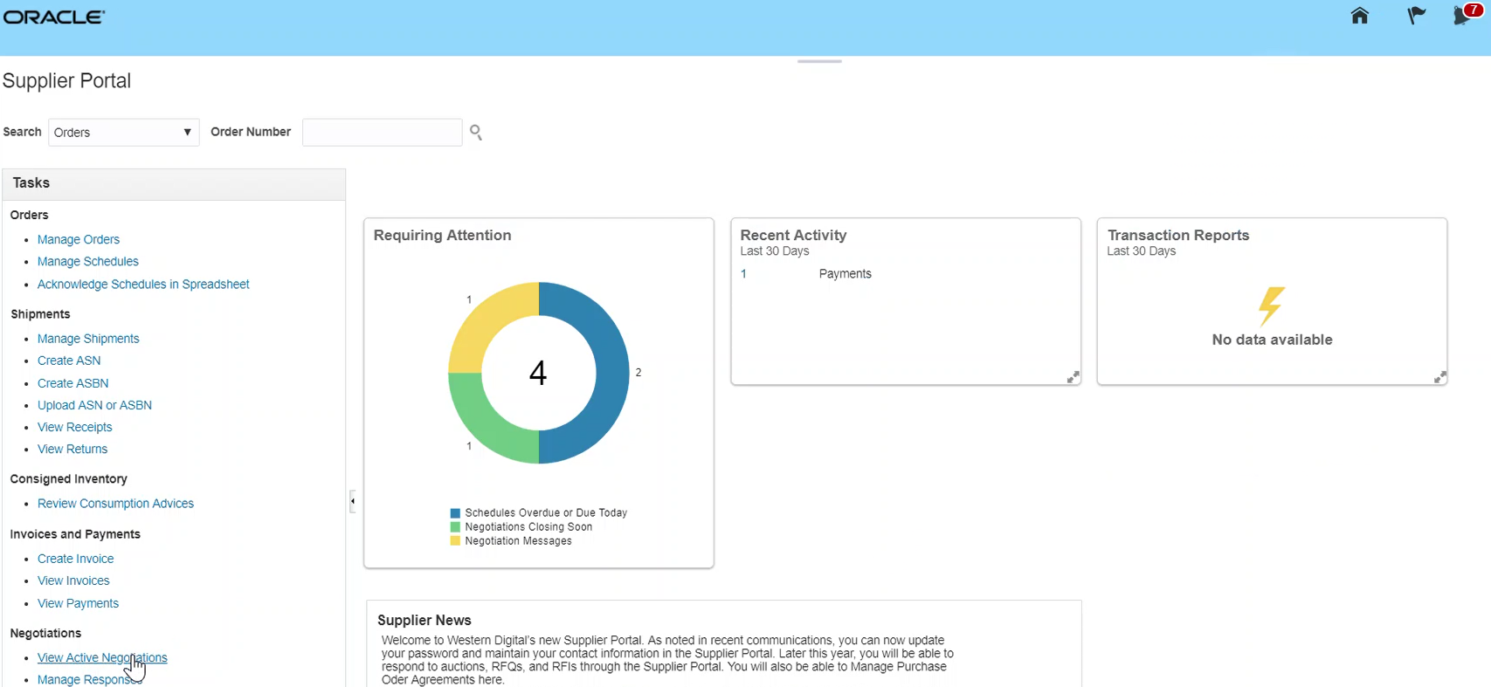
Perform Sourcing Negotiation (RFI/RFQ/Auction) (Cont’d)
Let’s view the steps to navigate to the View Negotiations page.
1. Access Cloud
From the Supplier Portal page that appears, click the View Active Negotiations link.
2. Access Home
3. Go to Supplier
Portal
4. View Negotiation
5. Acknowledgement

Slide 7
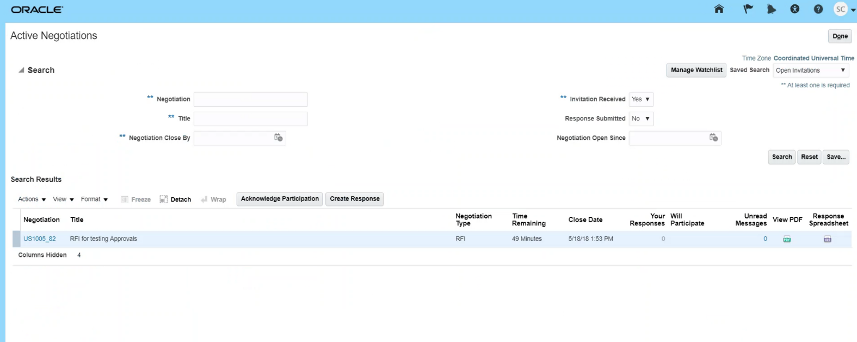
Perform Sourcing Negotiation (RFI/RFQ/Auction)
Let’s view the steps to acknowledge participation.
1. Access Cloud
From the Active Negotiations page, select the negotiation line item. Click Acknowledge Participation.
2. Access Home
3. Go to Supplier
Portal
4. View Negotiation
5. Acknowledgement

Slide 8
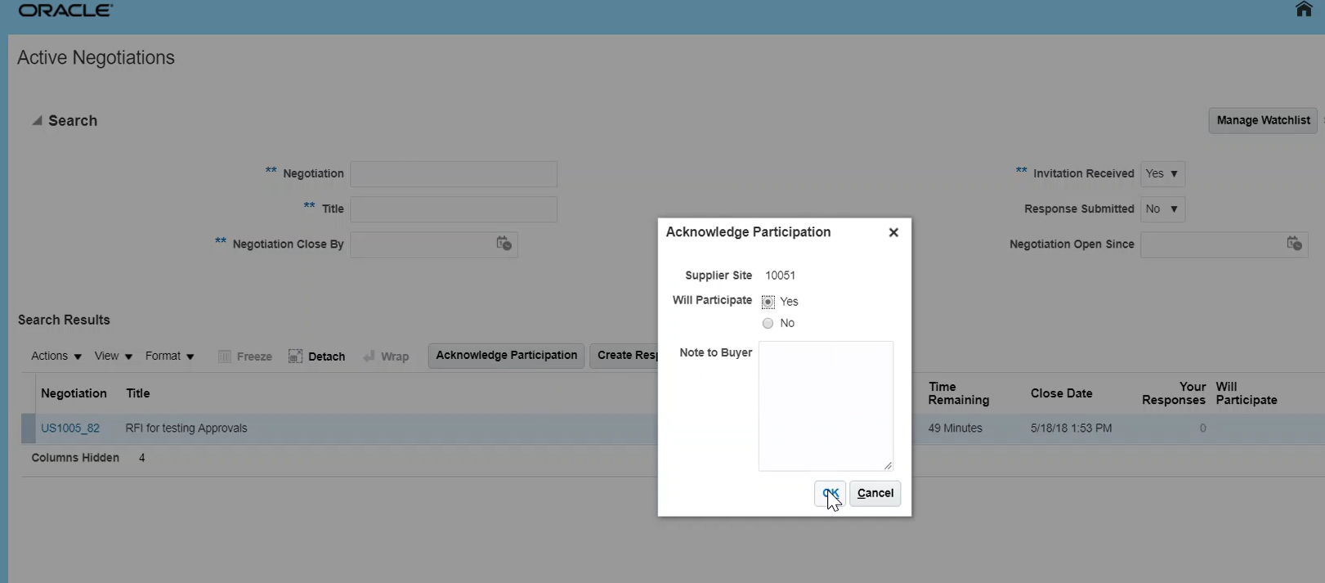
Perform Sourcing Negotiation (RFI/RFQ/Auction) (Cont’d)
Let’s view the steps to confirm participation.
6. Confirm Participation
Click the Yes radio button to acknowledge participation.
Click the OK button to proceed.
7. Create Response
8. Select Date
9. Answer Question
10. Submit Response

Slide 9
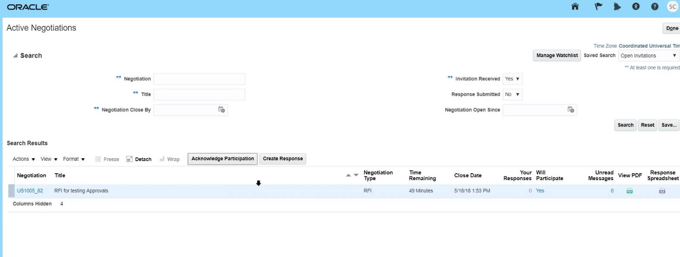
Perform Sourcing Negotiation (RFI/RFQ/Auction) (Cont’d)
Let’s view the steps to go to the create responses section.
6. Confirm Participation
Select the specific negotiation line item. Click the Create Response button.
7. Create Response
8. Select Date
9. Answer Question
10. Submit Response

Slide 10
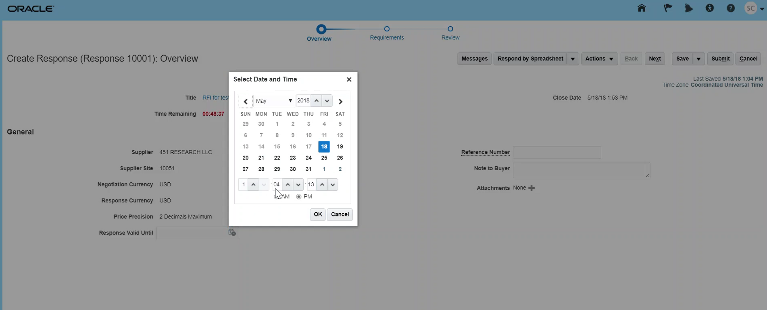
Perform Sourcing Negotiation (RFI/RFQ/Auction) (Cont’d)
Let’s view the steps to select the specific date the response is valid till.
6. Confirm Participation
From the Response Valid Until drop-down menu, select the specific date and time. Click the OK button.
7. Create Response
8. Select Date
9. Answer Question
10. Submit Response

Slide 11
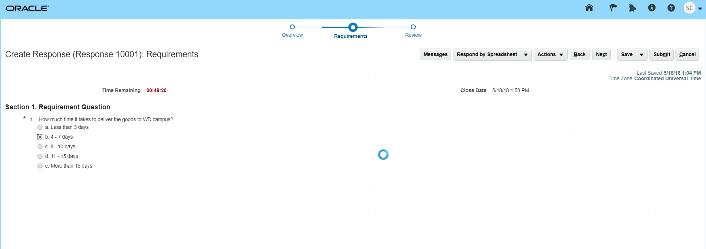
Perform Sourcing Negotiation (RFI/RFQ/Auction) (Cont’d)
Let’s view the steps to answer the specific questions.
6. Confirm Participation
From the Create Response page, enter the response to the question. Click the Next button.
7. Create Response
8. Select Date
9. Answer Question
10. Submit Response

Slide 12
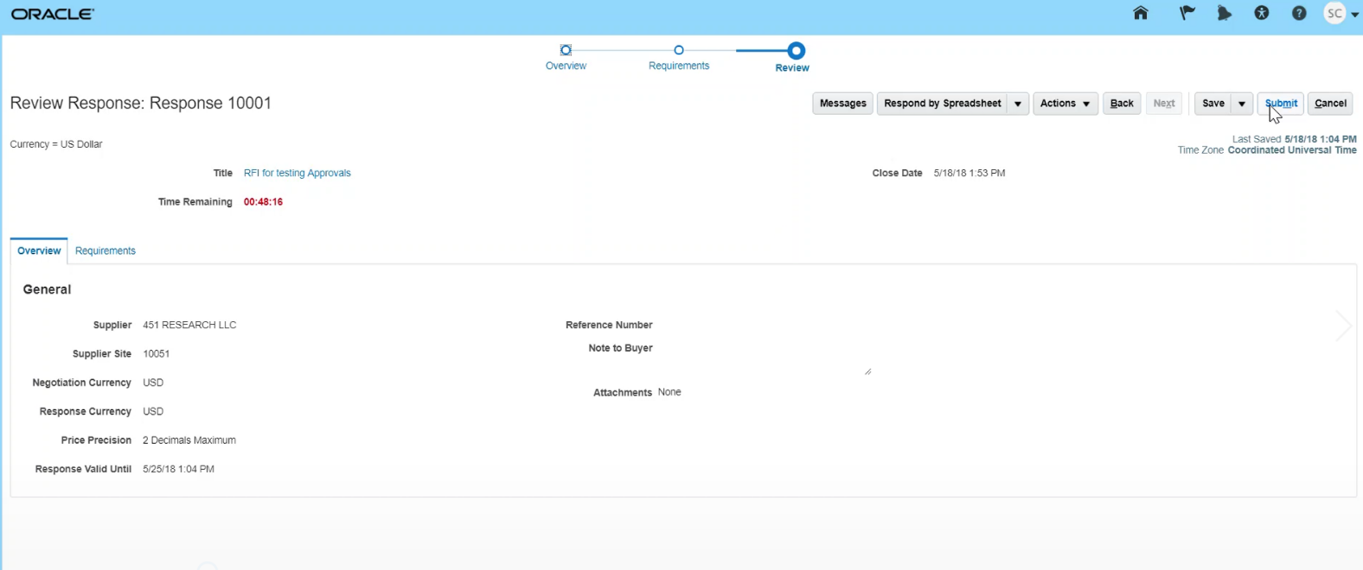
Perform Sourcing Negotiation (RFI/RFQ/Auction) (Cont’d)
Let’s view the steps to submit the supplier response.
6. Confirm Participation
7. Create Response
Click the Submit button to submit the response.
8. Select Date
9. Answer Question
10. Submit Response

Slide 13
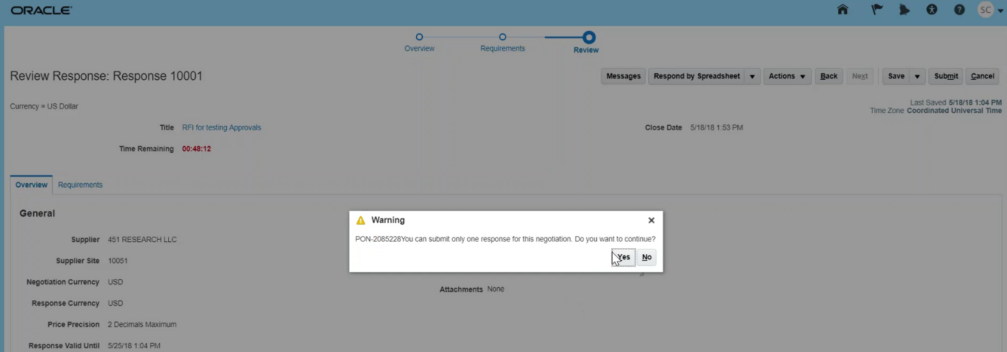
Perform Sourcing Negotiation (RFI/RFQ/Auction) (Cont’d)
Let’s view the steps to confirm the submission of the response.
11. Confirm Submission
From the Warning pop-up window that appears, click the Yes button.
12. View Confirmation

Slide 14
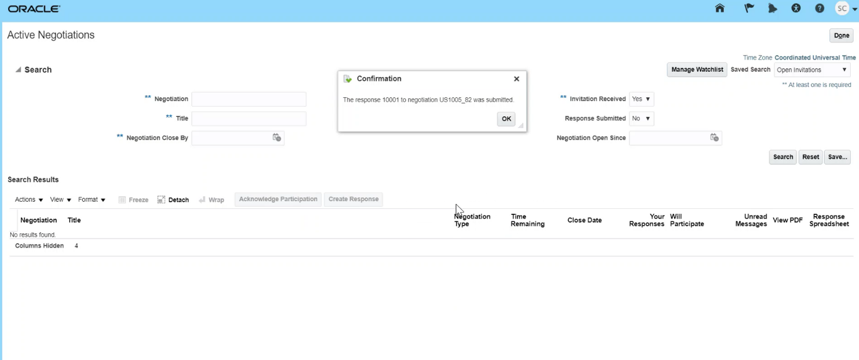
Perform Sourcing Negotiation (RFI/RFQ/Auction) (Cont’d)
Let’s view the steps to review the confirmation of the response.
11. Confirm Submission
The confirmation pop-up window appears. The supplier response has been submitted.
12. View Confirmation
Congratulations! You have successfully submitted the response! Great job!

