Slide 1
RESPONDING TO AN RFQ/ RFP

Slide 2



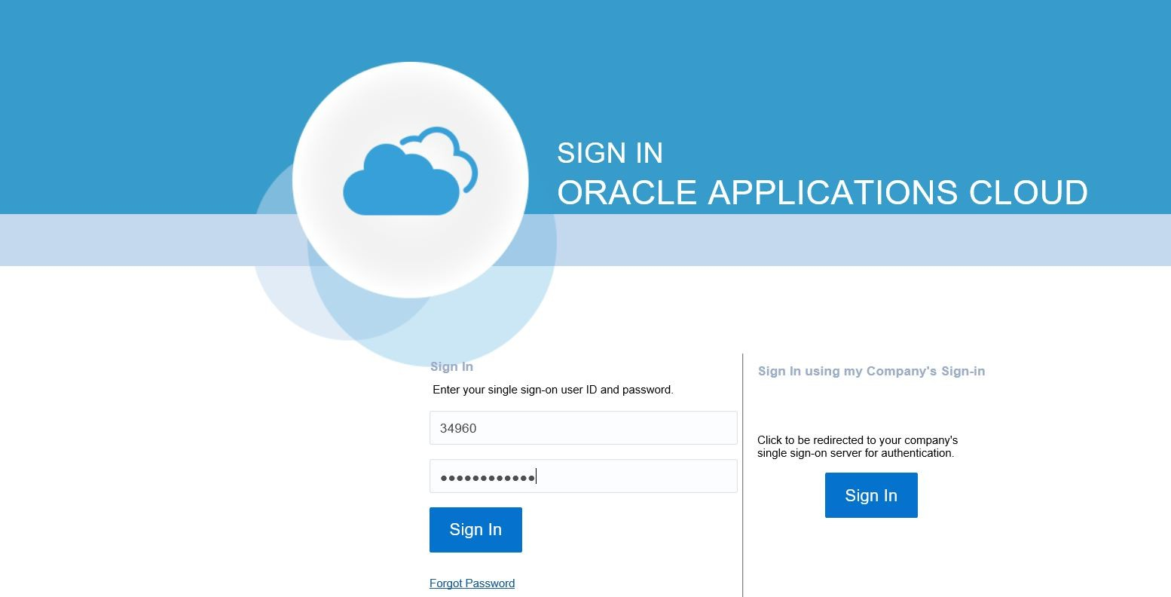








Respond to RFQ/RFP- Welcome to WD Oracle Cloud
Let’s view the transaction steps for performing sourcing negotiations. First, let’s log into Oracle Cloud.
1. Access Cloud
Enter the specific link for Oracle Cloud in the browser. Then, enter your username and password.
2. Access Home
3. Go to Supplier Portal
Click the Sign In
button.
4. View Negotiation
5. Edit Profile

Slide 3
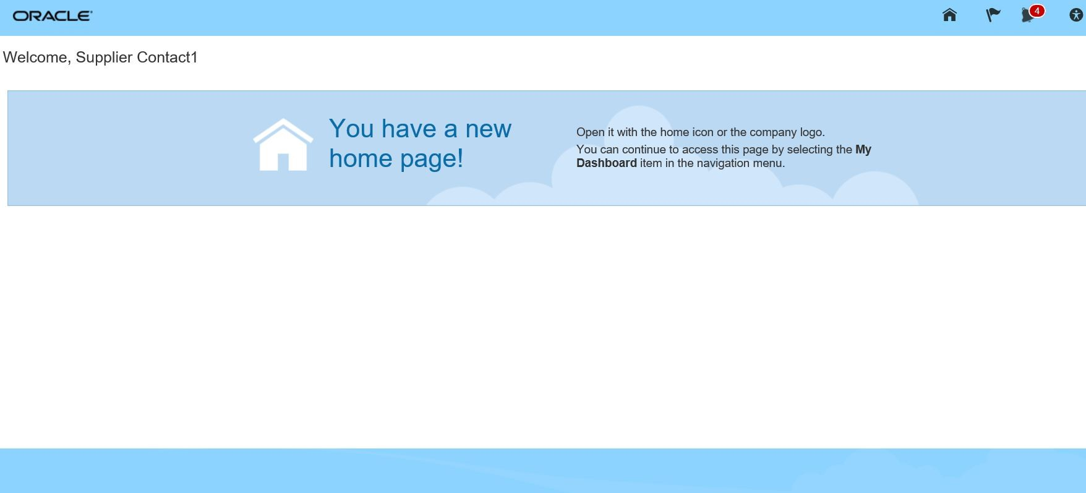

Respond to RFQ/RFP
Let’s view the steps to navigate to the Oracle Cloud homepage.
1. Access Cloud
From the Oracle Cloud homepage, click the Home icon. This will take you to the Oracle Cloud main page.
2. Access Home
3. Go to Supplier Portal
4. View Negotiation
5. Acknowledgement

Slide 4


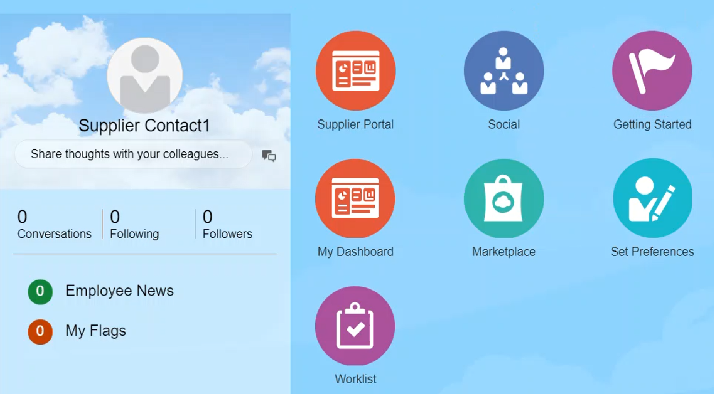
Supplier/s Response
Suppliers are registered (as Prospective or Spend Authorized) and have access to the respective Portal.
Invited Supplier
(Each Supplier acts independently and accesses their own site)
Login to Oracle Cloud with the Supplier’s credentials.
Click on Supplier Portal

Slide 5


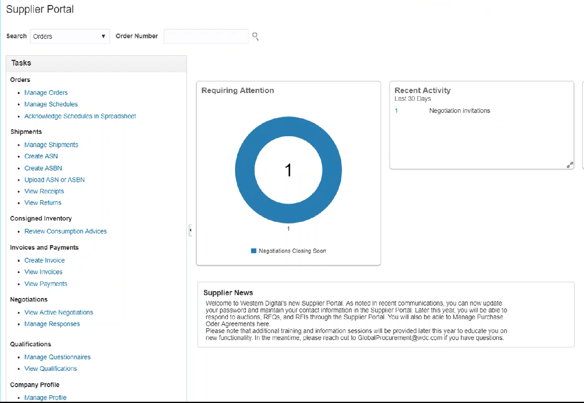

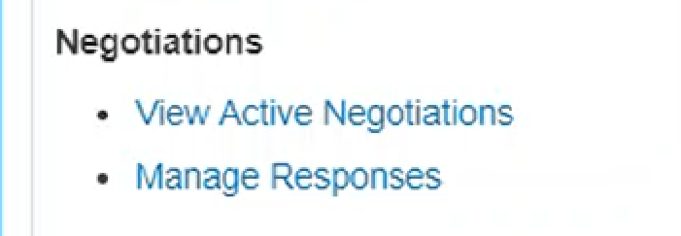
Supplier/s Response
Under the Negotiations section, click the View Active Negotiations link,
Or
Under Recent Activity
Click on the “number” next to Negotiation Invitations

Slide 6
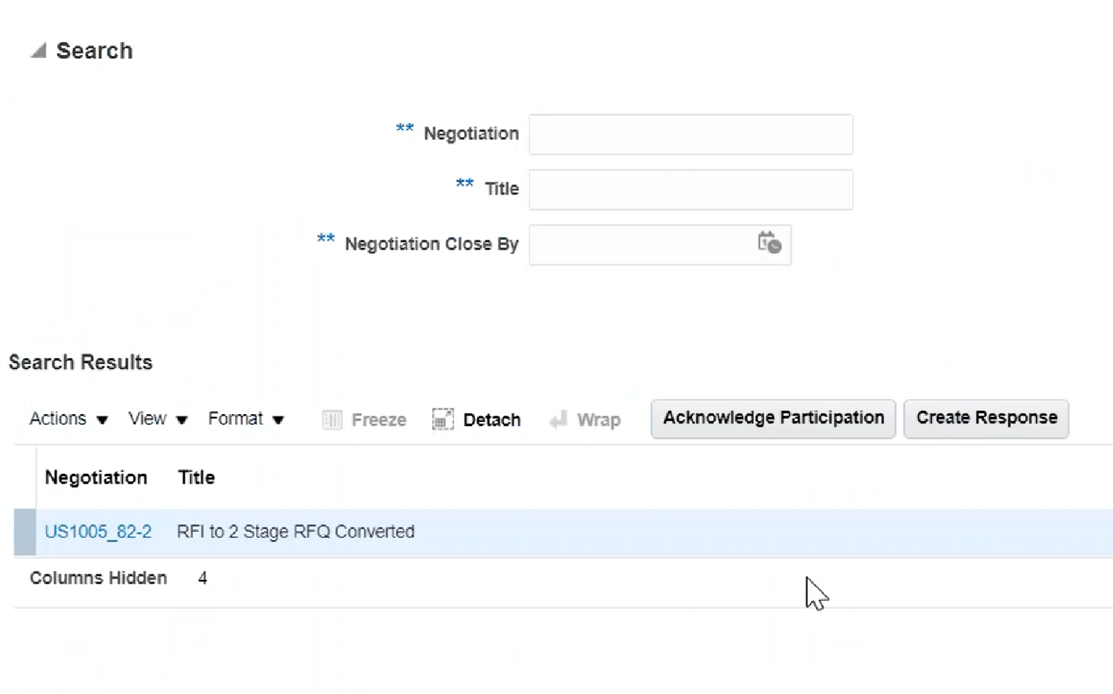

Supplier/s Responses
To acknowledge participation:
Select on the desired Negotiation (RFQ)
Click on Acknowledge Participation
This is advantageous for the supplier to acknowledge participation because it will let the Sourcing Professional know the supplier plans to respond.
They can include a message if they wish.
If they intend to not participate, do communicate the same to the buyer/ commodity manager. Do not Acknowledge participation if so.
Reply to RFx@wdc.com For the above scenario.

Slide 7
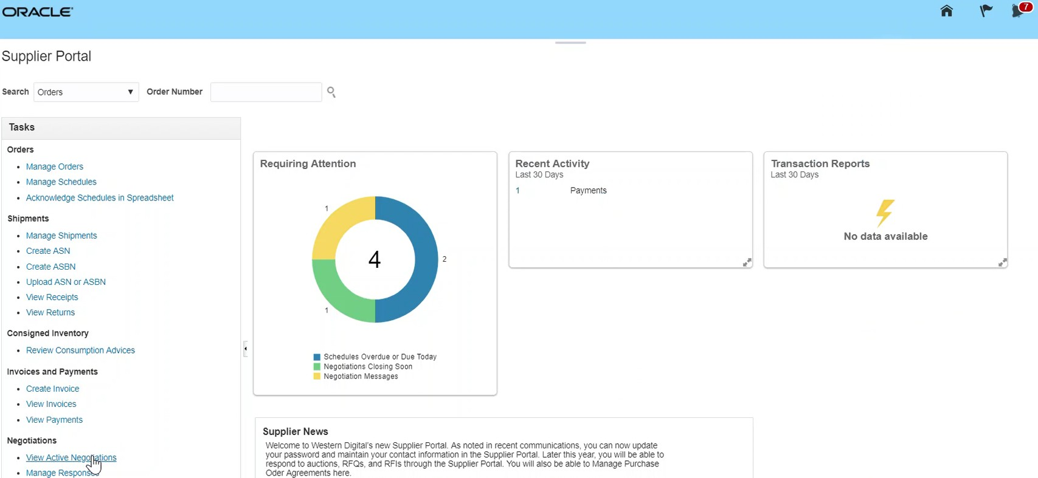
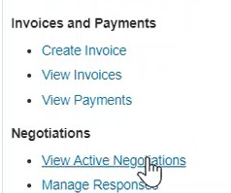
Respond to RFQ/RFP
Let’s view the steps to navigate to the View Negotiations page.
1. Access Cloud
From the Supplier Portal page that appears, click the View Active Negotiations link.
2. Access Home
3. Go to Supplier Portal
4. View Negotiation
5. Acknowledgement

Slide 8
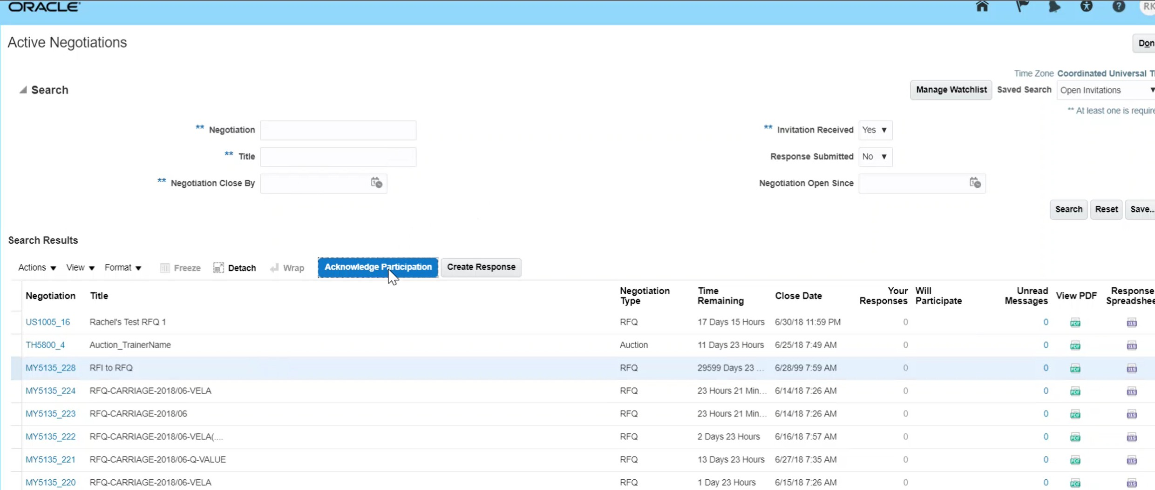

Respond to RFQ/RFP
Let’s view the steps to acknowledge participation.
1. Access Cloud
From the Active Negotiations page, select the negotiation line item. Click Acknowledge Participation.
2. Access Home
3. Go to Supplier Portal
4. View Negotiation
5. Acknowledgement

Slide 9
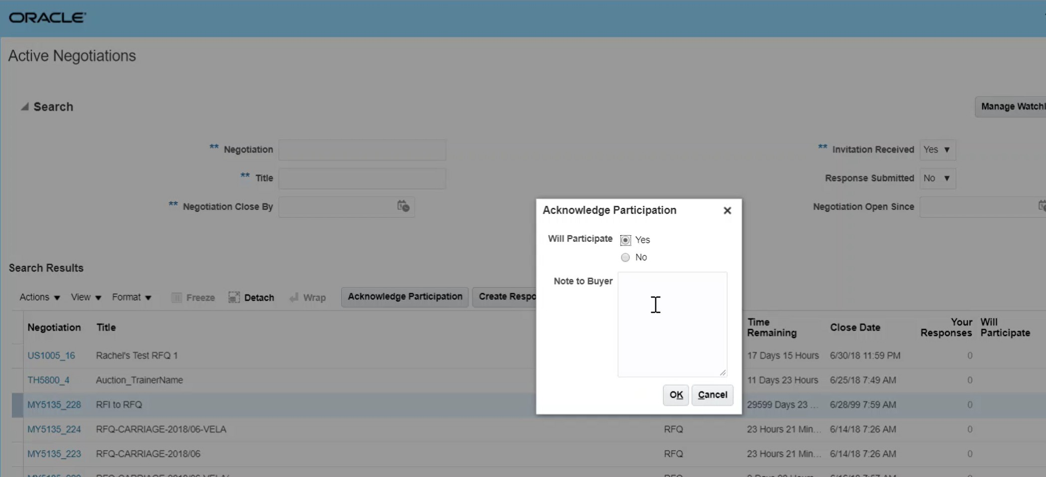
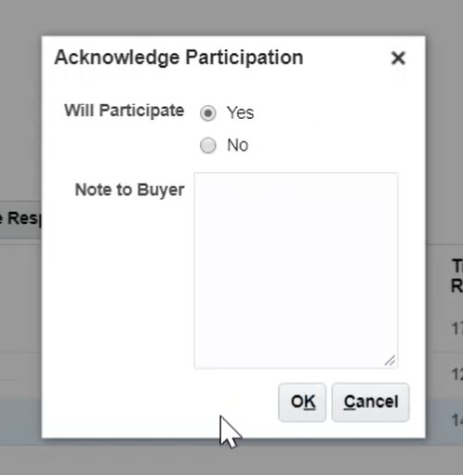
Respond to RFQ/RFP
Let’s view the steps to confirm participation.
6. Confirm Participation
Click the Yes radio button to acknowledge participation in the negotiation.
7. Create Response
8. Overview Train stop
Click the OK
button to proceed.
9. Requirements Train stop
10. Lines Train stop

Slide 10

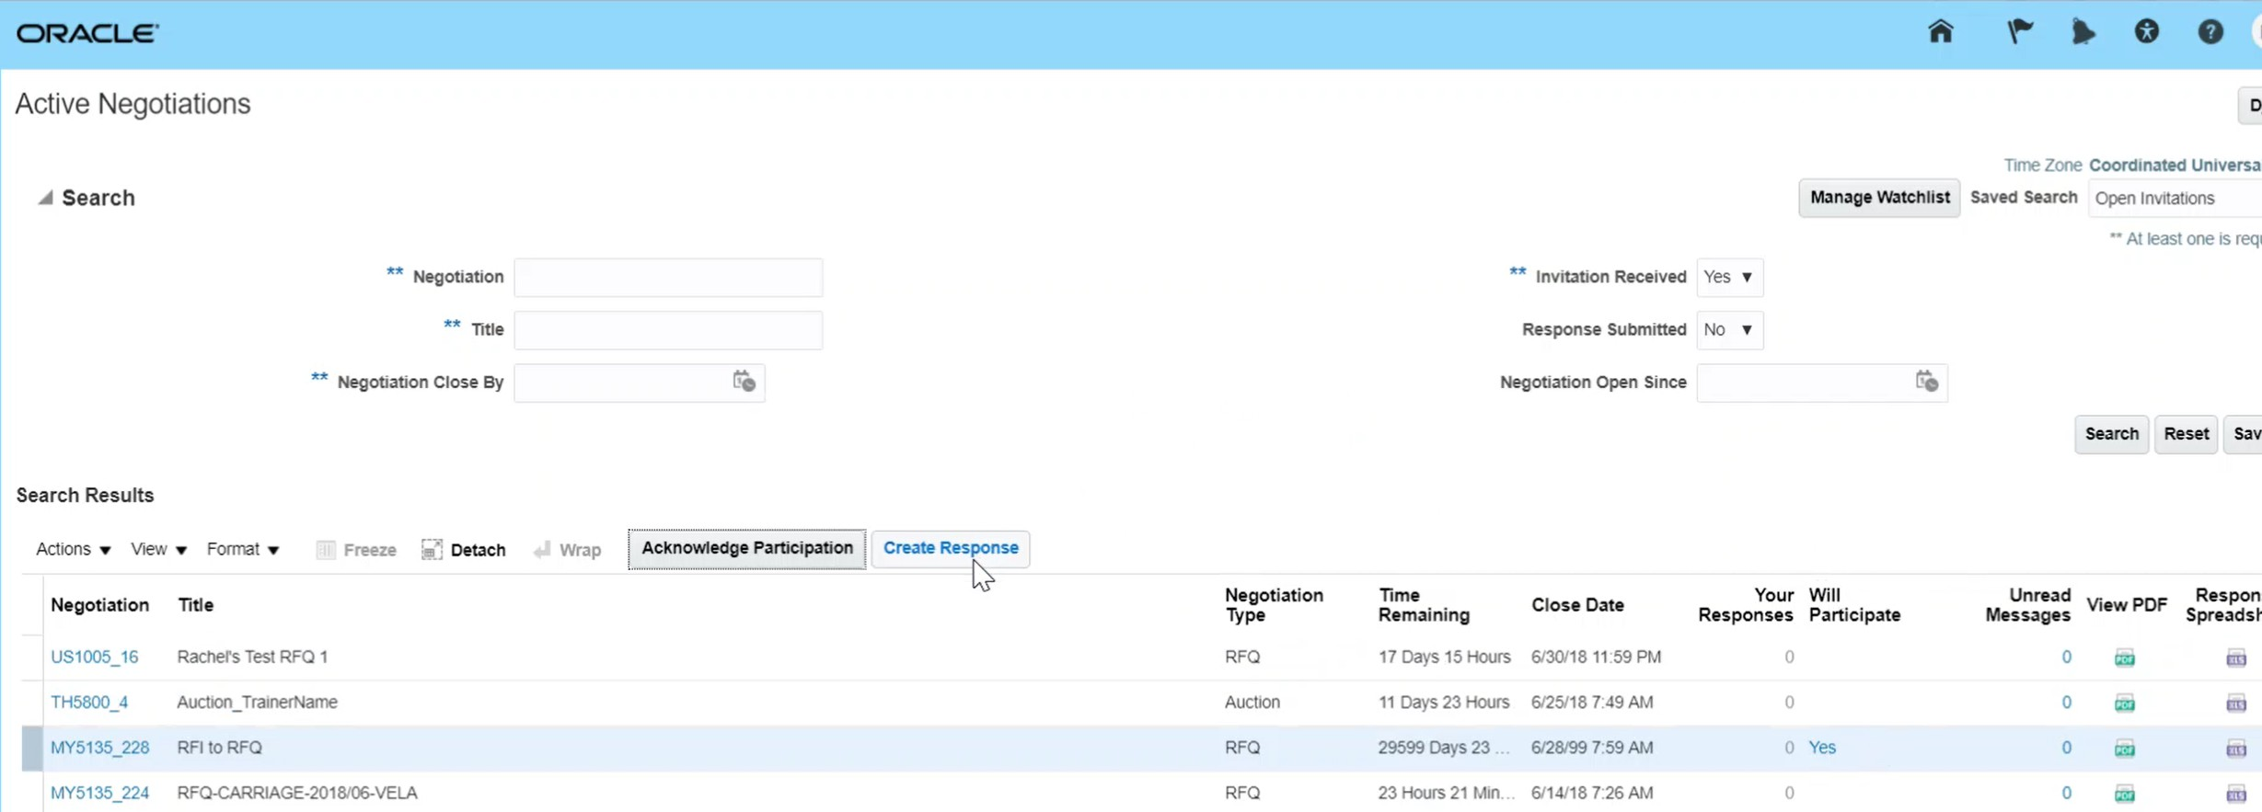
Respond to RFQ/RFP
Let’s view the steps to go to the create responses section.
6. Confirm
Participation
Select the specific negotiation line item. Click the Create Response button.
7. Create Response
8. Overview Train stop
9. Requirements Train stop
10. Lines Train stop

Slide 11
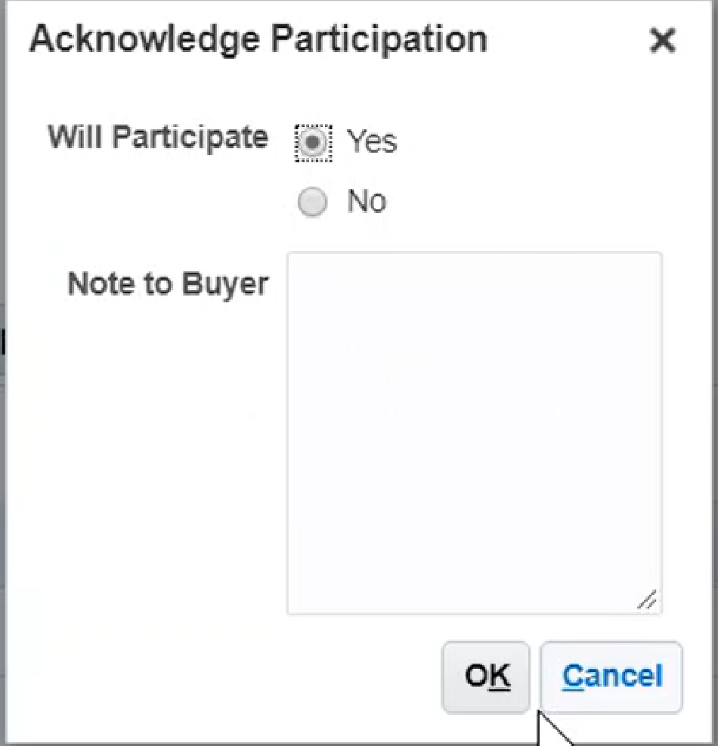



Supplier/s Responses
Acknowledging Participation.
On the Acknowledge Participation pop-up box, select the Yes
A message to the Sourcing Professional can be Added
Click OK
7

Slide 12

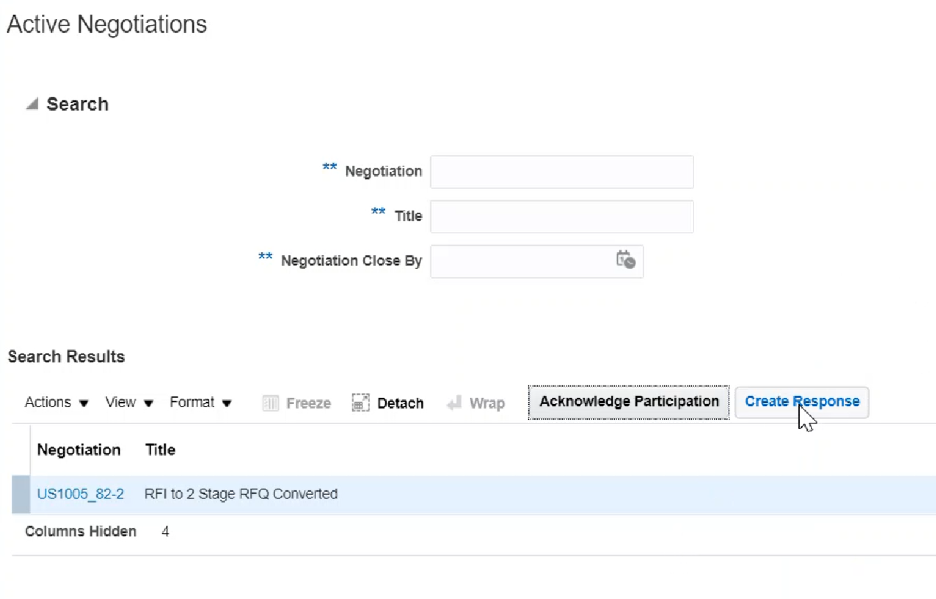

Supplier/s Submit Responses
 | Placeholder for Screenshot
Select the desired negotiation (RFQ).
Click Create Responses

Slide 13
Supplier/s Submit Responses
 | Placeholder for Screenshot
Select the desired negotiation (RFQ).
Click Create Responses

Slide 14

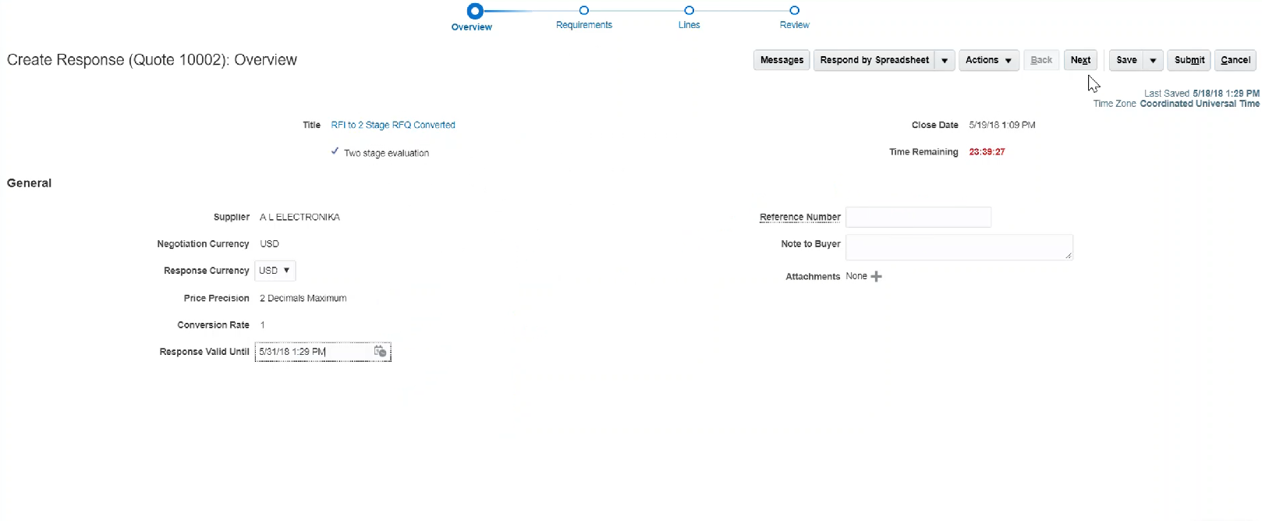
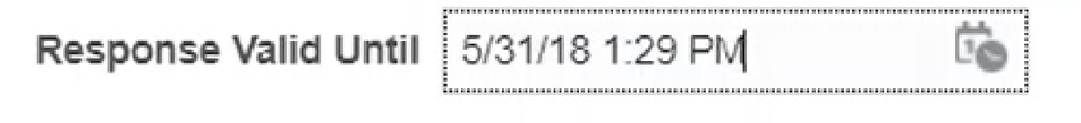
Supplier/s Submit Responses
Response Valid Until
Supplier can put a time limit for how long the quote is valid for.
Click on the Calendar to select a date
Select a date for the Response Valid Until field.
Attachments
Supplier can add additional data e.g. spec sheet, drawings

Slide 15

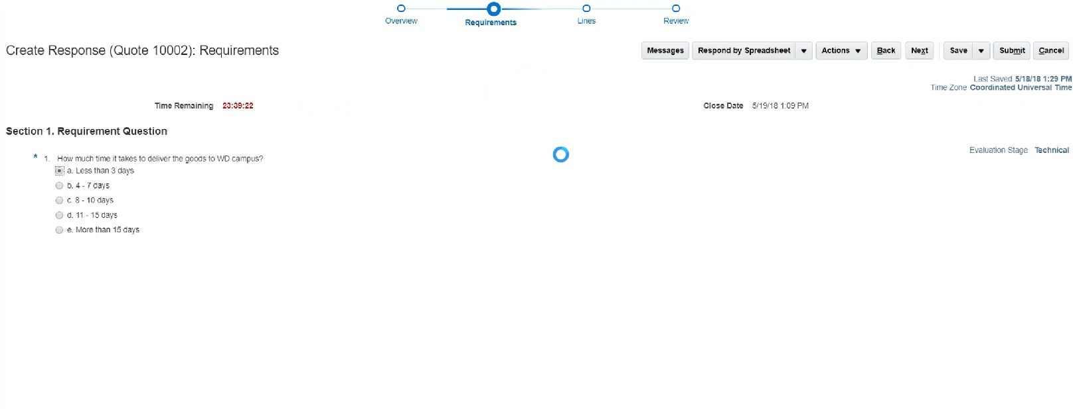

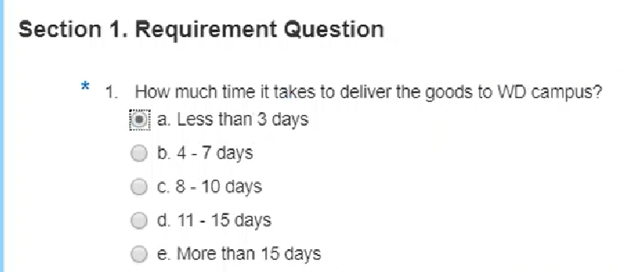
Supplier/s Responses
Supplier will follow the “train stops” similar to how the Sourcing Professional created the RFQ.
Complete the Requirements Questions
When Completed
Click Next
Placeholder for Screenshot
12

Slide 16

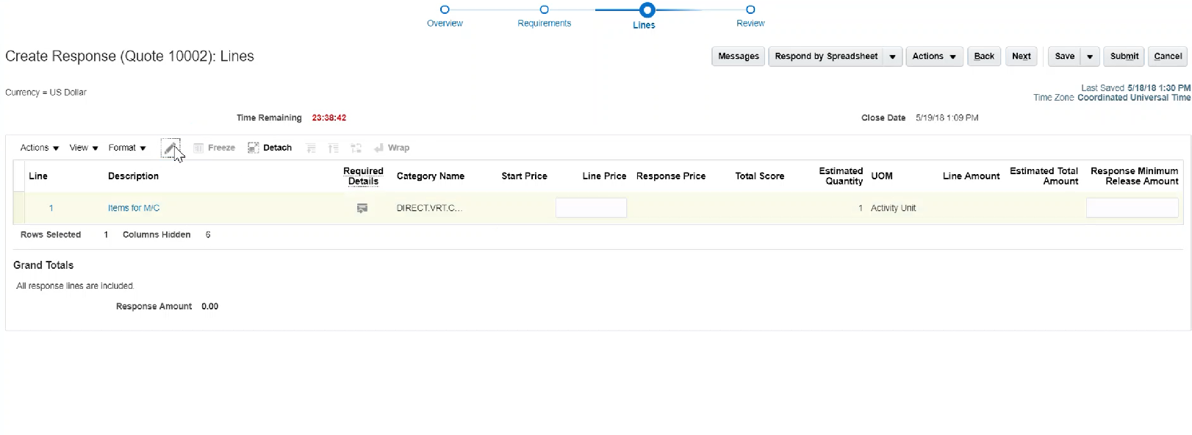

Supplier/s Responses
Adding more information at the line level.
Edit (Pencil icon)
Select the line and click the Pencil
icon to add more information.
Placeholder for Screenshot

Slide 17
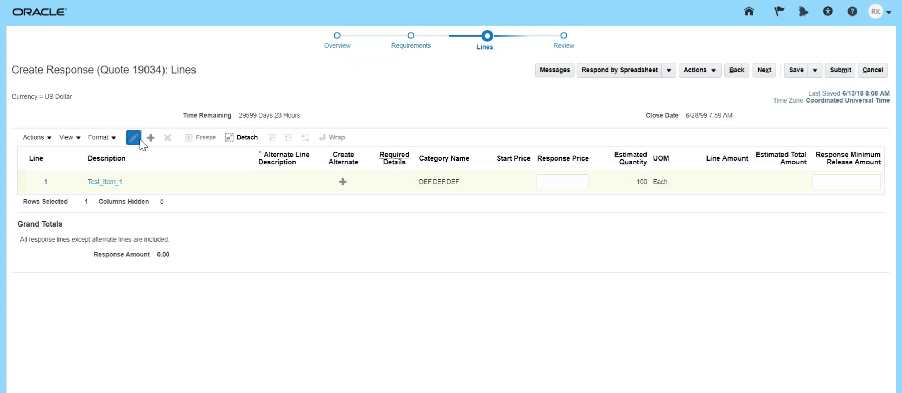
Respond to RFQ/RFP
Let’s view the steps to enter information under the Lines train stop.
6. Confirm
Participation
Enter information in the Response Price field.
Click the Next
button.
7. Create Response
8. Overview Train stop
9. Requirements Train stop
10. Lines Train stop
21

Slide 18
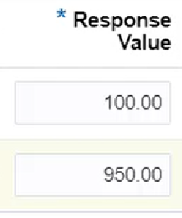

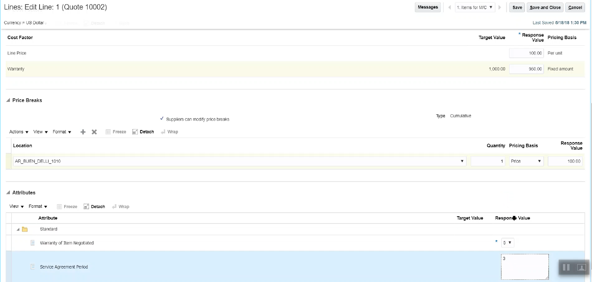
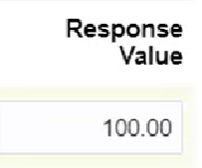


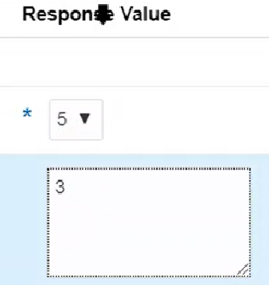
Supplier/s Responses
Cost Factors and Price Breaks
Response Value for Cost Factor Supplier will be prompted to complete each of the Cost Factor prices.
Response Value for Price Breaks Supplier will be prompted to enter in pricing per price breaks (and can amend the price breaks if you have allowed them to in the RFQ you set up).
Response Value for Attributes Supplier will be prompted to enter in Attributes,
Validity of the response, Payment Terms,
Termination Notice for Convenience, Lead Time,
MOQ – Minimum Order Quantity,
MPQ – Minimum Packaging Quantity.
Placeholder for Screenshot
10

Slide 19

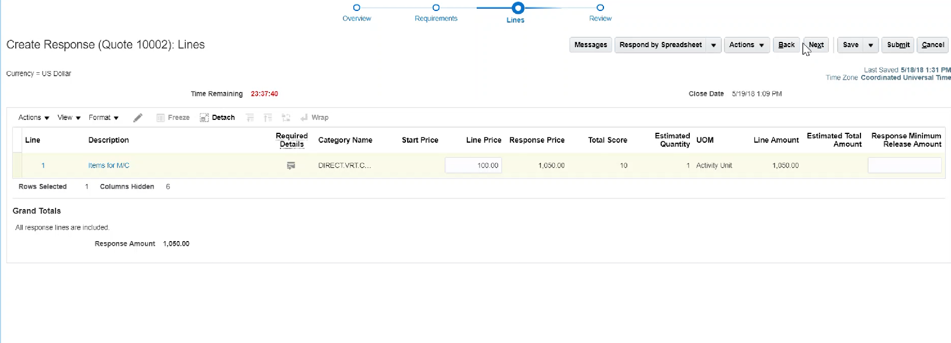
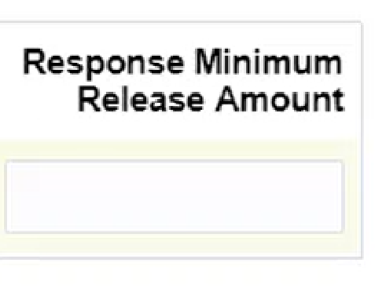
Supplier/s Responses
Response Minimum Release Amount
The Supplier may require a “Response Minimum Release Amount”
This is the smallest value you can buy at one time
Placeholder for Screenshot

Slide 20

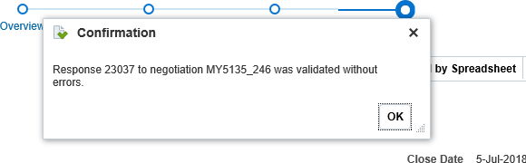

Supplier/s Responses
Click on any of the Train Stops to review the information
Or
Click on the Table of Contents to the left to go to that page to review the
information
Validate Your Work
Action > Validate
This step will confirm all of the mandatory fields have been
completed. All Good? Click Publish (submits the RFQ for Approval)
When all of the information has been completed:
Click Save > Submit
Note: The Sourcing Professional will get an email or notification that the supplier has responded.

Slide 21
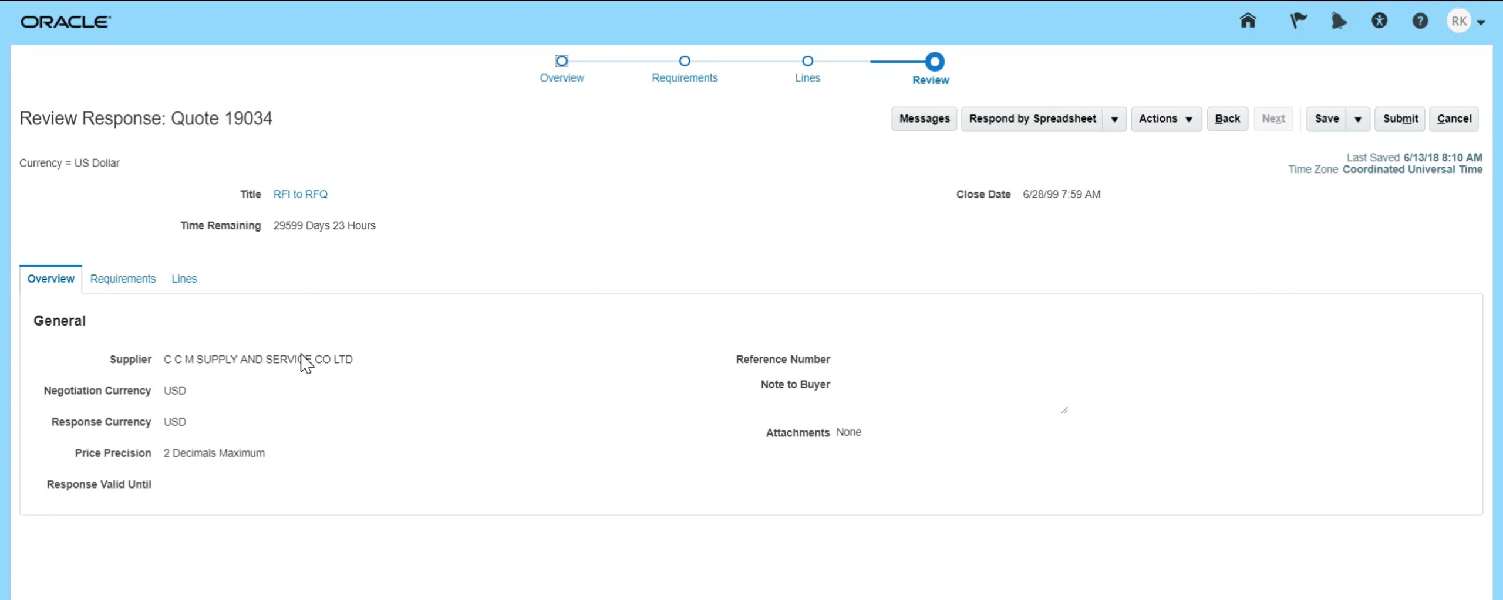

Respond to RFQ/RFP
Let’s view the steps to submit the supplier response.
11. Review Train stop
Click the Submit button to submit the response.
12. Submit Responses
13. Confirm Submission
14. View Confirmation
10. Submit Response

Slide 22
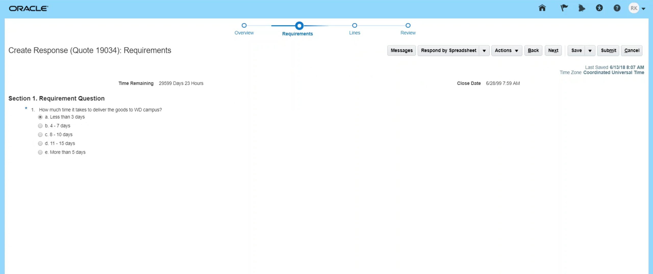
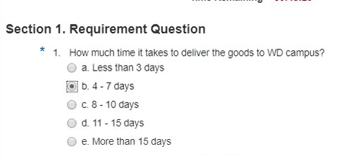
Respond to RFQ/RFP
Let’s view the steps to enter information under the Requirements train stop.
6. Confirm
Participation
From the Create Response page, enter the response to the question. Click the Next button.
7. Create Response
8. Overview Train stop
9. Requirements Train stop
10. Lines Train stop

Slide 23
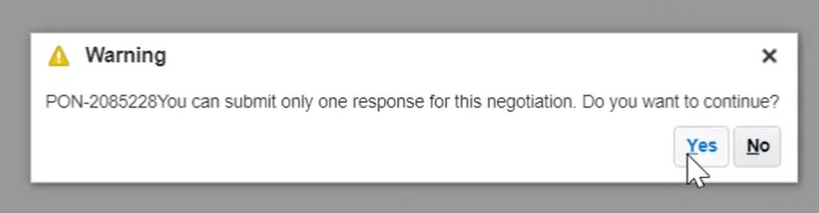
Respond to RFQ/RFP
Let’s view the steps to confirm the submission of the response.
11. Review Train stop
From the Warning pop-up window that appears, click the Yes button.
12. Submit Responses
13. Confirm Submission
14. View Confirmation
10. Submit Response

Slide 24
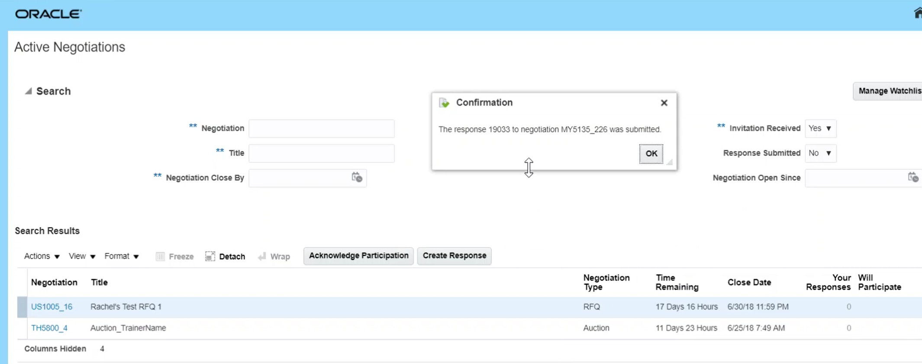
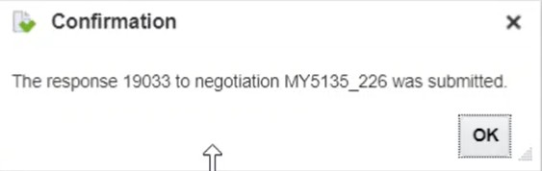
Respond to RFQ/RFP
Let’s view the steps to view the confirmation of the response.
11. Review Train stop
The confirmation pop-up window appears. The supplier response has been submitted. Click on the OK button.
12. Submit Responses
13. Confirm Submission
14. View Confirmation
Congratulations! You have successfully submitted the response! Great job!
10. Submit Response

