Slide 1
SUPPLY CHAIN COLLABORATION TRAINING FORECAST REVIEW & COMMIT

Slide 2
Course Agenda
Topic | Objective
Review Supplier Forecast & Provide Supply Commit | How suppliers will review forecast and provide commit against the forecast
IMAGE/ICON
IMAGE/ICON

Slide 3
REVIEW SUPPLIER FORECAST & PROVIDE SUPPLY COMMIT
Notes:
This section will cover details of how to review forecast and provide commit using different options available.

Slide 4


Review Supplier Forecast & Update Supply Commit-Overview
Supply Planning Collaboration: Order forecasts will be shared with suppliers and get their commitment to deliver critical components, assemblies and materials when you need them.
Forecast
Use Manage Order Forecasts and Commits page to
View Order Forecast Data
Update Commits against the Forecast
Download & Upload Commit Data
Download Forecast, Commit along with other measures
Buyers / Planners
Suppliers
Commit
Following topics will be covered
Order Forecast & Commit Page (Supplier View)
Commit against Forecast (Different Options)
Notes:
Manage Order Forecast and Commit page is used to review and provide commit against the forecast by Suppliers
Suppliers can download forecast, commits and other measures available in Excel

Slide 5
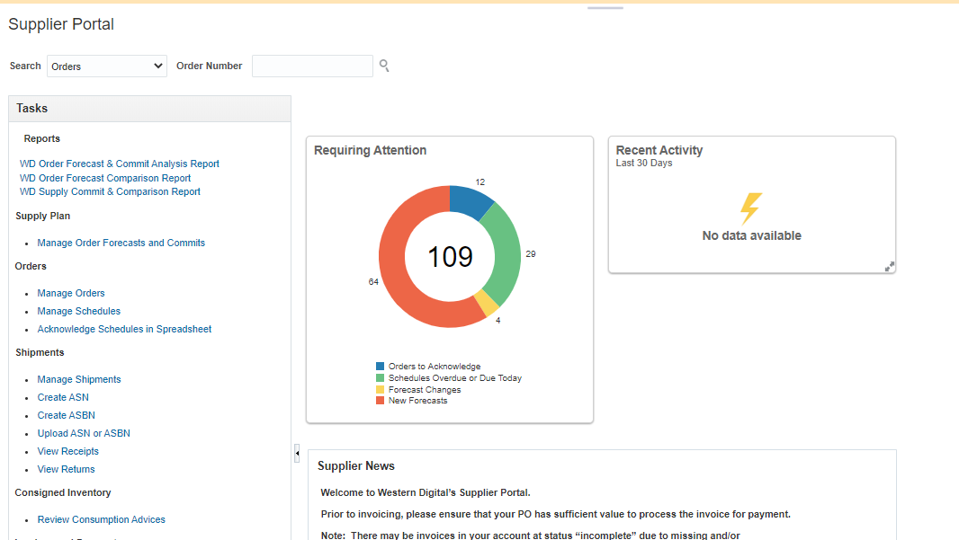
1.0 Order Forecast and Commit (Supplier’s View)
Navigation – Supplier Portal Work area → Suppliers Landing Page
Suppliers will see summary of the new forecasts
Notes:
This is the supplier landing page when supplier will login.

Slide 6
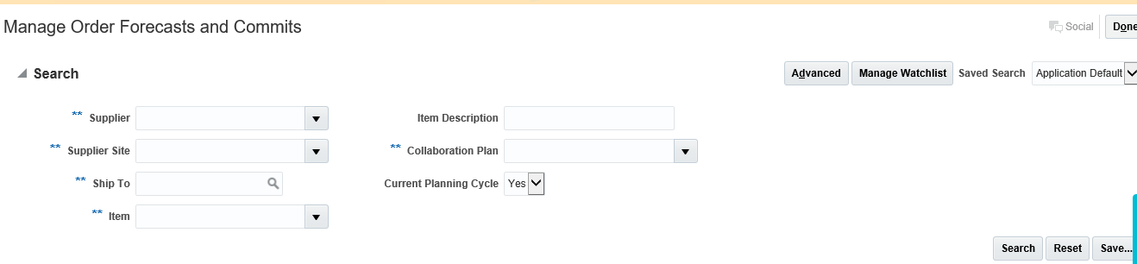
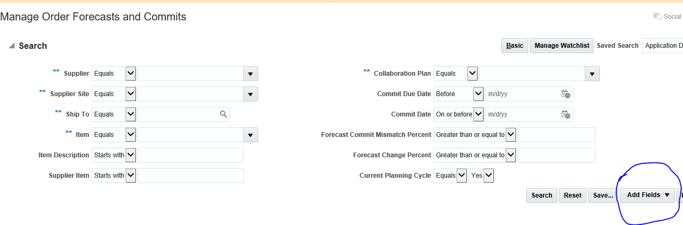
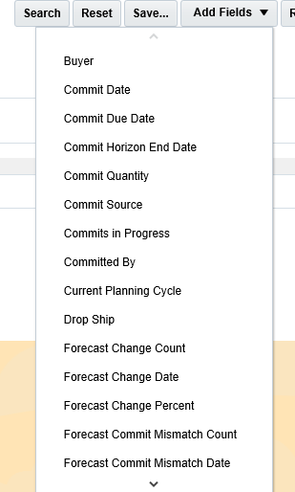
Order Forecast and Commit (Supplier’s View)
Navigation – Supplier Portal Work area → Supply Plan → Manage Order Forecasts and Commits
1
Search for Forecast based on multiple search criteria available. For more details, click on Advanced.
3
2
To add more fields on main search screen, click on Add Fields
Notes:
Search for Order Forecast & Commits based on multiple search criteria available. In case more such criteria need to be enabled, click on Advanced and provide other search criteria’s. In case more search criteria need to be added to main search screen, click on Add Fields and add as required.

Slide 7
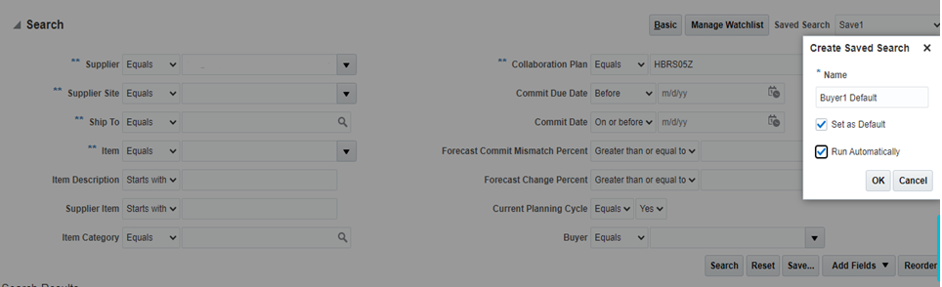
Order Forecast and Commit – Save Search Criteria
Once the fields are added, provide default values and save the search criteria
Click on Save and provide a Name for the search criteria provided.
Check Set as Default if the same search criteria need to be run as default.
Check Run Automatically, if the save search criteria needs to be run automatically whenever the screen opens
Notes:
Click on Save and provide a Name for the search criteria provided.
Check Set as Default if the same search criteria need to be run as default.
Check Run Automatically, if the save search criteria needs to be run automatically whenever the screen opens

Slide 8
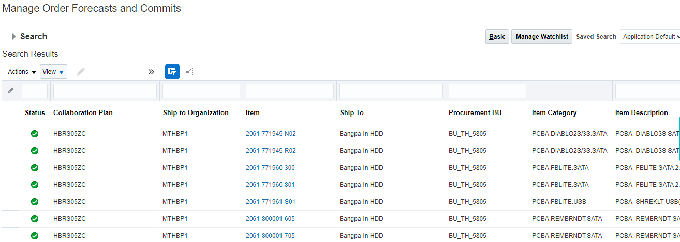
Order Forecast and Commit
Based on the Search criteria, search result will be shown
Click on the Item link to see the details of an item
Notes:
Click on the item link to open details for an item.

Slide 9
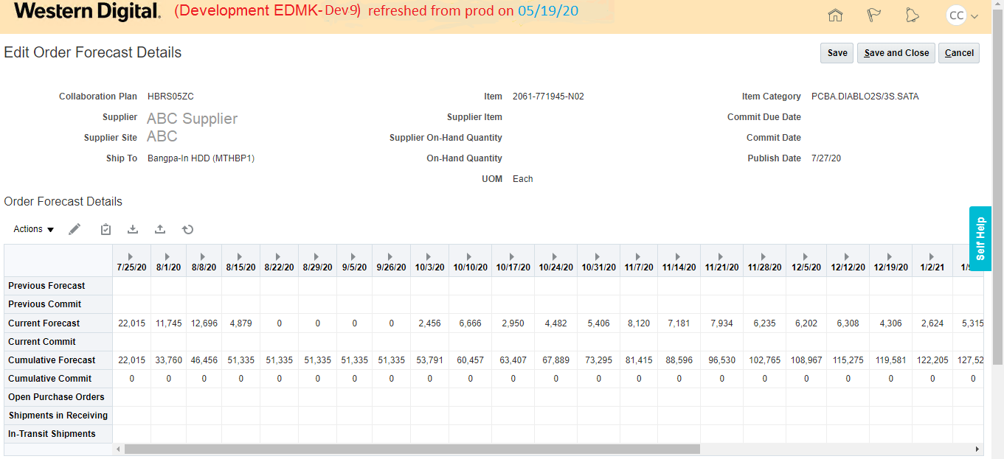
Order Forecast and Commit
Details of the selected item will be shown
Review Order Forecast (Current & Cumulative)
Notes:
Review Order Forecast for different buckets

Slide 10
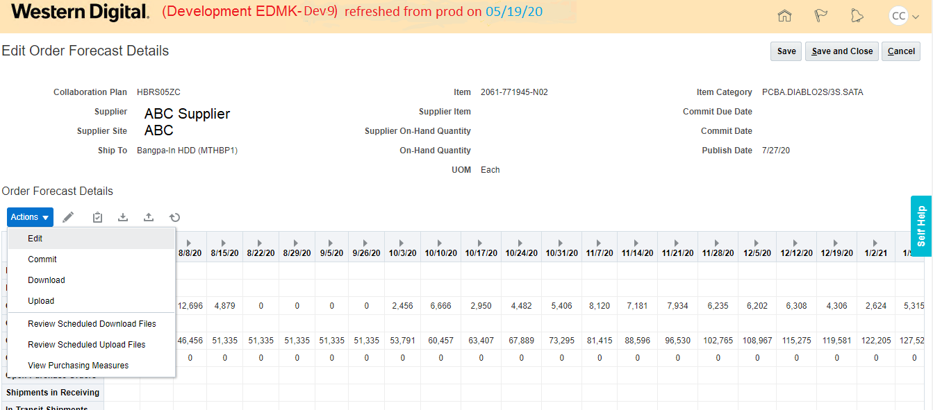
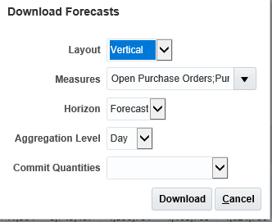
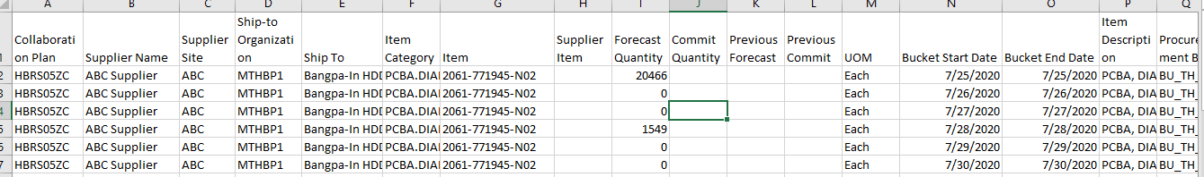
Order Forecast and Commit
Download all records for review
1
Click on Action and Download
Select different parameters for download
2
3
Notes:
Download records by clicking on Action → Download.
Provide details of download parameters in the new window opened
Layout – Vertical or Horizontal
Measures
Horizon – Forecast or Commit
Aggregation Level – Day or Week

Slide 11
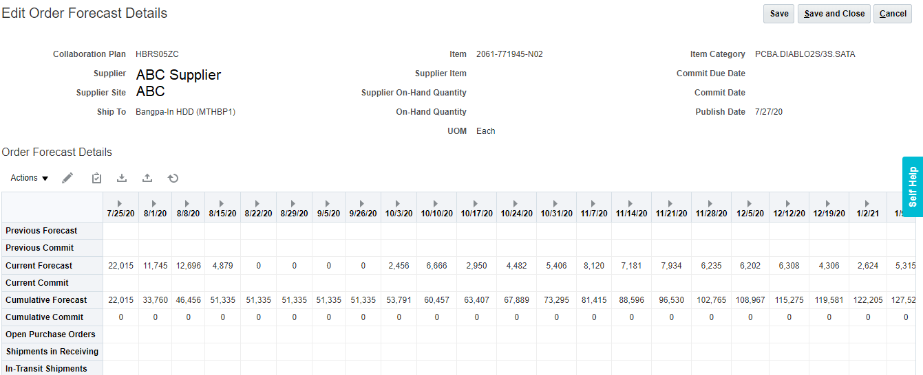
2.0 Commit against Forecast
Navigation– Supplier Portal Work area → Supply Plan → Manage Order Forecasts and Commits
Search for Forecast based on multiple search criteria available and select the item for which commit to be provided
Note: Commit can be done only at the level of Forecast Granularity i.e if Forecast is Weekly, commit can also be done Weekly. Daily commits cannot be done in this case
Notes:
Note: Commit can be done only at the level of Forecast Granularity i.e if Forecast is Weekly, commit can also be done Weekly. Daily commits cannot be done in this case

Slide 12
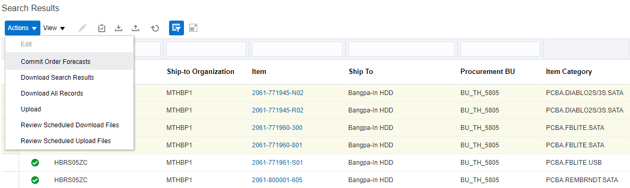
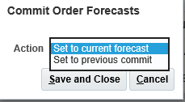
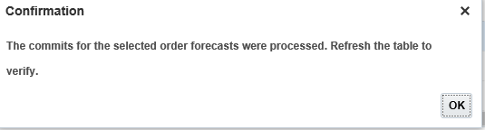
Commit against Forecast – Option 1
Option 1 – Mass update the commit values for multiple items together
Select multiple items records on the main search page. Click on Action → Commit Order Forecast
1
Select multiple records or all records and click on Action → Commit Order Forecast
2
3
Select the option for Commit and click on Save and Close
Set to Current forecast
Set to previous commit
Notes:
Multiple records or all records can be selected for mass update of commit values. Once selected for update, click on Action → Commit Order Forecast for mass update. Following options for commit update will be displayed in a new window:
Set to Current forecast
Set to previous commit
Select the appropriate measure to update the commit values. Please note that Previous commit will not be applicable for the first time the commit is provided.
Re query the records to see the changes

Slide 13
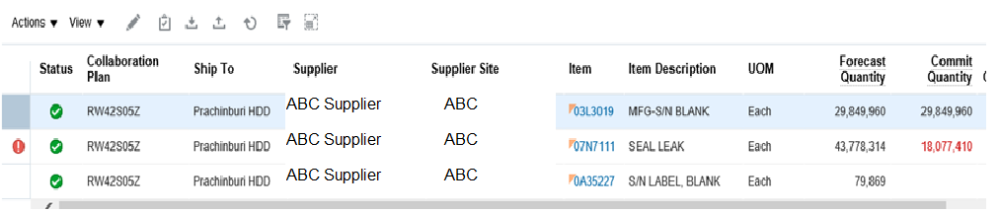
Commit against Forecast – Option 1
Re query the records to see the changes
Can see exceptions where forecast does not match commit
Commit values are updated based on the parameter selected
Notes:
When re query the records, all the changes to the commit values will be visible. Also note that system will show exception for the records for which forecast and commit values does not match.

Slide 14
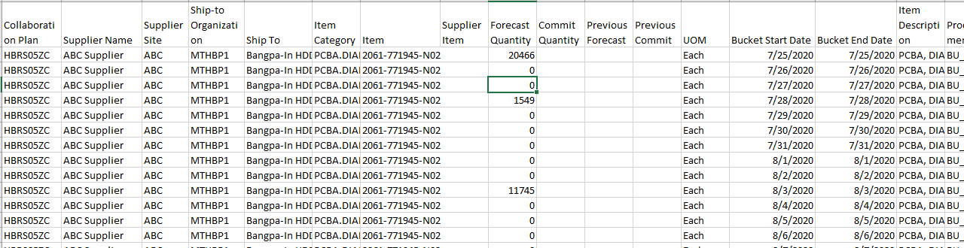
Commit against Forecast – Option 2
Option 2 – Mass update the commit values for multiple items together by downloading in excel and uploading the updated file
Search for specific criteria and . Click on Action → Download Search Result
1
click on Action → Download Search result
2
Check that details of all the items in Search criteria is downloaded
Notes:
Search records by providing specific search criteria and to download, click on Action → Download Search result. Download the file and make changes to the commit values. Once done, save the file and upload.

Slide 15
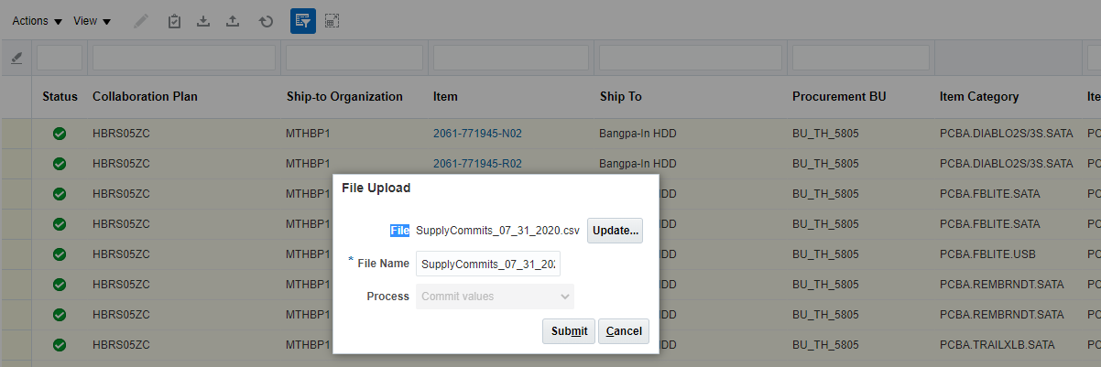
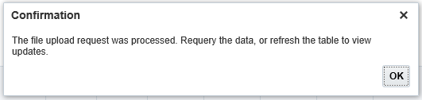
Commit against Forecast – Option 2
Make changes to the excel file (Add/Edit the commit values) and upload the file
3
Upload file by clicking on Action → upload or by clicking upload button and click on Submit
4
Click on Ok and re query the data to see the uploaded values
Notes:
Make changes to the file by providing new values for the commit or editing the earlier values. Once done, upload the file by clicking Action → Upload or by clicking on the Upload button.
System will display a message when the file was successfully uploaded.
Re query the data to see the changes.

Slide 16
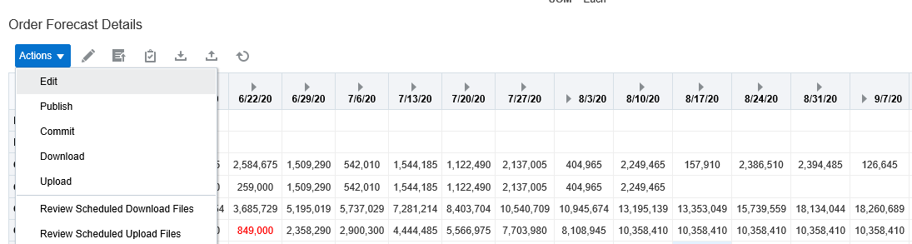
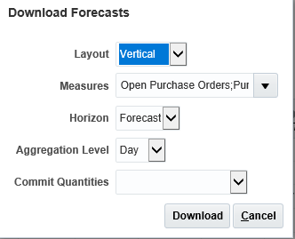
Commit against Forecast – Option 3
Option 3 – Item level update – Download data in Excel, Edit/update data and Upload data
Forecast and Commit data can be downloaded in excel format and necessary changes can be made to commit data. Once done, the file can be uploaded back .
1
Download records by clicking on Action → Download or by clicking download button
3
Select different parameters for download
2
Notes:
Download records by clicking on Action → Download.
Provide details of download parameters in the new window opened
Layout – Vertical or Horizontal
Measures
Horizon – Forecast or Commit
Aggregation Level – Day or Week
Commit Quantities – Set to current forecast or Set to previous commit. While downloading itself the commit values can be downloaded with this option and can be updated before uploading.

Slide 17
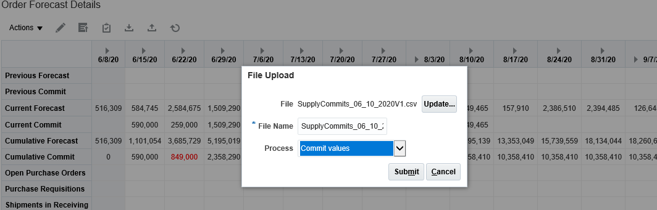
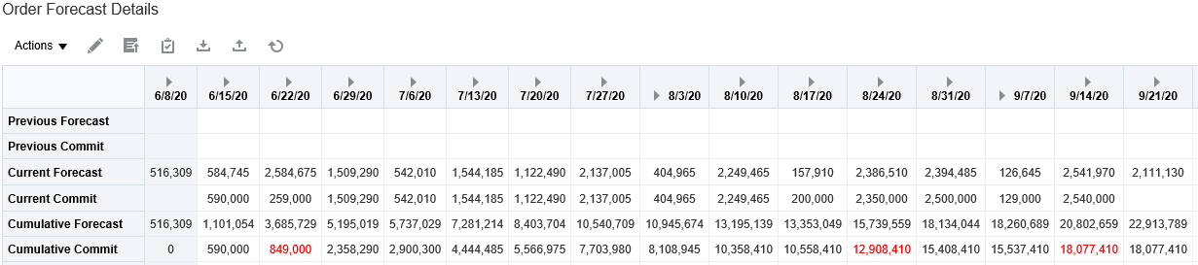
Commit against Forecast – Option 3
Make changes to the excel file (Add/Edit the commit values) and upload the file
4
Upload file by clicking on Action → upload or by clicking upload button and click on Submit
For all records, where Current Commit is less than Current Forecast, Cumulative commit value is shown in RED
5
6
Click on Ok and re query the data to see the uploaded values
Notes:
Make changes to the file by providing new values for the commit or editing the earlier values. Once done, upload the file by clicking Action → Upload or by clicking on the Upload button.
System will display a message when the file was successfully uploaded.
Re query the data to see the changes.
Note that where ever the current commit is less than current forecast, cumulative commit for that record is shown in Red.

Slide 18
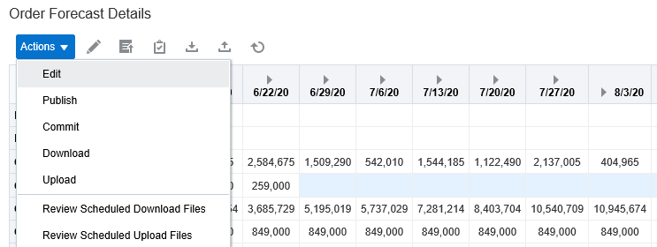
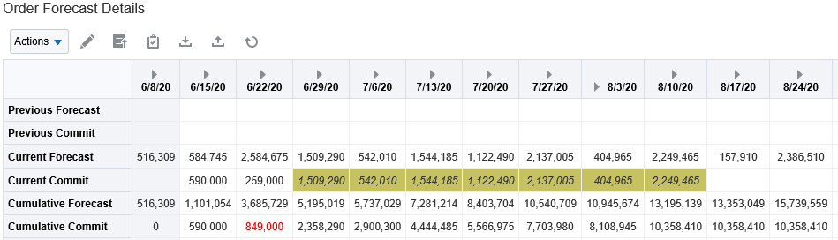
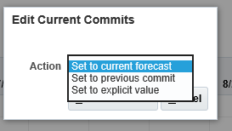
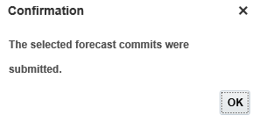
Commit against Forecast – Option 4
Option 4 – Update the commit values for an item with different options available
Select multiple records or all records and click on Action → Edit or Edit button
1
Select multiple records or all records and click on Action → Edit or click on Edit button
3
Once updated, click on Commit button or Action → Commit
2
Select the option for Commit and click on Save and Close
Set to Current forecast
Set to previous commit
Set to explicit values
Notes:
Multiple records for an item or all records can be selected for mass update of commit values. Once selected for update, click on Action → Edit or on the Edit button for mass update. Following options for commit update will be displayed in a new window:
Set to Current forecast
Set to previous commit
Set to explicit values
Select the appropriate measure to update the commit values. Please note that Previous commit will not be applicable for the first time the commit is provided.
Once all the records are updated, click on button “Commit” or Action → Commit

Slide 19
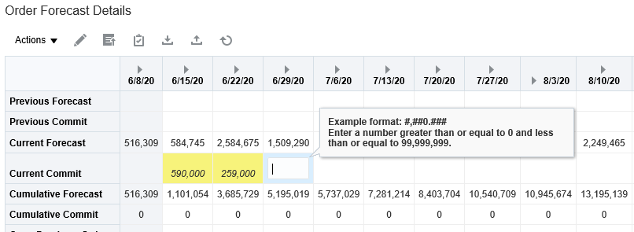
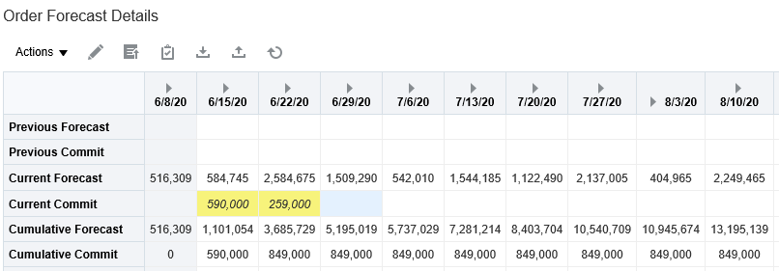
Commit against Forecast – Option 5
Option 5 – Update Commit values for individual buckets manually
1
Update Commit values for individual records and save
2
After saving the records, Cumulative Commit will be calculated and displayed. Click on Commit icon or Action → Commit to update the values
Notes:
Suppliers can provide Commit by manually inputting the commit numbers against each buckets
Once the commit numbers are saved, cumulative commit will be calculated and displayed in Cumulative Commit measure.
Click on the Commit Icon or Action → Commit to commit the numbers.

Slide 20
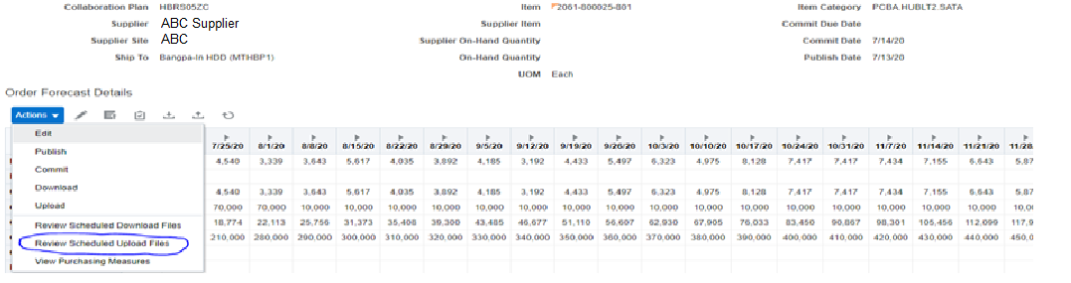
Status of File after uploading Commit
Navigation – Supplier Portal Work area → Supply Plan → Manage Order Forecasts and Commits → Action → Review Scheduled Upload Files
1
Open Review Upload Files
Notes:
Supplier user can upload new commits or update existing commit values
Once the files are uploaded, users can check the status of the files uploaded for any errors and the reason of error.

Slide 21
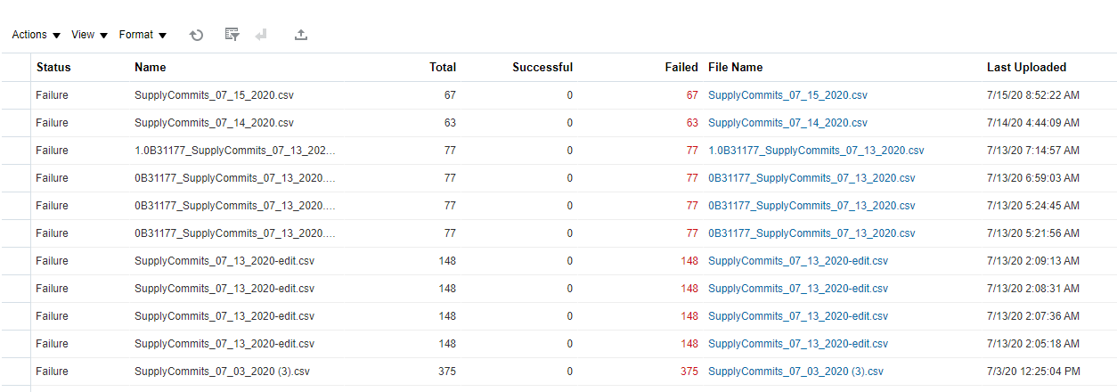
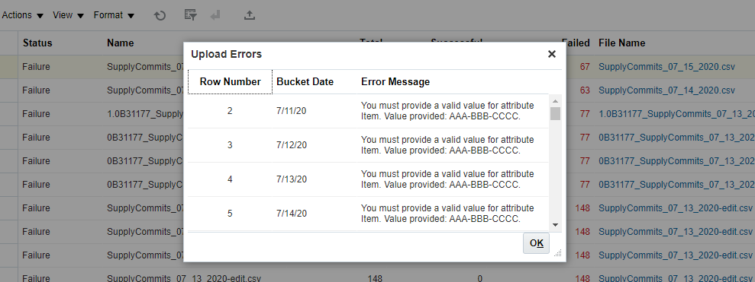
Status of File after uploading Commit
Click on Error link to see the error reason
2
Check number of records succeeded and number of records in error
Check the error message details to ascertain the reason of error
Notes:
The Review Schedule Upload Files will have following details
Status – Status can be Success, Partial Success or Failure
Name – Name of the file uploaded
Total – Total number of records uploaded
Successful – Number of records uploaded successfully
Failed – Number of records failed
File Name – Name of the file uploaded which can be downloaded for review
Last Update – Last update date and time
When user click on Failed records, a new screen will show the details of error message for all the failed records.

Slide 22
Learning Summary
Following topics are covered in the section
Order Forecast & Commit Page
Search based on different parameters available
Download records for review
Commit against forecast
Manual update
Mass update commit values by using different options
Download records, Edit records and upload
Mass update for multiple items together using various commit options available
Download records for multiple items, edit and upload
Notes:
Following topics are covered in the section:
Order Forecast & Commit Page
Search based on different parameters available
Download records for review
Commit against forecast
Manual update
Mass update commit values by using different options
Download records, Edit records and upload
Mass update for multiple items together using various commit options available
Download records for multiple items, edit and upload

Slide 23
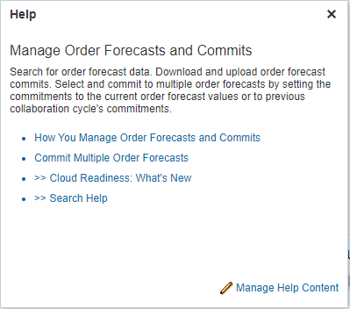
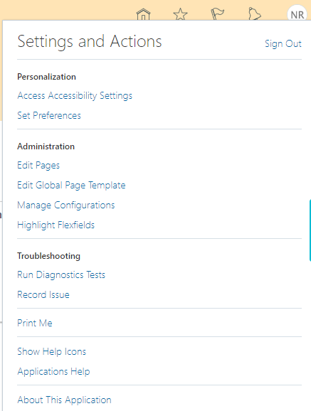
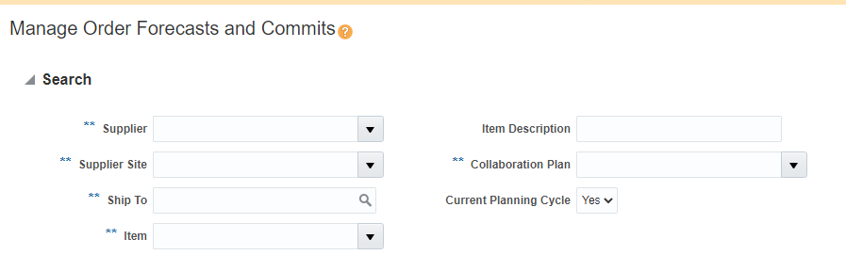
Additional References
1
On Setting and Actions, click on Show Help Icons to enable help.
3
Help Menu will get enables for each page and Users can click on help menu to get additional help.
2
Notes:
Users can click on Settings & Actions and enable Show Help Icons. This will enable help for different pages and users can click on the help icon to get more details about that topic.

