Slide 1
SUPPLY CHAIN COLLABORATION TRAINING MANAGE SUPPLIER ONHAND
Notes:
Welcome to the Oracle Cloud Supply Chain Collaboration Training. This training will enable users to understand how to upload on hand on Supplier portal

Slide 2
Course Agenda
Topic | Objective
Manage Supplier Onhand | How suppliers can upload items on hand quantities
IMAGE/ICON
IMAGE/ICON
Notes:
At the end of this course users will have understanding of how to upload supplier on hand on portal

Slide 3
MANAGE SUPPLIER ONHAND
Notes:
Narration:
This section will cover how to manage Supplier On Hand by using Supply Chain Collaboration.

Slide 4
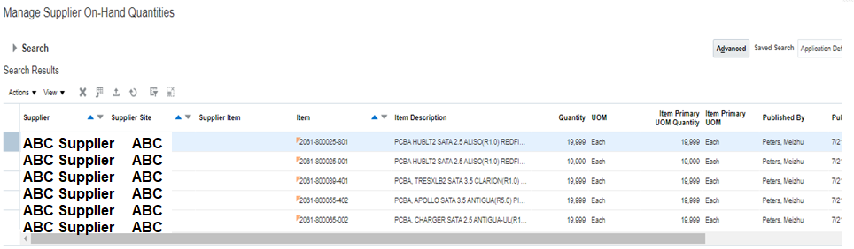
Overview – Manage Supplier On hand
Formatting Tip
Supplier can upload the On Hand quantities for a specific Supplier site on the portal thus enabling better planning decisions
Allows users to manage supplier on-hand quantities at the supplier site level
Supplier on-hand quantities can be managed by either Supplier or Planner on behalf of supplier
Supplier on-hand quantities are visible on Manage Supplier On Hand Quantities page and in Forecast Commit and Analysis Report providing additional information to take planning decisions
IMAGE/ICON
IMAGE/ICON
Note: For VMI suppliers, On-Hand will be loaded automatically in the system based on VMI feeds from 3PL; hence suppliers need not upload the on-hand through Supplier portal. Also, the on-hand should be inventory available for WD for a specific Manufacturing location.
IMAGE/ICON
Notes:
Supplier can upload the On Hand quantities for a specific Supplier site on the portal thus enabling better planning decisions
Allows users to manage supplier on-had quantities at the supplier site level
Supplier on-hand quantities can be managed by either Supplier or Planner on behalf of supplier
Supplier on-hand quantities are visible on Manage Supplier On Hand Quantities page and in Forecast Commit and Analysis Report providing additional information to buyer to take planning decisions

Slide 5
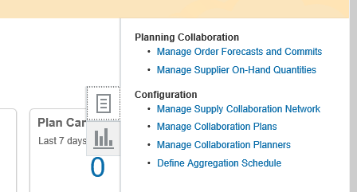
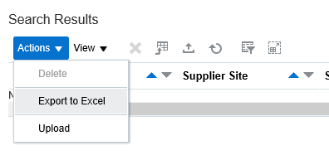
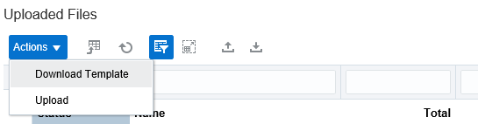
Upload Supplier On-Hand Quantities
Navigation – Supplier Portal Work area → Supply Plan → Manage Supplier On-Hand Quantities
1
2
Click on Action → Upload
A new window will open
3
Click on Download Template to download template for the first time
Notes:
Once the template is downloaded, the same template can be used every time to upload the on hand quantities.

Slide 6
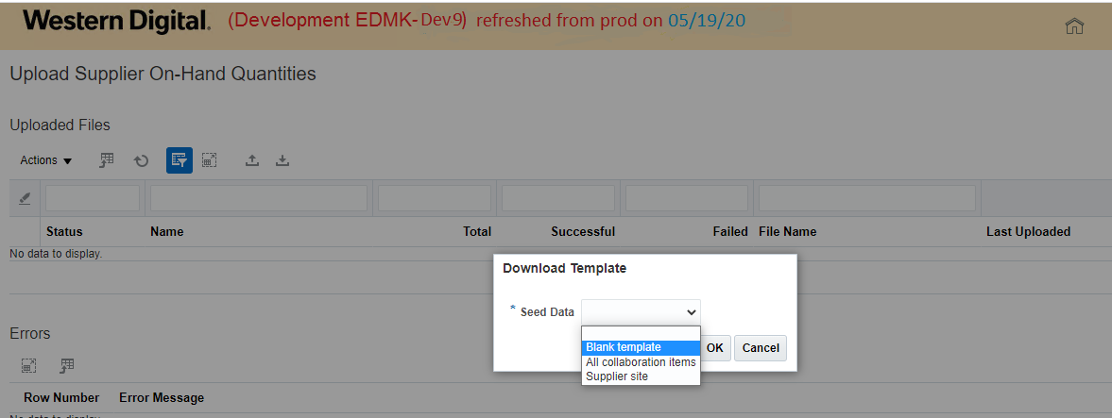
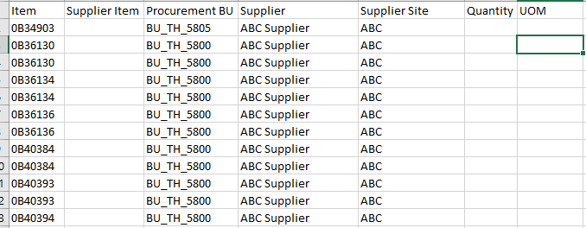
Upload Supplier On-Hand Quantities
4
Select Template Seed Data as All Collaboration Items and click on Ok
5
Notes:
Once the template is downloaded, the same template can be used every time to upload the on hand quantities.

Slide 7
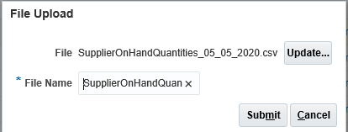
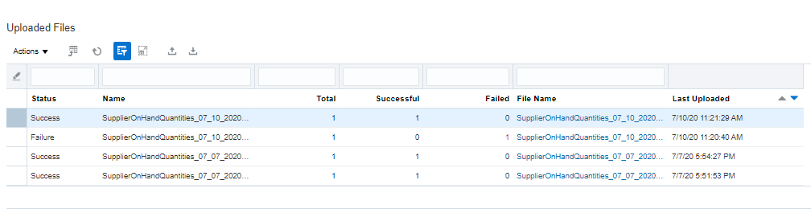
Upload Supplier On-Hand Quantities (Supplier / Planner)
Once the file is updated with current on hand quantities data, upload the file on portal.
4
5
Post Submit, user can monitor the upload status
Notes:
Update the data template with Quantities & UOM.
Once the file is updated with data, upload the file on portal by using upload feature. The upload process can be monitored for completion and the on-hand reviewed from Manage Supplier On Hand screen.

Slide 8
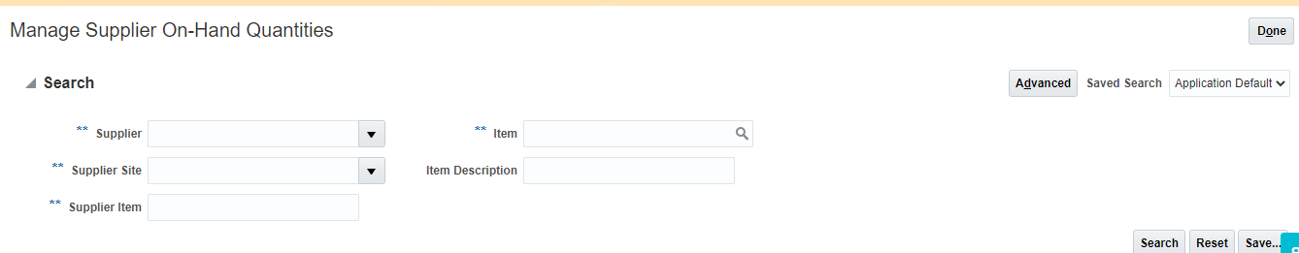
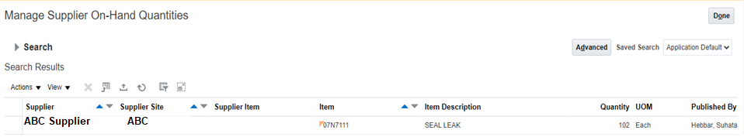
View Supplier On Hand Quantities
Navigation – Supplier Portal Work area → Supply Plan → Manage Supplier On-Hand Quantities
1
Provide Search Criteria and click on Search
Search Result will show details of Supplier On hand quantities based on search criteria
2
Notes:
View the On hand quantities uploaded using Manage Supplier On Hand Quantities page. Provide relevant Search criteria in the search window and the results will be displayed in Search Results window.

Slide 9
Important Considerations for Supplier On Hand Upload
Formatting Tip
WD needs supplier Inventory (SOH) to be tracked by each Inventory Organization. Hence during the upload process it is important that correct Supplier Site is selected.
For each supplier providing material to specific WD location, Location specific Sites have been created as per below naming convention
<Org Code><SOH><Running Number>
BU_TH_5805
MTHBP101
MTHBP201
MTHPRB01
Illustration for ABC Supplier
MTHBP2SOH01
MTHPRBSOH01
MTHBP1SOH01
IMAGE/ICON
IMAGE/ICON
In the above example, if ABC Supplier is receiving the vendor forecast for MTHBP1 site and providing On-Hand against Bang Pa-In site, MTHBP1SOH01 should be chosen while uploading On-Hand.
If ABS supplier is receiving the vendor forecast for MTHBP2 site (Cross site products) and providing on hand against Bang Pa-In site, then MTHBP2SOH01 site should be chosen while uploading On-Hand.
If ABS supplier is receiving the vendor forecast for MTHPRB site and providing On-Hand against MTHPRB site, then MTHPRBSOH01 site should be chosen while uploading On-Hand.
Note: These sites are Planning only (Enable for Sourcing Only) sites for each Supplier corresponding to each Inventory Org for which Supplier On Hand needs to be tracked
Notes:
WD needs supplier Inventory (SOH) to be tracked by each Inventory Organization. Hence during the upload process it is important that correct Supplier Site is selected.
For each Supplier a unique Planning only site will be created for each organization against which the on hand needs to be tracked.
The Site code will contain the Inventory Organization Code.
Supplier need to upload the on hand quantities against the Supplier site that corresponds to the specific inventory organization.

Slide 10
Supplier On Hand Upload Table
Formatting Tip
 | Received Through
Entity Type | Frozen Stock (Friday 7 A.M) | Hub Stock (Daily 7 A.M)
Subcon Suppliers | B2B Upload | VMI
Component Suppliers (WD Direct Buy) | VMI | VMI
Component Suppliers (Subcon Buy) | Oracle SCC Upload | Oracle SCC Upload
Component Suppliers (Turn Key components) | Oracle SCC Upload | Oracle SCC Upload
IMAGE/ICON
IMAGE/ICON
B2B Upload – Currently connection established and receiving the data every week Friday 7 A.M
VMI - From the VMI HUB we receive the inventory quantity every day by 7 A.M
Oracle SCC Upload – Suppliers need to upload their inventory through Supplier Collaboration Tool
Notes:
WD needs supplier Inventory (SOH) to be tracked by each Inventory Organization. Hence during the upload process it is important that correct Supplier Site is selected.
For each Supplier a unique Planning only site will be created for each organization against which the on hand needs to be tracked.
The Site code will contain the Inventory Organization Code.
Supplier need to upload the on hand quantities against the Supplier site that corresponds to the specific inventory organization.

