Slide 1
SUPPLY CHAIN COLLABORATION TRAINING
REPORTS
Notes:
Welcome to the Oracle Cloud Supply Chain Collaboration Training. This training will enable users to understand how to run various reports available in Supply Chain Collaboration Cloud.

Slide 2
COURSE AGENDA
Topic | Objective
Forecast Commit Analysis Report | To understand how to run report and various details covered in the report
Order Forecast & Comparison Report | To understand how to run report and various details covered in the report
Supply Commit & Comparison Report | To understand how to run report and various details covered in the report
IMAGE/ICON
IMAGE/ICON

Slide 3
FORECAST COMMIT ANALYSIS REPORT
Notes:
This section will cover details of Forecast Commit Analysis Report

Slide 4
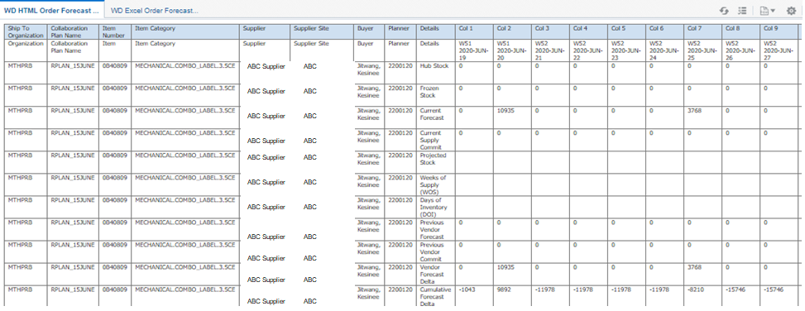
Forecast Commit Analysis Report
Formatting Tip
  Forecast is published to Suppliers every week and Supplier will provide Commit against the Forecast every week. When the Forecast is published to the supplier and after the commitment is received from suppliers, planners & Suppliers will need some additional information along with forecast & commit values to arrive at some critical decisions. The additional details along with the forecast and commit details will help planner & suppliers to take necessary action to correct the plan. The report will provide the additional details as required in a specific format and will have the functionality to download the report in excel format also
Notes:
Forecast Commit Analysis Report will calculate and display various measures required by a planner and supplier for analysis. Details available and updated in cloud will be used to calculate various measures and will be displayed in a specific format for users to do analysis.

Slide 5
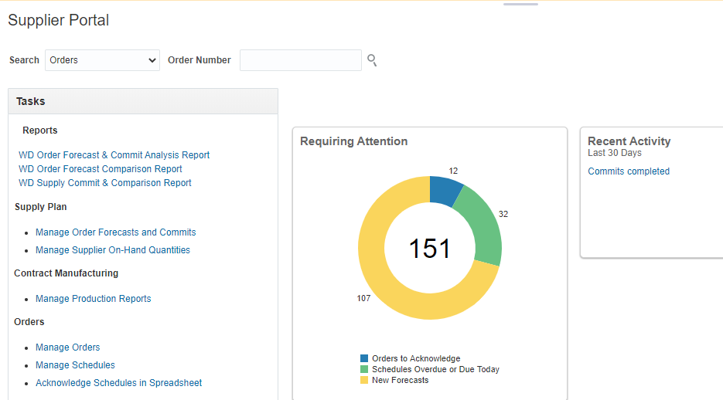
Forecast Commit Analysis Report – How to Run
  Navigation – Supplier Portal → Reports displayed on Left Side → Click on WD Order Forecast & Commit Analysis Report
Click on report and the report will open in a new window

Slide 6
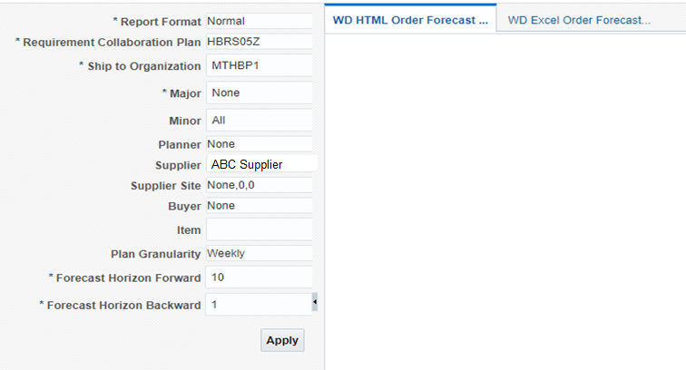
Forecast Commit Analysis Report – Parameters
  When Click on Open, a new page will open which has parameter window
Provide different parameters to execute the report. Some of the parameters are mandatory and some optional. Select relevant parameters as applicable and click on Apply to run the report
If Excel output is required, click on the WD Excel Order Forecast and Commit Analysis Report Tab and click Apply.
Notes:
Parameters for the Report: Provide different parameters to execute the report. Some of the parameters are mandatory and some optional. Select relevant parameters as applicable and click on Apply to run the report. Following Parameters are available:
Report Format (Mandatory Parameter) – Normal & Summary
Requirement Collaboration Plan (Mandatory Parameter) – Select the relevant plan name from the list of values
Ship to Organization (Mandatory Parameter) – Select either one organization or multiple organizations from list of values
Major – Will be defaulted to None and not required
Minor – Will be defaulted to All. No Need to select any value
Planner (Optional Parameter) - Not Required
Supplier –Suppliers will not be able to select any other suppliers and will not be able to view data for any other suppliers.
Supplier Site (Optional Parameter) - Select appropriate Supplier Site
Buyer (Optional Parameter) – Not Required
Item (Optional Parameter) – Search and select one or multiple items. This parameter is optional.
Plan Granularity (Optional Parameter) – Default value is Weekly. Select from the list of values from Daily, Weekly or Monthly. Depending on the value selected, report will display data in that bucket.
Forecast Horizon Forward (Mandatory Parameter) – Provide a numeric values for the parameter Forecast Horizon Forward. Depending on the parameter Plan Granularity provided, report will display number of buckets selected in this parameter. Example: If Plan Granularity selected is Daily and Forecast Horizon Forward is 25, report will display data for 25 buckets in daily buckets.
Forecast Horizon Backward (Mandatory Parameter) – Provide a numeric values for the parameter Forecast Horizon Backward. Depending on the parameter Plan Granularity provided, report will display number of buckets selected in this parameter. Example: If Plan Granularity selected is Daily and Forecast Horizon Backward is 4, report will display data for past 4 buckets in daily buckets.

Slide 7
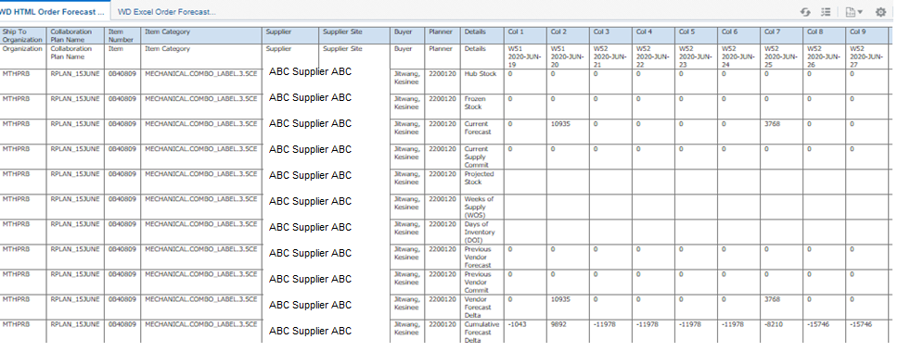
Forecast Commit Analysis Report – HTML Output
  Provide relevant parameters and click on Apply
Report output can be viewed on the screen by selecting WO HTML Order Forecast Commit Analysis Data Report tab or can be downloaded in excel format using WO Excel Order Forecast Commit Analysis Data Report
Notes:
Report output can be viewed on the screen using the HTML tab available on the page or can be downloaded in excel using the Excel tab available on the page. Following measures are shown in the report for individual items in case of Normal view and will be consolidated for multiple items in case of Summary view:
Hub Stock
Frozen Stock
Current Forecast
Current Supply Commit
Projected Stock
Weeks of Supply (WOS) calculated based on Frozen Stock
Days of Inventory (DOI) calculated based on Frozen Stock
Previous Vendor Forecast
Previous Vendor Commit
Vendor Forecast Delta
Cumulative Forecast Delta
Supply Commit Delta
Cumulative Supply Commit Delta
Projected Stock (Hub Stock)
Days of Inventory (Hub Stock)

Slide 8
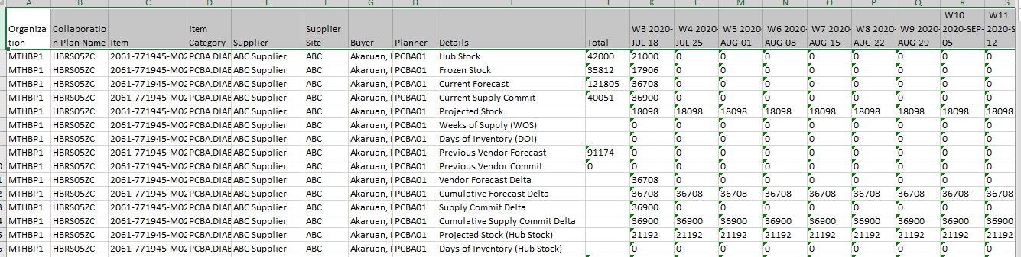
Forecast Commit Analysis Report – Excel Output
  Provide relevant parameters and click on Apply after selecting Excel Tab
Report output can be downloaded in excel format using WO Excel Order Forecast Commit Analysis Data Report
Notes:
When the report is executed by clicking on the Excel tab, report will be downloaded in excel format and user can open the same to review the details.

Slide 9
Forecast Commit Analysis Report – Measures – 1 /3
  Key Measures explanation
1. HUB Stock : On-Hand QTY, we receive either from VMI or through supplier upload every day 7 A.M
2. Frozen Stock : On-Hand Quantity, which is received from suppliers as on Friday 7 A.M (Used in MRP)
3. Current Forecast : Latest MRP forecast for the suppliers
4. Current Supply Commit : Latest supply commit provided by suppliers
Notes:
When the report is executed by clicking on the Excel tab, report will be downloaded in excel format and user can open the same to review the details.

Slide 10
Forecast Commit Analysis Report – Measures – 2/3
  Key Measures explanation
5. Projected Stock : (Frozen Stock + Current Supply Commit) – Current Vendor Forecast
6. Weeks of Supply (WOS) : Projected stock (N Week) / Current Vendor forecast (N + 1 Week)
7. Days of Inventory (DOI) : Projected stock (N Week) / Current Vendor forecast (N + 1 Week) / 7 days
8. Previous Vendor Forecast : Last week Vendor forecast
9. Previous Vendor commit : Last week Supply Commit
Notes:
When the report is executed by clicking on the Excel tab, report will be downloaded in excel format and user can open the same to review the details.

Slide 11
Forecast Commit Analysis Report – Measures – 3/3
  Key Measures explanation
10. Vendor Forecast Delta: Current Vendor Forecast – Previous Vendor Forecast
11. Cumulative Forecast Delta : Cumulative Delta (10)
12. Supply Commit Delta : Current Supply Commit – Previous Supply Commit
13. Cumulative Supply Commit Delta : Cumulative Delta (12)
14. Projected Stock (Hub Stock) : (Hub Stock + Current Supply Commit) – Current Vendor Forecast
15. Days of Inventory (Hub Stock) : Projected Stock (Hub Stock) / Current Vendor Forecast (Week N+1)/7
Notes:
When the report is executed by clicking on the Excel tab, report will be downloaded in excel format and user can open the same to review the details.

Slide 12
ORDER FORECAST & COMPARISON REPORT
Notes:
This section will cover details of Order Forecast & Comparison Report

Slide 13
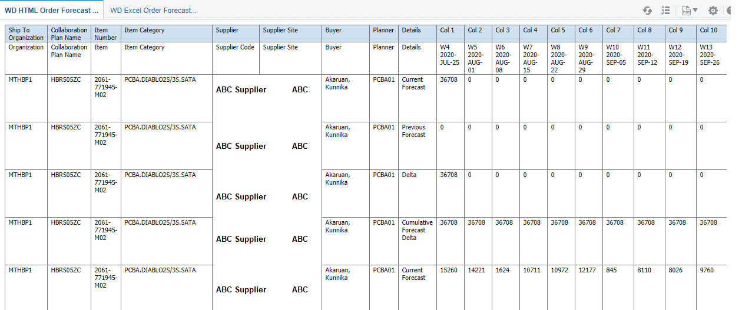
Order Forecast & Comparison Report
Formatting Tip
  Forecast is published to Suppliers every week and Supplier will provide Commit against the Forecast every week. When the Forecast is published to the supplier, planners & Suppliers will review the Forecast, Previous Forecast & Delta. Current forecast details along with previous forecast and delta will help planner & suppliers to take necessary action to correct the forecast if required. The report will provide the forecast details as required in a specific format and will have the functionality to download the report in excel format also.
Notes:
Order Forecast Comparison report will display forecast values, previous forecast values, delta and Cumm Delta between the two forecast based on the parameter selected.

Slide 14
Order Forecast & Comparison Report– How to Run
  Navigation – Supplier Portal → Reports displayed on Left Side → Click on WD Order Forecast Comparison Data Report
Click on report and the report will open in a new window

Slide 15
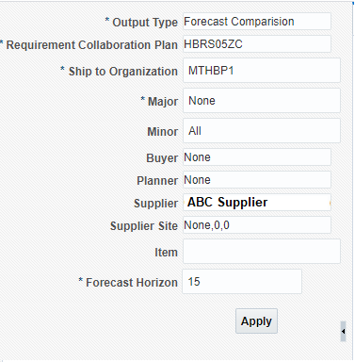
Order Forecast & Comparison Report – Parameters
  When Click on Open, a new page will open which has parameter window
Provide different parameters to execute the report. Some of the parameters are mandatory and some optional. Select relevant parameters as applicable and click on Apply to run the report
Notes:
Parameters for the Report: Provide different parameters to execute the report. Some of the parameters are mandatory and some optional. Select relevant parameters as applicable and click on Apply to run the report. Following Parameters are available:
Output Type (Mandatory Parameter) – Forecast Comparison & Forecast Only
Requirement Collaboration Plan (Mandatory Parameter) – Select the relevant plan name from the list of values
Ship to Organization (Mandatory Parameter) – Select either one organization or multiple organizations from list of values
Major (Mandatory Parameter) – None, Not Required
Minor (Optional Parameter) – Not Required
Supplier (Optional Parameter) – Suppliers will not be able to select any other suppliers and will not be able to view data for any other suppliers.
Supplier Site (Optional Parameter) - Select Supplier site as required
Buyer (Optional Parameter) – Not Required
Planner (Optional Parameter) - Not Required
Item (Optional Parameter) – Select Item or multiple items from list of values. This is a optional parameter.
Forecast Horizon (Mandatory Parameter) – Provide a numeric values for the parameter Forecast Horizon. Plan will display data for the number of weeks provided in this parameter. Example: If the value provided is 25, plan will display data for items based on other parameters for next 25 weeks.

Slide 16
Order Forecast & Comparison Report – HTML Output
  Provide relevant parameters and click on Apply
Report output can be viewed on the screen by selecting WO HTML Order Forecast Comparison Data Report tab or can be downloaded in excel format using WO Excel Order Forecast Comparison Data Report
Notes:
Report output can be viewed on the screen using the HTML tab available on the page or can be downloaded in excel using the Excel tab available on the page. Following measures are shown in the report for individual items when selected Forecast Comparison:
Current Forecast
Previous Forecast
Delta
In case the parameter selected is Forecast only, the report will display Current Forecast only for the items.

Slide 17
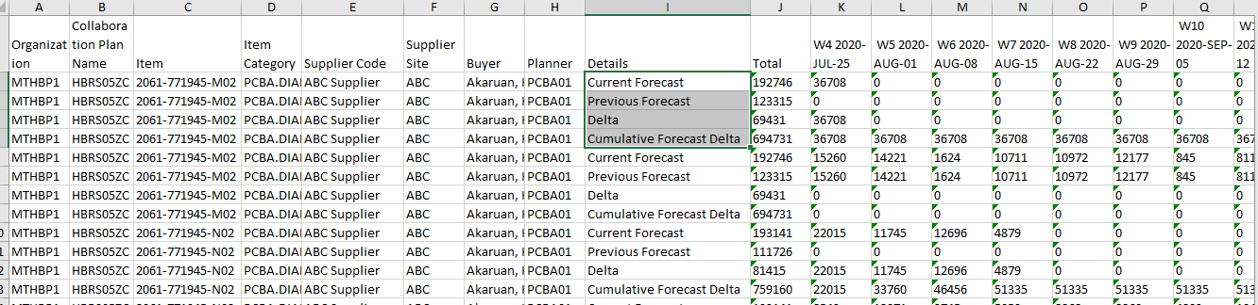
Order Forecast & Comparison Report – Excel Output
  Provide relevant parameters and click on Apply after selecting Excel Tab
Report output can be downloaded in excel format using WO Excel Order Forecast Commit Analysis Data Report
Notes:
When the report is executed by clicking on the Excel tab, report will be downloaded in excel format and user can open the same to review the details.

Slide 18
SUPPLY COMMIT & COMPARISON REPORT
Notes:
Narration:
This section will cover details of Collaboration Network and how to create and edit collaboration network.

Slide 19
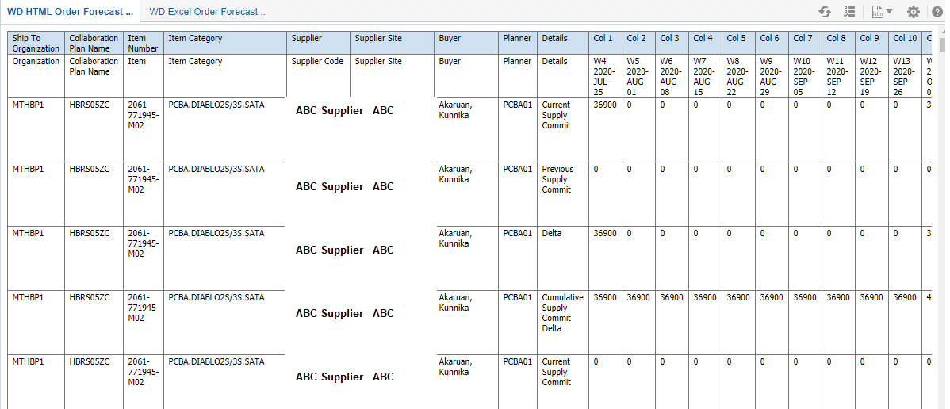
Supply Commit & Comparison Report
Formatting Tip
  Forecast is published to Suppliers every week and Supplier will provide Commit against the Forecast every week. When the Forecast is published to the supplier and after the commitment is received from suppliers, planners & Suppliers will review the Commit and needs details on the previous commit along with Delta. The additional details along with the forecast and commit details will help planner & suppliers to take necessary action to correct the commit if required. The report will provide the additional details as required in a specific format and will have the functionality to download the report in excel format also.
Notes:
Supply Commit Comparison report will display commit values, previous commit values, delta and Cumm Delta between the two commits based on the parameter selected.

Slide 20
Supply Commit & Comparison Report– How to Run
  Navigation – Supplier Portal → Reports displayed on Left Side → Click on WD Supply Commit and Comparison Data Report
Click on report and the report will open in a new window

Slide 21
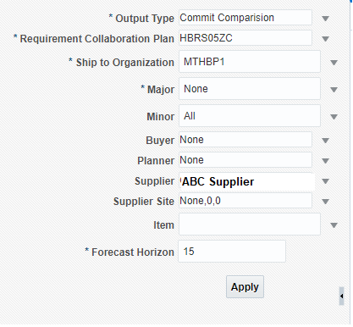
Supply Commit & Comparison Report – Parameters
  When Click on Open, a new page will open which has parameter window
Provide different parameters to execute the report. Some of the parameters are mandatory and some optional. Select relevant parameters as applicable and click on Apply to run the report
Notes:
Parameters for the Report: Provide different parameters to execute the report. Some of the parameters are mandatory and some optional. Select relevant parameters as applicable and click on Apply to run the report. Following Parameters are available:
Output Type (Mandatory Parameter) – Commit Comparison & Commit Only
Requirement Collaboration Plan (Mandatory Parameter) – Select the relevant plan name from the list of values
Ship to Organization (Mandatory Parameter) – Select either one organization or multiple organizations from list of values
Major (Mandatory Parameter) – Not Required
Minor (Optional Parameter) – Not Required
Supplier (Optional Parameter) – Suppliers will not be able to select any other suppliers and will not be able to view data for any other suppliers.
Supplier Site (Optional Parameter) - Select appropriate Supplier Site
Buyer (Optional Parameter) – Not Required
Planner (Optional Parameter) - Not Required
Item (Optional Parameter) – Select item or items from the list. This is an optional parameter.
Forecast Horizon (Mandatory Parameter) – Provide a numeric values for the parameter Forecast Horizon. Plan will display data for the number of weeks provided in this parameter. Example: If the value provided is 25, plan will display data for items based on other parameters for next 25 weeks.

Slide 22
Supply Commit & Comparison Report – HTML Output
  Provide relevant parameters and click on Apply
Report output can be viewed on the screen by selecting WO HTML Order Forecast Comparison Data Report tab or can be downloaded in excel format using WO Excel Order Forecast Comparison Data Report
Notes:
Report output can be viewed on the screen using the HTML tab available on the page or can be downloaded in excel using the Excel tab available on the page. Following measures are shown in the report for individual items:
Current Supply Commit
Previous Supply Commit
Delta
Cumm Delta
In case the parameter selected is Commit only, the report will display Current Supply Commit only for the items.

Slide 23
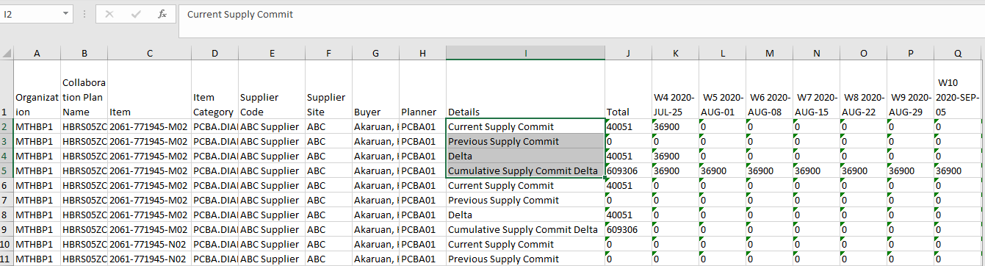
Supply Commit & Comparison Report – Excel Output
  Provide relevant parameters and click on Apply after selecting Excel Tab
Report output can be downloaded in excel format using WO Excel Order Forecast Commit Analysis Data Report
Notes:
When the report is executed by clicking on the Excel tab, report will be downloaded in excel format and user can open the same to review the details.

Slide 24
Topic Learning Summary
Learning from the section
Forecast Commit Analysis Report
Order Forecast & Comparison Report
Supply Commit & Comparison Report
Notes:
In the prior section we learned about the following Reports:
Forecast Commit Analysis Report
Order Forecast & Comparison Report
Supply Commit & Comparison Report

